Slide 1
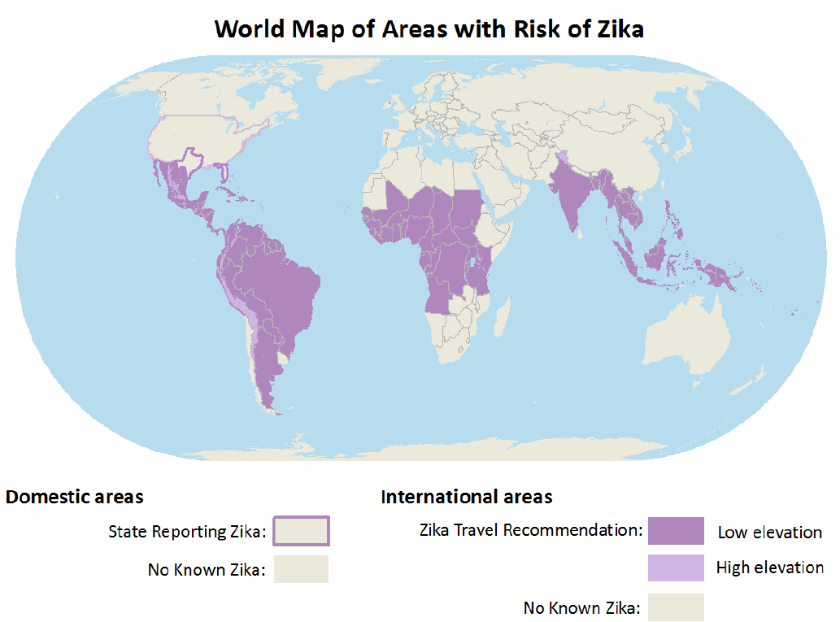
Zika Vaccine DeveLOpMENT at HHS
Armen Donabedian
ASPR/BARDA
4th Annual CLS Symposium
Auburn University
March 31, 2017
https://wwwnc.cdc.gov/travel/files/zika-areas-of-risk.pdf
Notes:
The purpose of this presentation is to provide an overview of the Zika vaccine pipeline with
A focus on candidates supported by the US government and
To share some of our operational thinking with you.

Slide 2

Rick Bright, Ph.D
BS in Biology
(Medical Technology)
Auburn University
Class of ‘97
Director, Biomedical Advanced Research and Development Authority (BARDA)
Deputy Assistant Secretary in the Office of the Assistant Secretary for Preparedness and Response (ASPR)
U.S. Department of Health and Human Services

Slide 3

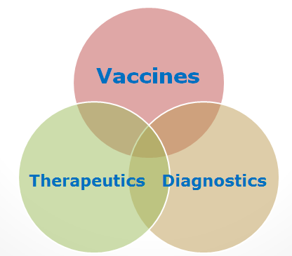
BARDA’s Mission
BARDA’s mission is to develop and make available medical countermeasures to address Chemical, Biological, Radiological, and Nuclear (CBRN) threats, Pandemic Influenza (PI), and Emerging and Infectious Diseases (EID).

Slide 4

Medical Countermeasures
Medical Devices
Antimicrobials
Diagnostics
Vaccines
Therapeutics

Slide 5
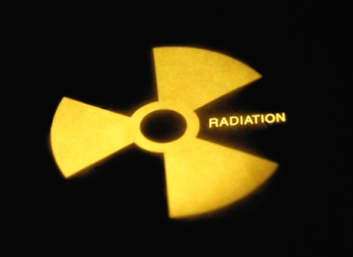
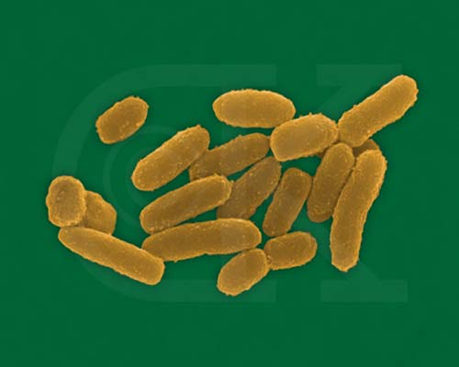
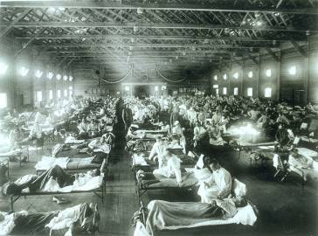

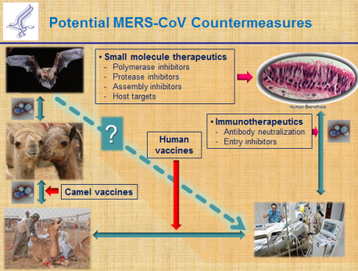
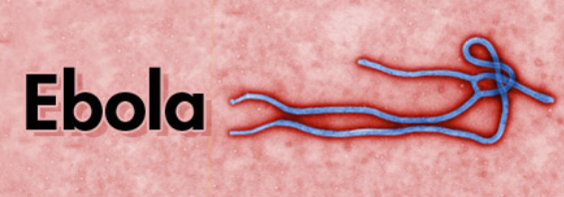
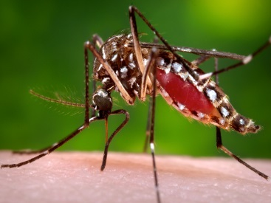
Man-made and Natural Threats
CBRN Threats
  Chemical nerve agents & cyanide
  Biothreats (anthrax, smallpox, plaque, tularemia, viral hemorrhagic fever, and others)
  Radiological and Nuclear agents
Pandemic influenza
Emerging infectious diseases
MERS-CoV
ZIKA

Slide 6
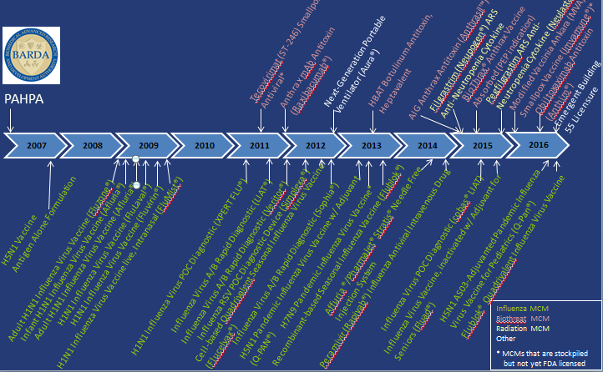
An impressive track record of success
through Public-Private Partnerships

Slide 7
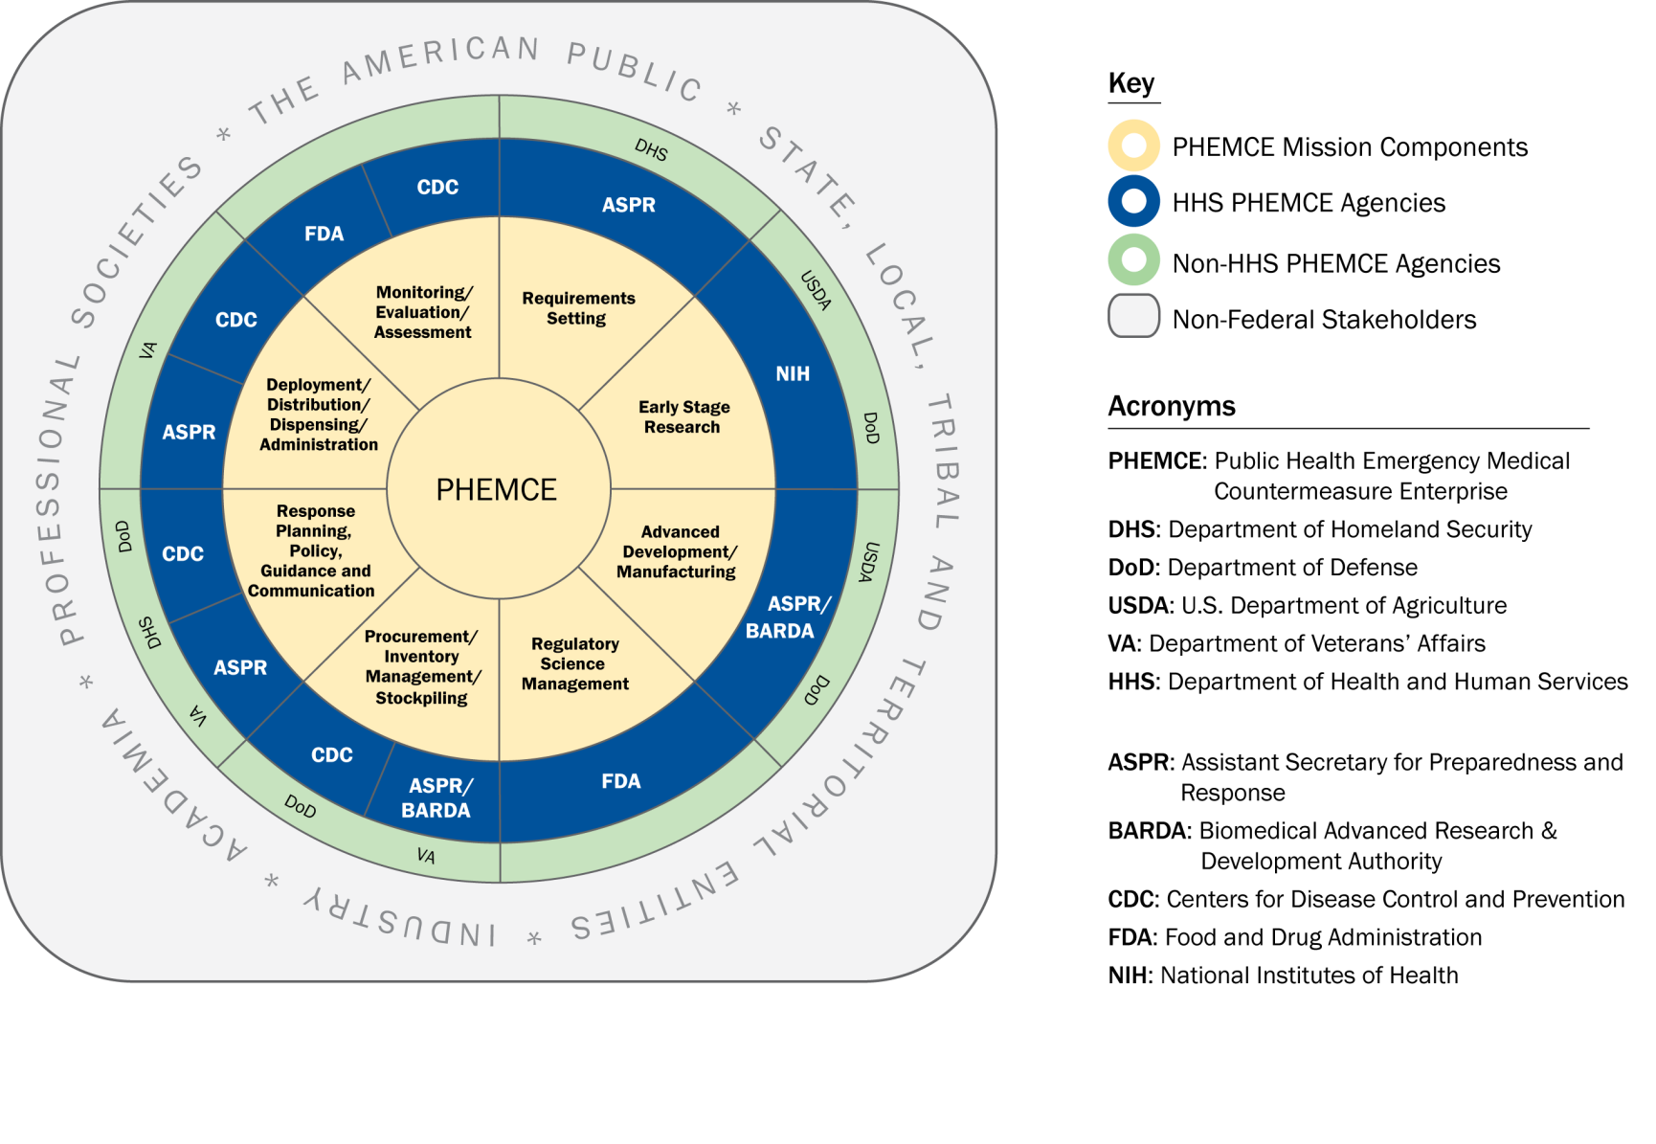
Public Health Emergency Medical Countermeasures Enterprise (PHEMCE) Governance

Slide 8
Public Health Emergency Medical Countermeasures Enterprise (PHEMCE) Governance (2)

Slide 9
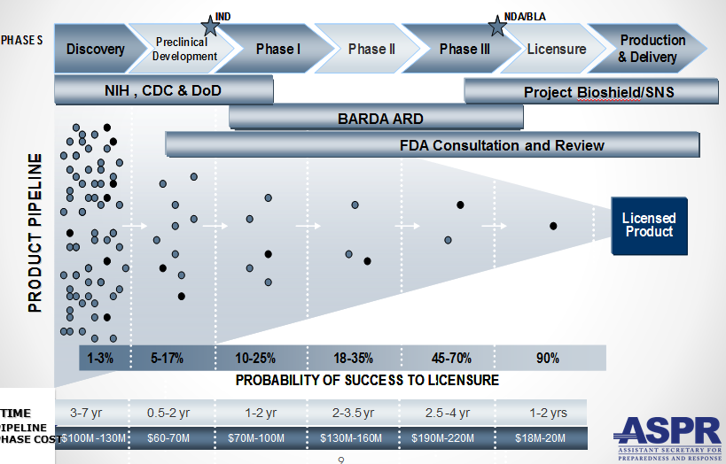
Vaccine & Drug Development is still Expensive, Risky and Lengthy

Slide 10
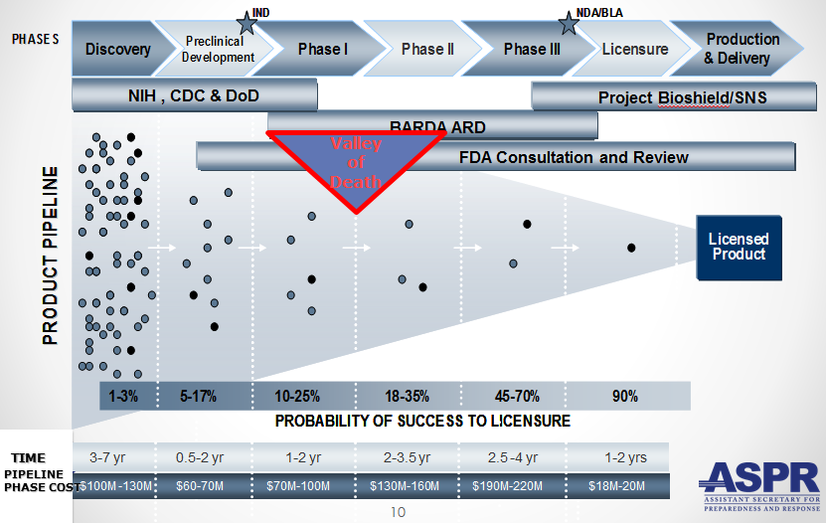
Vaccine & Drug Development is still Expensive, Risky and Lengthy

Slide 11
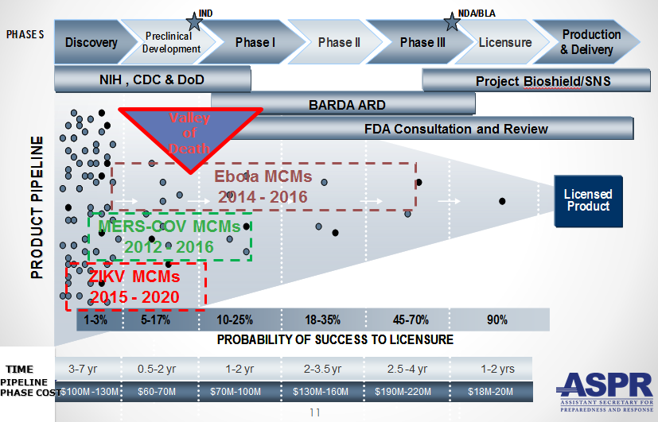
Vaccine & Drug Development is still Expensive, Risky and Lengthy

Slide 12
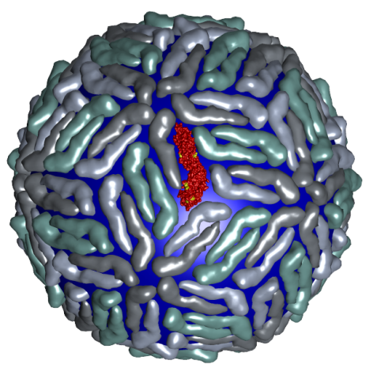
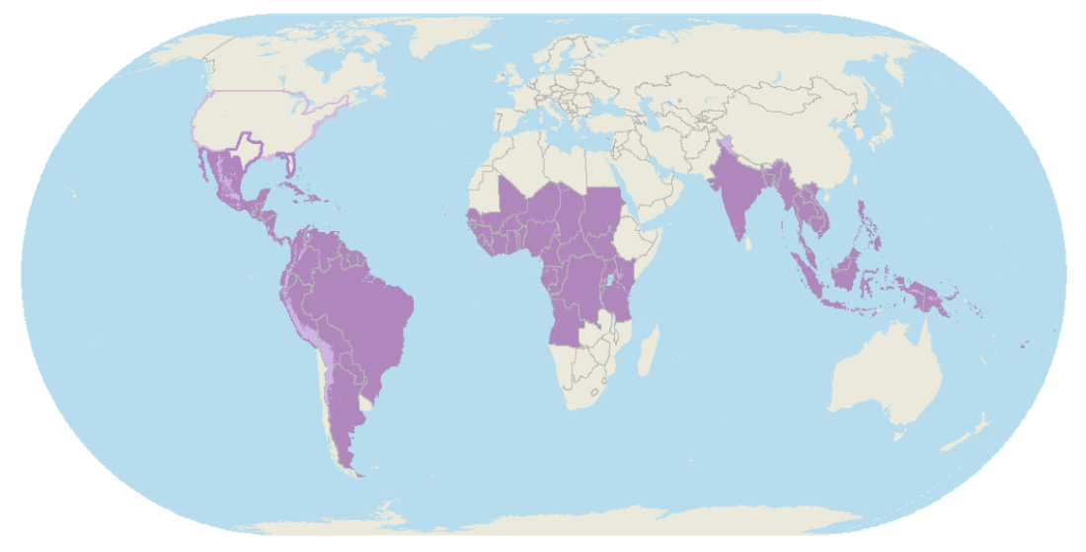
Zika Virus
Zika virus (ZIKV) belongs to the family Flaviviridae (e.g., dengue, West Nile, Yellow Fever, Japanese encephalitis)
Brief history
  First isolated in Zika forest in 1947 with limited human infections in Africa and SE Asia through 2006
  Emerged in Micronesia in 2007, and French Polynesia in 2008
  Current outbreak began in Brazil in 2015
  Currently found in over 60 countries and territories worldwide
  HHS Secretary declared a public health emergency in Puerto Rico (8/12)

Slide 13
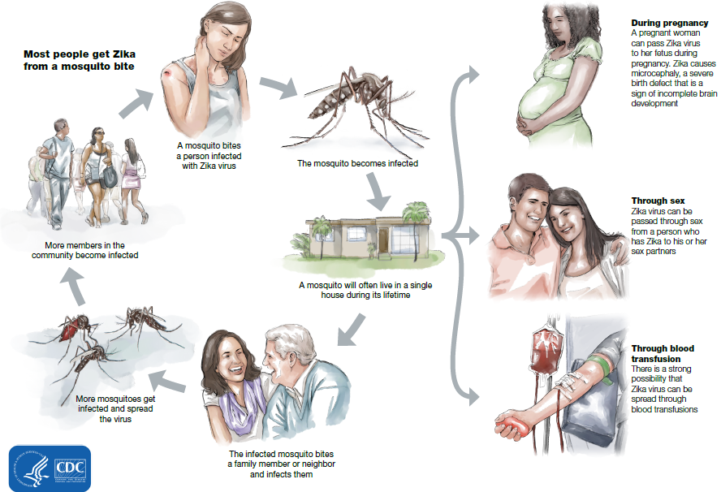
How Zika Spreads
13

Slide 14
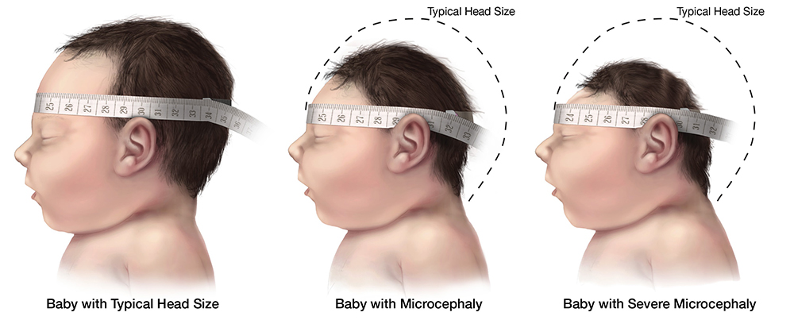
Congenital Zika Syndrome
Multi-faceted syndrome with broad-ranging neurological sequelae, unknown long-term health consequences
Reported in 61 countries and territories as of 3/10/17
Over 3,571 cases of microcephaly and/or CNS malformation reported (41 in US; 3,530 in Brazil)
http://apps.who.int/iris/bitstream/10665/253604/1/zikasitrep20Jan17-eng.pdf?ua=1

Slide 15
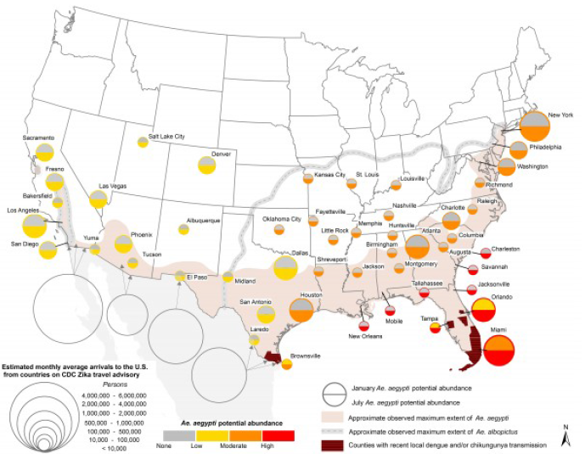
Seasonal Aedes Aegypti Abundance(2)
Monaghan AJ, Morin CW, Steinhoff DF, Wilhelmi O, Hayden M, Quattrochi DA, Reiskind M,
Lloyd AL, Smith K, Schmidt CA, Scalf PE, Ernst K. On the Seasonal Occurrence and
Abundance of the Zika Virus Vector Mosquito Aedes Aegypti in the Contiguous United
States. PLOS Currents Outbreaks. 2016 Mar 16 . Edition 1. doi:
10.1371/currents.outbreaks.50dfc7f46798675fc63e7d7da563da76.
15

Slide 16
Seasonal Aedes Aegypti Abundance (2)
Monaghan AJ, Morin CW, Steinhoff DF, Wilhelmi O, Hayden M, Quattrochi DA, Reiskind M,
Lloyd AL, Smith K, Schmidt CA, Scalf PE, Ernst K. On the Seasonal Occurrence and
Abundance of the Zika Virus Vector Mosquito Aedes Aegypti in the Contiguous United
States. PLOS Currents Outbreaks. 2016 Mar 16 . Edition 1. doi:
10.1371/currents.outbreaks.50dfc7f46798675fc63e7d7da563da76.
16

Slide 17
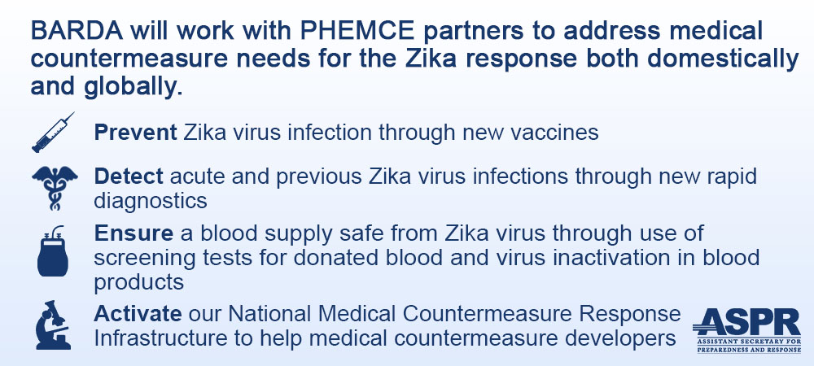
ASPR/BARDA Priorities
17

Slide 18
US Zika Vaccine Goals
2016-2018
Aim #1: Evaluate available vaccine candidates to assess safety, efficacy, and immunogenicity and identify protective immune correlates during the time of highest disease incidence
By 2018
Aim #2: Deploy an available vaccine under an appropriate regulatory mechanism to US populations at high risk of exposure
By 2020
Aim #3: Work with industry partners to commercialize vaccine(s) for broad distribution

Slide 19
Prevention of ZIKV Infection
There is currently no licensed ZIKV vaccine available, however…
Vaccine for other flaviviruses have been developed and used for over 70 years
Active development programs for Dengue and West Nile vaccines have been ongoing for over 30 years, exploring a variety of vaccine platforms to develop vaccines for these flaviviruses
Experiences gained and vaccine platforms developed for other flaviviruses could be leveraged for ZIKV vaccine development
Notes:
Inset picture shows an assembly filling line of vaccine vials.
Zika R&D efforts accelerated greatly by NIAID, WRAIR, and BARDA
A coordinated, multi-disciplinary, multi-agency portfolio management team was established to oversee and accelerate vaccine development

Slide 20
Assumptions
Vaccine that reduces the incidence of symptomatic clinical disease, or infection, will substantially lower the risk of CZS and of sexual transmission, and decrease the frequency of infected mosquitos
Vaccine-elicited neutralizing antibodies will be required for protective immunity
An immune correlate can be identified that will provide critical data for vaccine candidates
Corporate partners will remain committed
Candidate vaccine(s) will be manufactured at sufficient scale to support Aims 2 and 3
USG-driven mechanism will facilitate development

Slide 21
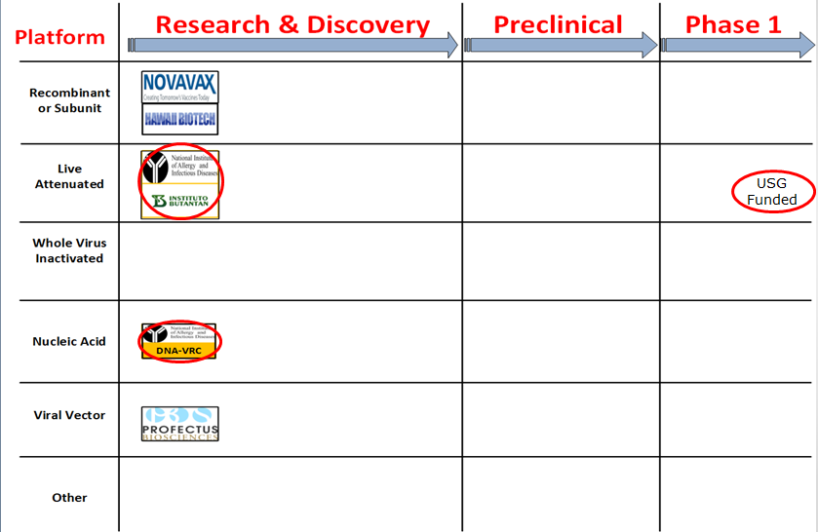
Zika Virus Vaccine Landscape February 2016
Notes:
I turn now to review of the Zika virus vaccine candidates pipeline.
The candidates we discover during our explorations and surveys are organized by platform and stage of development. We call the resulting array of candidates a landscape.
Well, the state of the Zika vaccine candidate ‘landscape’ when the WHO declared Zika to be a public health emergency was sparse.

Slide 22
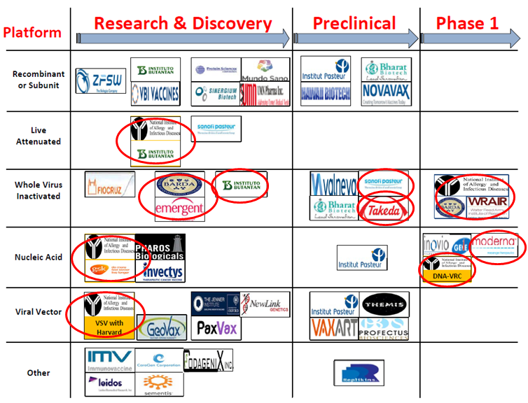
Zika Virus Vaccine Landscape March 2017
See also the WHO vaccine pipeline tracker for continuing updates
http://who.int/immunization/research/vaccine_pipeline_tracker_spreadsheet/en/

Slide 23
HHS Zika Vaccines in Development
Nucleic Acid Vaccines
  DNA – NIAID/VRC, pending partnership
  mRNA - NIAID/GSK, BARDA – novel vaccine delivery methodologies
  mRNA – VRC/BARDA/Moderna Therapeutics
Whole-particle inactivated vaccines
  Based on DoD platform for flavivirus inactivation
  WRAIR/NIAID/BARDA/SP
  BARDA/Takeda
Live-attenuated dengue/ZIKV chimeric –
  Based on NIAID dengue vaccine candidate, for non-obstetric population,
  NIAID/Butantan
Vesicular stomatitis virus (VSV)
  NIAID/Harvard

Slide 24
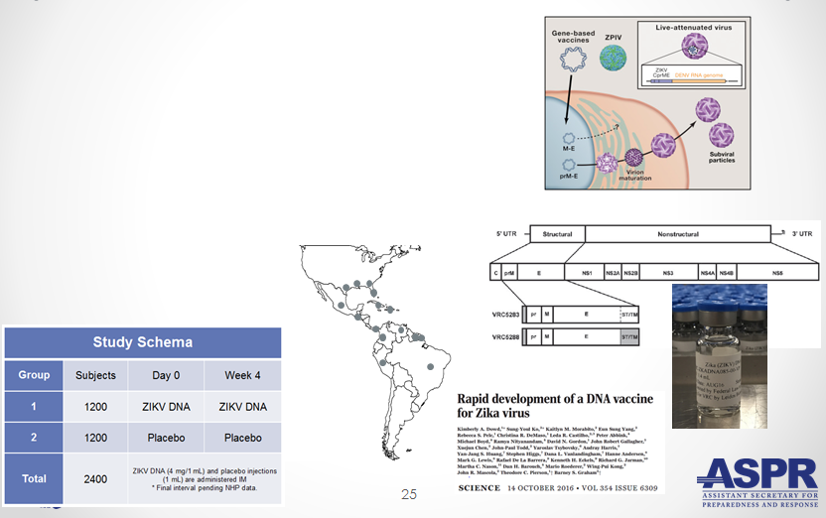
Nucleic Acid Vaccines
NIAID/VRC Zika DNA vaccine
  Fully protective in murine and NHP models
  Two Phase 1 trials to determine optimal construct, regimen and delivery - results by 2Q17
  Phase 2a/2b trial to begin in April 2017 in Latin America
Notes:
DNA vaccine expressing prM and E proteins was immunogenic in mice and non-human primates and protection from viremia after ZIKV challenge was correlated with serum neutralizing activity.
Phase 1 trial is underway with results available early in the second quarter of this year. A phase 2 trial is planned and julie ledgerwood will be providing a complete update tomorrow afternoon.

Slide 25
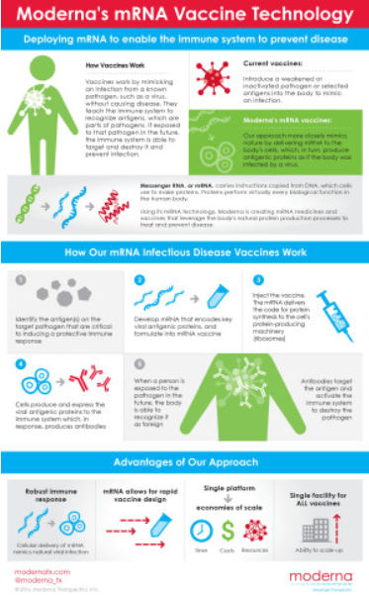
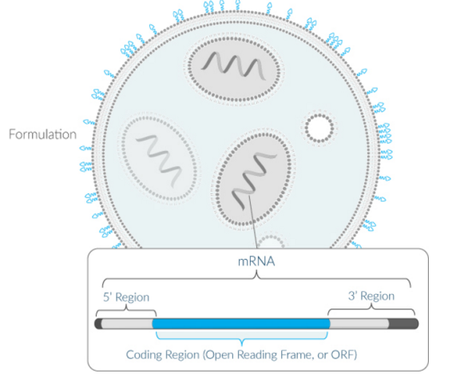
Nucleic Acid Vaccines (2)
Moderna mRNA Vaccine
  Novel chemistry enables mRNA to elude intracellular innate immune responses and act like a native mRNA to express foreign gene
  Robust, protective immunological responses in animal models
  Needle and syringe delivery
  Phase 1 initiated in December 2016
Lipid NanoParticle
Notes:
Phase 1 trial started assessing various mRNA doses with full results available in the fall.
Mike Watson will update the workshop tomorrow afternoon.

Slide 26

Inactivated Zika Vaccines (ZPIV)
Two candidates in development: Sanofi Pasteur and Takeda
Formalin-inactivated Zika virus, alum-adjuvanted
“Proof-of-concept” lot manufactured by WRAIR based on technology used for Japanese Encephalitis vaccine
Vaccine is fully protective in mice and NHP models
NIAID and WRAIR will conduct four Phase 1 clinical trials to evaluate safety and immunogenicity
WRAIR is transferring technology to Sanofi Pasteur – accelerating development
BARDA awarded development contracts to Sanofi and Takeda to manufacture and license an inactivated Zika vaccine
Notes:
5 clinical trials planned with ZPIV (Q4 2016-Q1 2017)
Four single-site trials testing ZPIV alone
St. Louis University (NIAID/VTEU) – Dose sparing, ongoing
WRAIR – Prior vaccination with other flavivirus vaccines (YF, JE), ongoing
BIDMC (WRAIR) – Alternate dose schedule, ongoing
Puerto Rico (NIAID/VTEU) – Population previously exposed to flavivirus infection, initiates in Feb. 2017
One trial testing ZPIV in combination with Zika DNA vaccine prime (VRC)
Takeda manufacturing expertise in Hikari, Japan

Slide 27

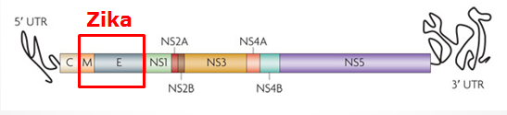
Live Attenuated Dengue/Zika Chimeric Vaccine
Developed by NIAID/Laboratory of Infectious Diseases using attenuated live dengue vaccine platform
Dengue vaccine in Phase 3 trials (Brazil)
Zika vaccine built on dengue 2 backbone
Phase 1 trial to launch in 2017

Slide 28
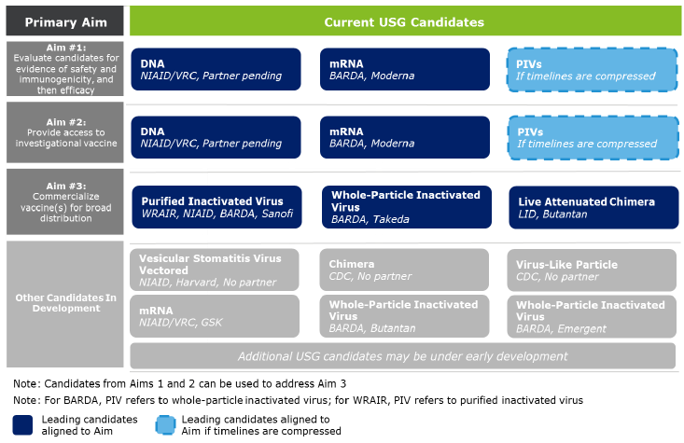
Alignment of USG Vaccine Candidates to Aims
28

Slide 29
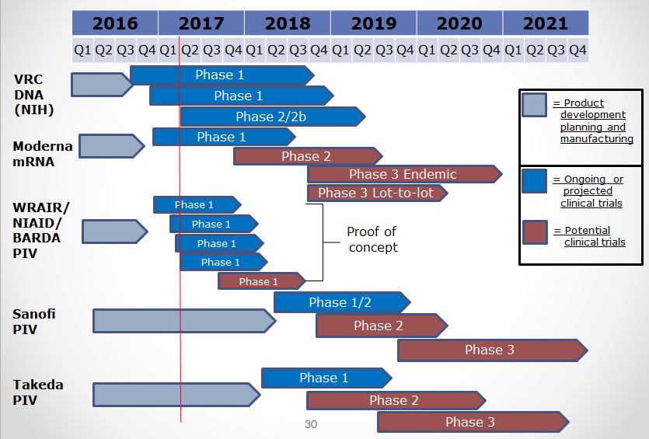
USG ZIKV Trials – Proposed Timelines

Slide 30
Purpose of Setting Product Characteristics
Pre-decisional Procurement Sensitive
    Align USG on minimal and preferred characteristics for Zika vaccine candidates
    Communicate USG intent on Zika vaccines to existing and potential industry partners
    Set criteria for prioritizing and down-selecting candidates
Criteria will evolve as new data are available
30

Slide 31
Product Characteristic Setting Considerations for Aim 2
Make candidate vaccine(s) available under an appropriate regulatory mechanism by 2018 to US populations at high risk of exposure, including travelers to areas where outbreaks persist
Example Characteristics | Example Considerations
Target Population | Identify individuals at greatest risk. Both females and males? Who should be excluded?
Indication | How should the efficacy of the vaccine be determined (measured)?
Efficacy | What magnitude of efficacy is acceptable? How long should it last?
Safety/ Reactogenicity | What is an acceptable safety profile?
Route of Administration | Intramuscular? Are multiple injections acceptable?
Dose Schedule | How many doses will be necessary? When should they be administered?
Product Stability and Storage | Are frozen vaccine doses acceptable? How long should the vaccine remain potent at 2-8°C? At room temperature? Should a preservative be allowed?

Slide 32
Aim 2 Strategy
Rapid preclinical (murine and NHP) and Phase 1 clinical evaluations (sero-negative and sero-positive)
Development of cGMP manufacturing processes
Phase 2b efficacy study endpoints
  Disease
  Infection
Standardized assays to establish potential immune correlates of protection
Establish regulatory framework with FDA

Slide 33
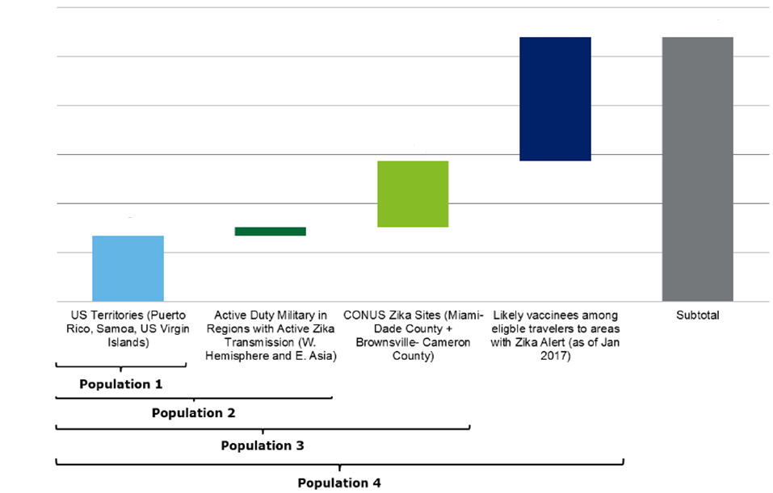
Aim 2 Target Population Considerations
Limited vaccine supply and delivery
Greatest risk populations
Risk – benefit assessment

Slide 34
Aim 3 Strategy
Work with industry partners to develop robust cGMP manufacturing processes
Assume that Phase 3 efficacy will be determined in field trials using clinical and/or infectivity endpoints
Prepare for potential that epidemic will wane and accelerated approval path will be required– USG developing NHP model to assess correlates of protection
Provide sufficient financial support to carry through Phase 3

Slide 35
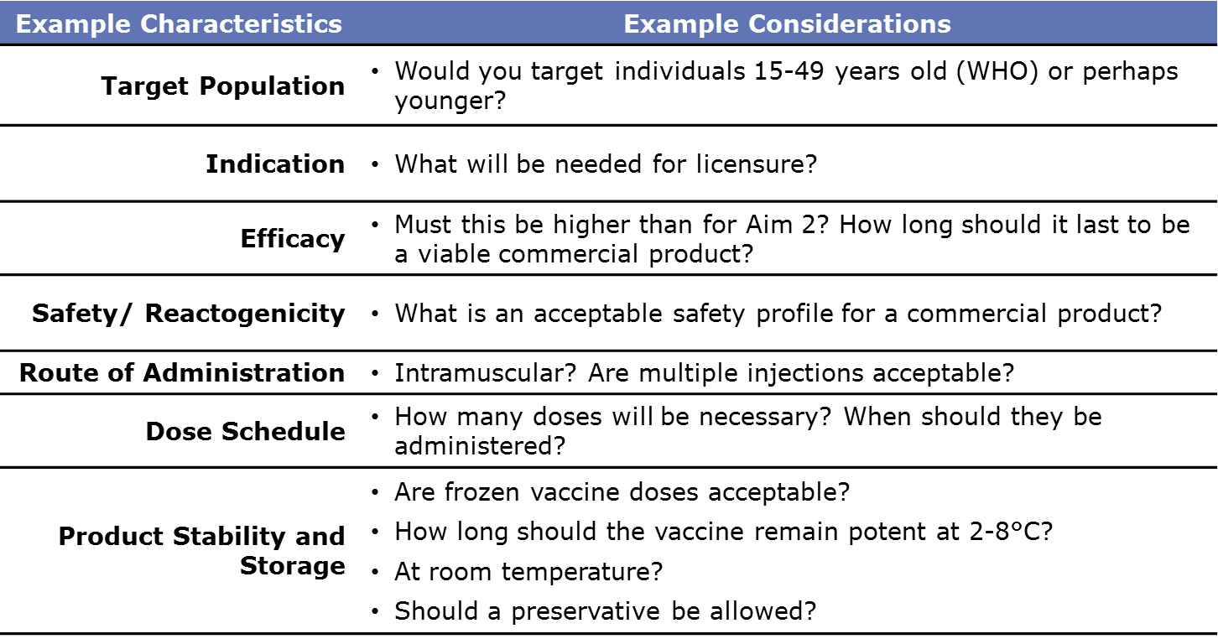
Notional Product Characteristics for Aim 3
  Work with industry partners to commercialize vaccine(s) for broad distribution by 2020

Slide 36
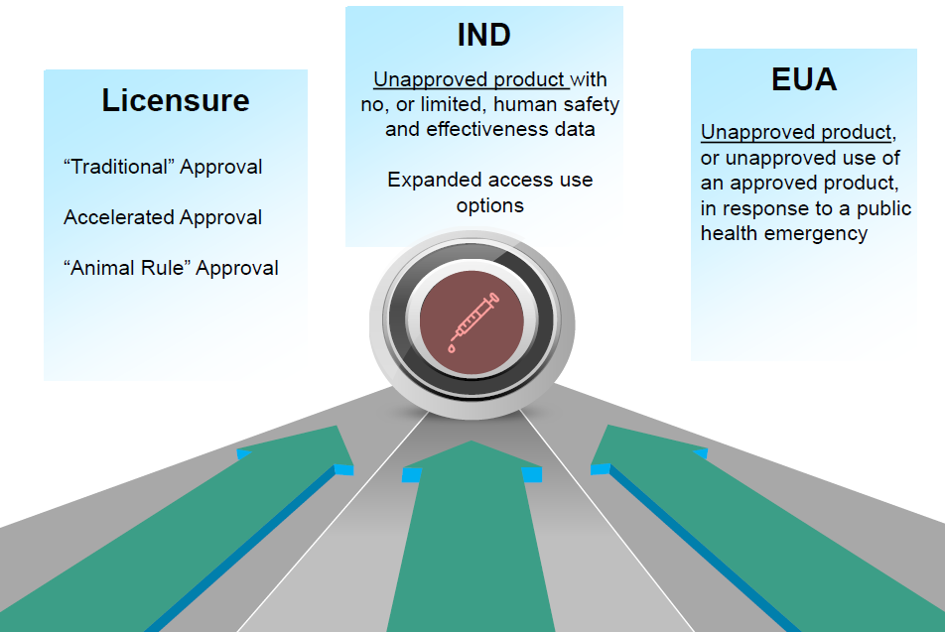
Regulatory Framework to Make Zika Vaccine Available

Slide 37
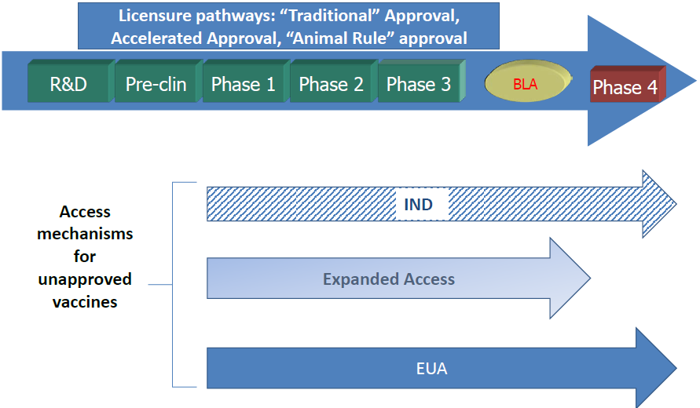
Clinical Development of Vaccines for Licensure
37

Slide 38
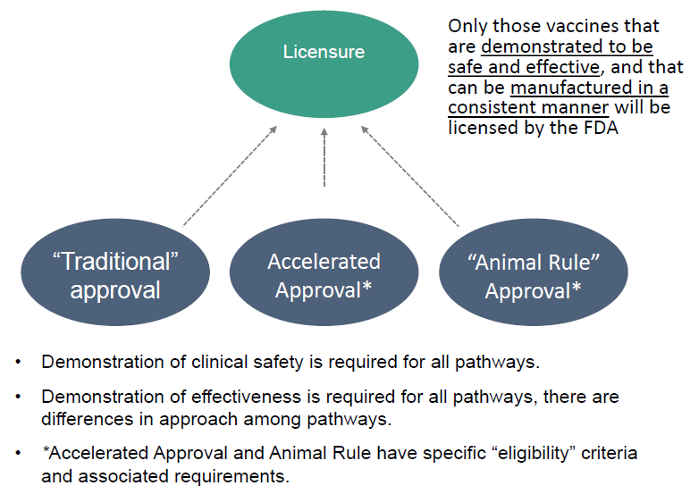
US Licensure Pathways
Notes:
“Traditional” Approval”
based on adequate and well-controlledclinical studies demonstrating:
Prevention of diseaseorImmunologic response
scientifically well-established immunologic marker to predict protection that can be reliably measured in a validated assay
facilitated by an understanding of disease pathogenesis and mechanism by which vaccine prevents disease
ZikaVaccine Considerations
Feasibility of conducting an “outbreak” field trial
Ethical considerations of randomizing to a placebo or inactive control
May need immunogenicity data to bridge non-outbreak area populations (traveler’s indication)
Trial size will vary depending on attack rate, endpoint of interest (infection vs disease outcome), estimate of vaccine efficacy
Accelerated Approval
for product addressing serious or life-threatening illnesses AND provide meaningful therapeutic benefit over existing therapy
adequate and well-controlledclinical trial using surrogate endpoint reasonably likely to predict clinical benefit; need to verify clinical benefit post-approval (21 CFR Subpart E, 601.41)
Zika Vaccine Considerations
A surrogate endpoint needs to be identifiedAssay precision, validation and performance
Confirmatory trial designAdequate and well controlled in a post-licensure setting (may be ongoing a the time of approval
Animal Rule Approval
for serious or life-threatening conditions;
definitive human efficacy studies not ethical or feasible;
efficacy based on adequate and well-controlledanimal studies;
need to verify clinical benefit during exigency
Not applicable to products that can be approved via “traditional” or accelerated approval pathways
(21 CFR Subpart H, 601.90-95)
Zika Vaccine Considerations
Pathophysiological mechanism of toxicity of the substance and prevention by the product needs to be reasonably well understood
>1 animal species that mimics human disease and response to vaccine (unless single species sufficiently well characterized)
Animal endpoint clearly related to desired benefit in the humans
Improved survival
Prevention of major morbidity e.g. congenital malformations

Slide 39
Zika Incidence and Implications for Vaccine Trials
Modeling studies suggest that Zika incidence in the Americas in 2017 is anticipated to be much lower than in 2016.
  This conclusion is driven by the estimation that the pool of susceptible individuals has been significantly depleted in the first waves of infection
  Available data quality is very poor
  With these same important caveats, the declining incidence trend is expected to continue into 2018
Declining incidence and difficulty with case ascertainment pose significant challenges to vaccine efficacy clinical trials
  In order to be well-powered, prospective vaccine efficacy studies targeting symptomatic illness or infection may need to be very large
  Using alternate endpoints (paired with suitable animal studies) or human challenge studies should be considered
Notes:
NIH, CDC, and BARDA have been working with a group of 3 academic modeling teams to consider potential 2017 incidence in Latin America to inform clinical trial site selection
The study focused on eight priority countries (selected by NIH):
Brazil
Colombia
Costa Rica
Dominican Republic
Ecuador
Mexico
Panama
Peru
The primary questions were:
Are any regions (states, departments, provinces) in these countries anticipated to have at least a 10% incidence of Zika infection in 2017?
What is the relative anticipated infection rate across regions within each country?
These estimates could not be immediately compared across countries due to methodological differences
Only one of the 3 models in the study made explicit estimates of anticipated incidence, and for this model:
No states, provinces, or departments in the eight priority countries were expected to have projected Zika infection rates ≥10% in 2017
Five provinces in two countries were anticipated to have projected Zika infection rates ≥5% in 2017; three of these were also relatively highly-ranked regions by at least two models in the study
Ecuador: Sucumbios, Esmeraldas, and Orellana
Peru: Tumbes and Piura
There were 21 municipalities that had at least a 5% probability of having a Zika virus infection rate ≥10% in 2017; nine of these were in 8 states, provinces, or departments that were relatively highly-ranked regions by at least two models in the study
Colombia: Tumaco in Narino state
Ecuador: Lago Agrio/Nueva Loja in Sucumbios province
Mexico: Los Mochis and Culiacan in Sinaloa state, and Tampico in Tamaulipas State
Peru: Piura in Piura department, Tumbes in Tumbes department, Tarapoto in San Martin department, and Pacallpa in Ucayali department
The qualitative implication of the study was that the total number of participants, number of study sites, and/or duration of study follow-up for the study may need to be increased to meet efficacy endpoints.
Outside of the few examples highlighted on the previous slide, explicit incidence projections at the state, province, or department level were all less than 1%
Nearly all were less that 0.5%
The significant majority were less than 0.1% (and in many cases less than 0.01%)
If these declining incidence trends continue as expected, Zika incidence in late 2017 and 2018 would be expected to be comparatively very low
Data about persistence of detectable virus in whole blood and urine is sparse, and suggests that only a fraction of individuals may have extended detection windows
Mansuy et al. (Eurosurv.)– 2 out of 5 individuals with virus expected to be detectable in WB at 30 days after symptom onset
Murray et al. (EID) – single individual with positive WB samples up to 81 days after symptom onset
Lustig et al. – 5 individuals with positive WB samples from within first month after symptom onset; 3 out of 4 individuals with positive samples in second month
Paz-Bailey et al. (NEJM) – estimated ~40% of infected individuals would have detectable virus in urine during first two weeks, and ~60% during first week after symptom onset
Symptomatic illness rates of ~20% will further limit observed event rates in clinical studies if symptomatic disease is used as an endpoint

Slide 40
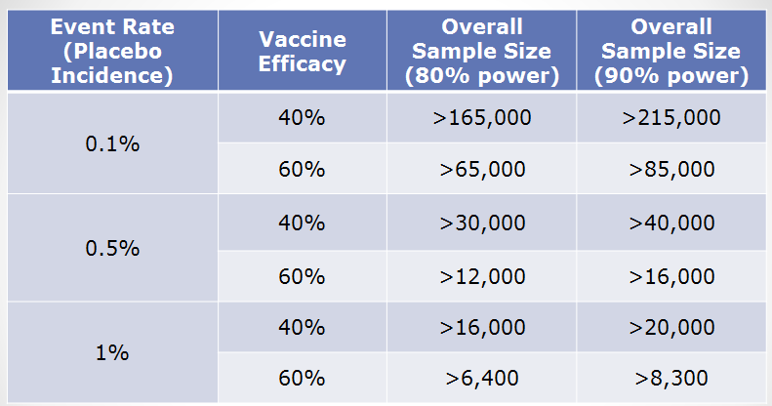
Power Implications
Prospective vaccination studies would need to be very large in order to be well-powered to detect vaccine efficacy against symptomatic disease or infection
These assume a two-sided conditional exact test with 5% alpha, and ignore loss to follow-up and any stratification by baseline Zika or flavivirus status

Slide 41


Slide 42
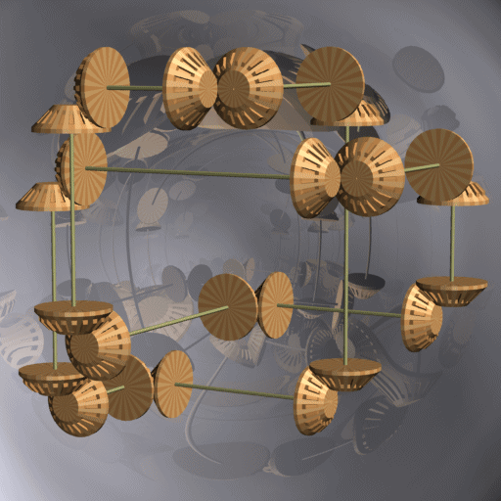

Slide 43
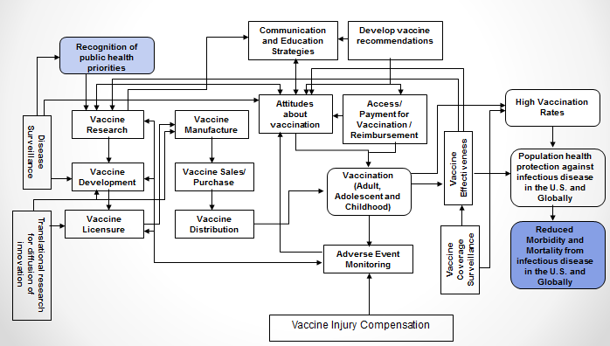
The Vaccine and Immunization Enterprise
The perpetual effort to break down barriers of cooperation throughout the vaccine development enterprise

Slide 44


Slide 45
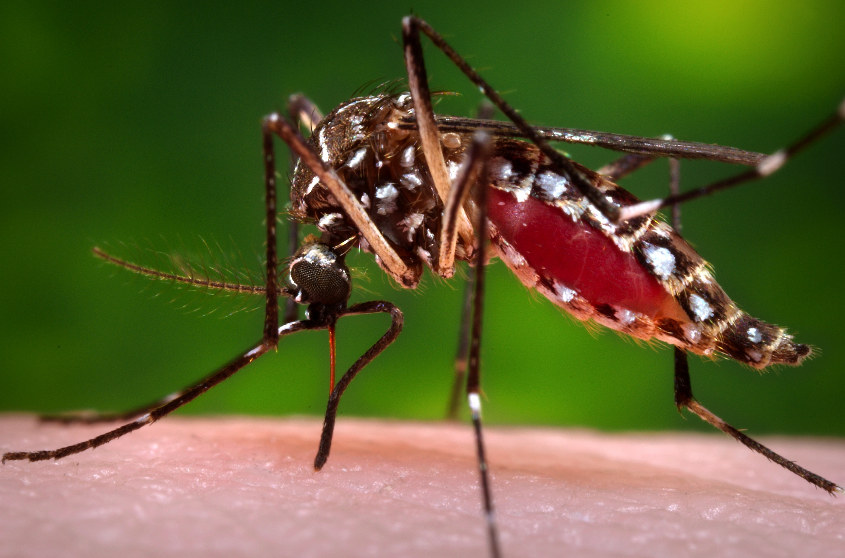


THANK YOU
Photo credit: CDC/James Gathany
Notes:
Final slide shows a picture of a Aedes aegypti mosquito taking a blood meal.

