Slide 1
Thrombotic Thrombocytopenic Purpura From bench to bedside Long Zheng, M.D., Ph.D. Robert B. & Jean Adams Professor Director, Division of Laboratory Medicine, Department of Pathology, University of Alabama at Birmingham, Birmingham, AL 35249

Slide 2
Outline
A patient I saw
Discovery of the mechanism of the disease
How can a laboratory help diagnosis?
Current and potential novel therapeutics
Prospective

Slide 3
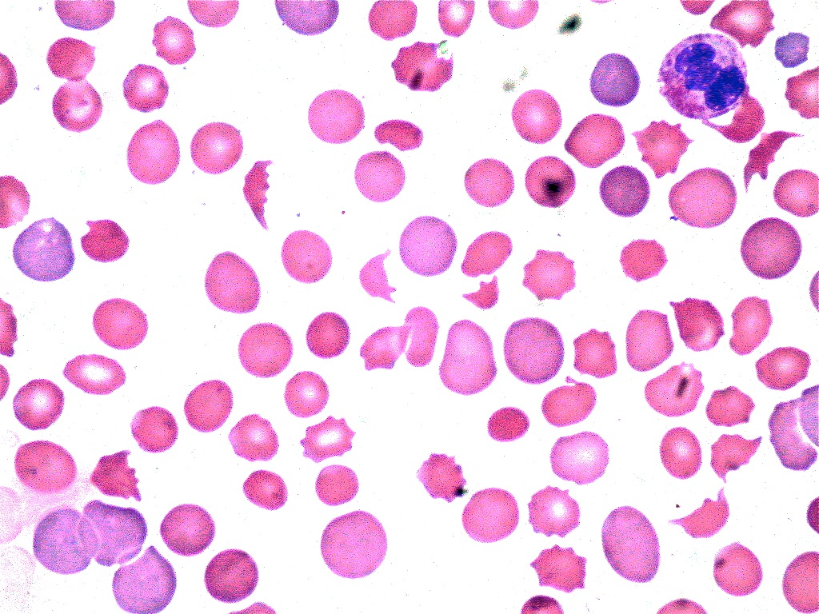
42 Y AAF presented with lethargy, blurred vision, and disorientation in May 1999.
Blood count: Platelet 24,000/μl and Hb 9.6 g/dL
Chemistry: LDH 1,157 U/L, haptoglobin 0.09 g/L,
creatinine: 1.6 mg/dL
Normal PT and PTT, and negative DAT.
CT scan: multiple infarcts in the brain.
Blood smear: >10schistocytes

Slide 4
What is the diagnosis of this case?
Thrombotic thrombocytopenic purpura (TTP)
Thrombocytopenia (low platelet count)
Microangiopathic Hemolytic Anemia
low Hemoglobin
low hematocrit
low haptoglobin
elevated LDH and slight elevation of Cr
fragmentation of red blood cells
Organ ischemia or dysfunction
Neurological signs & symptoms
Renal failure
Abdominal pain, N/V and diarrhea

Slide 5
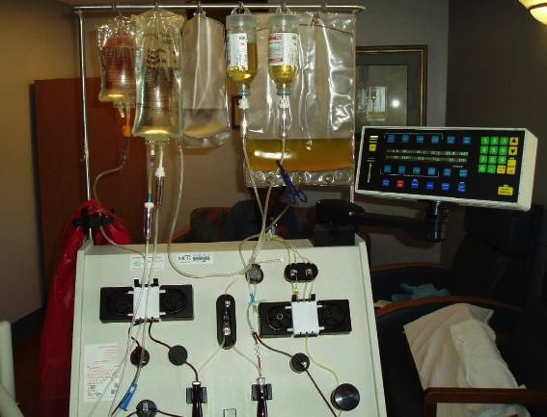
Plasma exchange work is the only effective therapy
Daily plasma exchange 1.0-1.5x volume
Dr. Tim Godnough
(1999)
- Removes “evil humours”
- Replenishes “something good”

Slide 6
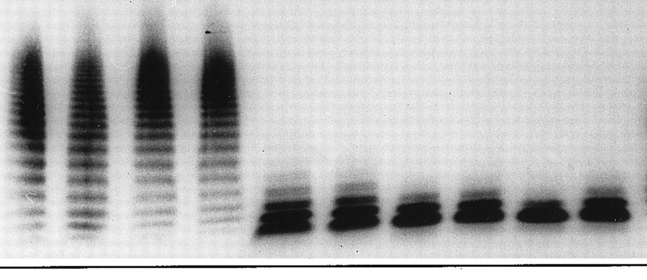
Deficiency of a plasma VWF–cleaving protease in patients with chronic relapsing TTP
Chronic
Relapsing TTP
Asymptomatic
family members
NHP
Dr. Bernhard Lämmle
-1997
Sample
1
2
1
2
1
2
1
2
1
2
VWF-cleaving
protease
Urea or
guanidine
Shear
Furlan M et al. Blood 1997; 89:3097-3103

Slide 7
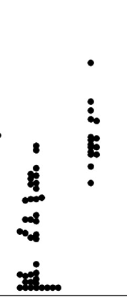
Autoantibodies against VWF-cleaving protease detected in most patients with acquired TTP
50:50 mixing
200-
200-
Dr. Han-Mou Tsai
- 1998
150-
150-
VWF-cleaving activity (%)
100-
100-
Residual VWF-cleaving activity (%)
50-
50-
0-
0-
Acute
Rem
Acute
Rem
IgG purified from protein A-Sepherose is responsible for
the inhibitory activity
Tsai and Lian. NEJM, 1998

Slide 8
J Biol Chem. 2001 Nov 2;276(44):41059-63. Epub 2001 Sep 13.
Structure of von Willebrand Factor-cleaving Protease (ADAMTS13), a Metalloprotease Involved in Thrombotic Thrombocytopenic Purpura*
Xinglong Zheng‡§, Dominic Chung§¶, Thomas K. Takayama‖, Elaine M. Majerus**, J. Evan Sadler**‡§§ and Kazuo Fujikawa¶
Departments of ‡Pathology, **Medicine, and §§Biochemistry and Molecular Biophysics and Howard Hughes Medical Institute, Washington University School of Medicine, St. Louis, Missouri 63110 and the Departments of ¶Biochemistry and ^{‖I}Urology, University of Washington, Seattle, Washington 98195

Slide 9
Landmark discoveries toward our understanding of the pathogenesis of TTP
-1924
-1960
-1978
-1982
-1997
-2001
-1998
Other diseases
TTP
1st case
description
Moschcowitz
Plasma
factor
deficiency
Schulman
Upshaw
Ultra large
VWF
“evil humour”
Moake
VWF-cp &
autoantibody
Furlan
Tsai
Identification
& cloning of
ADAMTS13
Gerritsen
Fujikawa
Soejima
Zheng
Levy
87 years
Saha, McDaniel, Zheng. JTH 2017 (submitted)

Slide 10
Pathogenesis of TTP
All patients have plasma ADAMTS13 activity < 10% of normal.
Hereditary TTP: Severe ADAMTS13 deficiency but no inhibitor is detected or ADAMTS13 mutations detected
<5%
Acquired TTP: Inhibitors or anti-ADAMTS13 IgGs are detected.
>95%

Slide 11
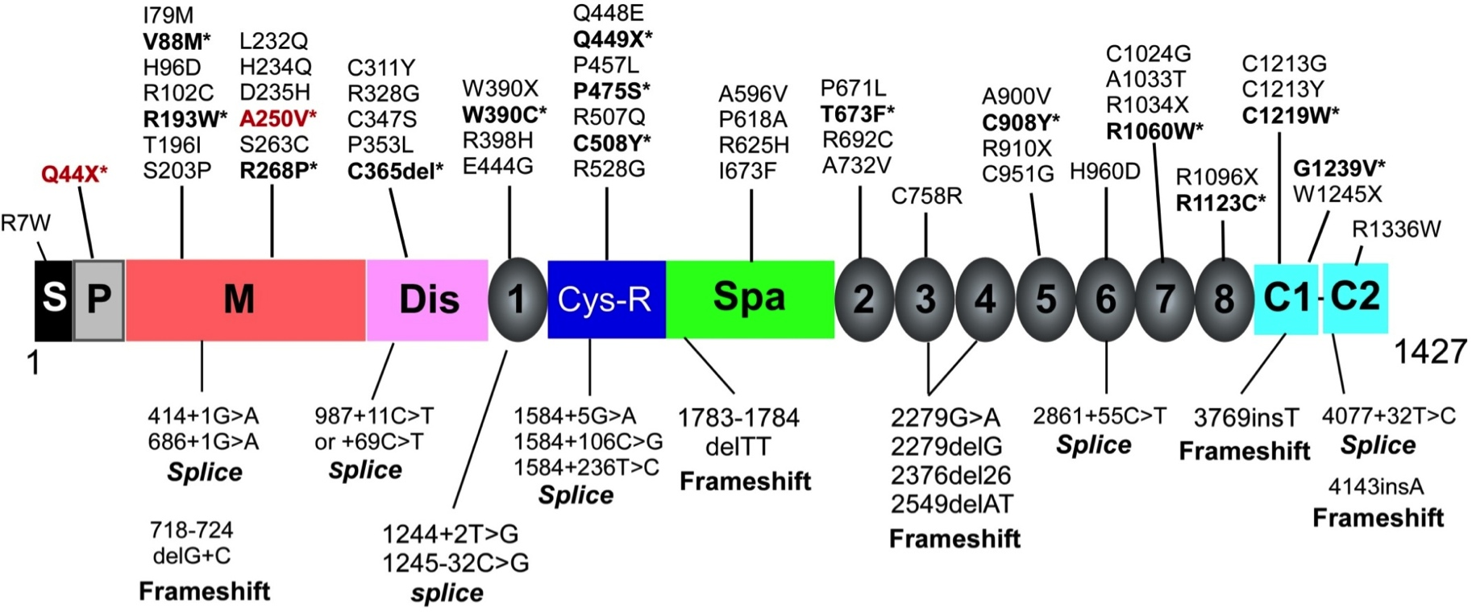
ADAMTS13 mutations are the primary cause of hereditary TTP
on
The only known function is to cleave von Willebrand factor, thereby reducing platelet agglutination and thrombus formation
- 195 kDa protein
- Produced in liver
- Plasma concentration: 0.5-1.2 mg/dL
59% missense; 13% nonsense
13% deletions; 6% insertions
9% alternative splicing
>200
A majority of cases have compound heterozygous mutations
Levy et al. Nature, 2001.
Zheng & Sadler. Ann. Rev. Pathol., 2008;3:249-77.

Slide 12
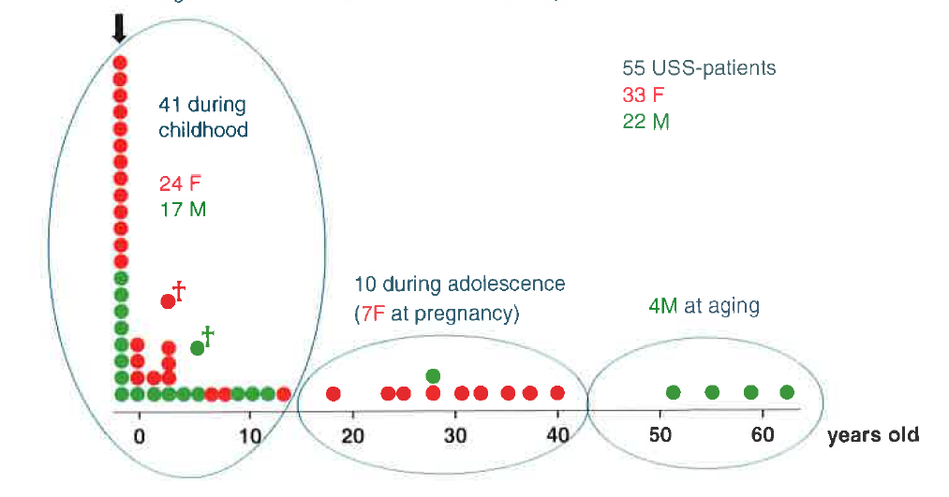
Age of onset for the 1st thrombocytopenia in patients with hereditary TTP varies greatly
All patients except for one have ADAMTS13 activity < 0.5%
Early onset
(75%)
Late onset (25%)
Other genetic or environmental factors may contribute to the pathogenesis of TTP
Fujimura et al. ADAMTS13 Biology and Disease
ed. By G.M. Rodgers, Springer 2015

Slide 13
What could be a potential trigger?
Infection and inflammation
Complement amplification conditions
Pregnancy
Certain medications
Surgery
TTP must be differentiated from hemolytic uremic syndrome (HUS)

Slide 14
TTP vs. HUS
Favors TTP
Favors HUS
Platelets < 30,000/μl
Normal or near normal renal function
Response to plasma exchange
ADAMTS13 activity (<10%)*
Less severe thrombocytopenia
Significant renal dysfunction (cr. >2.2 mg/dL)
Lack of complete response to plasma exchange
Normal ADAMTS13 (>20%)
*ADAMTS13 activity is the single most important test to distinguish TTP from aHUS.
Bentley. ADAMTS13 Biology and Disease
ed. By G.M. Rodgers, Springer 2015

Slide 15
How is ADAMTS13 test performed?
FRETS-rVWF73
Tyr-Met
Normal
ADAMTS13
Rate of fluorescence (AU/sec)
TTP Patient
Tyr
Met
0
15
30
45
60
Time (min)
% Activity = Patient Slope/Normal Slope x100

Slide 16
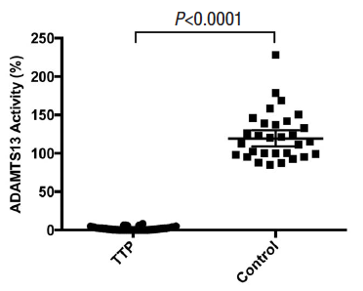
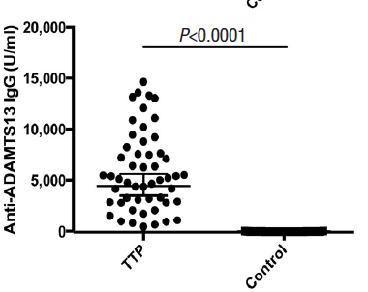
Plasma ADAMTS13 activity and anti-ADAMTS13 IgG in patients with acquired TTP at UAB medical Center
(N=52)
(N=30)
(N=52)
(N=30)
Cao et al.

Slide 17
Autoantibodies appear to bind the spacer domain where it interacts with substrate VWF
Anti-A13 IgGs
CUB
v
v
v
v
v
v
v
TSP1 2-8
Five small flexible loops in the spacer domain are specifically targeted by autoantibodies from TTP patients.
Casina et al, PNAS, 2015, Aug 4;112:9620-5

Slide 18
How do you treat TTP?
Hereditary TTP
Plasma infusion or rADAMTS13 (clinical trial)
Acquired TTP
Plasma exchange
Immune suppression
Corticosteroids
Vincristine
Cyclosporine
Cyclophosphamide
Rituximab and
Bortezomib

Slide 19
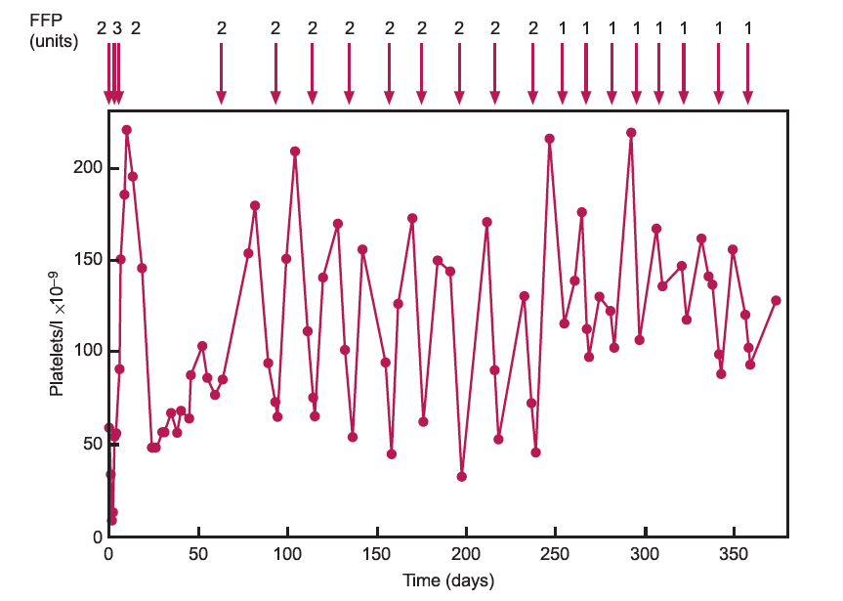
Platelet counts in patients with hereditary TTP after plasma infusion
Furlan & Lammle. Best Pract. Res. Clin. Haematol. 2001, 14, 437-454

Slide 20
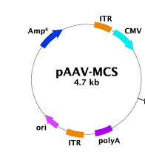
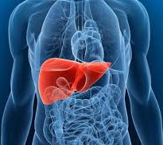
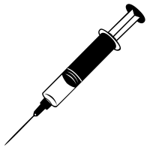
AAV8-based gene therapy for cure
of hereditary TTP
pAAV8-
mMDTCS
MDTCS
Zheng lab at UAB

Slide 21
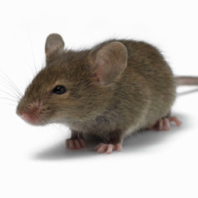
AAV8-mediated liver expression of rADAMTS13 protects Shigatoxin-induced TTP in mice
100-
AAV8-mMDTCS
Shigatoxin
50-
ADAMTS13 activity (%)
CBC
0-
Adamts13^{-/-}
0
14
(Days)
0
14
28
42
Days
B
Jin et al. Blood. 2013,121(19):3825-9

Slide 22
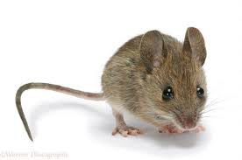
AAV8 gene therapy dramatically reduced the mortality rate in Adamts13^{-/-} mice after Stx-2 challenge
Stx-2
AAV8-hAAT-mMDTCS
2.6x10¹¹ vg/kg
Survival rate (%)
AAV8-hAAT-LacZ
2.6x10¹¹ vg/kg
Jin et al. Blood. 2013,121(19):3825-9

Slide 23
Plasma exchange is not adequate for treatment of acquired TTP
In-hospital mortality remains as high as 20%
30% of patients who survived the initial episode experienced exacerbation or relapses
Adverse effects associated with administration of plasma or catheter
Call for better therapeutics

Slide 24
Novel therapies are urgently needed for acquired TTP
Antibody-resistant rADAMTS13
Platelet-delivery of rADAMTS13
Anfibatide, a GP1b antagonist isolated from snake venom

Slide 25
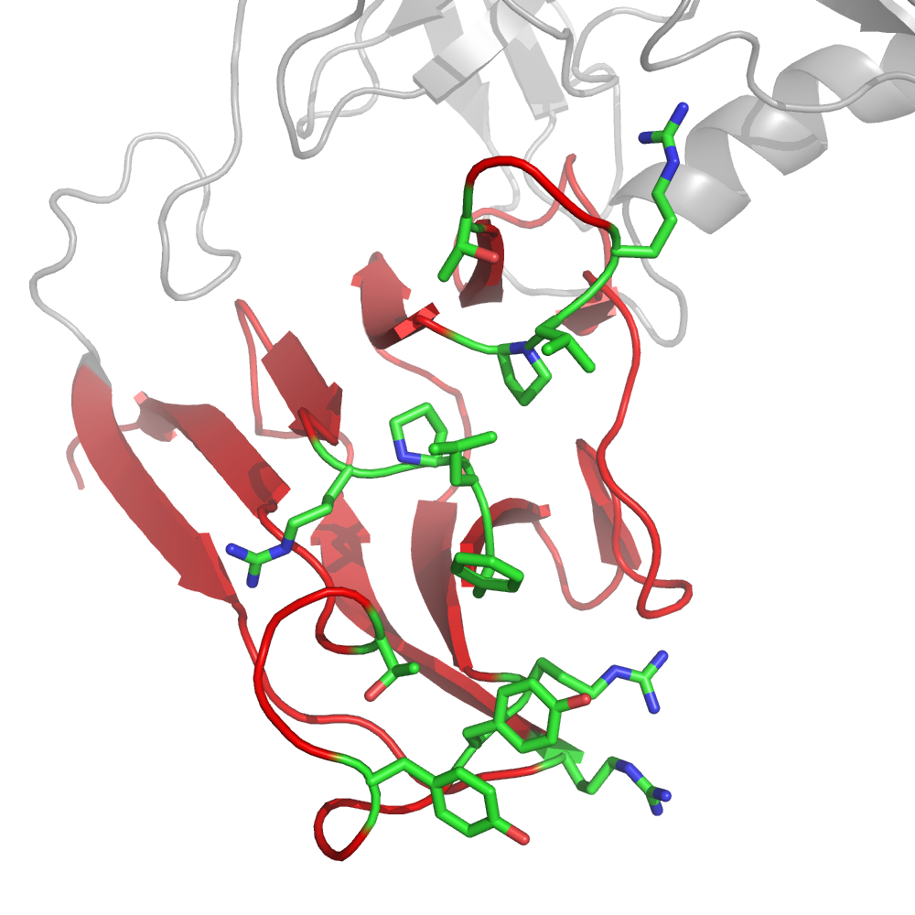
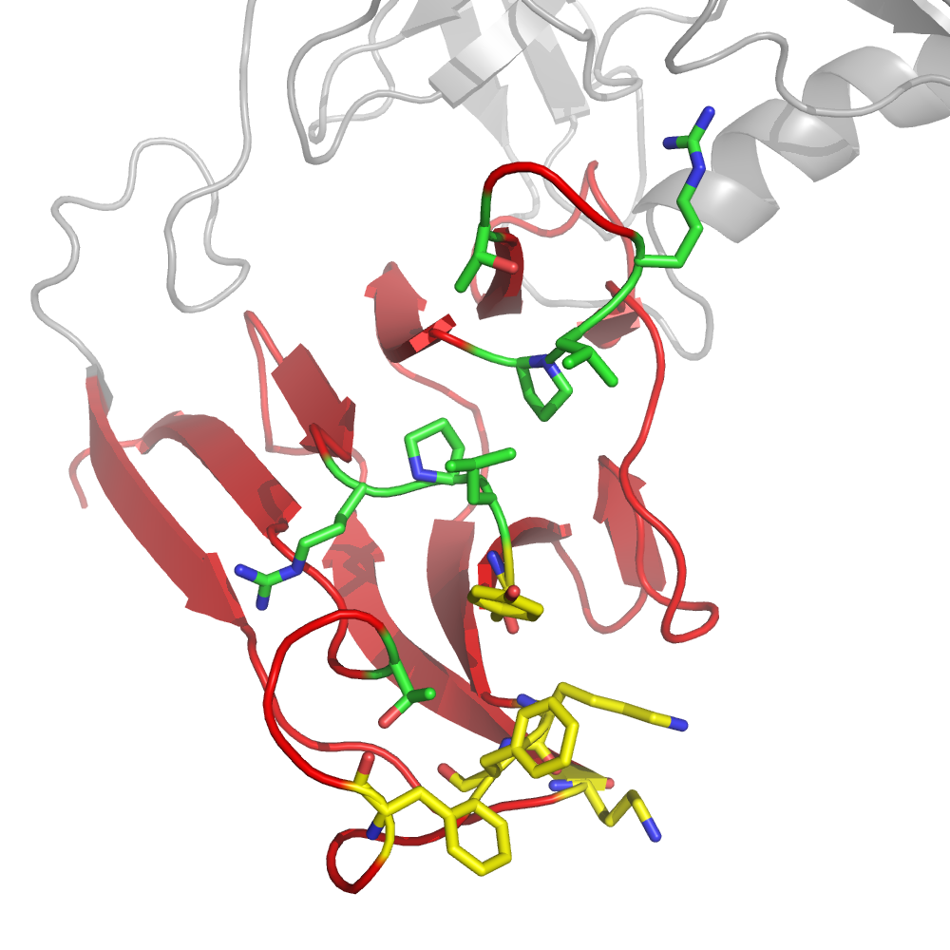
Cosmetic Surgery on ADAMTS13
β7-β8
loop
R636
T633
β8
β7
β6
β3
β10
P590
L591
β1
F592
592Y
R660
R660
T669
661F
660K
Y661
Loop A
Y661
β9-β10
loop
568K
R568
Y665
665F
Y665
Jian et al, Blood, 2012; 119:3836-43.

Slide 26
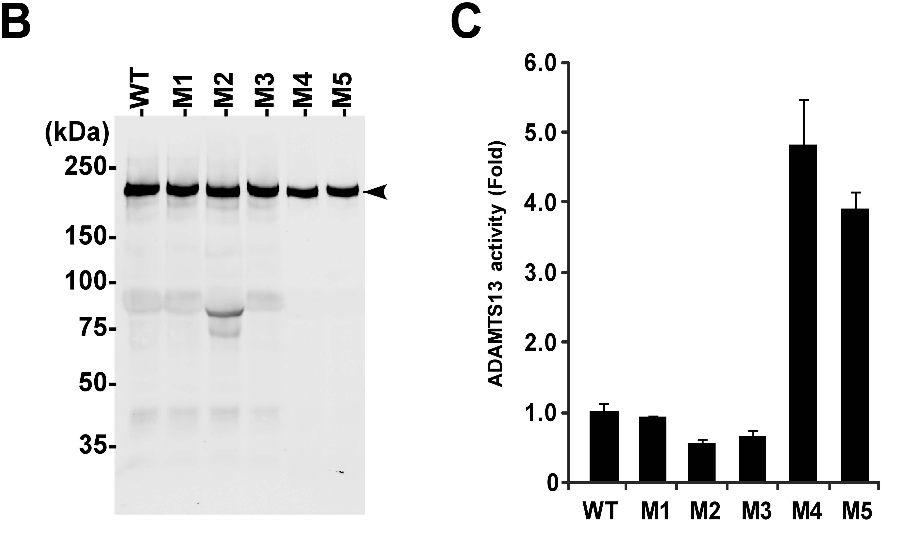
rADAMTS13 variants (M4 & M5) exhibit an increased specific activity by 4-5 fold
Jian et al, Blood, 2012; 119:3836-43.

Slide 27
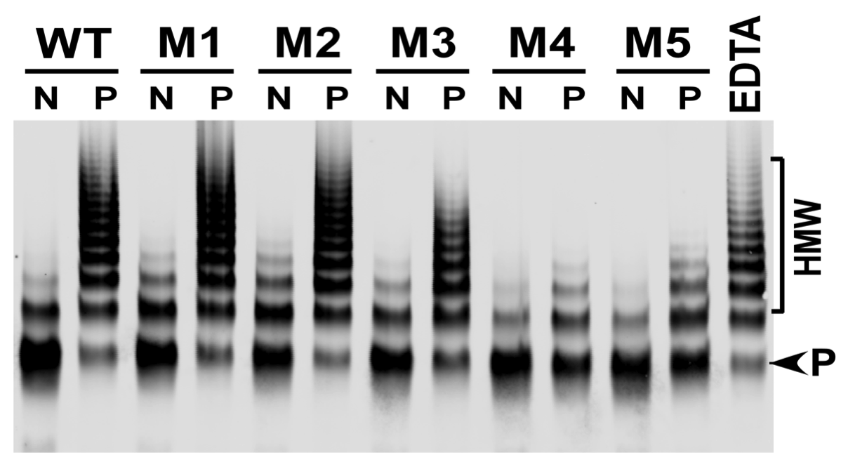
rADAMTS13 variants (M4 & M5) are more resistant to inhibition by autoantibodies from TTP patients
rADAMTS13
+ normal or patient
plasma
37°C,
60 min
Residual activity
N: normal human plasma
P: TTP patient plasma
ADAMTS13 variants are resistant to ≈85% TTP patient plasma IgGs.
Jian et al, Blood, 2012; 119:3836-43.
Notes:
More interestingly, ADAMTS13-M4 and M5 were more resistant to inhibition by anti-ADAMTS13 autoantibodies from TTP patients as shown in this slide.

Slide 28
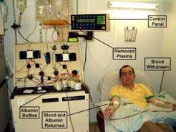
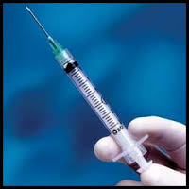
The autoantibody-resistant rADAMTS13 variants may be used to treat acquired TTP without plasma exchange
arADAMTS13
Superenzyme
or

Slide 29
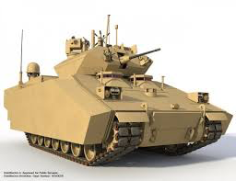
Platelet delivery of rADAMTS13
Hypothesis:
Anti-ADAMTS13
IgG
ADP
Collagen
ADAMTS13
Thrombin
Shear
VWF
multimers
Degraded
VWF
Quiescent
Platelets
Activated
Platelets
Notes:
Platelet ADAMTS13 is releasable upon stimulation.
Locally released ADAMTS13 will not be inhibited by anti-ADAMTS13 IgG, therefore efficacious even in the presence of inhibitors

Slide 30
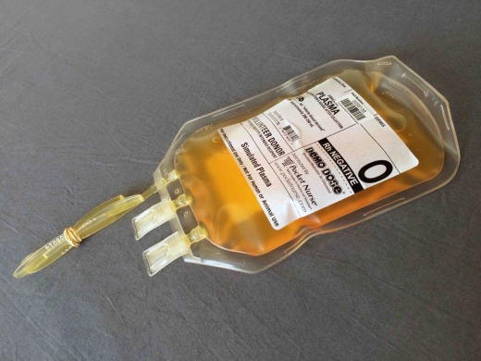
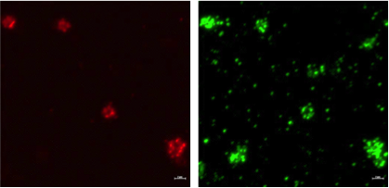
Human platelets uptake rADAMTS13 in a dose-dependent manner
rADAMTS13
37 °C
25 °C
rADAMTS13 (ng)
rA13 (μg/ml)
rA13 (μg/ml)
(kDa)
0
12.5
25
50
100
0
20
40
80
0
20
40
80
230-
180-
116-
66-
40-
A13
VWF
12-

Slide 31
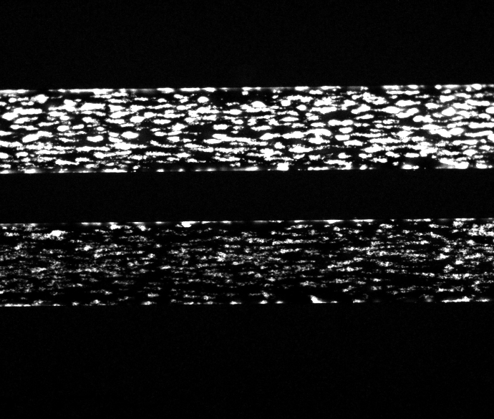
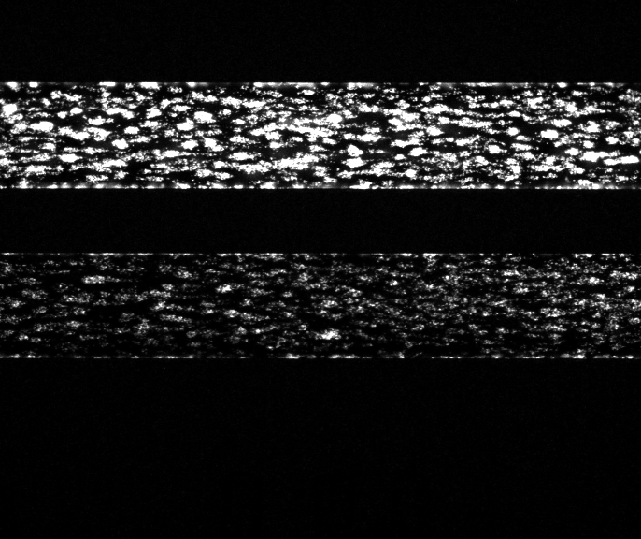
Platelet-delivered rADAMTS13 is efficacious in reducing the rate of thrombus formation under shear
PBS
N=3
rA13
50 μg/ml
PBS
N=3
rA13
100 μg/ml

Slide 32
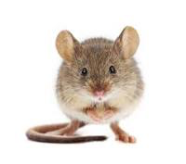
Transgenic mice expressing rADAMTS13
in megakaryocytes and platelets in mice
Adamts13^{-/-}
TG^{Plt+A13}
Pickens et al. Blood, 2015,125(21):3326-34

Slide 33
Platelet-delivered rADAMTS13 reduces the rate of thrombus formation in mesenteric arteriole after FeCl₃ injury
KO
WT
TG
Time (min)
Pickens et al. Blood, 2015,125(21):3326-34
Notes:
Young male mice were anesthetized
Fluorescently dye Rhodamine G (0.2mg/mL) injected by retro orbital plexus of the eye.
Abdominal wall incision made and isolation mesentery performed.
Arterioles are visualized with fluorescent microscope
Injury achieved by applying filter paper dampened with 10 % FeCl₃ on vessel for 5 min followed by vessel monitoring for 30 min after injury until occlusion.
Quantitative analysis performed with NIS-Elements software to determine fold increase thrombus formation over time.

Slide 34
Platelet-delivered rADAMTS13 is efficacious against Shigatoxin-induced TTP in ADAMTS13^{-/-} mice
Adamts13^{-/-}
Shiga toxin
“TTP-like” syndrome
Murine rVWF
p<0.01
p=0.261
Pickens et al. Blood, 2015,125:3326-34

Slide 35
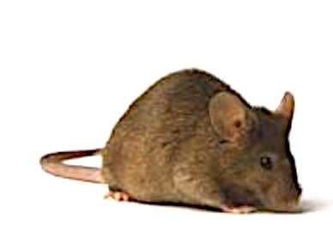
Platelet-delivered rADAMTS13 significantly reduces TTP-associated mortality in the presence of inhibitor
Anti-ADAMTS13
mAb (4-20)
WT or TG^{PtA13}
7(h)
10 μg/gram rVWF
C
B
*****
Pickens et al. Blood, 2015,125:3326-34

Slide 36
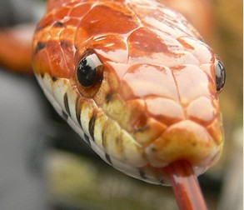
Anfibatide, a GP1b antagonist, isolated from Snake Venom
Activated
VWF
Anfibatide
Quiescent

Slide 37
Anfibatide protects Adamts13^{-/-} mice against Shigatoxin-induced TTP in a dose-dependent manner
Untreated
Treated
Zheng et al. Blood Adv. 2016, 1:1,75-83

Slide 38
Anfibatide eliminates microvascular thrombosis in Adamts13^{-/-} mice after shigatoxin challenge
Brain
Liver
Brain
Liver
Heart
Kidney
Heart
Kidney
Lung
Splenn
Lung
Splenn
Zheng et al. Blood Adv. 2016, 1:1,75-83

Slide 39
Take home…...
TTP is a fatal blood clot disorder.
Deficiency of ADAMTS13 activity is the primary cause.
Plasma infusion or plasma exchange remains the standard of care.

Slide 40
Gene therapy,
rADAMTS13 (antibody-resistant),
Platelets delivery of rADAMTS13,
and the antagonists of VWF-platelet
interaction
May one day become the treatment
of choice in the future.

Slide 41
Acknowledgement
Zheng lab:
Wendy Cao, M.D., Ph.D
Vikram Pillai, Ph.D.
Catherine Zander, Ph.D.
Liang Zheng, Ph.D.
Jenny McDaniel, M.D.
Jay Li, Ph.D.
Nicole Kocher, B.S.
Moh Abdelgawwad, M.D.
Huy P. Pham, M.D., M.P.H.
Lance A. Williams, M.D.
Marisa Marques, M.D.
Robin Lorenz, M.D., Ph.D.
Grant supports
Answering TTP foundation
National Institute of Health

