Slide 1
The Specimen
What It’s All About

Slide 2
Frozen vs. Room Temp vs. 4ºC
If it says frozen … it means frozen
Example: CK Isoforms
Receive many calls …”I need to add on a CK iso to a specimen you already have. (RT serum)
Will not be any good – Why not??
See next slide

Slide 3
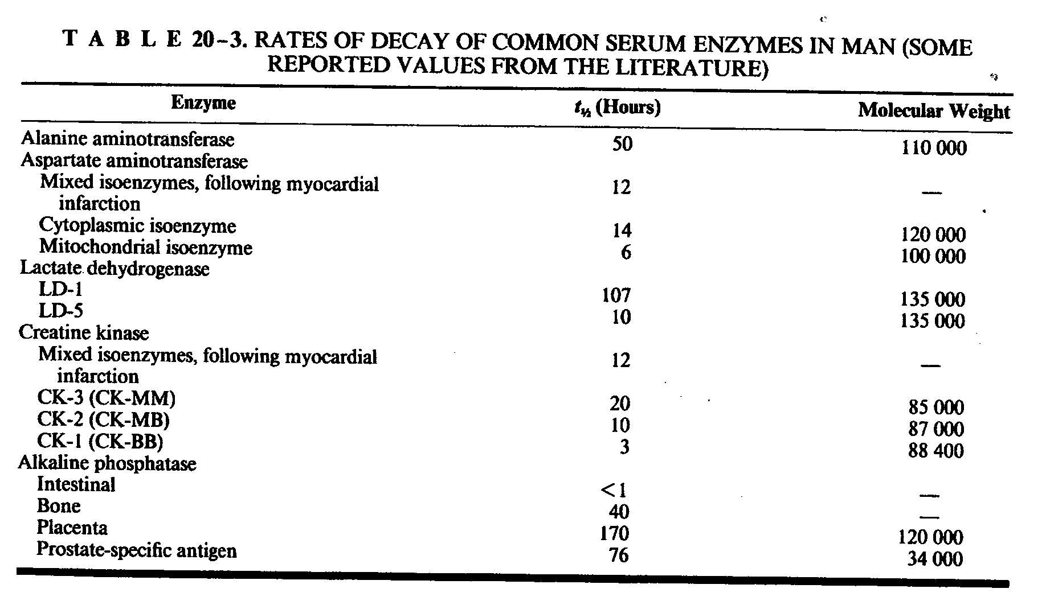

Slide 4
Frozen vs. Room Temp vs. 4ºC, cont’d
The requirements are not made to make your life difficult – they are made to assure that the patient gets the correct result.
Some assays require RT specimens and are not optimal with frozen or refrigerated specimens, e.g., LD isoenzymes
Frozen or 4ºC specs will affect LD 4 and 5 - decrease

Slide 5
Plasma vs. Serum
They are NOT the same
Some analytes are stable in serum but not in plasma
…… and visa versa
e.g., renin (p), potassium (s or p), iron (s)
For some analytes, it doesn’t matter

Slide 6
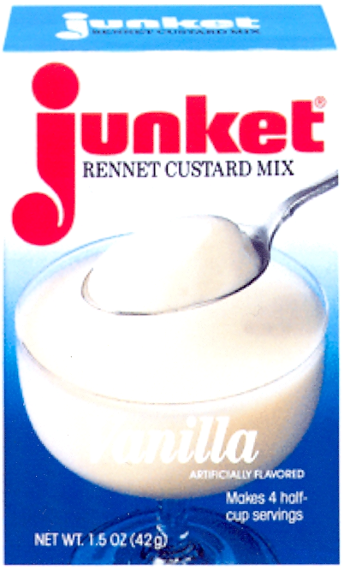

Slide 7
Urine Preservatives
They are necessary
We supply the correct containers and will get them to you ASAP, if needed
Example:
Urine Catecholamine frac – if acid (6N HCl) is not in the container from the beginning of the collection, the values will be underestimated from 10 – 60% … and no, I can’t tell ahead of time what the reduction will be.
“But what if I need an acid-free collection also. Do I have to collect a second 24 hr collection?”
See next page

Slide 8
No, you don’t !! – The P-Splitter

Slide 9
Urine Preservatives
Please use the proper preservative in the urine collection container(s) … for the sake of the patient
Refer to pgs 24-26 in the 2014 Quest Diagnostics Directory of Services for the correct information
….. and use the P-splitter if needed !!

Slide 10
Urine Cultures - the dilemma!
“Why can’t I send my urine culture to Quest in a sterile cup? My hospital lets me do it?”
The answer is mathematics ….. and bacterial growth
A positive urine culture is generally agreed to be >100,000 colonies

Slide 11
Urine Cultures - the dilemma, cont’d
Bacterial growth doubles every 30 minutes in unpreserved urine
Scenario:
Client submits a urine sample in a sterile container – urine has in it 2000 colonies
This specimen, if analyzed at time zero would be reported as “negative”
But let’s look at what happens if the specimen is allowed to remain in this container for 3 hrs before plating/analysis.

Slide 12
Urine Cultures - the dilemma, cont’d
0 hours – 2,000 colonies
0.5 hours – 4,000 colonies
1.0 hours – 8,000 colonies
1.5 hours – 16,000 colonies
2.0 hours – 32,000 colonies
2.5 hours – 64,000 colonies
3.0 hours – 128,000 colonies – UTI!!!

Slide 13
Urine Cultures – the dilemma, cont’d
In 3 hours, a negative urine has become a positive urine culture, simply due to unrestricted bacterial growth in a STERILE URINE CONTAINER
Therefore, it is essential for the PATIENT that a Quest Diagnostics’ urine culture preservative tube be used when submitting a urine culture.

Slide 14
Blood Culture Issues
MUST use bottles supplies by Quest
Other bottles cannot fit on the blood culture automation used by Quest
Bottles will be set up manually and are read 1x/day vs every 5 minutes
Cultures should be obtained PRIOR to the use of systemic antimicrobials
Use a different venipuncture site for each set of of draws (i.e., right arm/left arm)

Slide 15
Blood Culture Issues, cont’d
10mL of blood per bottle
Do NOT use iodine to swab the top of the culture bottle
Do NOT overfill bottle (>12 mL)
If <8 mL, place all in aerobic bottle
If >8 mL but <20 mL, place 10 mL in aerobic and remainder in anaerobic bottle.

Slide 16
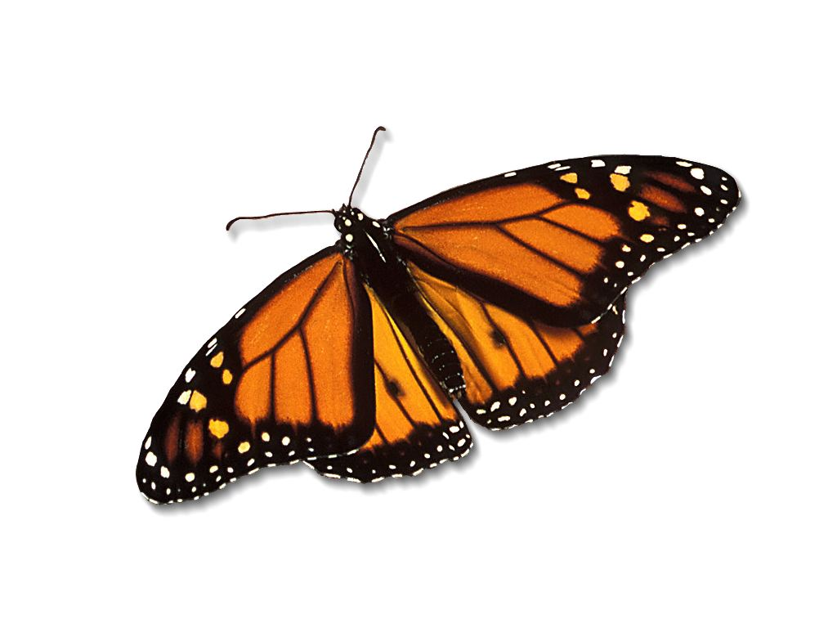

Slide 17
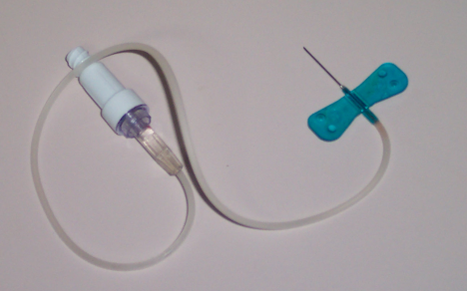

Slide 18
Problems with “butterflies”
When should “butterfly” needles be used?
For pediatric patients where an ample vein is not available
For neonatal phlebotomy
For geriatric phlebotomy where “rolling” veins are present – maybe not !!!! – does anyone remember double tourniquets???

Slide 19
Problems with “butterflies”, cont’d
When should “butterfly” needles not be used?
For routine phlebotomy
For any assay where hemolysis is a major interference

Slide 20
WHY????
Butterfly needles, while easier to manipulate, can cause significant issues in laboratory testing. Due to the small diameter of most butterfly needles (23 gauge or smaller), passage of whole blood through these openings can cause significant hemolysis of the collected specimen and the smaller the gauge, the more likely hemolysis will occur. In addition, due to the tubing connected to these small gauge needles, tube type-to-tube type contamination can occur, e.g., EDTA whole blood being contaminated with Red Top/SST whole blood and visa versa. These issues may in fact require recollection, a fact that obviates any advantages initially realized by phlebotomy with butterflies.

Slide 21
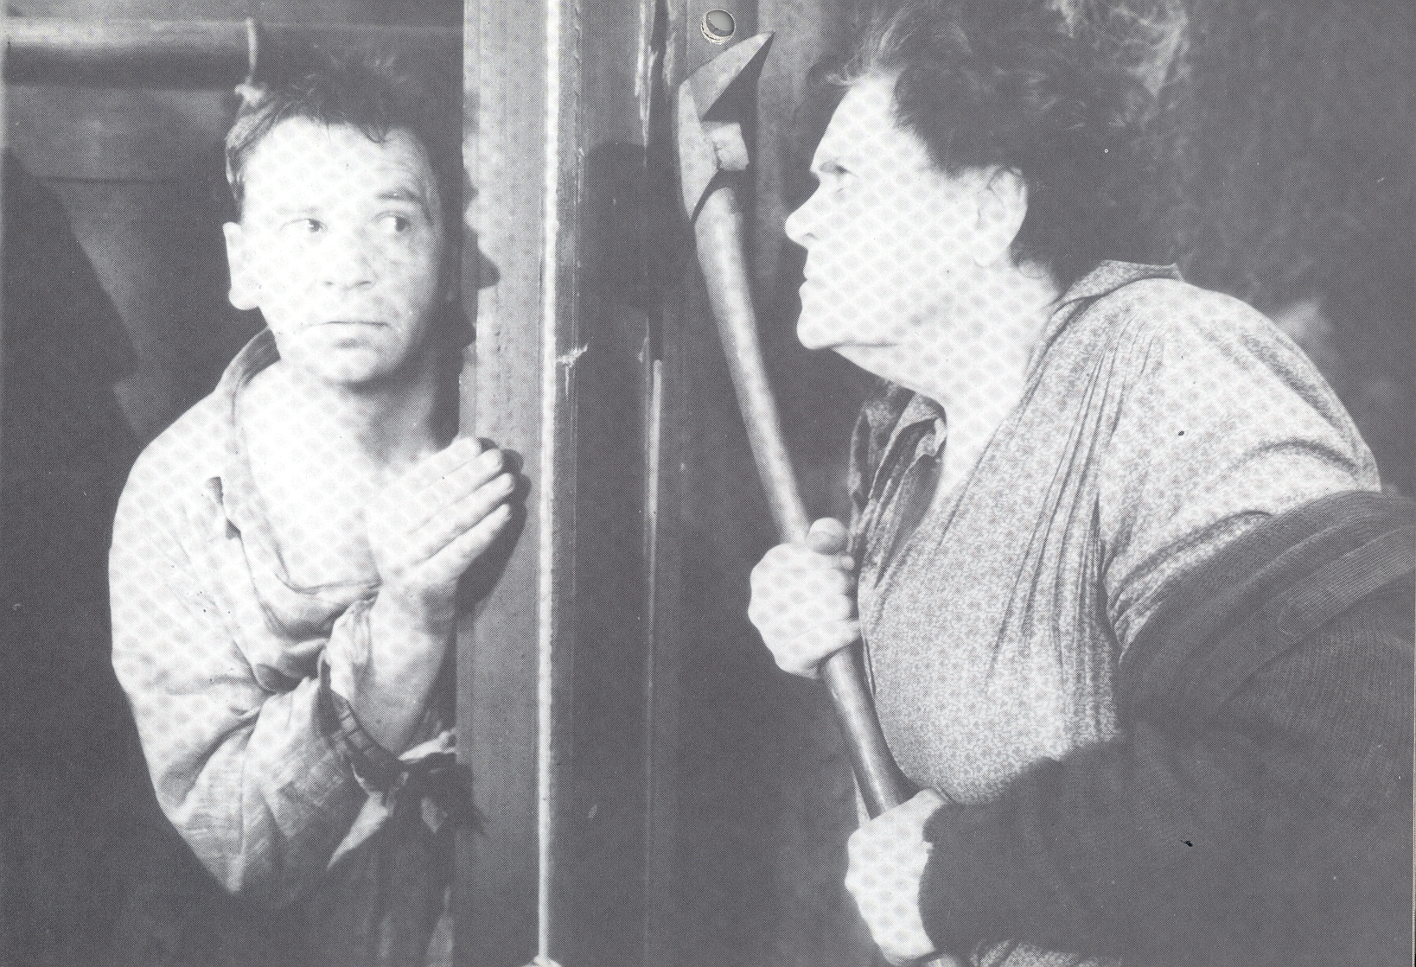

Slide 22
Order of Draw
Client is complaining of “…elevated potassiums from Quest…”
Patient is repeated at the local hospital and guess what? … the potassium is normal. “So what is the problem with Quest?”
We obtained the specimen the hospital had run … and got a normal value for K⁺.
We sent our specimen to the hospital … and they got an elevated K⁺.
So what’s going on?

Slide 23
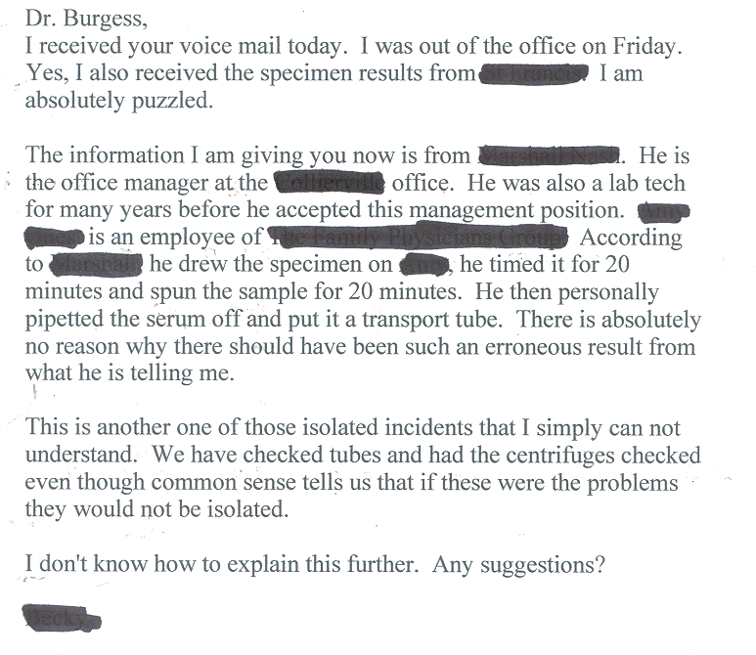
Client Commentary

Slide 24
Quest (my) Response

Slide 25
Client “Re-Response”

Slide 26
Correct Order of Draw
Blood culture tubes or vials/Yellow Culture (SPS)
Sodium Citrate (Light Blue Top)
Serum Tube (SST or plain Red Top)
Heparin (Green Top)
EDTA tube (Lavendar Top) or Tan Top
Royal Blue EDTA (Trace Metal)
Glycolytic Inhibitor Tube (Gray Top)
Yellow (ACD)
Baer, DM, et al. Investigating Elevated Potassium Values. MLO. November 2006; 24-31.

Slide 27
Proper Collection Techniques for Serum Vacutainers®
A properly prepared specimen is critical for optimal laboratory results and to minimize the occurrence of the following:
Elevated potassiums
Suppressed glucoses
“Specimen received unspun” comment on reports
“Quantity not sufficient” (e.g., QNS) comments on reports
Falsely elevated lactate dehydrogenase levels
“Red Blood Cells present in specimen” comment on report
In order for a serum specimen to be properly ready for analysis, it must be properly collected … and processed. The following procedure MUST be followed to assure a proper serum specimen and thus to avoid the above-noted situations.
ORDER of DRAW
The order in which specimens are drawn during the phlebotomy procedure plays a VERY important part in determining the quality of results obtained from laboratory testing. The order of draw listed below and recommended by the Clinical Laboratory Standards Institute (CLSI H3-A5, vol 23, No 32, 8.10.2) is an absolute requirement in order to eliminate cross contamination of specimens with additives from a previous tube or container. The recommended Order of Draw and inversion frequencies are:
Blood Cultures (yellow top)– invert 8-10 times
Citrate Tube (light blue top) – invert 3-4 times
Gel Separator Serum Tube (tiger top) or Red top tube – invert GENTLY 5 times
Heparin Tube (green top)– invert 8-10 times
Plasma Gel Separator Tube – invert 8-10 times
EDTA (lavender) tube – invert 8-10 times
Fluoride tube (e.g., gray top) – invert 8-10 times
Allow the SSTs and red top serum tubes (cf, #3, above) to clot a minimum of 25 minutes but no longer than 45 minutes. Tubes should be allowed to clot in a vertical position (e.g. in a test tube rack) and at ROOM temperature unless otherwise noted.
If your centrifuge is a swing bucket centrifuge, spin the SSTs and serum tubes for 20 minutes at 2200 RPM.
If your centrifuge is a fixed angle model, please call Client Supply at (800) 877-8805, option 2 and a swing head centrifuge will be sent to your site ASAP.
PLEASE SEE PHOTOS ON REVERSE SIDE OF THIS MEMO FOR EXAMPLES OF POORLY PREPARED AND WELL PREPARED SPECIMENS

Slide 28
POOR SPIN – NOTE CLOT PROTRUDING BETWEEN TUBE AND GEL BARRIER – DID NOT CLOT LONG ENOUGH PRIOR TO SPINNING
GOOD FIXED ANGLE SPIN – PROPER CLOT TIME AND PROPER SPIN TIME
GOOD SWINGING BUCKET SPIN AND CLOT TIME – NOTE LEVEL GEL BARRIER

Slide 29
Borderline Increase in Calciums

Slide 30
“What’s Wrong with Your Calciums?”
Nothing
Most probably an issue with clot time prior to activation of gel barrier
See next slide

Slide 31
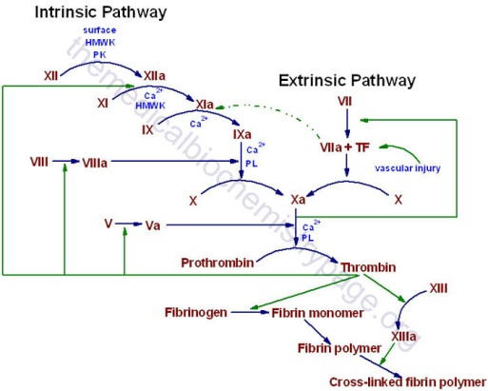

Slide 32
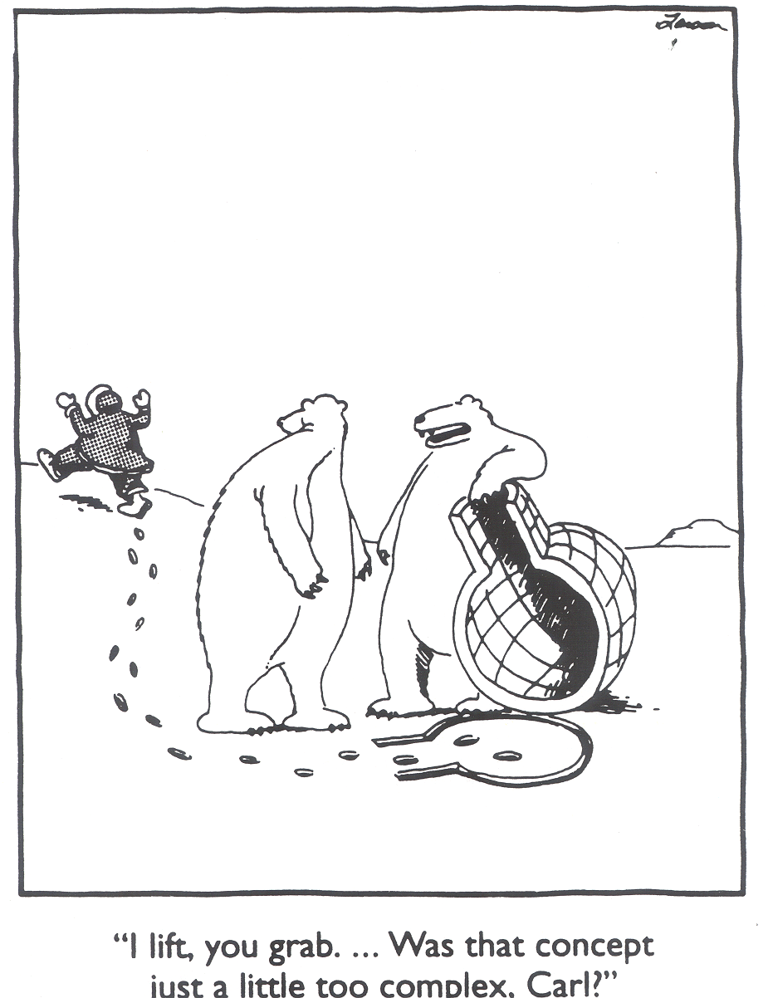

Slide 33
The Impending Crisis
…….. and the necessary solutions.

Slide 34
Scenario: Dr’s. Appt. for a Routine Checkup
Your blood is drawn for a routine physical
5 days later, the Dr’s office call and states that they need “more blood” for the testing
You ask “Why”
The answer – the lab to which your specimens were sent did not have sufficient Med Techs (CLSs) to perform the testing promptly and the samples are now out of stability.
Is this far fetched?????

Slide 35
Unfortunately, the answer is no.
And why is this the case???

Slide 36
The Hard Cold Facts
78% of the schools of Medical Technology open in 1980 ……….. are now closed
In my laboratory, the average age of a Medical Technologist is 55 years of age
Within 4-7 years, approximately 36% (~ 100 of my Medical Technologists) will be eligible for retirement.
There is currently no way I will be able to fill all of these positions, which, by law, I need to run and report my laboratory values

Slide 37
The Problem … and the reason
The Patients’ Perception
The Cocktail Party

Slide 39
So What Are the Solutions?
Start exposing children to the profession in Middle School – High School is too late
Begin exposing teachers to the profession – they have no idea it exists
Take every opportunity presented to you to talk about your profession

Slide 40
Lab Medicine 101
Good
Quick
Cheap
……..Pick 2

