Slide 1
The Role of Public Health Microbiology and Emerging Infectious Diseases
Robert & Jean Adams Foundation’s
3rd Annual Clinical Laboratory Science Symposium
Auburn University Montgomery
April 1, 2016
Sharon P. Massingale, Ph.D. HCLD/CC(ABB)
Alabama Department of Public Health
Bureau of Clinical Laboratories

Slide 2
DISCLAIMER:
I have no conflict of interest
relevant to this
talk.

Slide 3
Objectives
Describe primary responsibilities of a public health microbiologist.
Demonstrate examples of new technologies used to detect emerging infectious diseases.
Define the public health microbiologist's role in the detection, surveillance, investigation of microbial diseases.
Provide real-life examples that demonstrate the public health microbiologist's role in the detection, surveillance, investigation of microbial diseases.

Slide 4
Meet the Micro twins:
Sal-mon-ella & Brucella
Job Description: Public Health Microbiologist
So what is it you think that they do?

Slide 5
What is a Public Health Microbiologist?
Public health microbiology cross-cuts several fields
Human, animal, food, water, & environmental microbiology
Infectious diseases are the main focus of PH labs
Public health microbiology laboratories roles
Detection & monitoring outbreak response
Provide scientific evidence to prevent and control infectious diseases.

Slide 6
Role of PH Microbiologist
Their priority is to controlling epidemics and pandemics
Contribute to the prevention of communicable diseases, such as tuberculosis, plague, diphtheria, rabies, foodborne illnesses and sexually transmitted diseases, by observing and researching the relationships between microorganisms, diseases and public health
Trace the origins of outbreaks or monitor prevalence and spread of diseases already endemic in a community,

Slide 7
Role of PH Microbiologist
PHLs often work for a government health department
Their services are essential to the core functions of public health
services include disease surveillance, diagnosis of new and recurring infectious and zoonotic diseases, environmental and vector testing, toxicology, and monitoring the safety of drinking water, recreational water, and food supplies
serve as reference laboratories for private, commercial laboratories

Slide 8
Eleven Core Functions for public health laboratory system /align with PH Essential Services
APHL/CDC considers these as minimum requirement for optimal service

Slide 10
Important Roles of PH Microbiologists (Core Expanded)
Confirm diagnosis for targeted interventions (detection, monitoring, outbreak response, and providing scientific evidence)
Identify (new) types of pathogens
Population-dynamics
Virulence, persistence, resistance
Implications for control measures
Microbiological safety of food and water
Quality assurance of diagnostic results
Information management, communication and coordination
Biosafety
Develop new tests/ Optimize existing tests
Basic/applied research for new insights and innovative solutions to health problems (vaccine and antibiotic development)

Slide 11
PH Microbiologists is Multidisciplinary & Must Network
Public health microbiology laboratory scientists work effectively across disciplines
Pertinent partners: epidemiologists and clinicians
Other examples: Veterinarians, Environmentalists, Nurses, Laboratory specialists
It’s important that activities be coordinated to reach common PH goals for surveying infectious disease!

Slide 12
Multiple expertise is needed !
Public Health
Infectious diseases
Telecom. & Informatics
International field experience
Laboratory
Epidemio-
logy
Information management

Slide 13
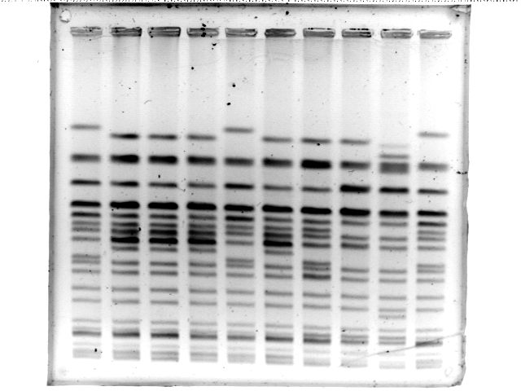
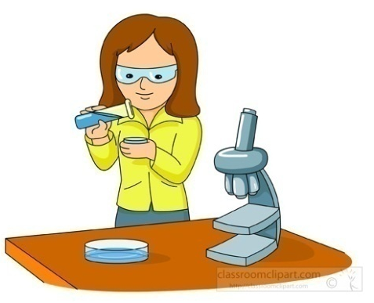
Network Example – Foodborne Investigation
Health Officer Leading Investigation
Environmentalist Collecting
E. coli
PFGE
Laboratory Testing
(Clinical & PH)
Epidemiologists Analyzing
Notes:
Multidisciplinary work

Slide 14
Tools that PH Microbiologists Use to Detect Infectious Diseases

Slide 15
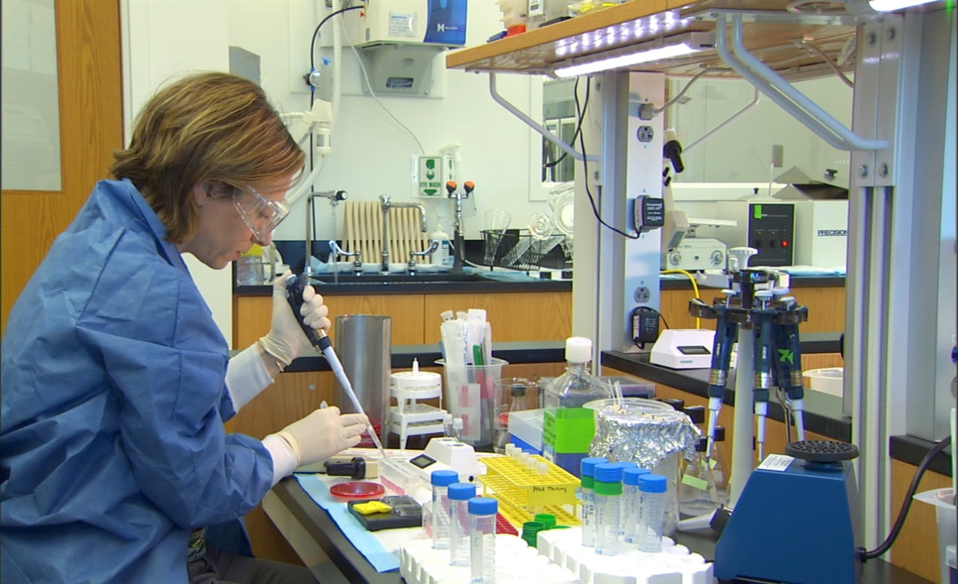
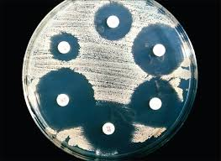

Slide 16
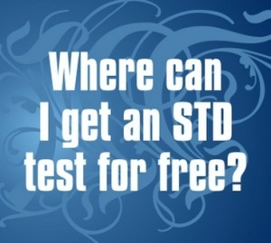
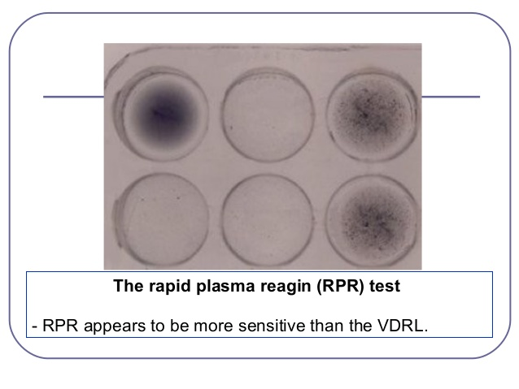

Slide 18
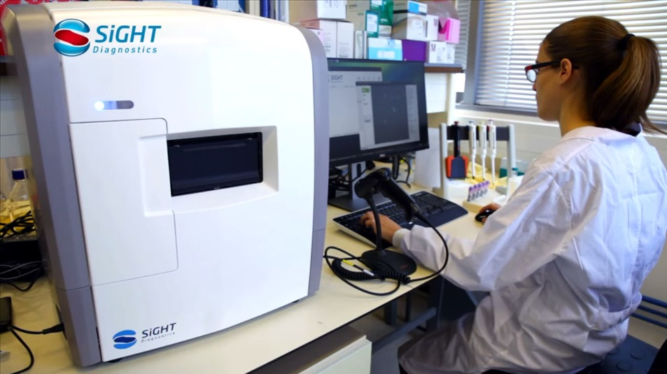
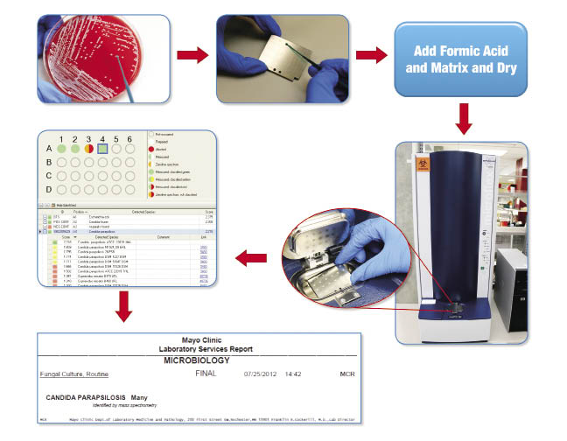

Slide 19
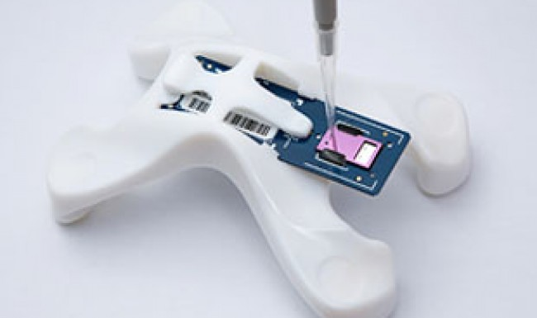
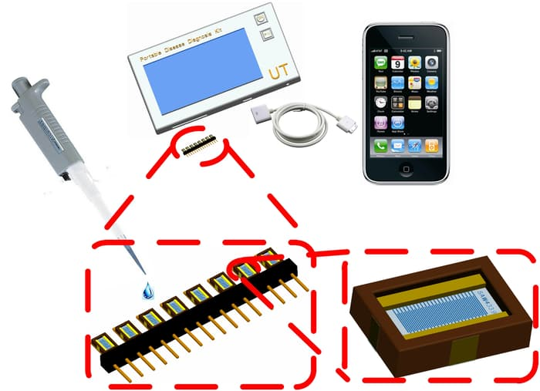

Slide 21
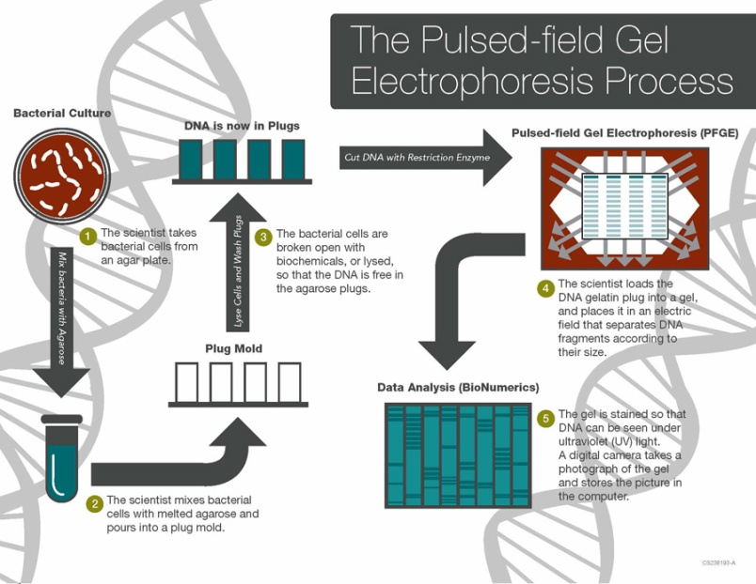
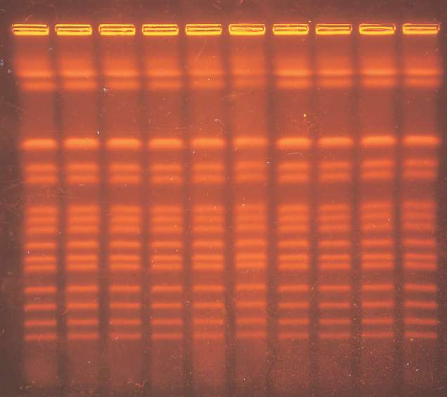
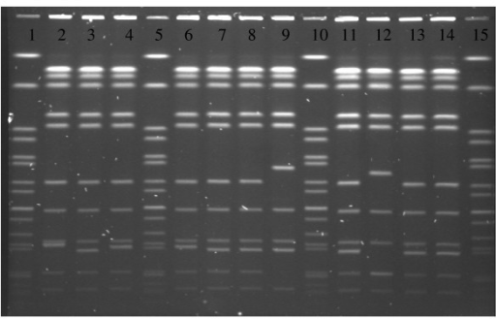
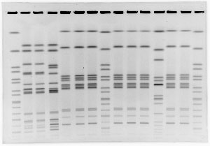
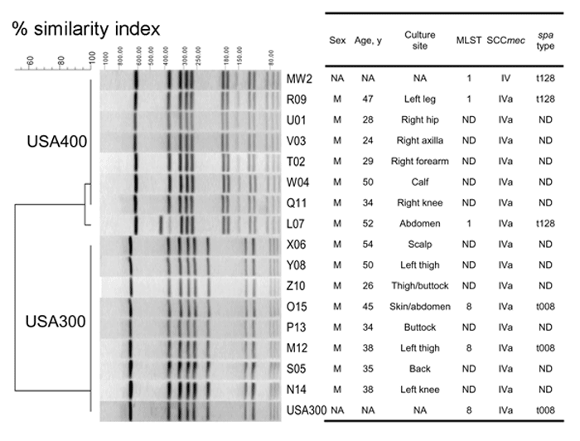
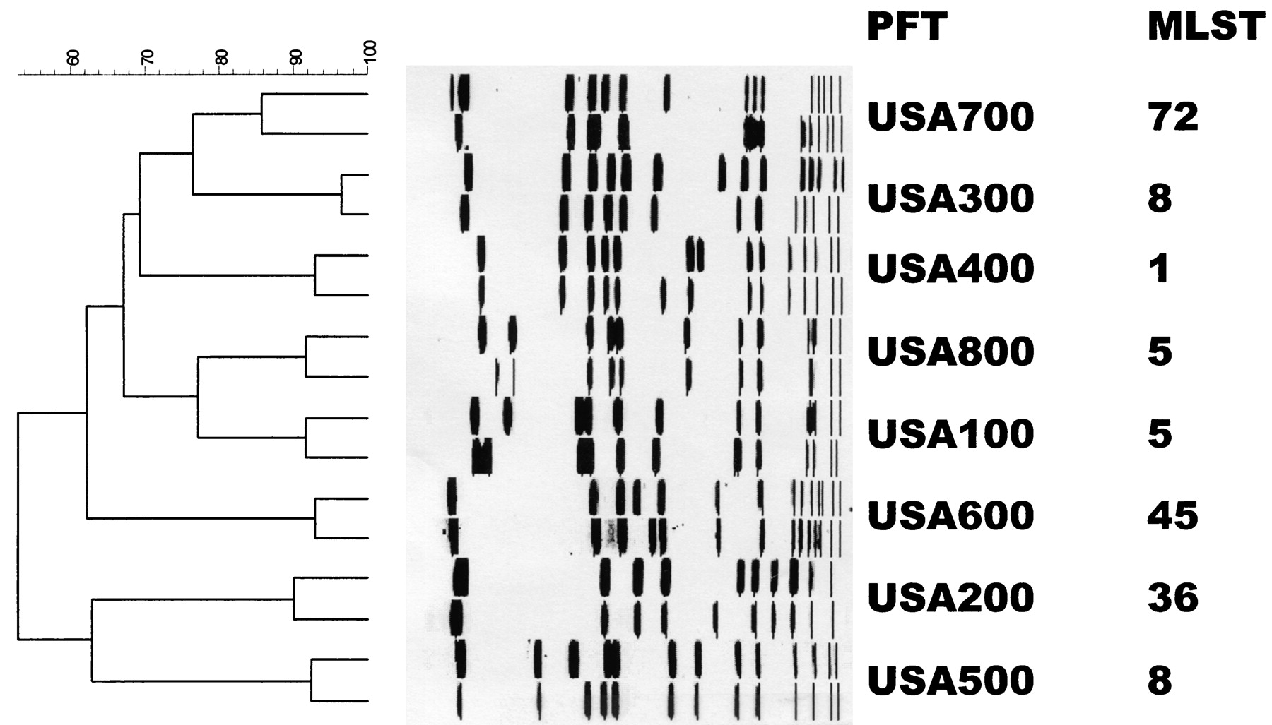

Slide 22
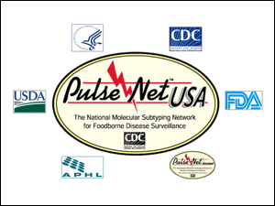

Slide 23
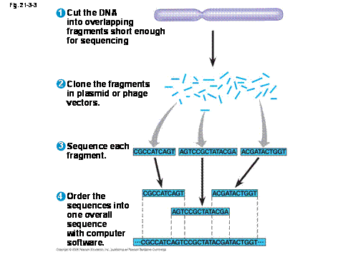
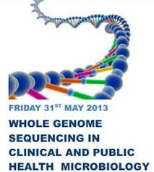
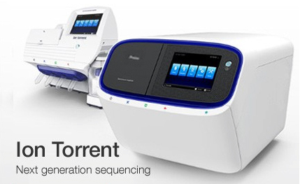

Slide 24
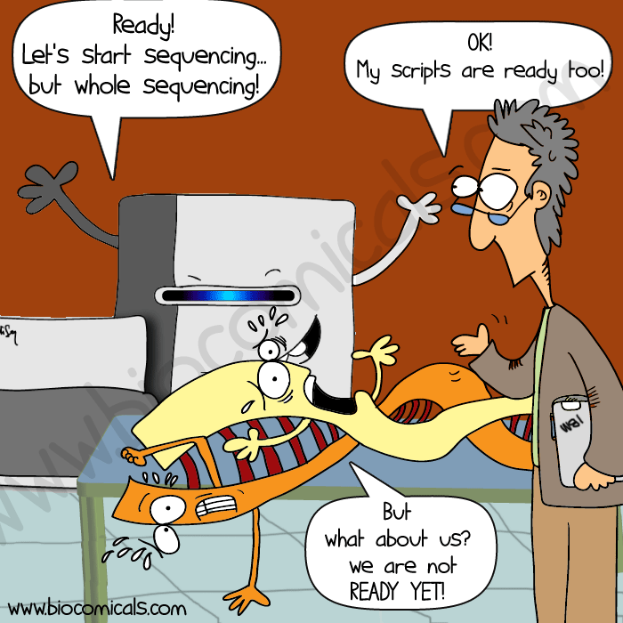
Are we ready for whole genome sequencing?

Slide 25
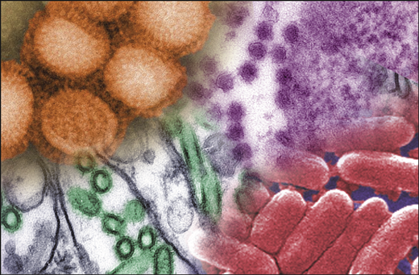

Slide 26
Role of the Microbiology Laboratory in Infectious Disease Surveillance, Alert and Response

Slide 27
How are Infectious Diseases Surveyed?
Surveillance -ongoing and systematic collection, analysis and interpretation of essential health data
Data used for planning, implementation and evaluation of public health practice
Recent experiences of emerging microbial threats, the re-emergence of infectious disease problems and the possibility of bioterrorism are evidence for the need to implement infectious disease surveillance programs.
Microbiology laboratories play a pivotal role
They have the first opportunity to detect these problems and should participate in the design of reporting strategies and dissemination of this information

Slide 28
ROLE OF THE PUBLIC HEALTH PROFESSIONAL (1)
Establish surveillance for:
Unusual diseases
Drug resistant agents
Assure laboratory capacity to investigate new agents (e.g., high-throughput labs)
Develop plans for handling outbreaks of unknown agents
Inform physicians about responsible antimicrobial use

Slide 29
ROLE OF THE PUBLIC HEALTH PROFESSIONAL (2)
Educate public about
Responsible drug compliance
Emergence of new agents
Infection sources
Vector control
Malaria prophylaxis
Be aware of potential adverse effects of intervention strategies
Anticipate future health problems
Promote health and maximize human functional ability

Slide 30
National Surveillance: Current Situation
Independent vertical control programmes
Surveillance gaps for important diseases
Limited capacity in field epidemiology, laboratory diagnostic testing, rapid field investigations
Inappropriate case definitions
Global surveillance and intervention programs must be developed to prevent new epidemics and pandemics.
Prevention and containment measures rely on a well-prepared public health infrastructure and PHL plays a most important role.
Changes in host, vector, or pathogen conditions, whether natural or artificial, can result in conditions that encourage the explosive emergence or reemergence of certain infectious diseases

Slide 31
Worldwide Surveillance Determines Incidence of Endemic, Epidemic, and Pandemic Disease

Slide 32
Examples of Emerging Infectious Diseases
Hepatitis C- First identified in 1989
In mid 1990s estimated global prevalence 3%
Hepatitis B- Identified several decades earlier
Upward trend in all countries
Prevalence >90% in high-risk population
Zoonoses- 1,415 microbes are infectious for human
Of these, 868 (61%) considered zoonotic
70% of newly recognized pathogens are zoonoses

Slide 33
Major Infectious Disease Epidemics since 1980
Dengue/DHF-1970s, SE Asia, global
HIV/AIDS-1980s-Africa,global
Drug resistant TB-1990s, US, global
Cholera-1991-Americas
Plague-1994-India, global
Foot & Mouth disease-1995,2000- Taiwan & UK
West Nile-1990s-Mediterranean, Americas
BSE-1990s- UK, Canada, US
Swine fever, 1996- Netherlands
H5N1 influenza-1997- HK-global
Nipah encephalitis-1998-Malaysia,Asia
SARS-2002- Asia, global
Chikungunya-2004-Africa, Asia
H1N1 influenza-2009-Mexico/global

Slide 34
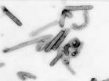
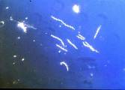
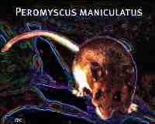
Emerging Zoonoses: Human-animal interface
Bats: Nipah virus
Ebola virus
Marburg virus
Avian influenza virus
Borrelia burgdorferi: Lyme
Deer tick (Ixodes scapularis)
Mostomys rodent: Lassa fever
Hantavirus Pulmonary Syndrome

Slide 35
The Global Threat of Infectious Diseases Emerging and re-emerging diseases
Emerging diseases
Re-emerging diseases
Adapted from Morens, Folkers, Fauci 2004 Nature 430; 242-9

Slide 36
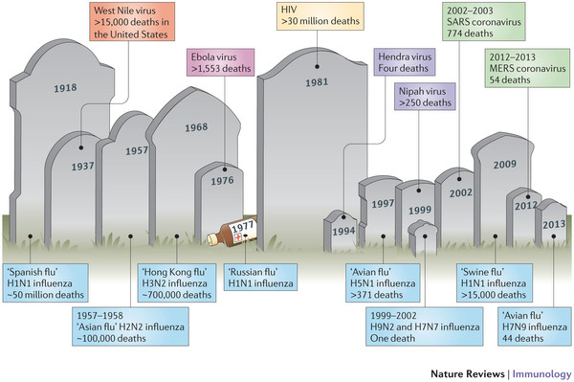
Nature Reviews Immunology 13, 851–861(2013)

Slide 37
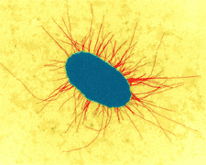
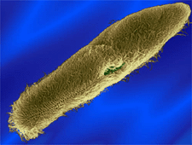
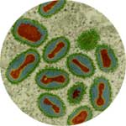
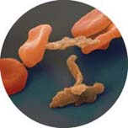
Emerging and Reemerging Infectious Diseases
Emerging Infectious Diseases: A Threat to Global Public Health and Economic Security

Slide 38
Examples of Re-Emerging Infectious Diseases
Diphtheria- Early 1990s epidemic in Eastern Europe(1980- 1% cases; 1994- 90% cases)
Cholera- 100% increase worldwide in 1998 (new strain eltor, 0139)
Human Plague- India (1994) after 15-30 years absence. Dengue/ DHF- Over past 40 years, 20-fold increase to nearly 0.5 million (between 1990-98)
Notes:
In India, plague reemerged in August 1994, when it was detected in the Beed district of Maharashtra. This was followed by pneumonic plague in Surat in Gujarat state, resulting in over 50 deaths and inducing a mass exodus of people. Eventually plague was reported from 12 Indian states.

Slide 39
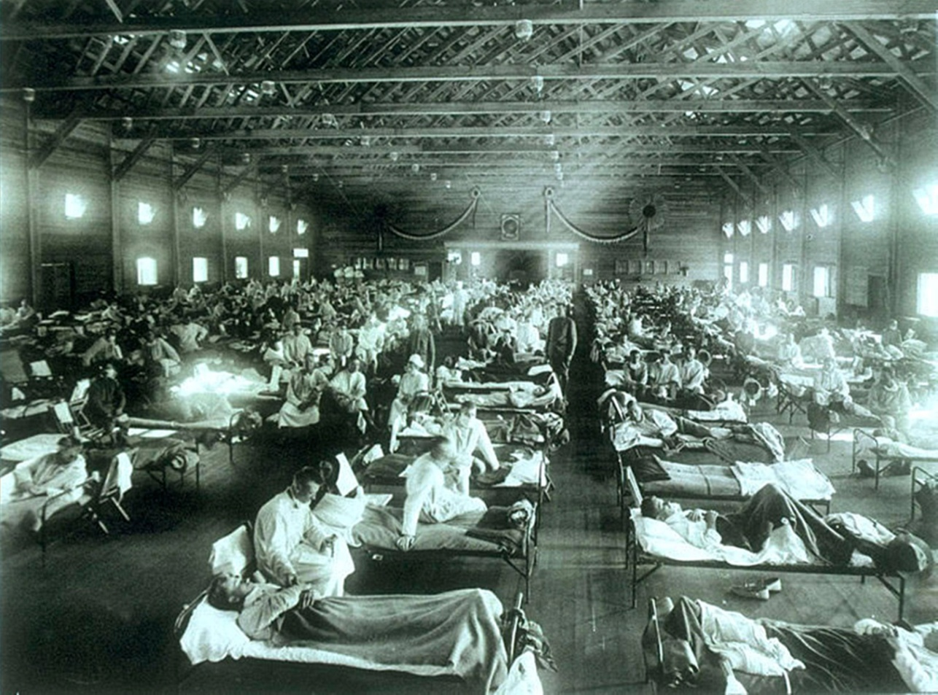
Why are microbes still causing problems???
Understanding how once dormant diseases are now re-emerging is critical to controlling the damage such diseases can cause.

Slide 40
FACTORS CONTRIBUTING TO EMERGENCE OR RE-EMERGENCE OF INFECTIOUS DISEASES
Demographic change: people move to previously uninhabited remote areas of the world
Exposure to new sources of infectious agents, insects and animals
Breakdowns of sanitary and other public health measures in overcrowded cities (e.g., slums)
Economic development and changes in the use of land, including deforestation, reforestation, and urbanization
Global warming - climate changes cause changes in distribution of agents and vectors
Change in human behaviours
Increased use in child-care facilities, sexual and drug use behaviours, and patterns of outdoor recreation
Social inequality

Slide 41
FACTORS CONTRIBUTING TO EMERGENCE OR RE-EMERGENCE OF INFECTIOUS DISEASES
International travel and commerce that quickly transport people and goods vast distances
Changes in food preparation, processing and handling
Evolution of pathogenic infectious agents by which they may infect new hosts, produce toxins, or adapt by responding to changes in the host immunity.(e.g. influenza, HIV)
Development of resistance by infectious agents such as Mycobacterium tuberculosis and Neisseria gonorrhoeae to chemoprophylactic or chemotherapeutic medicines.

Slide 42
FACTORS CONTRIBUTING TO EMERGENCE OR RE-EMERGENCE OF INFECTIOUS DISEASES
Resistance of the vectors of vector-borne infectious diseases to pesticides.
Immunosuppression of persons due to medical treatments or new diseases that result in infectious diseases caused by agents not usually pathogenic in healthy hosts.(e.g. leukemia patients)
Deterioration in surveillance systems for infectious diseases, including laboratory support, to detect new or emerging disease problems at an early stage
Lack of political will – corruption, other priorities

Slide 43
FACTORS CONTRIBUTING TO EMERGENCE OR RE-EMERGENCE OF INFECTIOUS DISEASES
Biowarfare/bioterrorism: An unfortunate potential source of new or emerging disease threats (e.g. anthrax and letters)
War, civil unrest – creates refugees, food and housing shortages, increased density of living, etc.
Famine causing reduced immune capacity, etc.

Slide 44
Public Health Measures for the Control of Disease

Slide 45
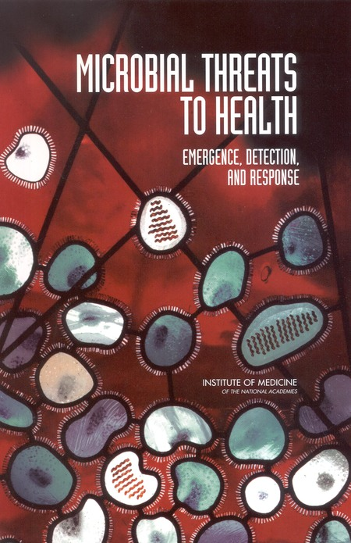
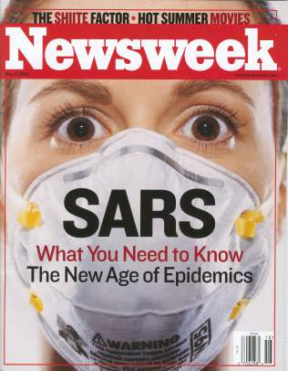
Microbial Threats to Health

Slide 46
STRATEGIES TO REDUCE THREATS
IMPROVE GLOBAL SURVEILLANCE (continued)
Utilize geographical information systems
Utilize global positioning systems
Utilize the Global Atlas of Infectious Diseases (WHO)
Increase and improve laboratory capacity
Coordinate human and animal surveillance
USE OF VACCINES
Increase coverage and acceptability (e.g., oral)
New strategies for delivery (e.g., nasal spray administration)
Develop new vaccines
Decrease cost
Decrease dependency on “cold chain”
NEW DRUG DEVELOPMENT

Slide 47
STRATEGIES TO REDUCE THREATS
DEVELOP POLITICAL WILL AND FUNDING
IMPROVE GLOBAL EARLY RESPONSE CAPACITY
WHO
National Disease Control Units (e.g. USCDC, CCDC)
The Centers for Disease Control and Prevention (CDC) in the United States, through the National Center for Infectious Diseases (NCID), operates a number of surveillance programs
Training programs
IMPROVE GLOBAL SURVEILLANCE
Improve diagnostic capacity (training, regulations)
Improve communication systems (web, e-mail etc.) and sharing of surveillance data
Rapid data analysis
Develop innovative surveillance and analysis strategies

Slide 48
STRATEGIES TO REDUCE THREATS
DECREASE INAPPROPRIATE DRUG USE
Improve education of clinicians and public
Decrease antimicrobial use in agriculture and food production
IMPROVE VECTOR AND ZOONOTIC CONTROL
Develop new safe insecticides
Develop more non-chemical strategies e.g. organic strategies
BETTER AND MORE WIDESPREAD HEALTH EDUCATION (e.g., west Nile virus; bed nets, mosquito repellent)

Slide 49
STRATEGIES TO REDUCE THREATS
DEVELOPMENT OF PREDICTIVE MODELS BASED ON:
Epidemiologic data
Climate change surveillance
Human behavior
ESTABLISH PRIORITIES
The risk of disease
The magnitude of disease burden
Morbidity/disability
Mortality
Economic cost
REDUCE POTENTIAL FOR RAPID SPREAD
DEVELOP MORE FEASIBLE CONTROL STRATEGIES

Slide 50
Key Tasks in Dealing with Emerging Diseases
Surveillance at national, regional, global level
epidemiological,
laboratory
ecological
anthropological
Investigation and early control measures
Implement prevention measures
behavioural, political, environmental
Monitoring, evaluation

Slide 51
Real-Life Examples of PH Laboratories in Action

Slide 52
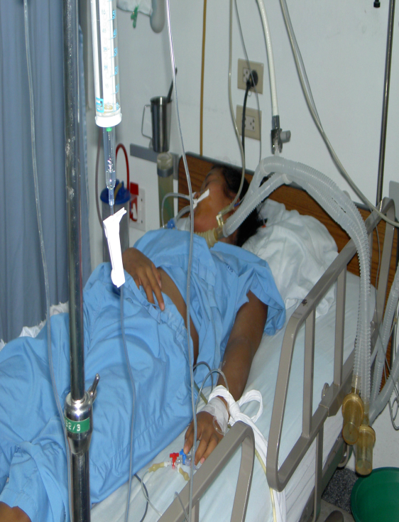
SARS: The First Emerging Infectious Disease Of The 21st Century
No infectious disease has spread so fast and far as SARS did in 2003
Notes:
SARS was first recognized at the end of
February 2003 in Hanoi, Viet Nam.
case, a middle-aged man business man who has traveled
extensively in South-East Asia before becoming unwell,
was admitted to hospital in Hanoi on 26 February 2003
with a high fever, dry cough, myalgia and mild sore throat.
Over the following 4 days he developed symptoms of adult
respiratory distress syndrome, requiring ventilator support,
and severe thrombocytopenia. Despite intensive
therapy he died on 13 March after being transferred to an
isolation facility in Hong Kong SAR.
On the basis of data from the SARS foci in Hanoi and Hong
Kong SAR, the incubation period has been estimated to be
2.7 days, but usually 3.5 days. Attack rates of >56% among
health care workers caring for patients with SARS is consistent
in both the Hong Kong and Hanoi foci.

Slide 53
CNN, 4 Oct 2007
CNN, 4 Oct 2007

Slide 54
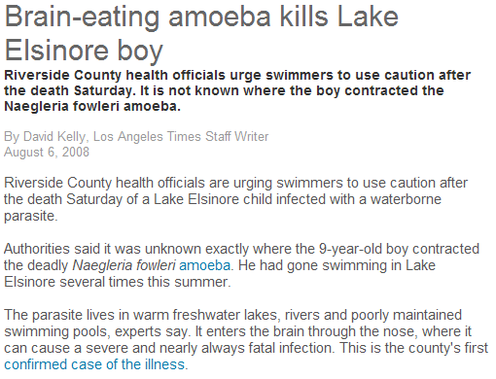

Slide 55
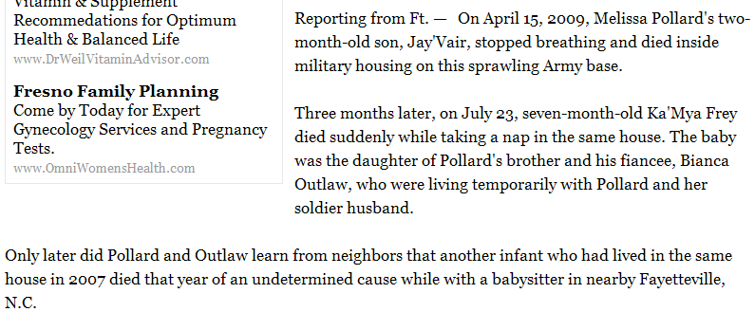
LA Times, 31 August 2010

Slide 56
In 2006, bagged fresh spinach contaminated with Escherichia coli O157:H7 caused about 200 cases of confirmed illness in the US and at least 3 deaths.
An investigation traced the source to domesticated animals, wildlife, and environmental factors.
Laboratorians found genetically identical strains of E.coli in both cattle raised near the spinach and in wild hogs.
Ecologists and hydrologists explained that unusual weather conditions allowed animal E. coli tainted feces to contaminate ground water and the irrigation system on the affected farm.
JAMA. 2010;303(2):117-124

Slide 57
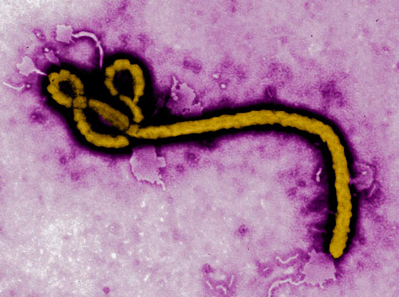
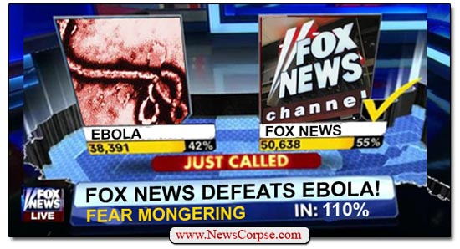

Slide 58
EBOLA
The Ebola outbreak in West Africa was first reported in March 2014
Rapidly became the deadliest occurrence of the disease since its discovery in 1976.
Killed five times more than all other known Ebola outbreaks combined.
The total number of reported cases is about 28,637.
The World Health Organization declared the last of the countries affected, Liberia, to be Ebola-free on January 13, 2016.

Slide 59
Ebola deaths
As of January 13, 2016 - 11,315 Deaths - probable, confirmed and suspected (Includes one in the US and six in Mali)
4,809 Liberia
3,955 Sierra Leone
2,536 Guinea
8 Nigeria
The WHO has warned that West Africa may see flare-ups of the virus!!!

Slide 60
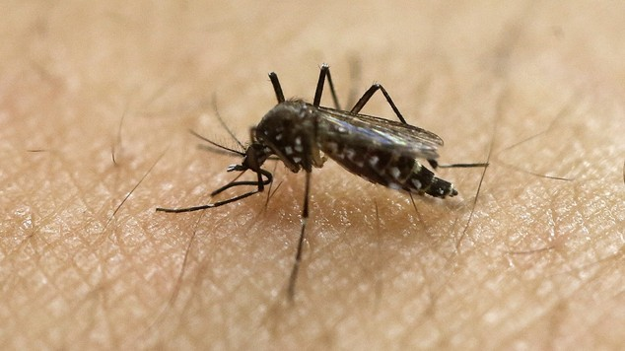
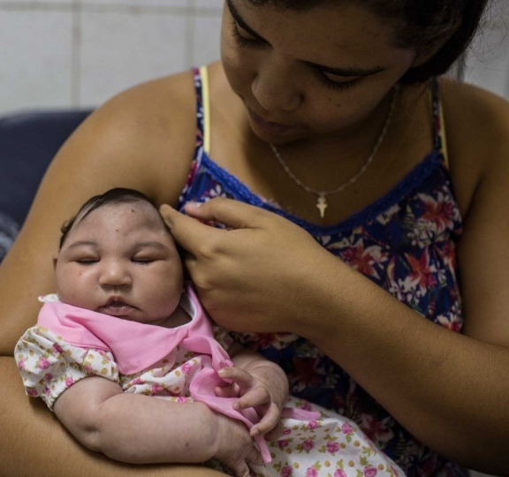

Slide 61
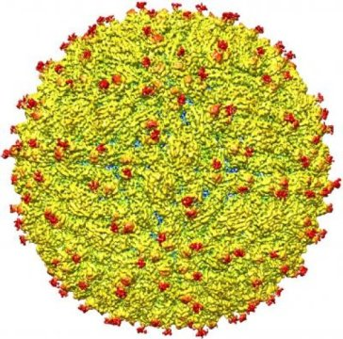

Slide 62
For sure we will always have a job . In the words of Dr. Williams Schaffner, “We are always at the Infectious Disease Roulette Table”.
We hoped you enjoyed learning about what we do. Finding Infectious Disease is our game.

