Slide 1
New Technologies in the Microbiology Laboratory – Are you IN?
April 1, 2016
D. Jane Hata, Ph.D. D(ABMM)
Director of Microbiology and Infectious Disease Serology Laboratories
Mayo Clinic in Florida

Slide 2
Disclosures
No funding disclosures
I will be discussing specific products as examples of technology
  Not an endorsement
  All information from the public domain
Approximate cost information
Notes:
Limit most comments to FDA-approved platforms, but will discuss a few tests under review at FDA

Slide 3
Objectives
New Technologies in the Microbiology Laboratory
  MALDI-TOF, Multiplexing, Next Generation Sequencing
Organism Identification
Antimicrobial susceptibility testing
Blood Culture
Does it really work?
Can we afford to do this?
Will it actually make a difference?
Notes:
Will discuss performance and accuracy as we go through the various technologies

Slide 4

Microbial Diagnosis and Characterization
“An exceedingly complicated problem”
Phenotypic
Who pays for it?
Which test do I use?
Who in the lab is going to do this?
What machine do I need?
Genotypic
Proteomic
Notes:
A gordian knot is often used as a metaphor for an intractable problem (disentangling an "impossible" knot) solved easily by loophole or "thinking outside the box" ("cutting the Gordian knot"):

Slide 5
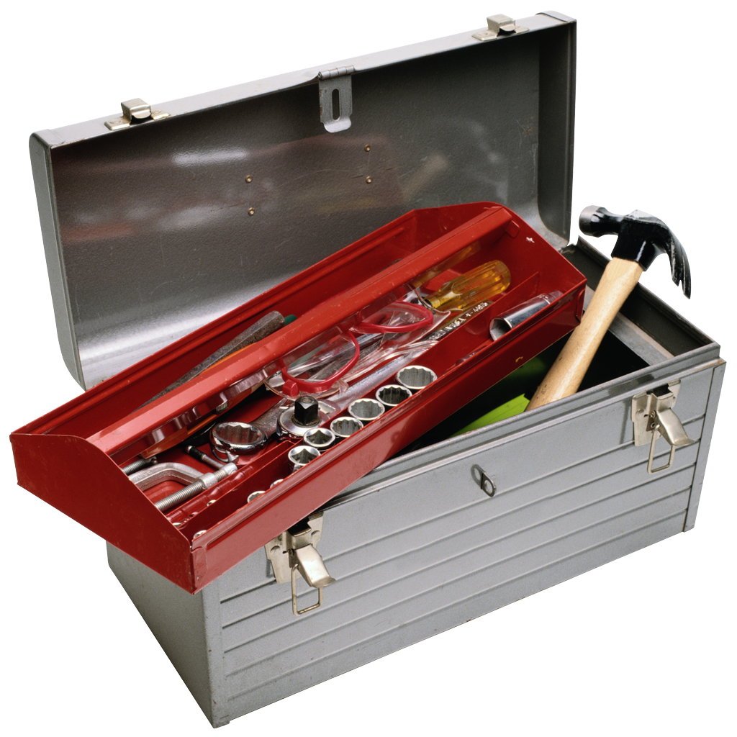
Why Should We Consider New Technologies?
Clinical testing requires speed, accuracy, sensitivity, specificity
Useful for pathogens that are difficult/dangerous to culture
Advances in technology has increased accessibility
Complimentary to other methods (even phenotypic methods!)
Notes:
Rapid results can save pharmaceutical costs and affect therapy. Aid in infection control
5

Slide 6
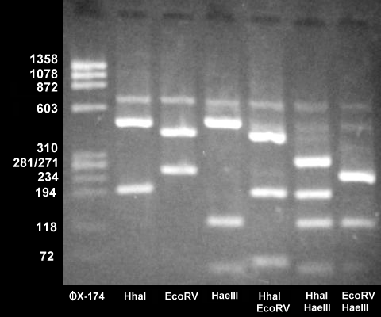
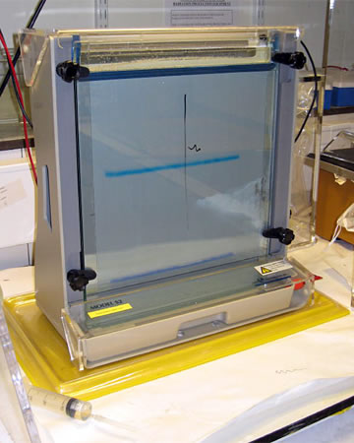
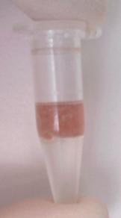
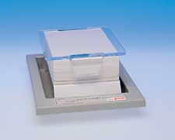
Molecular History
DNA extraction with phenol/chloroform
Restriction enzyme analysis
Gel electrophoresis
Southern Blots
  Radioactive probes

Slide 7
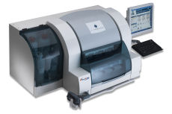
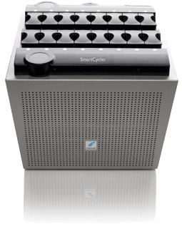
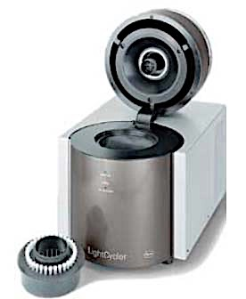
“History” of Molecular Automation
Nucleic Acid Extractors
  Consistent, reproducible extraction
Real-Time PCR
“Load and walkaway” systems
  Cepheid GeneExpert
Notes:
Walkaway systems combine extraction with amplification and detection in a single module
Robotics and liquid handling
Walk-away capability
Automated extraction, washing, concentration
Binding of nucleic acids to silica formulations
Consistent, reproducible extraction
Rapid time to result
Objective results
Closed systems - No additional sample handling
Quantitation
Data management
So easy that chemistry, nurses, or micro directors can do it

Slide 8
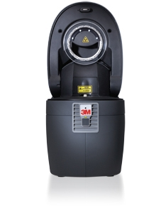
How to Increase Throughput
More, more, more!
More reactions
Fewer steps
Notes:
LC 480 plate with 384 reaction plate
Focus Direct amplification disk
Batch mode only; not random access
Cepheid GeneXpert Infinity 48, Infinity 80 also available

Slide 9


The Goal
Your Laboratory
Easy to use
Fast
Accurate
Reimbursable

Slide 10
Organism Identification
MALDI-TOF, PCR-based, Sequencing

Slide 11
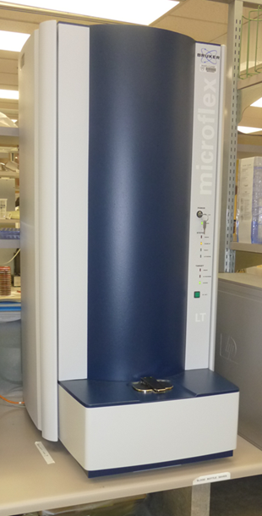
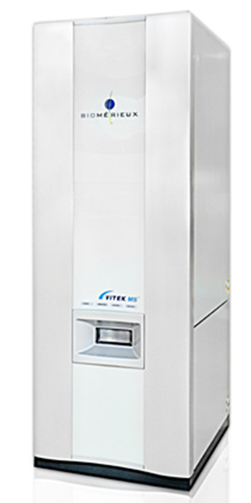
MALDI-TOF Mass Spectrometry
Matrix-Assisted Laser Desorption Ionization – Time of Flight
Generation of protein mass spectra from microorganisms
Formic acid/ethanol extraction of proteins
Matrix crystallizes with specimen
Vaporization of specimen via an N₂ laser
Ions accelerated across electric field
Time of flight depends on mass to charge ratio
Mass spectra corresponds to high abundance proteins
  HSP, ribosomal
Score based on comparison to spectra of known species in database
Bruker BioTyper
BioMeriéux
Vitek-MS
Notes:
Formic acid or 70% ethanol extraction also inactivates organisms
Low mass organic compound known as matrix mixed with clinical material . Matirx supplies structure and H2 ions for ionization
Co-crystalization of matrix and material allow for ionization of material.
hydroxycinnamic acid most often used
Large proteins such as ribosomal protiens up to 100k Da can be analyzed

Slide 12
10 minutes to identification

Slide 13
MALDI-TOF for GN Organism Identification (MCF Data)
Reference: MicroScan and 16sRNA
Intra and Inter-assay precision 100%
Accuracy: 98.2% (267/272)
  IVD isolates (MS): 96.9% (124/128)
  “Community” isolates (16S): 99.3% (143/144)
  Discrepants due to limitations in Bruker database (IVD version 1.0)
Notes:
IVD Instrument verification 2014
Reference method 16S sequencing
Intra – within - 10 spots per day; E. coli, H. influenzae, P. aeruginosa
Inter – between (20 day)
IVD isolates: 5-10 unique isolates of highly prevalent and highly available Gram negative organisms. This includes E. coli, Klebsiella sp., Proteus sp., P. aeruginosa (mucoid, normal, and wet), H. influenzae, Citrobacter sp., Enterobacter sp., S. marcescens, S. maltophilia, , Acinetobacter sp. 1-3 isolates of less prevalent and less available Gram negative isolates

Slide 14
MALDI-TOF Gram Negative Discrepant Isolates
MALDI-TOF | Microscan | 16S RNA
Burkholderia fungorum | Burkholderia cepacia
Aeromonas veronii | Aeromonas hydrophilia group
Burkholderia cenocepacia | Burkholderia cepacia
Providencia rettgeri |  | Providencia stuartii
Pseudomonas alcaliphila |  | Pseudomonas pseudoalcaligenes
Raoultella planticola |  | Raoultella ornithinolytica
Pseudomonas alcaliphila |  | Pseudomonas oleovorans

Slide 15
MALDI-TOF for GN Organism Identification (MCF Data)
Intra and Inter-assay precision 100%
Accuracy: 98.2% (267/272)
  IVD isolates (MS): 96.9% (124/128)
  “Community” isolates (16S): 99.3% (143/144)
  Discrepants due to limitations in Bruker database
Turnaround time to ID
  Microscan: 18 hours/panel
  MALDI-TOF: 45 minutes/isolate (includes extraction)
Notes:
96 spot plate
IVD Instrument verification 2014
Reference method 16S sequencing
Intra – within - 10 spots per day; E. coli, H. influenzae, P. aeruginosa
Inter – between (20 day)
IVD isolates: 5-10 unique isolates of highly prevalent and highly available Gram negative organisms. This includes E. coli, Klebsiella sp., Proteus sp., P. aeruginosa (mucoid, normal, and wet), H. influenzae, Citrobacter sp., Enterobacter sp., S. marcescens, S. maltophilia, , Acinetobacter sp.
Community:1-3 isolates of less prevalent and less available Gram negative isolates
Stenotrophomonas, Legionella, Providencia, Achromobacter
TAT – 45 min includes extraction; can do multiple isolates per target

Slide 16
MALDI-TOF for Gram Positives
Thick peptoglycan layer resists lysis
  Additional extraction needed
  Direct colony extraction with formic acid
CoNS – higher level of speciation as compared to phenotypic methods
  MALDI-TOF MS: 93.2%
  Phoenix: 75.6%
  Vitek -2: 75.2%
MRSA vs. MSSA
  Peak variability among different strain types
  May need database manipulation to group spa types
Clark A E et al. Clin. Microbiol. Rev. 2013;26:547-603
Szabados F. et al. 2012. J Infection. 65: 400-405
Notes:
Additional extraction entails use of lysostaphin, proteinase K, lysozyme
CoNS – MALDI equivalent to sequencing
CoNS Dupont C, Sivadon-Tardy V, Bille E, Dauphin B, Beretti JL, Alvarez AS, Degand N, Ferroni A, Rottman M, Herrmann JL, Nassif X, Ronco E, Carbonnelle E. 2010. Identification of clinical coagulase-negative staphylococci, isolated in microbiology laboratories, by matrix-assisted laser desorption/ionization-time of flight mass spectrometry and two automated systems. Clin. Microbiol. Infect. 16:998–1004
Szabados F. et al. 2012. Identical MALDI TOF MS-derived peak profiles in a pair of isogenic SCCmec-harboring and SCCmec-lacking strains of Staphylococcus aureus. J Infection. 65: 400-405.

Slide 17
Mis-identification Can Still Occur!
MALDI-TOF Identification | 16S rRNA Identification
Escherichia coli | Shigella sonnei
Escherichia coli | Shigella flexneri
Streptococcus pneumoniae | Streptococcus mitis
Escherichia coli | Raoutella planticola
Citrobacter freundii | Raoutella ornitholytica
Certain species so similar at proteomic level, spectra cannot be distinguished
Database improvements may not address this
Dekker JP, et al. 2011. CMN. 33:87-93
©2011 MFMER | slide-17

Slide 18
MALDI-TOF for Mycobacteria
Safety concerns
  Process in 70% EtOH, followed by extraction
Buckwalter et al: 162 Mycobacteria, 53 Nocardia, 43 Actinomycetes (enhanced dBase)
  88% of Mycobacterium species
  90% of Nocardia species
  51% of other aerobic actinomycetes
  Faster TAT than sequencing
  Poor performance
    ID from slow growing Mycobacteria from MGIT broth
    Mixed cultures (sweep from “haze”)
Buckwalter, S et al. 2016.J Clin Microbiol 54:376 –384
Notes:
Database is biggest concern
Mfg database did not perform as well, needed supplementation from MCR RUO dBase

Slide 19
MALDI-TOF for Anaerobes
274 clinical isolates
Compared to 16S rRNA sequencing
83.9% to species
7.2% to genus
8.8% no ID/mis-ID
Bacteroides fragilis – 100% (92)
Clostridium perfringens – 100% (12)
Eggerthella lenta – 77% (20/26)
Lee, W et al. Ann Lab Med 2015;35:69-75
Notes:
Vitek MS

Slide 20
MALDI-TOF for Fungi
Extraction can be challenging
Filamentous fungi
Yeast accuracy
  Bruker Biotyper: 84-99%
  Vitek MS – 84.3-95%
Species ID | Biotyper ID | Vitek MS ID
C. kefyr | Pseudomonas, Staphylococcus | C. kefyr
C. famata | Debaryomyces | C. famata
C. guilliermondii | Nocardia sp. | C. guilliermondii
S. cerevisiae | No ID | No ID
C. neoformans | No ID | No ID
R. mucilaginosa | No ID | No ID
Jamal, WY et al. 2014. Int Jour Inf Dis.26:167-170
Notes:
At this point in time, filamentous fungi are RUO only for both systems
Need more robust databases; rapid changes to taxonomy will make updated databases and FDA-approved databases more difficult to address

Slide 21
Cost Comparisons of Bacterial Identifications
 |  | Total Cost |  | Cost Savings
Organism | # of Samples | Traditional | MALDI-TOF | $$$ | %
Enterobacteriaceae | 7,503 | 51,717.18 | 13,355.34 | 38,361.84 | 74.2
Enterococcus spp. | 1,454 | 13,072.16 | 2,588.12 | 10,484.04 | 80.2
GN Non-Fermenters | 3,489 | 32,458.39 | 6,211.71 | 26,246.68 | 80.9
Staphlyococcus spp. | 5,790 | 17,383.04 | 10,306.20 | 7,076.84 | 40.7
Streptococcus spp. | 2,332 | 17,704.82 | 4,150.96 | 7,622.91 | 74.8
Yeast | 1,362 | 10,197.09 | 2,574.18 | 7,622.91 | 74.8
Total | 21,930 | 142,532.69 | 39,186.51 | 103,346.18 | 72.5
Tran, A. et al. 2015. Jour Clin Microbiol. 53: 2473-2479
Notes:
Study from UNC
Traditional: Vitek 2, indole, oxidase, API strips, agglutination for Strep grouping, Chromagar Candidia
GNF – Gram negative non-fermenters
Return on initial investment (approx. 200K) within 2 years

Slide 22
Molecular Amplification (PCR)
Single analyte detection and multiplex detection
Notes:
Focus on closed panels

Slide 23
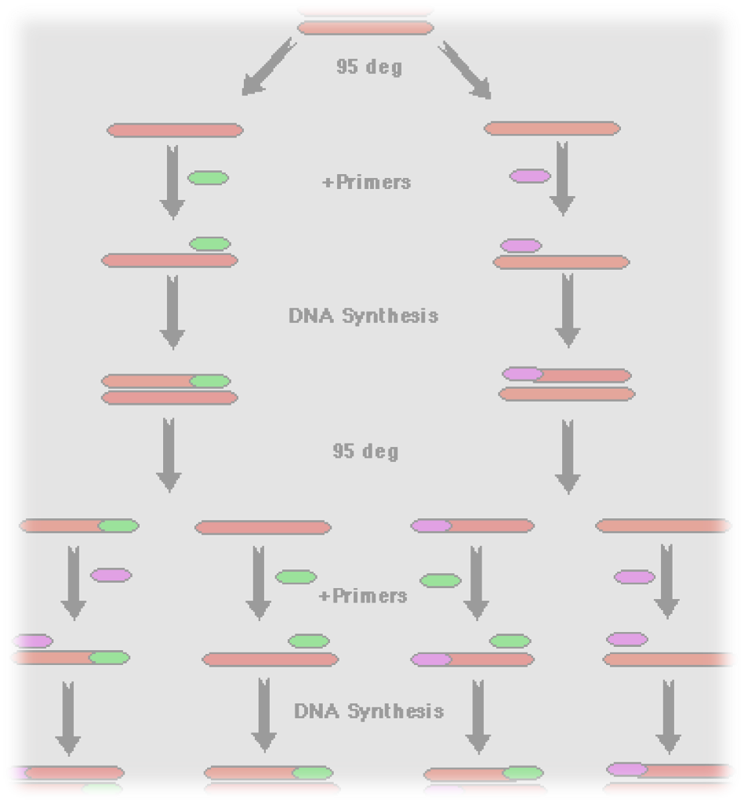
PCR
Amplification of short segments of DNA
20-40 Cycles
  Denaturation at 95º C
  Annealing at 55º C
  Extension at 72º C
Taq polymerase
Exponential amplification of DNA
Closed reactions
Real-time detection of amplicon
acccn.net

Slide 24
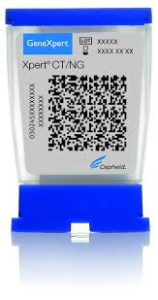
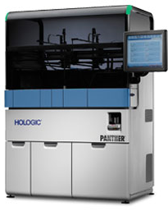
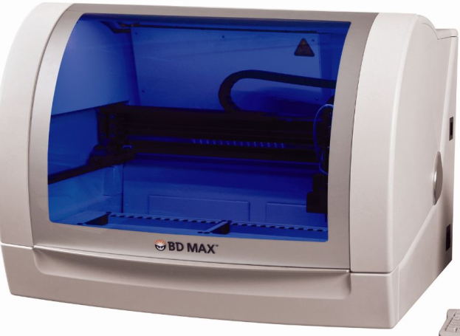
Single Target PCR
Cepheid GeneXpert
  MRSA
  C. difficile
  M. tuberculosis
Chlamydia trachomatis
Neisseria gonorrhoeae
Streptococcus agalactiae (GBS)
Notes:
Think about how to improve throughput

Slide 25
Molecular Multiplex Panels
What are they?
How do they work?
What is available?

Slide 26
Molecular Multiplex Panels
Syndromic testing
  Allow testing for a wide (and growing) number of pathogens
  Optimize the type and number of specimens needed
  Sepsis, diarrhea, encephalitis, pneumonia, et al.
Closed systems, but must still be very attentive to good molecular technique and cleaning to prevent contamination!
Notes:
Much discussion on possibility of contamination resulting in multiple target positives (4+ viruses in single sample)

Slide 27
Multiplex PCR
Multiple analytes in a single reaction/pack of reactions
  3-30 targets per panel
FDA-approved 2008
  Viral respiratory panels
  Gram positive and Gram negative bacteria from blood culture bottles
  GI pathogens (bacterial, viral, parasitic)
  Meningitis panels (bacterial, viral, fungal)
  STD’s
  Bioterrorism agents/Ebola (not FDA approved/EUA)
Notes:
First panel was Xtag for 12 respiratory viruses – open system, 8 hours, labor intensive

Slide 28
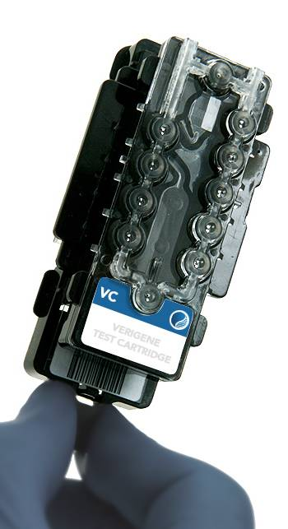
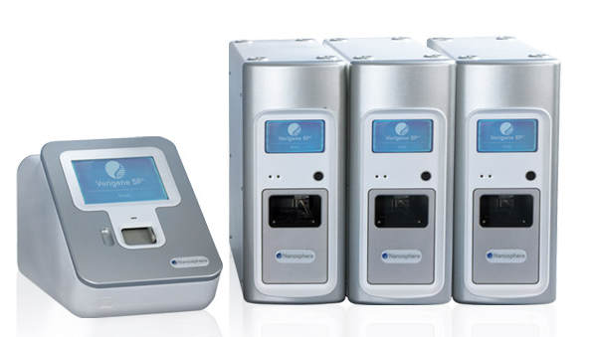
Nanosphere Verigene
Benchtop unit
  Processor 7.6”w X 18.7”h X 22.9”d
  Reader 11.7” w X 12.4” h X 20.5” d
Combines extraction, purification, amplification, hybridization in single unit
  Separate reader unit
2.0 hours per test
1 test per processor/reader
Respiratory panel – RP Flex
  13 viruses, Flu subtyping, 3 Bordetella sp.
Blood culture panel
  15 GP, 14 GN
GI panel
  5 bacteria, stx 1 and 2, 2 viruses
$50 – 80 per test
Instrument $20K per module
www.nanosphere.com
Notes:
Specimen Extraction—Magnetic bead-based RNA/DNA extraction from nasopharyngeal swab specimens obtained from symptomatic patients; (ii) Target Amplification--Multiplex RT-PCR- and PCR-based amplification of the extracted nucleic acids to generate target-specific amplicons; (iii) Hybridization—Amplicon hybridization to target specific capture DNA in a microarray format and mediator and gold-nanoparticle probe hybridization to captured amplicons. Silver enhancement of the gold nanoparticle probes bound at the capture sites results in gold-silver aggregates that are imaged optically with high efficiency by the Reader.
RP Flex – Only pay reagent cost for the tests that are resulted; not necessarily entire panel

Slide 29
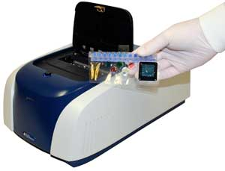
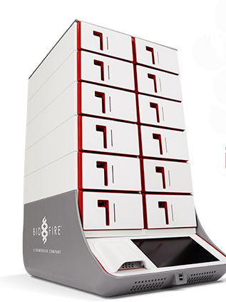
Multiplex Detection - Biofire Film Array
Extraction, DNA amplification, detection
Blood culture panel
  9 bacteria, 5 yeast, 3 resistance mechanisms
GI panel
  8 bacteria, 4 parasites,5 viruses
Meningitis panel
  6 bacteria, 7 viruses, Cryptococcus
Version 1 reader processes 1 strip at a time
  TAT 1.0 hours
$48,000.00 per reader (version 1)
$130.00 per test
New “Torch” instrument
www.BiofireDx.com/FilmArray/
Notes:
Torch under review at FDA

Slide 30
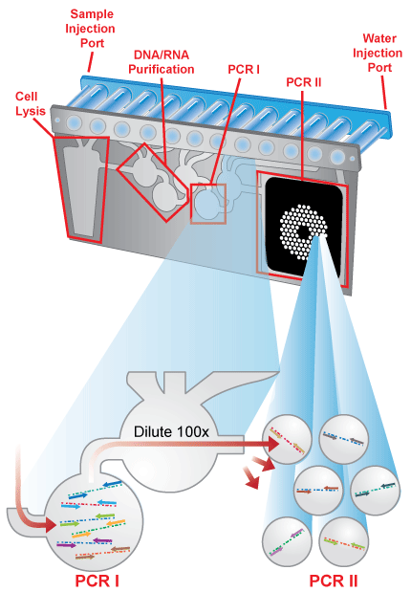
Biofire FilmArray
Lyophilized reagents
Nested, multiplex PCR
  2nd stage PCR detects 1st stage products
Microfluidics
Endpoint melting curve generates ID
www.BioFireDx.com

Slide 31
Molecular Multiplex Panels – Respiratory
Comparison of Biofire, Nanosphere Verigene (1.0) to Prodesse ProFlu for Influenza A, B, RSV
Sensitivity (N= 53)
  Verigene – 100%, 9.7% failure
  Biofire – 98%, 1% failure
Lower limit of detection (copies/mL)
  A 09H1N1: Verigene 4.08, Biofire 5.42
  FluB: Verigene 4.22, 4.93
  RSV: Verigene 4.89, Biofire 3.42
Butt, S.A. et al. 2014.Jour Clin Virol 61: 406–410
Notes:
Study from Albany Med. Center
PIV 1-4, hMPV, Adenovirus also tested in this study but not on Verigene 1.0 panel
All failed runs corrected on repeat
Difference in sensitivity was not statistically significant

Slide 32
Molecular Multiplex Panels – GI Panel
Pathogens detected in 832/1556 (53/47%)
100% sensitivity
  P. shigelloides, Salmonella, Y. enterocolitica, ETEC, STEC, E.C. 0157, Crypto., C cayetanensis, Giardia, Astrovirus, Rotavirus A, Sapovirus
>94.5% sensitivity
  Campylobacter, C. difficile, EAEC, EPEC, Shigella, Adenovirus, Norovirus
Sensitivity not established
  Vibrio cholerae, E. histolytica
N=230; RUO version
Khare, R. et al. 2014. Jour Clin Microbiol. 52:3667-3673
Buss, SN. et al. 2015. Jour Clin Microbiol. 53:915-925.
Notes:
Sapovirus- mild to moderate gastroentritis, usually in children
Khare study compared to culture; frozen specimens used
Mulit-site study
Buss study with IVD version compared to culture; fresh specimens used
Aeromonas not on IVD version; 24% sensitivity in RUO version – this is a relatively common pathogen, and labs will need to culture
Sensitivity between both studies virtually the same; 100%’s all agree except for Sapovirus (90.3% in Khare study)

Slide 33
Sanger Sequencing and Next Generation Sequencing

Slide 34
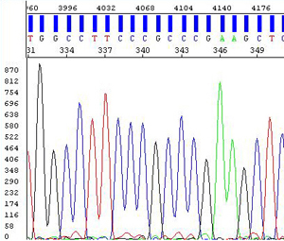
16S rRNA Sanger Sequencing
First used as tool to determine evolutionary relationships (1970’s)
1,550-bp rRNA gene
  Highly conserved
  Multiple copies
  Full length or partial length sequencing (500 bp)
> 98.7% sequence identity = Species ID
> 97% sequence identity = Genus ID
> 95% sequence identity = No ID
Woo, PCY, et al. 2008. Clin Microbiol Infect. 14:908-934
Green NM, et al. 2010. CMN. 32:151-159

Slide 35
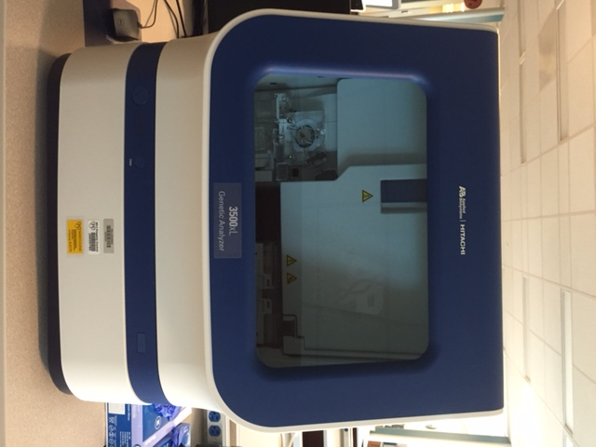
16S Sanger Sequencing Process
DNA Extraction
PCR with broad-range primers
Purification of PCR product
Sequencing via capillary electrophoresis
Sequence editing
24-48 hours
$100.00 per sequence
ABI 3500
Woo, PCY, et al. 2008. Clin Microbiol Infect. 14:908-934
Notes:
No automated steps; labor intensive

Slide 36
Issues with 16S rRNA Sequencing
Quality of database used
Poor discriminatory power for some genera
  Lack of sequence diversity
  May have to use an alternative target (HSP, rpoB)
Bacterial contamination may lead to overestimation of diversity in specimens with low bacterial loads
Significant equipment and reagent cost (>$200,000 to start)
Janda MJ, et al. 2007. Jour Clin. Microbiol. 45:2761-2764.
Notes:
.S. mitis, S. oralis, S. pneumoniae
N. cinerea, N. meningitidis

Slide 37
Advantages of 16S Sanger Sequencing
Considered the “gold standard” method
Detection of uncultivable bacteria
Identification of rare bacteria or unusual phenotypes
Identification of slow-growing bacteria (Mycobacteria)
Well established for anaerobes, Actinomycetes, Nocardia
Discovery of novel species
Woo, PCY, et al. 2008. Clin Microbiol Infect. 14:908-934

Slide 38
Next Generation Sequencing (NGS) – What is it?
  Targeted amplicon sequencing
    Target specific primers for PCR-mediated amplification
    Regions of interest are enriched and sequenced
    Identification of drug-resistance mutations
  Whole genome sequencing
    Non targeted
    Fragmentation followed by ligation
    Fragments of specific length are sequenced
Lefterova, M.I. et al. 2015. J Mol Diagn. 17:623-634.
Notes:
Also referred to as deep sequencing, high-throughput sequencing, or massive parallel sequencing

Slide 39
NGS – How Does it Work?
Create DNA templates (200 – 250bp)
Attach templates to a solid support array
  High density; billions of reactions
Add primer for DNA polymerase
Fluorescent dye labelled nucleotides are incorporated
Laser imaging of dyes to determine sequence at each base addition
Align sequences and assemble contiguous strand
Metzker, ML. 2010. Nature Reviews. 11:31-46

Slide 40
NGS – How Does it Work?
Longer sequence reads than Sanger
  Multiple reads of sequences 150-8500 bp
  Throughput up to 1500 gigabases
    1 gigabase (Gb) = 1 billion base pairs
    275,000 bp => 30 minutes
    1500 Gb => 3.5 days
  Must manage the data!
Shendure J and Ji H. 2008. Nature Biotechnology 26:1135-1145.
Notes:
Length of read dependent on instrument

Slide 41
NGS – What’s Available
No FDA-approved platforms or assays for microbiology
Instrument cost $100,000 - $700,000
CPT codes – GSP –Genomic Sequencing Procedures
  81410-81471
  $600 - $800 per sequence
Disorder specific multi-gene evaluations
Clonality assessment in lymphoma
Whole genome analysis of a neoplasm
www.amp.org/documents/AMPProposaltoAddressCodingfor GenomicSequencingProcedures_FINAL_pdf.
Notes:
No GSP codes for infectious disease

Slide 42
Quinoñes-Mateu, M et al. 2014. Jour Clin Virology. 61:9-19.
Notes:
Roche announced 454 facility closed, and sequencers phased out by 2016

Slide 43
Organism Identification by NGS
Dependent upon database quality
16S rRNA NGS for mixed infections
Uncultivatable/non-viable organisms
Direct from specimen
  Filter out human sequences and errors
Evaluation of microbiome diversity (WGS)
  BV, C. difficile disease
  Diagnostic utility not yet established
Comparison to MALDI-TOF in clinical lab
  88.5% agreement (N=130); 55 hours
Lefterova, M.I. et al. 2015. J Mol Diagn. 17:623-634
Notes:
How do we do it today – Ask audience
BV – increased bacteria hetergeneity, reduced Lactobacillus
C. Diff – Loss of Bacterioides Firmicutes (Bacillus, Lacto, Leuconostoc, non C. diff Clostridia)
Comparison of 1 laboratory day at Houston Methodist
Good for mixed cultures
Faster for Mycobacteria
ID CoNS to species

Slide 44
Mutation Analysis by NGS
Antiviral drug resistance
Eliminate phenotypic testing
  HIV resistant to HAART
  CMV
    Detect mutations in UL97 and UL54
  HCV
    Monitor mutations to new DAA drugs
  Influenza
    Antigenic shift and drift
Antimicrobial drug resistance
  β-lactamases
  KPC’s
  Useful for slow-growing bacteria (Mycobacteria)
  No MIC generated
Lefterova, M.I. et al. 2015. J Mol Diagn. 17:623-634
Quinoñes-Mateu, M et al. 2014. Jour Clin Virology. 61:9-19.
Notes:
UL 97 phosphotransferase
UL 54 DNA polymerase
DAA direct acting antiviral to HCV – sofosbuvir, ledipasvir
Genotypic testing for drug-resistant mutants recommended for therapy-naïve patients

Slide 45
New Methods for Antimicrobial Susceptibility Testing

Slide 46
Basic Concepts of AST
Kirby-Bauer disk diffusion – S, I, R interpretation
Agar dilution and broth microdilution – Minimum inhibitory concentration (μg/mL)
We can detect genes for resistance
  MecA, Van, KPC, TEM, SHV, OXA
  How do we generate an MIC for clinical interpretation?
  How do we keep up?
Notes:
KB developed in 1966
Reversion to KB disk with total lab automation systems
BMD basis of AST used in most labs

Slide 47
MALDI-TOF for Antimicrobial Susceptibility
Detection of :
  Change in spectra of drug based on enzymatic activity (β-lactamases)
  Change in spectra of organism in the presence/absence of antibiotic
  PCR product indicative of resistance gene (Van, Mec, KPC)
  Still no MIC…
vanBelkum, A. et al. 2013. Jour Clin Microbiol.51:2018-2024
Notes:
ESI/MS- Electrospray ionization mass spec

Slide 48
Detection of NDM Carbapenemase by
MALDI-TOF
Meropenem
No Meropenem
Hrabak, J. et al. 2012. Jour Clin Microbiol. 50:2441-2443
Notes:
NDM – New Dehli metallo-beta lactamase; hydrolyzes all B-lactams except aztreonam
3.0 MacFarland suspension of organism. Centrifuge 1.0mL and resuspend in Tris/SDS reaction buffer. Add 0.1 mM meropenem and incubate for 2 hours
Top: K. pneumoniae with no carbapenemase
Bottom: E. coli with NDM carbapenemase
406.61 – Meropenem peak; detected in top, hydrolyzed in bottom after incubation

Slide 49
Other New Methods for AST
Measure change of mass (femtogram 10¹⁵ g) secondary to antibiotic exposure using cantilevers
  Actively growing cells attach to sensor
Rotational spin of magnetic beads affected by bacterial mass
  Spin changes in response to inhibition of replication
Measurement of bacterial metabolism (e.g. heat) in microdroplets in response to antibiotic
  Isothermal microcalorimetry
No FDA-approved platforms yet
Notes:
Cantilever will change frequency of movement in response to additional mass

Slide 50
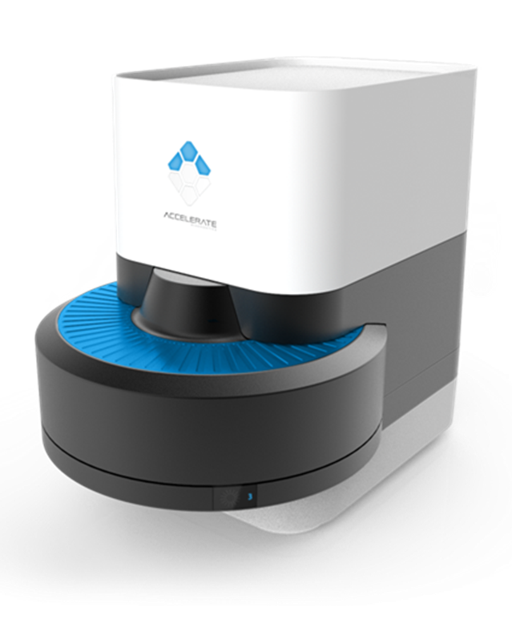
Real-Time Microscopy for AST
Accelerate Diagnostics (FDA approval pending)
ID direct from positive blood culture (1 hour)
MIC-based susceptibility (5 hours)
Gel electro-filtration removes and concentrates bacteria from blood culture broth
Bacteria are immobilized in a flowcell
PNA-FISH to ID bacteria and quantitate
Time-lapse imaging to monitor individual cell growth in antibiotic (dark-field imaging)
  Polymicrobial AST
Notes:
Don’t know cost/test yet – pending FDA approval

Slide 51
New Methods for Detection of Pathogens in Blood Cultures

Slide 52
Goals
Direct detection from positive blood culture bottle, OR direct from specimen (no culture)
  Reduce TAT
Accuracy
AST data to target therapy
From positive blood culture bottles
  MALDI-TOF
  Biofire
  Verigene
  Accelerate
Direct from specimen
  Accelerate and T2

Slide 53
T2 Biosystems
Candida panel
  C. albicans, C. tropicalis, C. parapsilosis, C. krusei, C. glabrata
Magnetic particle with Candida-specific ligand
Binding affects magnetic resonance (spin) of surrounding water molecules
  Magnetic resonance relaxometry
70% detection at 1 CFU/mL
TAT 3-5 hours; no culture needed
Candida FDA-Cleared; bacterial, hemostasis panels in development
$265.00 per test
Pfaller, M. et al. 2015. Future Microbiol. 11(1), 103–117
Paxton, A. April 2015. CAP Today

Slide 54
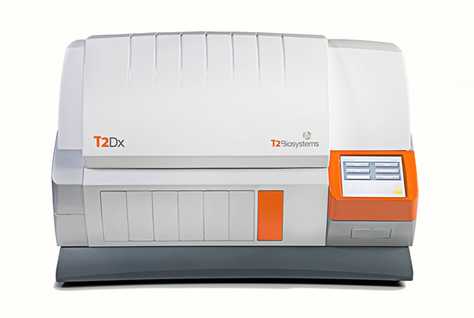
T2 Clinical Trial
250 contrived specimens
Grouped on basis of IDSA recommendations for treatment
Overall 91.1% sensitivity; 98.1% specificity
Group | Sensitivity | Specificity
C. albicans/tropicalis | 92.3% | 98.9%
C. parapsilosis | 94.2% | 99.3%
C. krusei/glabrata | 88.1% | 99.9%
Notes:
Compared to BacTAlert/Bactec/Versatrek

Slide 55
Target Comparison of Blood Culture Panels
Biofire |  | Verigene
GN | GP | GN | GP
E. coli | Staph. sp | E. coli | S. aureus
K. pneumoniae | S.aureus | K. pneumoniae | S. epidermidis
K. oxytoca | Streptococcus sp. | K. oxytoca | S. agalactiae
P. aeruginosa | S. agalactiae | P. aeruginosa | S. pneumoniae
S. marcescens | S. pneumoniae | Acinetobacter sp. | S. pyogenes
A. baumannii | S. pyogenes | Citrobacter sp. | S. lugdunensis
E. cloacae | Enterococcus sp. | Enterobacter sp. | S. anginosus
Proteus sp. | L. monocytogenes | Proteus sp. | Listeria sp.
H. influenzae |  |  | E. faecium
N. meningitidis | Candida (5) |  | E. faecalis
 |  |  | Micrococcus sp.
Biofire |  | Verigene
mecA | KPC | mecA | KPC | VIM
Van A/B | mecC | Van A | CTX-M | OXA
Van A/B |  | Van B | IMP | NDM
Resistance
Mechanisms
Notes:
Direct From positive blood culture bottle
Biofire – Also C. albicans, glabrata, krusei, parapsilosis, tropicalis
Verigene – Separate GP, GN tests. Genus call for Staph, Strep

Slide 56
Blood Culture Panel Performance Accuracy
Biofire BCID
Verigene
GP (N=99)
TAT 2 hours
Monomicrobial 97.9% (94/96)
Polymicrobial 75% (2/3)
Failure rate 1.0%
VanA 50% (1/2)
mecA 61% (35/57)
GN (N=1,799)
TAT 2 hours
Monomicrobial 97.9% (1590/1623)
Polymicrobial 54.5% (12/22)
Failure Rate 1.3%
25/26 K. variicola ID’d as K. pneumoniae
Resistance 98.2%
  OXA 94.3%
GP, GN and yeast (N=2207)
TAT approx. 1 h
Monomicrobial 97.7% (2629/2692)
Polymicrobial 54.3% (44/81)
Failure Rate 1.9%
A. pittii, junii ID’d as A. baumannii
Raoultella ID’d as K. oxytoca
Resistance 98.6% (728/738)
Kim, JS et al. 2016. BioMed Research Intl. Epub Jan.21.
Ledeboer, NA et al. 2015. Jour Clin Microbiol. 53:2460-2472
Salimnia, H. et al 2016. Jour Clin Microbiol. Epub Jan 6
Notes:
% concordance with reference culture method
Some orgs in polymicrobial cultures not a target of the Verigene GN panel
BCID yeast 99.2 % (248/250) specifid

Slide 57
Can We Afford to Do This?

Slide 58
Reimbursement for Molecular Testing
87502 Infectious agent detection by nucleic acid (DNA or RNA) $115
87503 Influenza virus, for multiple types or sub-types, multiplex reverse transcription and amplified probe technique $29
87631 Respiratory virus, 3-5 targets $175
87632 Respiratory virus, multiplex reverse transcription and amplified probe technique, multiple types or subtypes, 6-11 targets $291
87633 Respiratory virus, multiplex reverse transcription and amplified probe technique, multiple types or subtypes, 12-25 targets $568
87153 16S rRNA sequencing $158
87077 ID by MALDI-TOF $11
https://www.cms.gov/medicare/medicare-fee-for-service-payment/clinicallabfeesched/clinlab.html
Notes:
87077 - only for “additional method ID” – no specific code for MALDI-TOF

Slide 59
Reimbursement for Molecular Testing
87505 Infectious agent detection by nucleic acid (DNA or RNA); gastrointestinal pathogen (eg, Clostridium difficile, E. coli, Salmonella, Shigella, norovirus, Giardia), includes multiplex reverse transcription, when performed, and multiplex amplified probe technique, 3-5 targets
87506 Infectious agent detection by nucleic acid (DNA or RNA); gastrointestinal pathogen, includes multiplex reverse transcription, when performed, and multiplex amplified probe technique, 6-11 targets
87507 Infectious agent detection by nucleic acid (DNA or RNA); gastrointestinal pathogen, includes multiplex reverse transcription, when performed, and multiplex amplified probe technique, 12-25 targets
Notes:
So new, no pricing set yet

Slide 60
Will it Actually Make a Difference?

Slide 61
Molecular Multiplex Point/Counterpoint
Pros:
  Syndromic approach useful when diagnosis cannot be made based on symptoms
  Rapid time to result
  Must be a clear understanding of appropriate use and interpretation of test panel
Cons:
  Panels not justified for rare pathogens, specific patient populations, or when clinical syndromes can be delineated
  Understand the performance characteristics of each analyte to appreciate the positive and negative predictive value of the test
Schreckenberger PC and McAdam, AJ. 2015. JCM 53:3110 - 3115

Slide 62
Outcome Studies – CMR Meta-Analysis 1990-2011
Evaluate the evidence for the effectiveness of three rapid diagnostic practices in decreasing the time to targeted therapy for hospitalized patients with BSI
  Rapid molecular techniques (PCR, PNA-FISH) with rapid direct communication of result to provider
  Rapid molecular techniques without rapid direct communication of result to provider
  Rapid phenotypic techniques with rapid direct communication of result to provider
Any of the three practices may be more effective at increasing timeliness to targeted therapy than routine microbiology techniques
  The overall strength of recommendations are “suggestive”
Outcome studies are hard to do – need a systematic approach
Buelher, SS et al. 2016. CMR. 29:1-45.
Notes:
1827 papers down to 16 meeting all criteria
Evaluate the evidence for the effectiveness of three rapid diagnostic practices in decreasing the time to targeted therapy for hospitalized patients with BSIs by applying the systematic review methods for quality improvement practices of the Centers for Disease Control and Prevention’s (CDC’s) Laboratory Medicine Best Practices Initiative (LMBP) and translating the results into evidence-based guidance
There are not sufficient good-quality studies on any one molecular or phenotypic technique to evaluate the technique’s effectiveness alone.
No recommendation is made for or against the use of the three as- sessed practices of this review due to insufficient evidence
No recommendation is made for or against the use of the three assessed practices of this review due to insufficient evidence.
Each of these three practices has the potential to improve the time required to initiate tar- geted therapy and possibly improve other patient outcomes, such as mortality.

Slide 63
Summary
We want better, faster and “free”
MALDI-TOF
  Highly accurate and very fast
  Initially expensive, lower downstream costs
  FDA-approved
  Greatest exposure in laboratories
Sequencing
  16S still gold standard
  NGS high throughput
    Microbiome analysis
  No FDA-approved applications in microbiology (yet)

Slide 64
Summary
Molecular multiplex panels for syndromic testing
  Blood cultures, respiratory, GI, meningitis…
  Expensive (but getting better)
  Easy to do (but be careful)
Esoteric methods for ID and AST
  Magnetic resonance relaxometry (T2 Biosystems)
  Molecular ID and time-lapse imaging (Accelerate)

Slide 65
Summary
Reimbursement (CMS) is available for new methods
  Specific CPT codes for testing
Outcome studies
  Need to be systematic
  “Suggest” rapid testing + rapid communication will improve patient outcomes
Notes:
If there is reimbursement thru CMS – insurance generally follows

Slide 66
Thank you for your attention!
All of today’s participants will receive a free next-generation sequencing platform
April Fools!
Notes:
Don’t automatically dismiss the possibilities as “too hard” or “too expensive”
You will have to stay current and learn about new things
Embrace the amazing things we can do!

