Slide 1
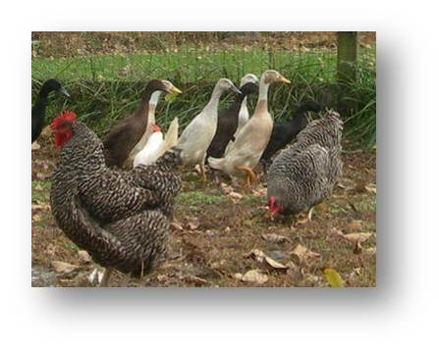
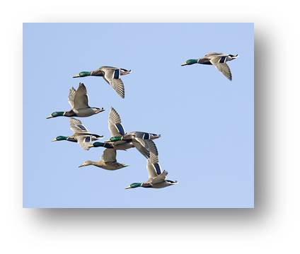
Highly Pathogenic Avian Influenza: An Emerging Disease Threat to the Alabama Poultry Industry
David L. Suarez D.V.M., Ph.D., A.C.V.M.
Research Leader Exotic and Emerging Avian Viral Disease Research Group
Southeast Poultry Research Laboratory
U.S. National Poultry Research Center, Athens, Georgia

Slide 2

AUM Senators….Warhawks!
Undergraduate Student 1982-83
Microbiology Major
Dr. Donald Roush

Slide 3
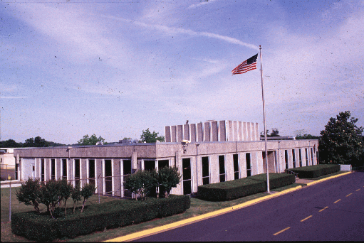
Southeast Poultry Research Laboratory
Agricultural Research Service (ARS) is the intramural research arm of the United States Department of Agriculture
ARS has over 100 research sites, often associated with Universities on animal, plant, food, and soil related projects
SEPRL is the ARS laboratory that studies Avian influenza and Newcastle disease virus, both Select Agents requiring BSL-3 facilities
Reference Center on avian influenza and Newcastle disease virus for the World Organization for Animal Health (OIE) and the Food and Agriculture Organization (FAO)

Slide 4
AL Agricultural Commodities 2012
VALUE OF SALES BY COMMODITY GROUP ($1,000)
Grains, oilseeds, dry beans, and dry peas | 435,465 | 33 | 50
Tobacco | (D) | 18 | 19
Cotton and cottonseed | 254,506 | 7 | 17
Vegetables, melons, potatoes and sweet potatoes | 50,332 | 33 | 50
Fruit, tree nuts, and berries | 23,872 | 27 | 50
Nursery, greenhouse, floriculture and sod | 242,589 | 19 | 50
Cut Christmas trees and short rotation woody crops | (D) | 31 | 49
Other crops and hay | 307,345 | 17 | 50
Poultry and eggs | 3,624,852 | 4 | 50
Cattle and calves | 429,349 | 31 | 50
Milk from cows | 28,113 | 44 | 50
Hogs and pigs | 33,424 | 31 | 50
Sheep, goats, wool, mohair, and milk | 5,675 | 33 | 50
Horses, ponies, mules, burros, and donkeys | 13,402 | 31 | 50
Aquaculture | 117,920 | 4 | 50
Other animals and other animal products | 3,467 | 42 | 50
TOP LIVESTOCK INVENTORY ITEMS (number)
Broilers and other meat-type chickens | 172,955,409 | 2
Layers | 9,435,605 | 12
Pullets for laying flock replacement | 5,457,121 | 9
Cattle and calves | 1,236,467 | 26
Quail | 1,104,670 | 2

Slide 5
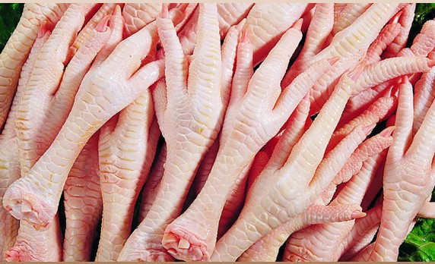
Economics of Broiler Production
In 2012 U.S. exported 19.9% of broiler production
Top 3 importing countries are Mexico, Canada, and Hong Kong
Every country has there own poultry industry that we are competing against
Avian influenza is often used as a non-tariff trade barrier to prevent exporting to certain countries
Primary export is chicken leg quarters
Chicken feet (paws) exported to Asia
U.S. industry dependent on exports

Slide 6
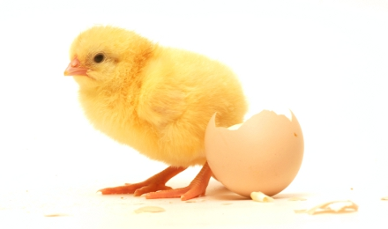
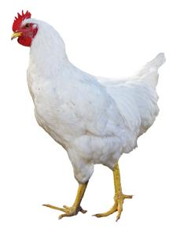
Broiler Production
Year | Market Age average days | Market Weight pounds, liveweight | Days Per Pound average days | Feed to Meat Gain pounds of feed to one pound of broiler, liveweight | Mortality percent
1925 | 112 | 2.5 | 44.8 | 4.7 | 18
1935 | 98 | 2.86 | 34.3 | 4.4 | 14
1940 | 85 | 2.89 | 29.4 | 4 | 12
1945 | 84 | 3.03 | 27.7 | 4 | 10
1950 | 70 | 3.08 | 22.7 | 3 | 8
1955 | 70 | 3.07 | 22.8 | 3 | 7
1960 | 63 | 3.35 | 18.8 | 2.5 | 6
1965 | 63 | 3.48 | 18.1 | 2.4 | 6
1970 | 56 | 3.62 | 15.5 | 2.25 | 5
1975 | 56 | 3.76 | 14.9 | 2.1 | 5
1980 | 53 | 3.93 | 13.5 | 2.05 | 5
1985 | 49 | 4.19 | 11.7 | 2 | 5
1990 | 48 | 4.37 | 11 | 2 | 5
1995 | 47 | 4.67 | 10.1 | 1.95 | 5
2000 | 47 | 5.03 | 9.3 | 1.95 | 5
2005 | 48 | 5.37 | 8.9 | 1.95 | 4
2006 | 48 | 5.47 | 8.8 | 1.96 | 5
2007 | 48 | 5.51 | 8.7 | 1.95 | 4.5
2008 | 48 | 5.58 | 8.6 | 1.93 | 4.3
2009 | 47 | 5.59 | 8.4 | 1.92 | 4.1
2010 | 47 | 5.7 | 8.2 | 1.92 | 4
2011 | 47 | 5.82 | 8.1 | 1.92 | 3.9
2012 | 47 | 5.95 | 7.9 | 1.9 | 3.7
2013 | 47 | 6.01 | 7.7 | 1.88 | 3.7
2014 | 47 | 6.12 | 7.5 | 1.89 | 4.3
2015 | 48 | 6.24 | 7.7 | 1.89 | 4.8
Herbert Hoover in campaign of 1928 promised “A chicken in every pot and a car in every garage”

Slide 7
U.S. Poultry Industry
World leader in poultry production
  Free of several major poultry diseases including avian influenza, Newcastle disease virus and very virulent infectious bursal disease
  Poultry infrastructure
  Genetics of birds
  Access to high quality corn and soybeans
  Diagnostic support and research
Landscape is constantly changing
  Emphasis on organic, cage free, antibiotic free production
  Backyard flocks becoming more common
  Competing globally with countries like Brazil

Slide 8
H5 Highly Pathogenic Avian Influenza Outbreak in the U.S. 2014-15
The HPAI outbreak was the largest animal disease outbreak ever in the United States based on number of animal affected!
49,700,000 birds either died or were euthanized during the outbreak
211 commercial flocks and 21 backyard flocks affected in 15 states
Government expenditures to control outbreak-1 billion
Cost to industry through business interruption and lost exports-3 billion
Cost to consumers because sharp increase in egg costs

Slide 9
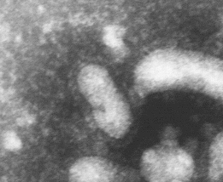
Influenza Virus
Segmented single stranded RNA genome
Four antigenic types: A, B, C, D
Type A:
  Human influenza H1N1, H3N2, pandemic H1N1
  Swine Influenza H1N1, H3N2
  Equine Influenza H3N8, H7N7
  Canine Influenza H3N8
  Avian Influenza(many bird species) H1-H16, N1-N9
  Bats H17N10, H18N11
Type B and C
  Primarily human
Type D (proposed)
  Cattle
Vary in pathogenicity

Slide 10
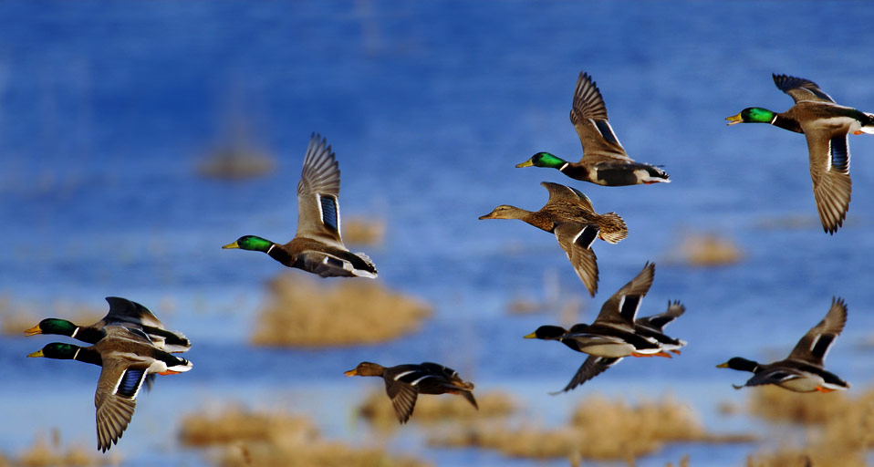

Slide 11
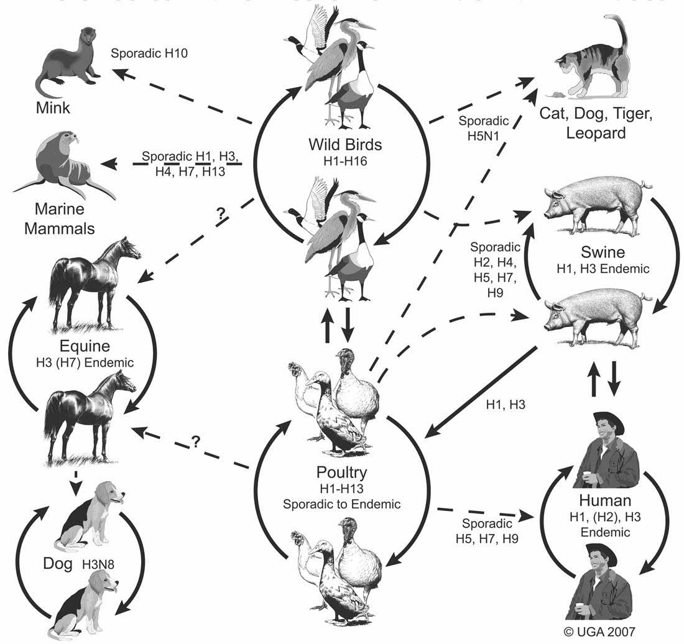
Swayne, D.E. Epidemiology of Avian Influenza in Agricultural and Other Man-Made Systems. In: Avian Influenza. Wylie-Blackwell (www.blackwellpublishing.com), 2008.
Notes:
AI viruses are not as gregarious as bacteria – they do not pass easily between species, but have natural barriers that require adaptation to pass between each animal

Slide 12





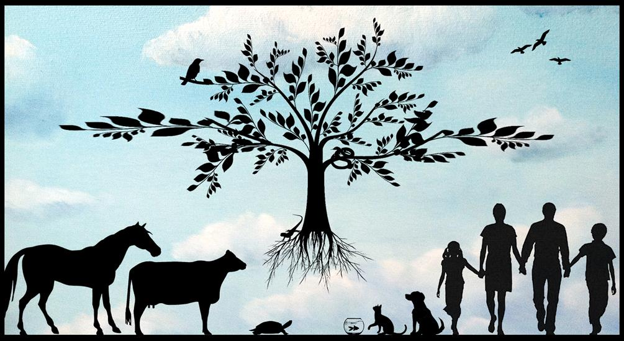
Human-Animal Health

Slide 13
Background for Avian Influenza
Low Pathogenic Avian influenza virus (AIV) is naturally found in wild birds (ducks, gulls, and shorebirds)
AIV is not normally found in chickens and turkeys
Transmission of AIV from wild birds to domestic poultry species (ducks>turkeys> chickens) occurs commonly
AIV on rare occasions may become established in chickens and turkeys and result in serious disease outbreaks
AIV once adapted to chickens and turkeys can be difficult to eradicate

Slide 14
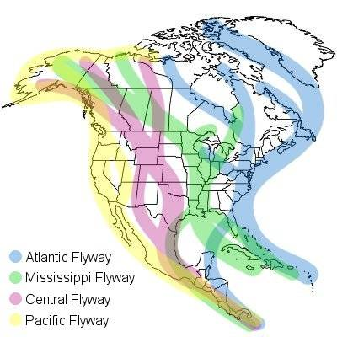
Migratory Bird Flyways

Slide 15

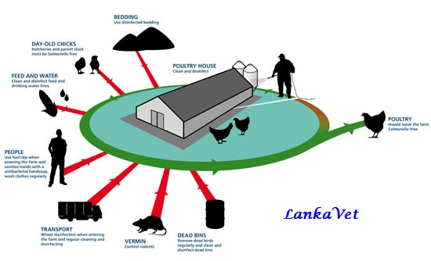
Biosecurity-Keeping Virus Off the Farm

Slide 16
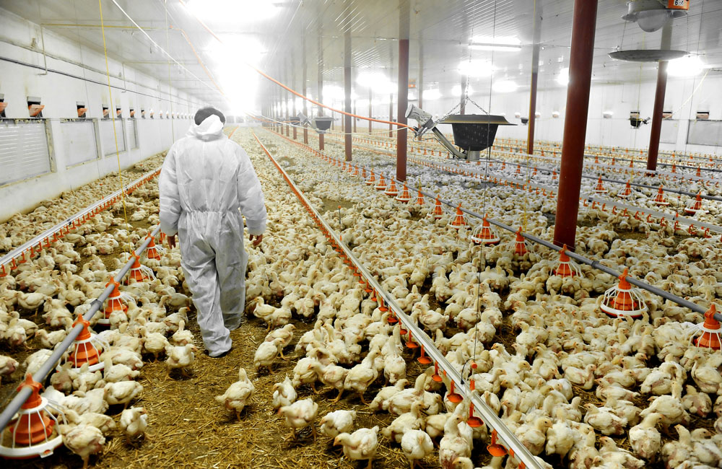

Slide 17
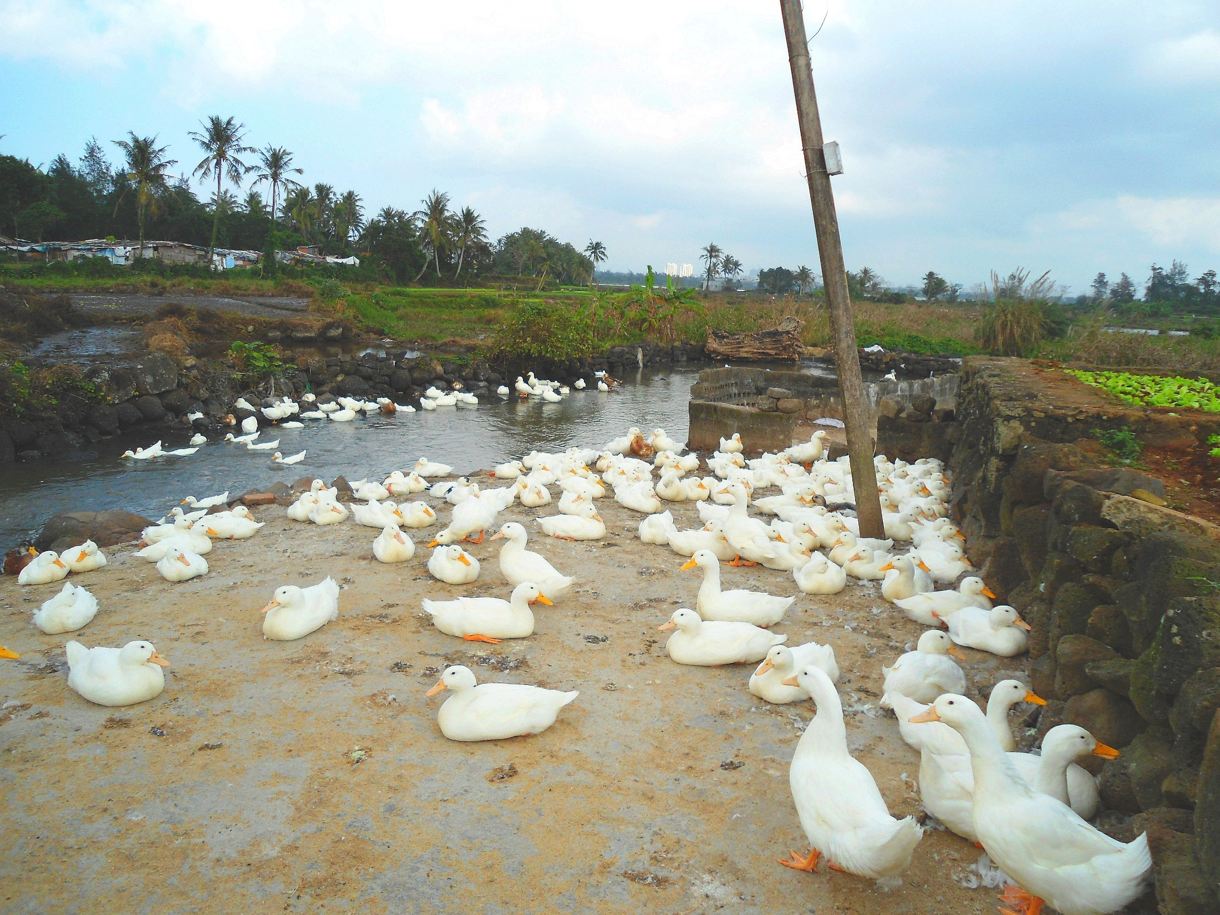
Duck Farm Hainan Province -Wikipedia Commons

Slide 18
Influenza: Infection and Disease
Infection may cause a wide range of clinical signs from no disease (asymptomatic), respiratory disease, to severe disease with high mortality
Localized Infection-mild to moderate disease
  Intestinal-wild ducks and shorebirds, poultry
  Respiratory-humans, swine, horses, poultry, domestic ducks, seal, mink
Systemic Infection-high mortality
  chickens, turkeys, other gallinaceous birds

Slide 19
Avian Influenza and Disease in Poultry
Influenza viruses are often divided into low pathogenic AI (LPAI) and highly pathogenic AI (HPAI)
Low pathogenic viruses often cause inapparent infections, localized respiratory infections with mild to moderate disease and mortality, drops in egg production
Highly pathogenic viruses cause a systemic disease with high mortality

Slide 20
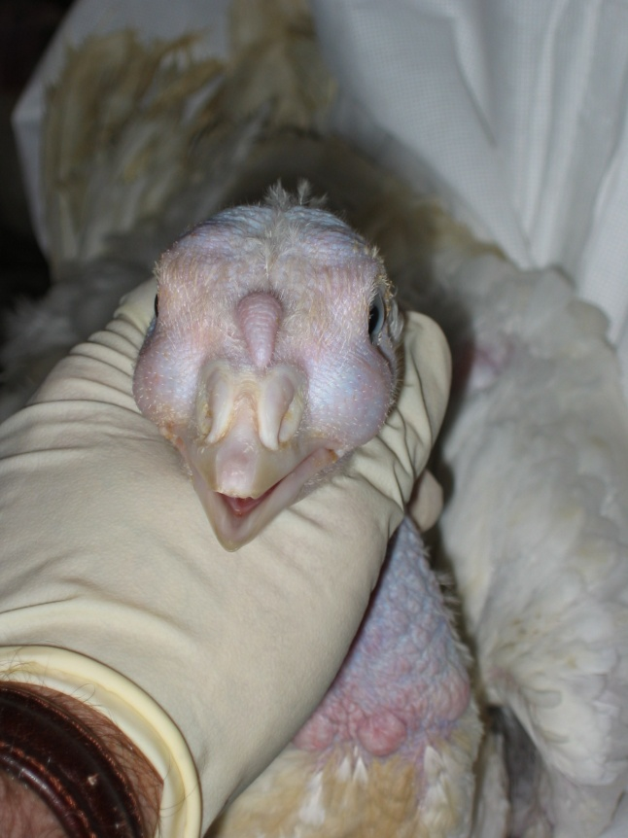

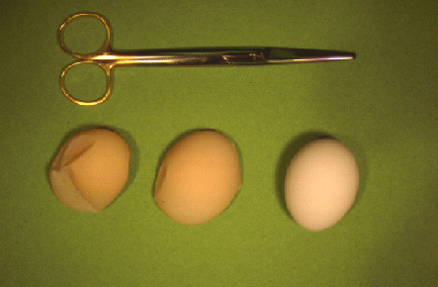
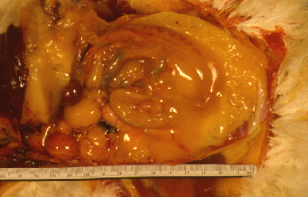
Low Pathogenicity Avian Influenza
Rhinitis & tracheitis
Ocular discharge
Drops in egg production

Slide 21
Highly Pathogenic Avian Influenza
Systemic, rapidly fatal disease of poultry
Only H5 and H7 subtypes are recognized to cause HPAI
OIE (World Organization for Animal Health) Reportable Disease
HA cleavage site critical virulence factor
Low pathogenic H5 and H7 AI viruses can mutate into the highly pathogenic form of the virus!

Slide 22
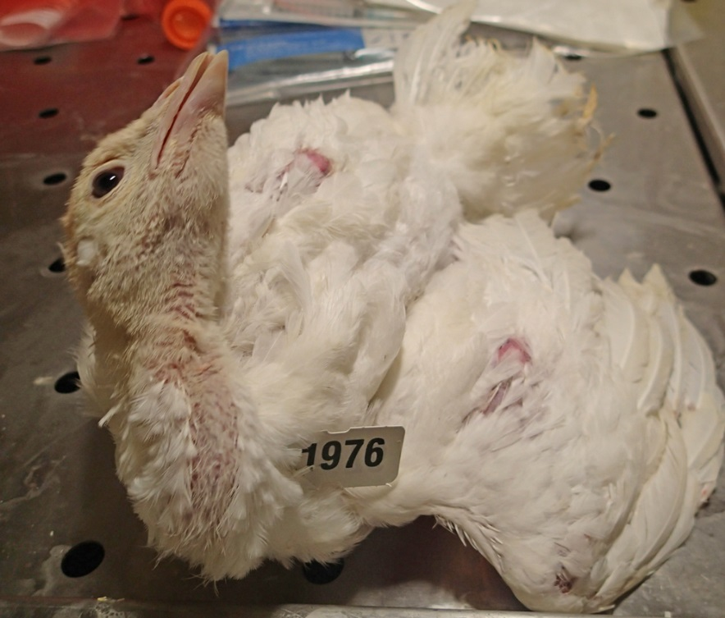
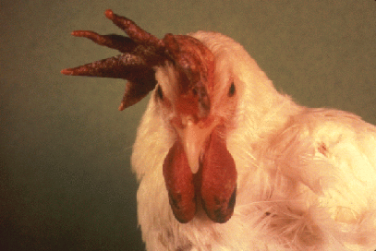
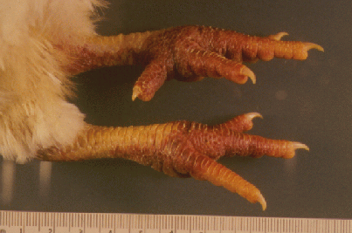
High Pathogenicity Avian Influenza
High death losses
Severe depression, neurologic signs, no feed consumption
Swollen comb/wattle
Hemorrhage in numerous tissues
Ilaria Capua

Slide 23
U.S. Control Strategy for Foreign Animal Disease
Rapid detection through National Animal Health Laboratory Network (NAHLN)
  Virus detection (Real-time RT-PCR, virus isolation)
  Serologic surveillance (millions of samples a year)
Rapid Response
  Most states have an avian influenza control plan
  For detections of low pathogenic H5 and H7 and all highly pathogenic avian influenza
  Provides resources, including indemnity, for rapid depopulation of infected flocks and dangerous contacts
  If the infected flock is euthanized quickly, reduces opportunity for virus transmission
  Quarantines, animal movement controls, increased biosecurity

Slide 24
39 HPAI Disease Events
1. 1959: Scotland, H5N1
2. 1961: S. Africa, H5N3
3. 1963: England, H7N3
4. 1966: Canada, H5N9
5. 1975: Australia, H7N7
6. 1979: Germany, H7N7
7. 1979: England, H7N7
8. 1983-84: USA, H5N2
9. 1983: Ireland, H5N8
10. 1985: Australia, H7N7
11. 1991: England, H5N1
12. 1992: Australia, H7N3
13. 1994: Australia, H7N3
§14. 1994-95: Mexico, H5N2
§15. 1995 & 2004: Pakistan, H7N3
16. 1997: Australia, H7N4
17. 1997: Italy, H5N2
*§18. 1996-2016: Asia, Europe, Africa, North America H5N1 (“panzootic”)
19. 1999-2000: Italy, H7N1
20. 2002: Chile, H7N3
21. 2003: Netherlands, H7N7
22. 2004: USA, H5N2
23. 2004: Canada, H7N3
24. 2004, 2006: S. Africa, H5N2 (ostriches)
§25. 2005: N. Korea, H7N7
26. 2007: Canada, H7N3
27. 2008: England, H7N7
28. 2009: Spain, H7N7
29. 2011-3: S. Africa, H5N2 (Ostriches)
30. 2012: Chinese Taipei, H5N2
§ 31. 2012-6: Mexico, H7N3
32. 2012: Australia, H7N7
33. 2013: Italy, H7N7
34. 2014-2016:Asia, Europe, and North America H5N8 and H5N2
35. 2015: Germany H7N7
36. 2015: England H7N7
37. 2015: France H5N9, H5N2
38. 2015: Chinese Taipei, H5N3, H5N2
39. 2016: USA, H7N8
*Largest epizootic in 50 yrs §Vaccine used in the control strategy
Notes:
24

Slide 25
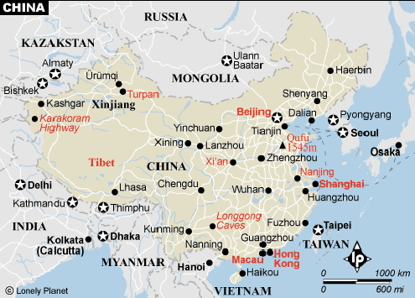
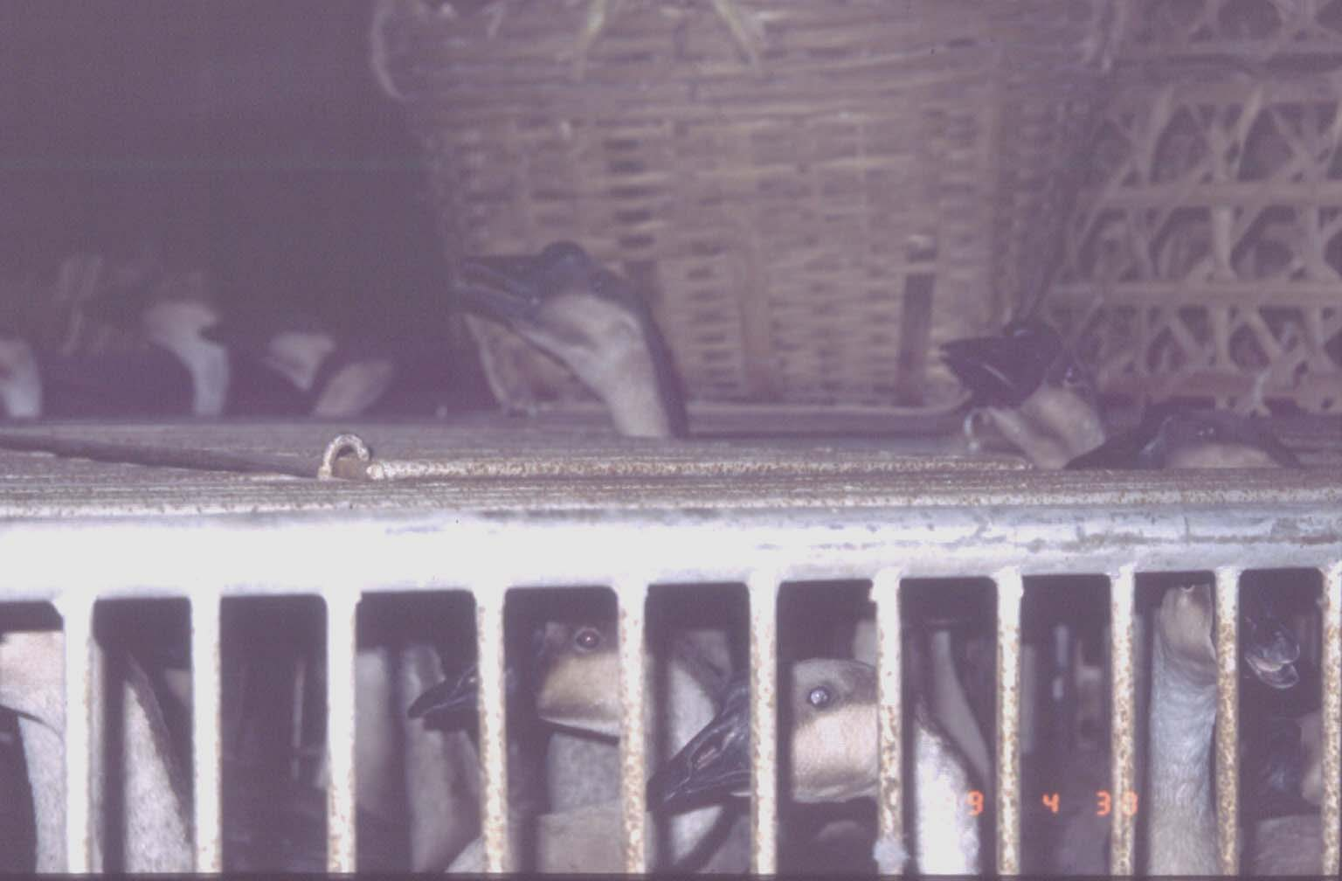
Goose/Guangdong H5N1 HPAI Epizootic
The Beginning, 1996
Guangdong, China
Geese with some mortality
H5N1 AI virus – HP for chickens
1997, Hong Kong:
  18 human cases, 6 deaths
  Depopulation of 1.4m poultry LPM and farms
Les Sims

Slide 26
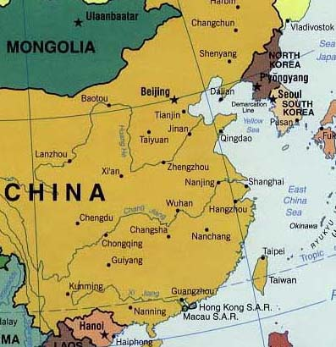
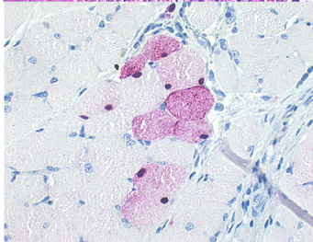
Asian H5N1 HPAI Epizootic
1999 H5N1 isolated from geese in Hong Kong
2001 H5N1 isolated from duck meat exported to S. Korea
  Isolated from meat juice - thawed and refrozen meat
  Meat from south China
AI virus:
  HP, chickens
  LP, mice
  NP, ducks
2003: H5N1 isolated in Japan from imported duck meat from China
Synbiotics2002

Slide 27
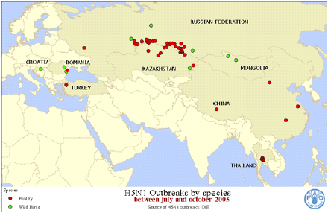
Asian HPAI 2003-04 Epizootics
Beginning - China: 1996- (H5N1)
Local extension - Hong Kong: 1997, 1999, 2001-3 (H5N1)
S. Korea: 2003-4 (H5N1)
Vietnam: 2004-6 (H5N1)
Japan: 2004 (H5N1)
Thailand: 2004-6 (H5N1)
Cambodia: 2004-6 (H5N1)
Laos: 2004-6 (H5N1)
Taiwan (smuggled ducks): 2003 & 5 (H5N1)
Indonesia: 2003 (H5N1)
Malaysia: 2004 (H5N1)

Slide 28
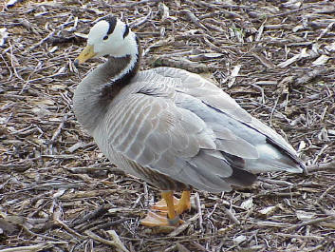
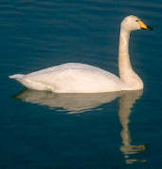
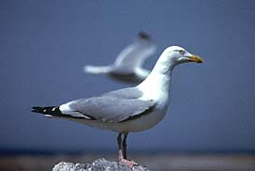
Role of Free-Living Aquatic Birds of H5N1
Until 2005, with one exception, HPAI was not thought to circulate in wild birds
Major outbreaks in 2005 and 2006 occurred in waterfowl species with mortality that indicated H5N1 clade 2.2 had jumped from domestic poultry to wild birds
Wild birds spread virus to poultry in Western Europe, the Middle East and Africa
Fewer infections and disease in 2007

Slide 29
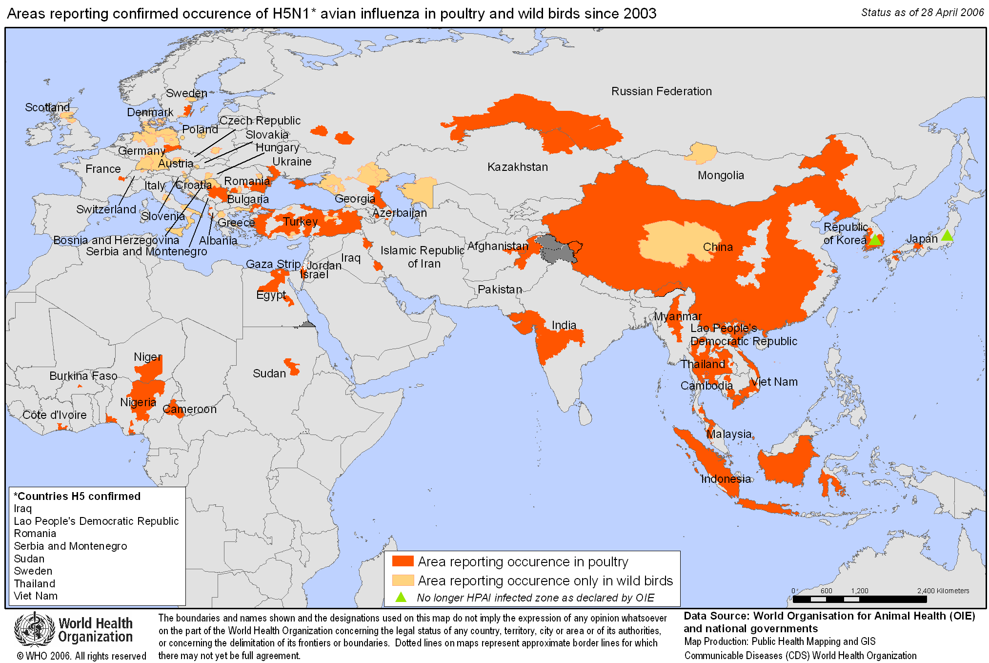
Extension of H5N1 HPAIV: 2006
60 countries with cases in wild birds and/or poultry
Over 250 million birds dead or culled since Jan. 2004 (FAO)

Slide 30
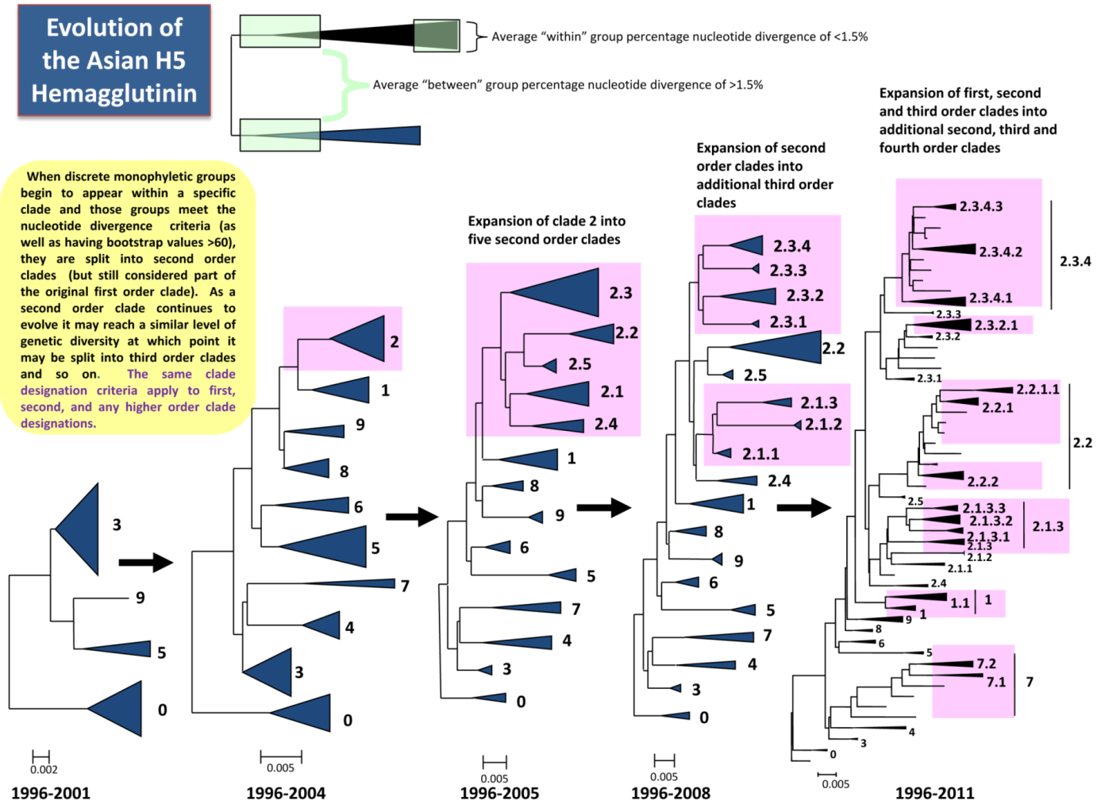
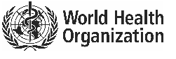
H5 Goose/Guangdong-lineage HPAIV
Since 1996 – H5N1 hemagglutinin changes – e.g. DRIFT (similar to human seasonal flu)
Since 2008 – reassortment of NA genes (N5, N6, N8, N2, N3)
2.3.4.4
2.3.2.1
2.2.1
2.1.3
1.1
7.2
2016
2012-…
Notes:
Diversification has given rise to numerous clades, which have distinct antigenic properties and virulence. In particular, clade 2.3.2.1 that dominates in Vietnam has evolved these past years into subgroups A, B, and C, which not necessarily share cross-protection.
In fact, new variants can escape immunity with vaccines based on classic strains, which rises the need for vaccine update.
For example, in Vietnam commercial vaccines Re-1 and Re-5 no longer provide protection against the new antigenic variants.

Slide 31
H5N1-Goose Guangdong Lineage
H5N1 HPAI-Goose Guangdong lineage first reported in 1996
Over 60 countries have reported outbreaks in poultry or wild birds
Hundreds of millions of birds died or were depopulated to control outbreak
Virus endemic in at least 6 different countries (China, Vietnam, Indonesia, Bangladesh, Egypt, and Cambodia)
Vaccination used in these countries to control disease
Over 650 human cases reported to WHO with high case fatality rate

Slide 32
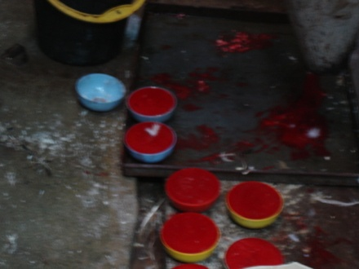
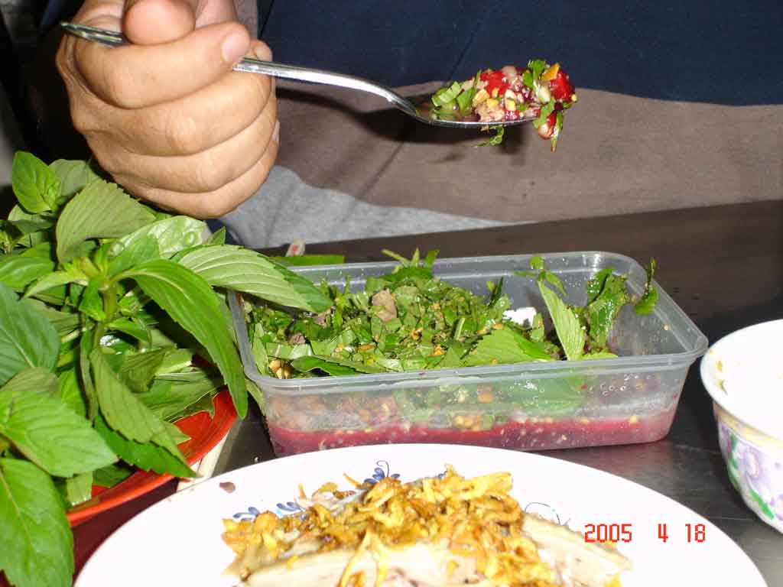
AI Virus Infections: Public Health Consequences
Potential Modes of Transmission to Humans
  Inhalation:
    Contaminated dust from farming operations
    Fine water droplets generated during slaughtering, defeathering, eviscerating and preparing
  Contact with oral/nasal mucus membrane or conjunctiva:
    Hand-transplantation of virus from contaminated surface (poultry feces, respiratory secretions or other contaminated products)
    Direct oral exposure in cleaning fighting cocks?
  Consumption of raw products?
    Duck blood pudding & internal organs
    No epidemiological evidence at this time
Notes:
“Countries affected by the deadly avian influenza H5N1 should not be too quick in restocking the premises, as this may lead to the disease flaring up again if cleaning and disinfection procedures were not totally effective”

Slide 33
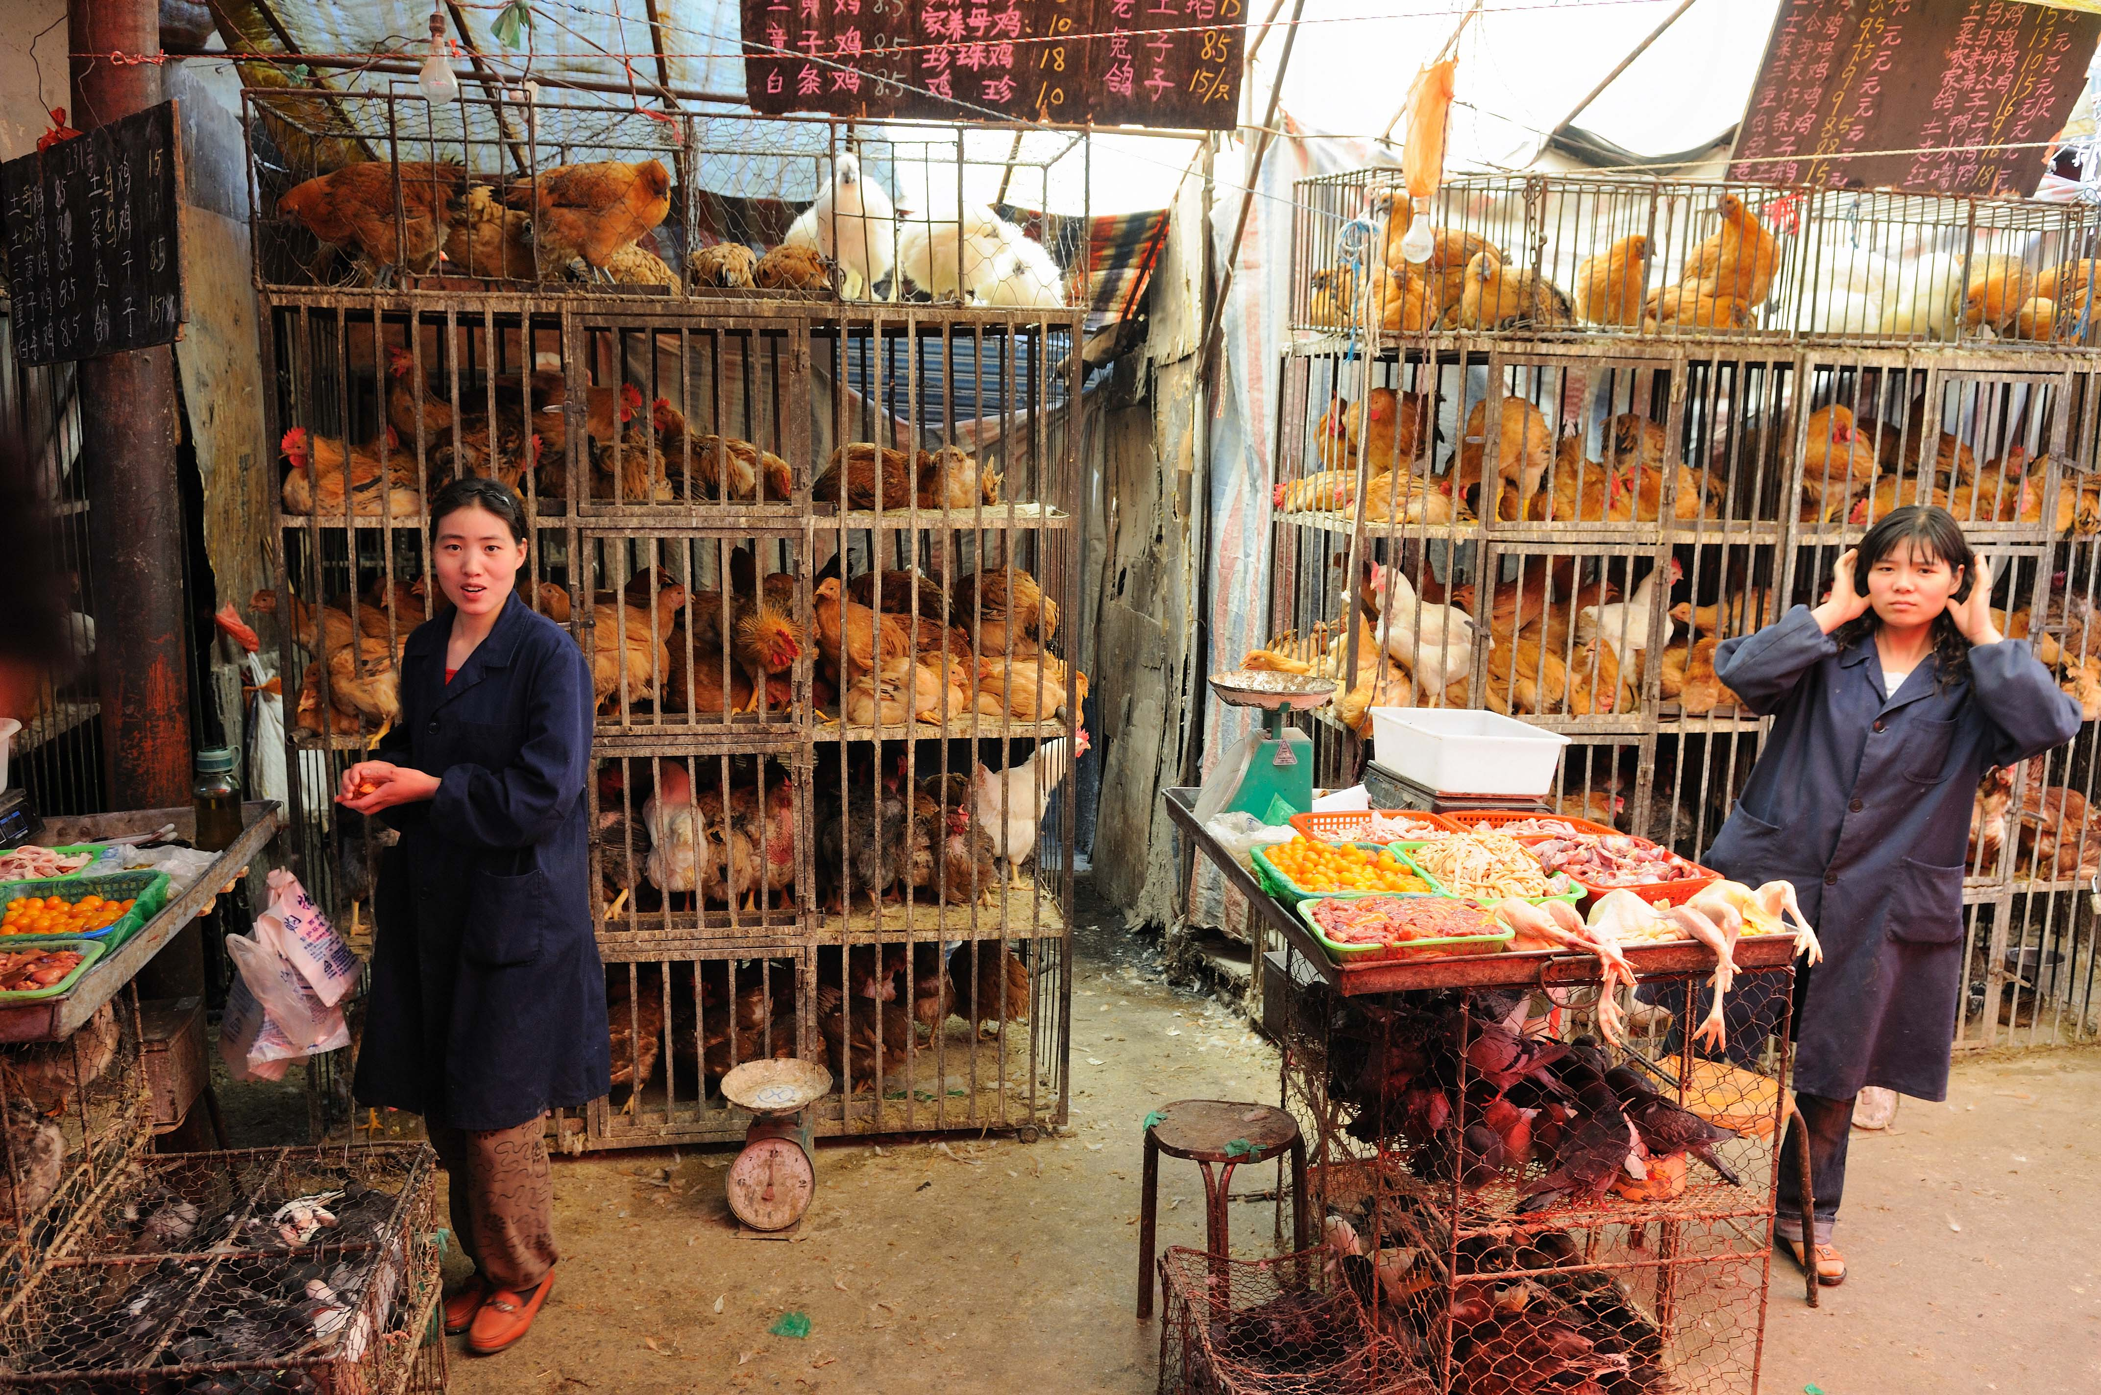
Chicken market Xining, China

Slide 34
Wild Bird Spread of HP H5 Asian lineage Viruses
Qinghai Lake lineage (Clade 2.2) emerged in 2005 and circulated until at least 2008
In 2008 a new lineage of virus emerged (clade 2.3.2.1) in wild birds that likely came from poultry
Circulated until at least 2010 in wild birds
In winter 2013-14 a new wild bird virus was isolated in China and Korea, H5N8 (clade 2.3.4.4)
The H5 gene is Asian lineage origin, but a new neuraminidase subtype was introduced by reassortment
Widespread outbreaks in South Korea in 2014
Similar viruses identified in Canada (H5N2) and the United States (H5N8, H5N2, H5N1) in late 2014

Slide 35
H5N8 HPAIV and derivatives: Eurasia
South Korea
  January 2014 reported in domestic birds
  Numerous outbreaks through September 2014
Japan
  April 2014 H5N8
  Outbreaks in chickens, swans cranes and wild ducks
China
  October 2014 H5N8
  Environmental sample and duck sample during routine surveillance
Russia
  December 2014
  Wild duck isolate
Europe
  November 2014-Feb 2015 in Germany, Netherlands, Italy, UK, Hungary
Taiwan
  January 2015 H5N8, H5N2, and H5N23 in poultry

Slide 36
Movement of H5N8 into North America

Slide 37
12/8/2015 to 6/12/2015 – H5 HPAIV in wild bird, backyard poultry and commercial poultry
309 detections (4 captive wild bird; 21 backyard; 209 commercial flocks, 75 wild birds)
  21 states affected (AR , CA, IA, ID, IN, KS, KY, MI, MN, MO, MT, NE, ND, NM, NV, OR, SD, UT, WA, WI, WY)
  ~ 48.6 million commercial birds: Turkeys ~7.5 million, Chickens ~41.1 million
Notes:
Recheck outbreaks to see

Slide 38
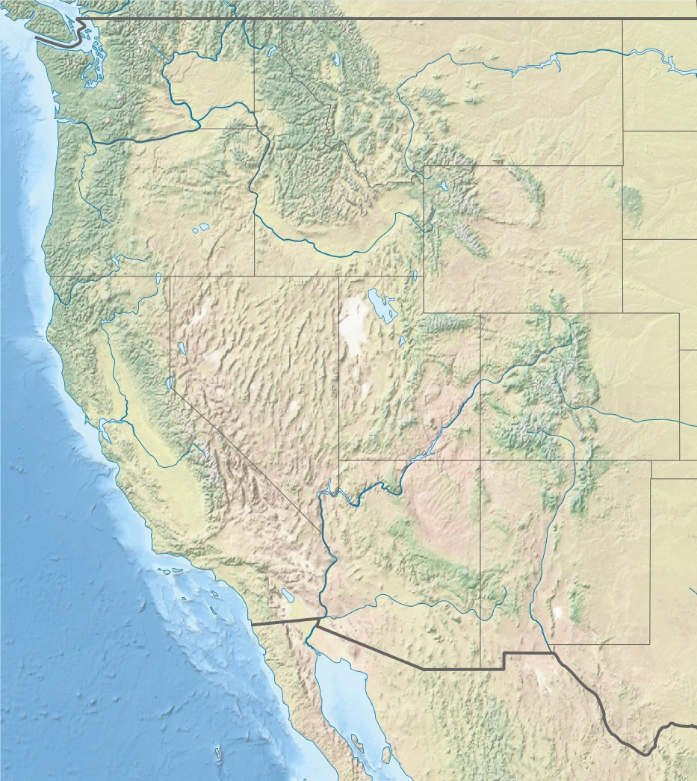
1
7
Poultry Outbreaks
1) OR H5N8 Dec 19, 2014
2) WA H5N2 Jan 3, 2015
3) WA H5N2 Jan 9, 2015
4) WA H5N2 Jan 16, 2015
5) ID H5N2 Jan 16, 2015
6) CA H5N8 Jan 23, 2015
7) WA H5N2 Jan 29, 2015
8) WA H5N2 Feb 2, 2015
9) WA H5N2 Feb 3, 2015
10)CA H5N8 Feb 12, 2015
8
4
9
1
2
3
2,4,6
3,5
5
6
10
Captive Raptors
1) WA H5N8 Dec 14, 2014
2) ID H5N2 Jan16, 2015
3) ID H5N8 Jan 29, 2015
4) ID H5N8 Feb 2, 2015
5) ID H5N8 Feb 6, 2015
6) ID H5N8 Feb 12, 2015

Slide 39
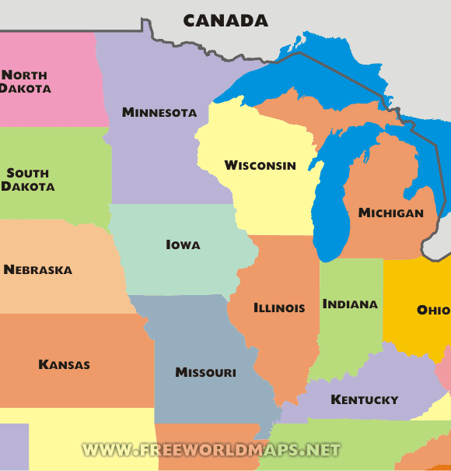
H5N2 2015 Outbreaks
March 2-8 1
March 9-15 4
March 16-22 0
March 23-29 1
Mar 30-Apr 5 4
April 6-12 8
April 13-19 16
April 20-26 29
Apr 27-May 3 26
May 4-10 32
May 11-17 21
May 18-24 12
May 25-31 14
June 1-7 17
June 8-17 3

Slide 40
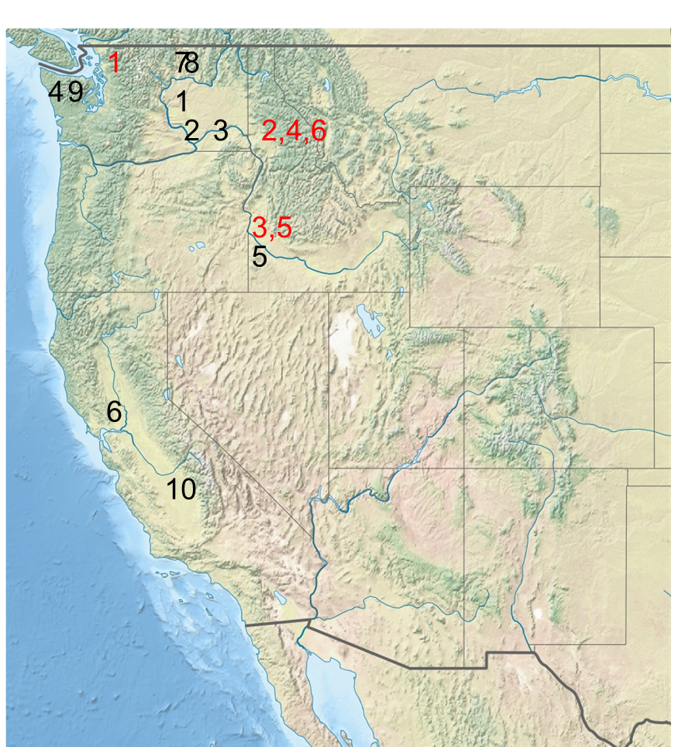
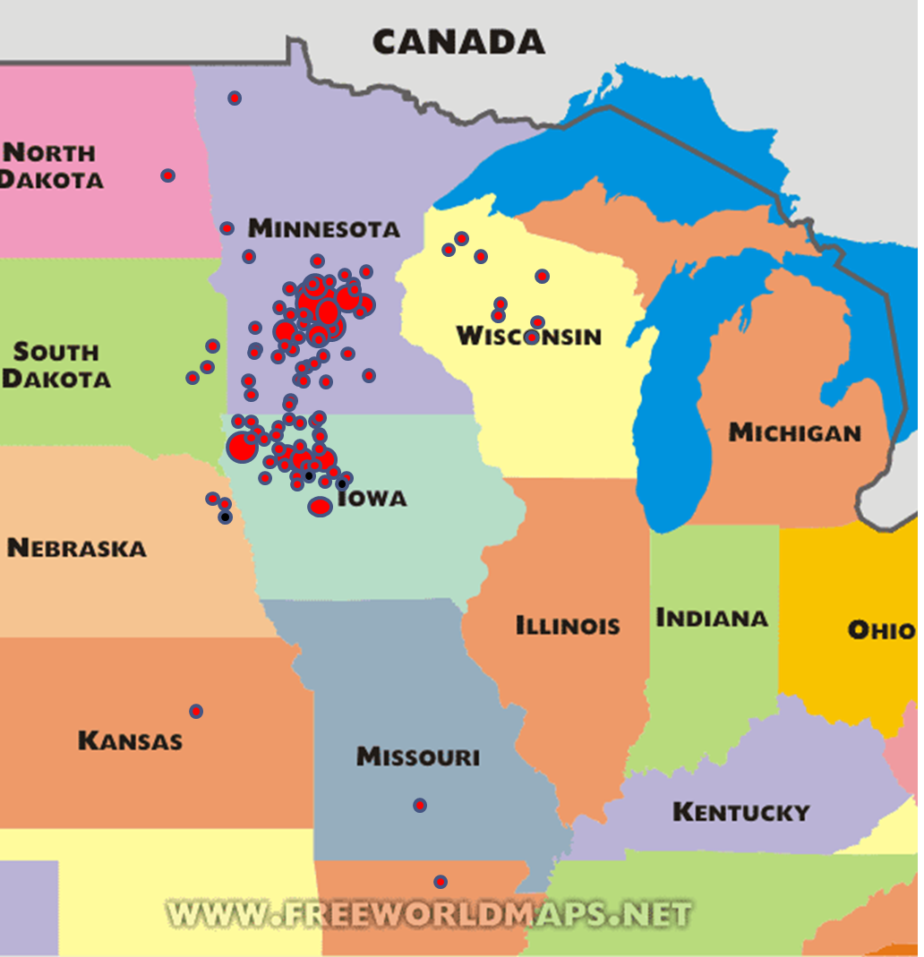
Why the difference in the Pacific Outbreak and the Midwest Outbreak?

Slide 41
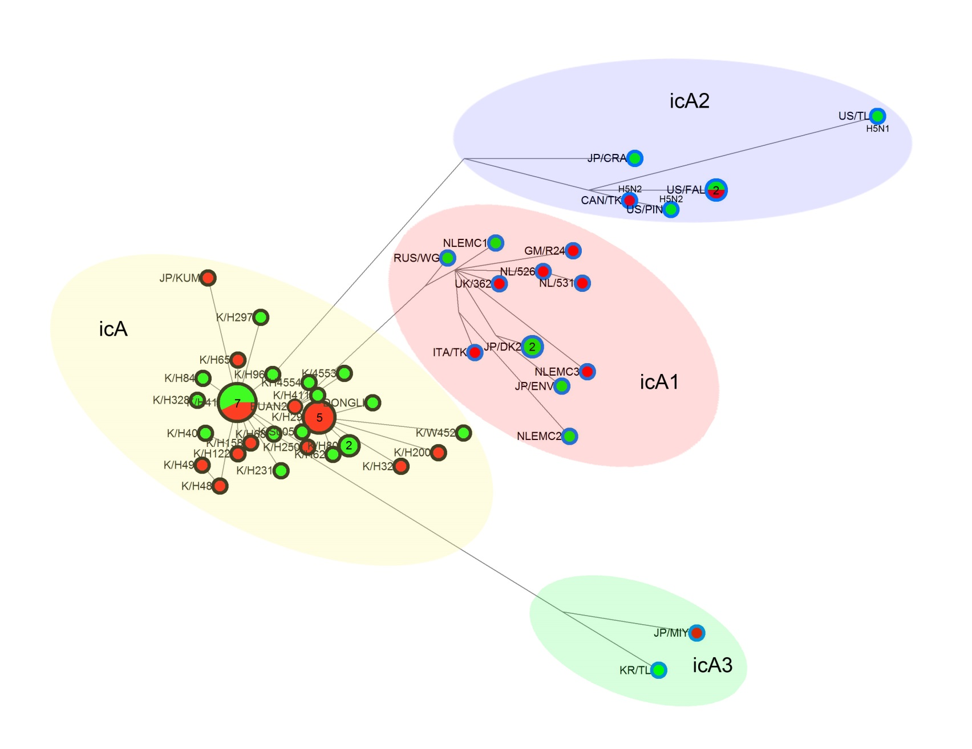
Fall 2014 – Winter 2015
Group icA:
2.3.4.4 HA
North America,
Japan
Chinese Taipei
Winter 2014
Russia, Europe, Japan
Korea/Japan
Japan & Korea
Lee et al., J Virol 89:6521–6524, 2015
Notes:
The median-joining network was constructed from the HA-encoding gene. This
network includes all of the most parsimonious trees linking the sequences. Each unique sequence is represented by a circle whose size reflects the frequency of the
sequence in the data set. Branch length is proportional to the number of mutations. Isolates are colored according to the origin and season of the sample as
follows: red inner circle, poultry farm isolates; purple inner circle, wild-bird isolates; black outer circle, early 2014 isolates; blue outer circle, late 2014 isolates.

Slide 42
H5Nx North America
Central & MS Flyways
Pacific Flyway
269 viruses, 3 genes (HA, M, PB2)
Initial spread by wild waterfowl
Later, farm-to-farm human activity
Notes:
long branches suggest point source introductions

Slide 43
Why is this outbreak so much different than previous outbreaks
Wild bird reservoir
  First time in U.S. dealing with wild bird reservoir of HPAIV
  The prevalence of infection in some wild duck species is higher than would normally be expected for a low pathogenic isolate
  Allowed exposure of poultry to HPAIV in over 20 states
Size of farms
  Egg layer operations in midwest are typically a million+ bird operation and have lots of movement on and off the farms
  Once virus introduced onto farm, the virus will adapt
Logistical issues
  Difficult to depopulate that large of numbers of birds
  Difficult to dispose of that large of number of birds
  Budget cuts at USDA reduced numbers of veterinarians

Slide 44
Depopulation and Disposal
3 depopulation methods used
  CO2 gas (used most commonly for layer hens)
  Firefighter foam (used most commonly with birds on the floor)
  Ventilation shutdown (used towards end of outbreak, but may be used more in future)
Disposal
  Composting (used most commonly)
  Landfill (difficult to get landfills to accept birds)
  Incineration (expensive, difficult to implement, and costly)
  Burial on site (environmental issues and perception issues)
Both issues delayed depopulation and contributed to spread of outbreak

Slide 45
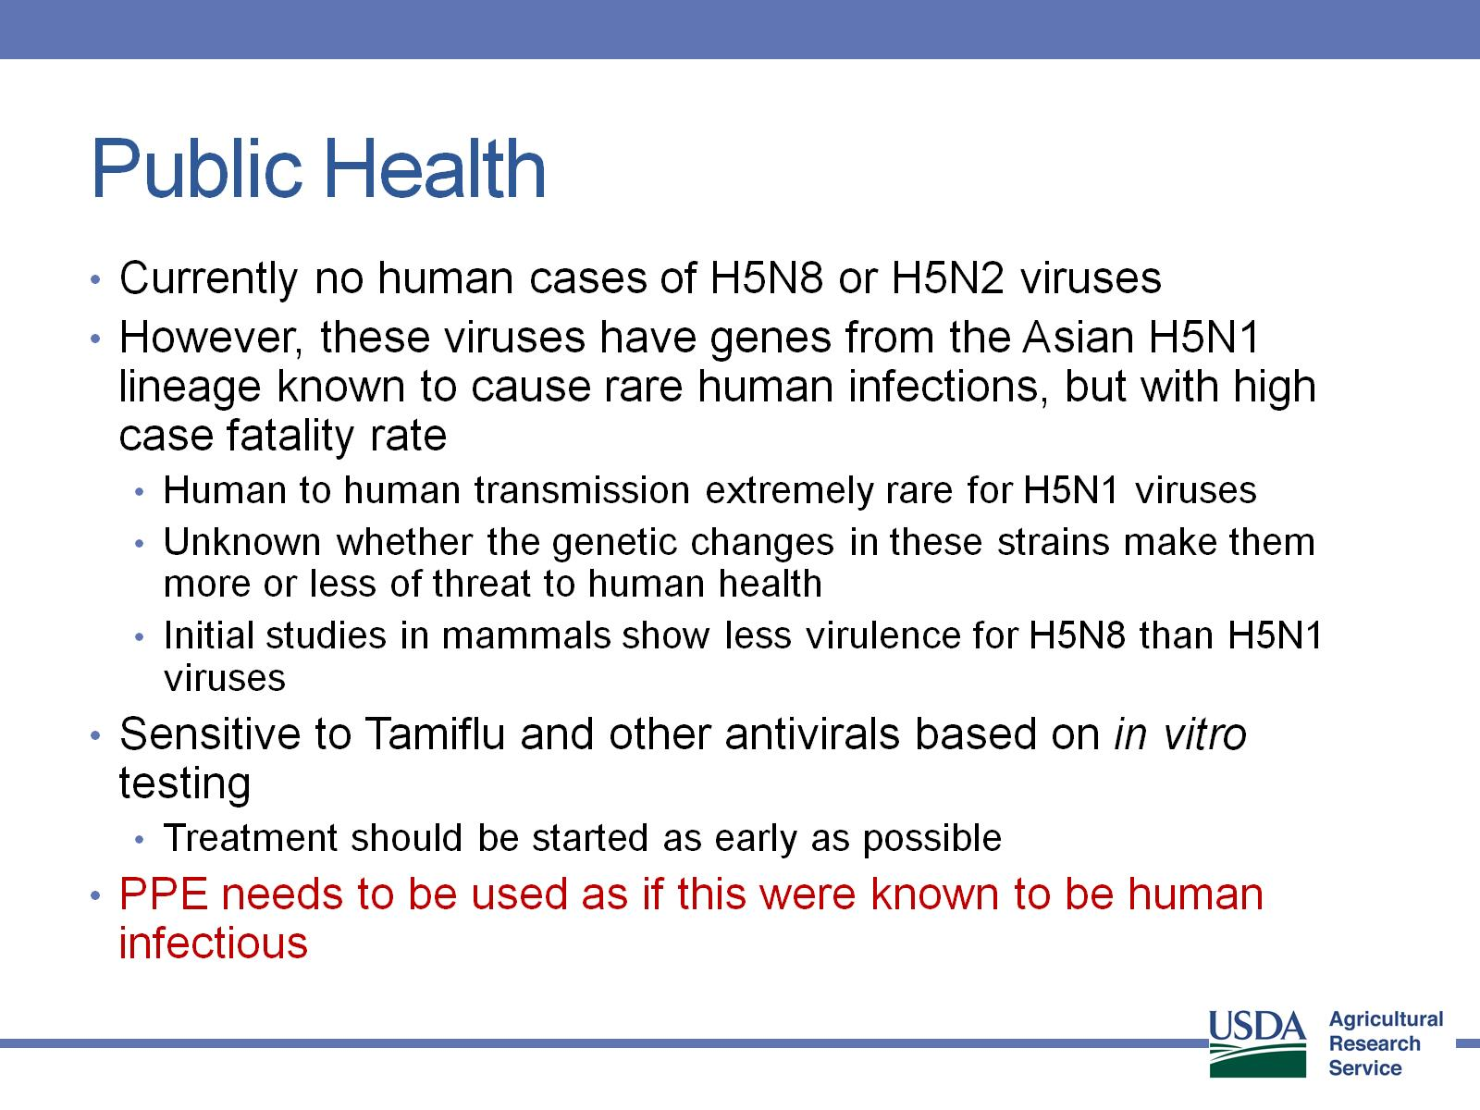
Public Health

Slide 46
Pathogenesis and Transmission
Determine any differences in infectivity, transmissibility & pathogenesis of the intercontinental H5Nx clade 2.3.4.4 HPAIV for gallinaceous poultry and mallard ducks
Approach
Used two earliest USA isolates:
  A/Gyrfalcon/Washington/41088/2014 (H5N8)
  A/Northern Pintail/Washington/40964/2014 (H5N2)
Intranasal infectious dose and contact transmission
  SPF White Leghorn chickens
  Commercial broad-breasted white turkeys
  Commercial Japanese quail, pheasant, Bob-white quail
  Mallard ducks
Pathogenesis studies: preclinical, clinical & dead birds for virus shedding, histopathology and IHC-virus distribution

Slide 47
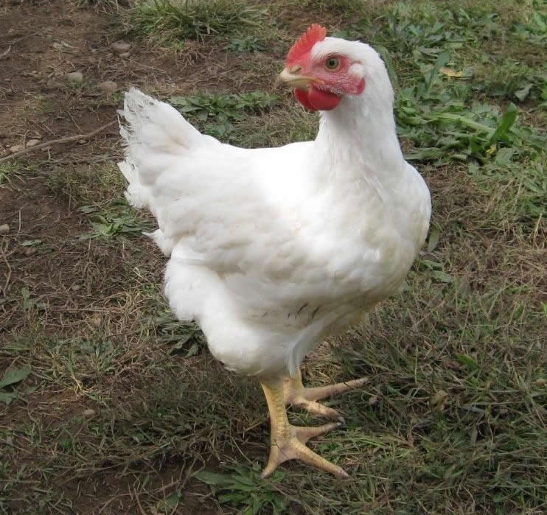
Infectious dose and virus transmission in chickens, turkeys and quail
Challenge with 10² 10⁴,10⁶ EID₅₀ of H5N8 and H5N2
Daily: Record mortality, clinical signs, gross lesions
Add 3 contacts to each dose group
0 1 2 3 4 5 6 7 8 9 10 11-14 days
Oropharyngeal and cloacal swabs collected for virus detection
Exposure by simulated respiratory (natural) route of infection.
Serology to determine infection status
Virus detected by quantitative real-time RT-PCR assay and virus isolation

Slide 48
Chickens: Infectious dose and transmission
 | Log 10 Dose | Inoculated dead/total (MDT) | Contact dead/total (MDT) | CLD50 Log 10
A/Gyrfalcon/Washington/41088/2014 H5N8 Dec 2014 | 2 | 0/5 | 0/3
 | 4 | 2/5 (4d) | 0/3 | 4.3
 | 6 | 5/5 (4.1d) | 0/3
A/Northern Pintail/Washington/40964/2014 H5N2 Dec 2014 | 2 | 0/5 | 0/3
 | 4 | 0/5 | 0/3 | 5.7
 | 6 | 3/5 (3d) | 0/3
A/Tk/AR/7791/2015 H5N2 March 2015 | 2 | 0/5 | 0/3
 | 4 | 0/5 | 0/3 | 5.1
 | 6 | 8/9 (2.3d) | 0/2
A/Tk/MN/12582/2015 H5N2 April 2015 | 2 | 0/5 | 0/3
 | 4 | 3/5 (2d) | 0/3 | 3.5
 | 6 | 8/8(2d) | 2/2

Slide 49
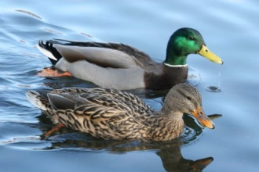
Mallards - Infectious dose and transmission
 | Log 10 Challenge Dose | Inoculated #pos/total | Mortality | Contact #pos/total | DLD50 Log 10
A/Gyrfalcon/Washington/41088/2014 H5N8 H5N8 Dec 2014 | 2 | 5/5 | 0/5 | 3/3
 | 4 | 5/5 | 0/5 | 3/3 | <2.0
 | 6 | 5/5 | 0/5 | 3/3
 | 7.5 | 5/5 | 0/5 | 3/3
A/Northern Pintail/Washington/40964/2014 H5N2 Dec 2014 | 2 | 5/5 | 0/5 | 3/3
 | 4 | 5/5 | 0/5 | 3/3 | <2.0
 | 6 | 5/5 | 0/5 | 3/3
 | 7.5 | 5/5 | 0/5 | 3/3

Slide 50
Conclusions
The H5Nx viruses were able to experimentally infect and transmit easily in mallard ducks with no clinical disease
Supports the role of wild birds in moving the virus to North America
Initial outbreaks in poultry in U.S. appear to be point source introductions with little farm to farm spread of virus
Later outbreaks have evidence of farm to farm spread as major contributor to spread
Control efforts in U.S. remain as early detection and stamping out of infected flocks

Slide 51
Future
Anticipate persistence of H5Nx HPAI in wild birds for at least 3 years
Potential for introduction anywhere in the U.S.
Increase in biosecurity and surveillance in poultry
Increase surveillance in wild birds
Increased resources to USDA to more quickly react to multiple outbreaks if they occur
Research to better understand the virus and provide improved control tools
Consumer trends in poultry promote increased likelihood of avian influenza outbreaks!

Slide 52
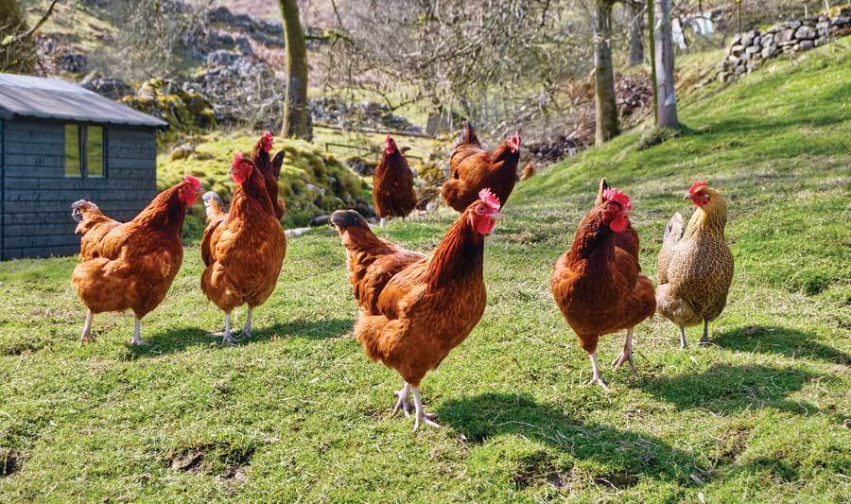

Slide 53
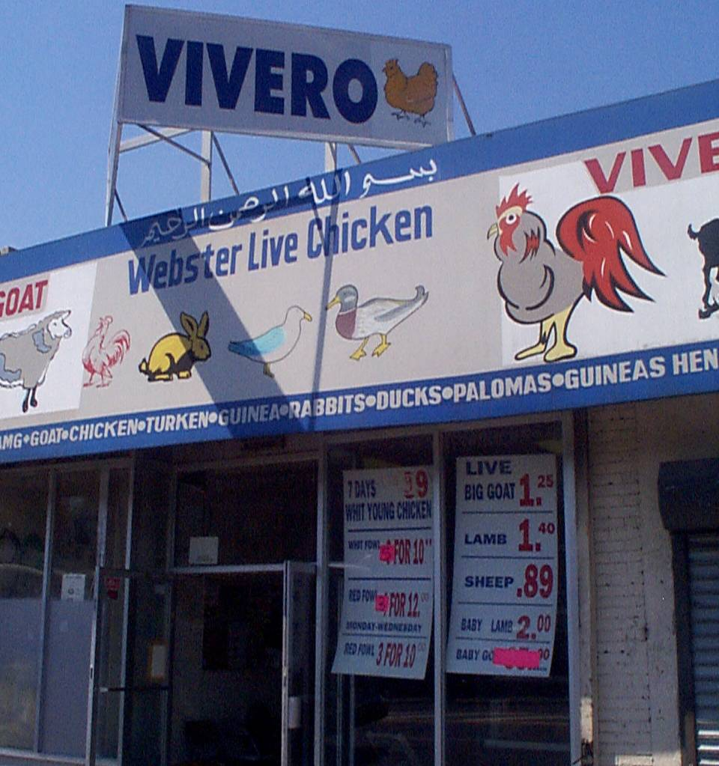

Slide 54
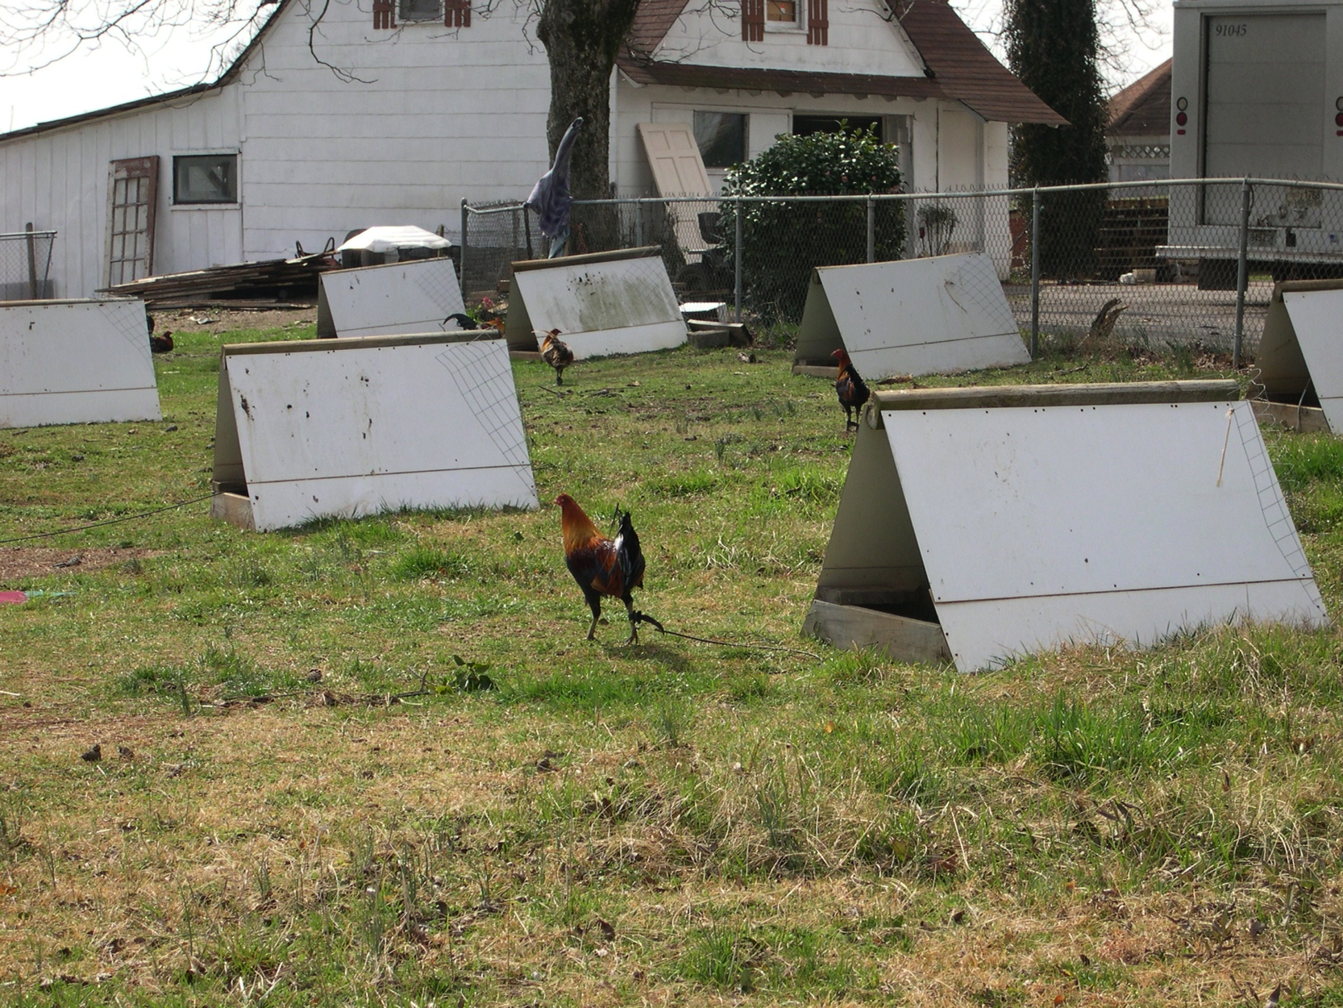

Slide 55



Contributors
SEPRL Avian Influenza Research Team: David Suarez, Mary Pantin-Jackwood, Erica Spackman, Darrell Kapczynski, David Swayne, Kateri Bertran, Mar Costa-Hurtado, Donghun Lee, Marisela Rodriguez, Yue Wang, Eric DeJesus, Charles Balzli, Kira Moresco, Diane Smith, Aniko Zsak, Scott Lee, Suzanne Deblois, Cam Greene, James Doster, Megan Christian, Nicolai Lee, Rebekah Lee, Samantha Pallas, Melissa Scott, Bill Gagnon, Roger Brock, Ronald Graham, Gerald Damron, Keith Crawford
NVSL: Mia Torchetti
Industry Veterinarians: David Rives, Eric Gonder, Raul Otalora
Funding
  USDA/ARS, APHIS, NIFA
  NIH/CEIRS

Slide 56
