Slide 1
Laboratory Diagnosis of Hemoglobin Disorders
Andrew N Young MD PhD
Southeast Region Medical Director
Quest Diagnostics
CLS Symposium
Auburn University at Montgomery
29 MAR 2019

Slide 2
Hemoglobin disorders (hemoglobinopathies)
Inherited abnormalities of hemoglobin synthesis
Thalassemias
  Quantitative hemoglobin disorders
  Structurally normal protein synthesized at below-normal levels
    Important example: beta thalassemia major
Structural hemoglobinopathies
  Qualitative hemoglobin disorders
  Structurally abnormal protein synthesized at near-normal levels
    Important example: sickle cell disease

Slide 3
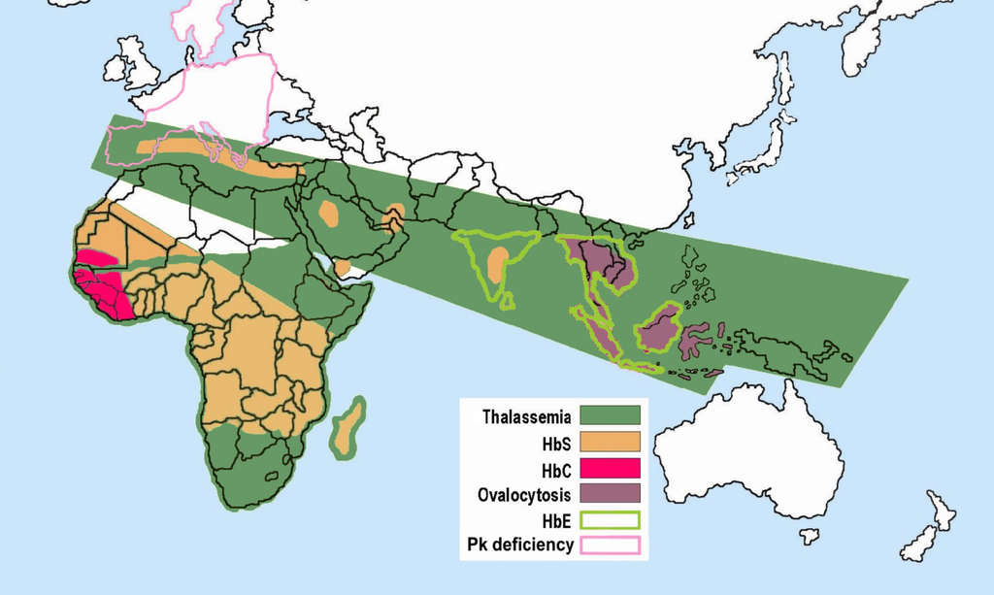
Hemoglobin disorders (hemoglobinopathies)
Highly prevalent in malaria-endemic regions
  7% of world population estimated to be genetic carriers
https://en.wikipedia.org/wiki/Genetic_resistance_to_malaria#/media/File:Red_Blood_Cell_abnormalities.png

Slide 4
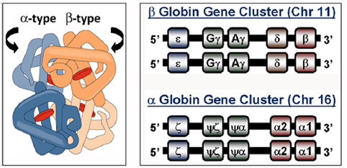
Hemoglobin: gene and protein structure
Linked α-type and β-type globin gene families
  α-globins on chromosome 16; β-globins on chromosome 11
  Genes are activated 5’ → 3’ during development
  Embryonic and fetal genes are suppressed postnatally
Tetrameric proteins: 2 α-type and 2 β-type globin chains
  O₂ binds to reduced (Fe²⁺) heme associated with each globin chain
Species | Chains | Fetus → Neonate | Adult
Hb F | α2γ2 | 75% | <1%
Hb A | α2β2 | 25% | 97%
Hb A2 | α2δ2 | <1% | 3%

Slide 5
Thalassemias

Slide 6
Thalassemia: pathobiology
Inherited quantitative hemoglobin disorders
  Structurally normal protein synthesized at below-normal levels
  Unbalanced synthesis of wild type globin chain
α thalassemia: excess β-type chains
  β4 (Hb H), γ4 (Hb Barts): unstable tetramers → hemolysis
β thalassemia: excess α-type chains
  α4: unstable, insoluble tetramers → intramedullary cell death, hemolysis

Slide 7
Thalassemia: classification
By affected globin gene(s): α, β, δ, δβ, etc
  α: most often due to large deletions of α globin genes
    α⁺ (“type 2”; 1 gene deletion) vs α⁰ (“type 1”: 2 gene deletion)
  β: most often due to point mutations in β globin gene resulting in underexpression
    β⁺ (reduced globin synthesis) vs β⁰ (absent globin synthesis)
By severity (zygosity): thalassemia minor vs major
  Minor: microcytosis +/– mild anemia (“thalassemic picture”)
  Intermedia: hemolytic anemia of variable severity
  Major: transfusion-dependent hemolytic anemia
    Complications of therapy: iron overload and alloimmunization

Slide 8
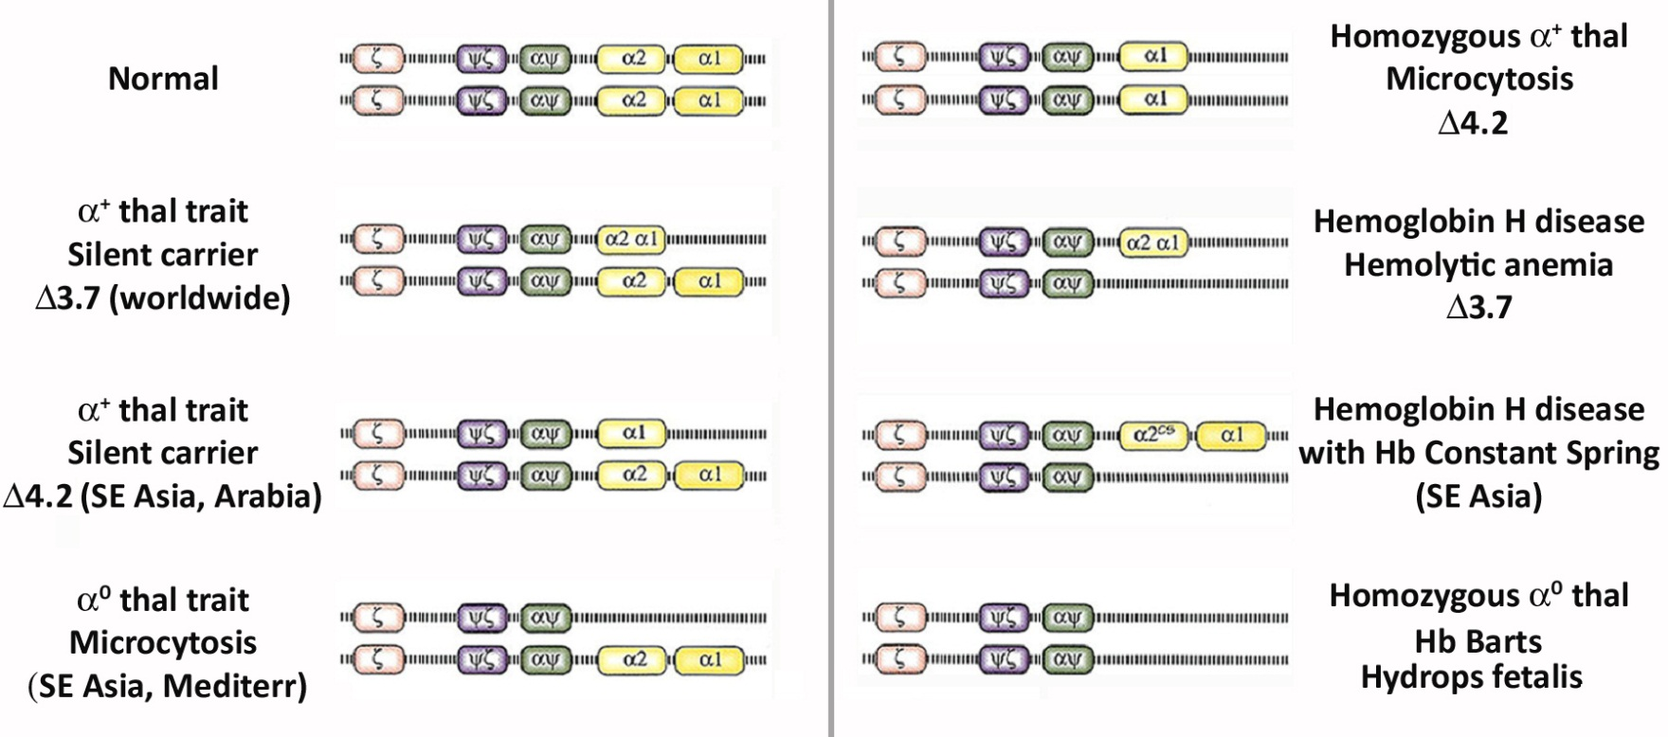
α Thalassemia: genotypes and phenotypes
Syndrome | Genotype | Hematology | Hemoglobins
Minor | Loss of 2 α genes | Microcytosis | A; A2 Normal
Intermedia | Loss of 3 α genes | Microcytic hemolytic anemia | A; Hb H; A2 Normal
Major | Loss of 4 α genes | Incompatible with survival | Hb Barts

Slide 9
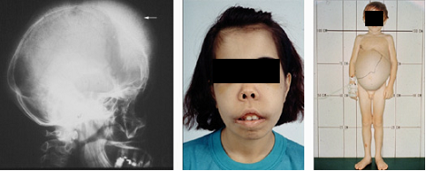
β Thalassemia: genotypes and phenotypes
Syndrome | Genotype | Hematology | Hemoglobins
Minor | β / β⁺ ; β / β⁰ | Microcytosis | A; F ↑; A2 ↑
Intermedia | β⁺ / β⁺ | Microcytic hemolytic anemia | A ↓↓; F ↑↑; A2 ↑
Major | β⁺ / β⁰ ; β⁰ / β⁰ | Microcytic hemolytic anemia | A ↓↓; F ↑↑; A2 ↑
↑ Hb A2 (5-10%): Diagnostic hallmark of β thalassemia syndromes
β- thalassemia major:
Hemolytic anemia, splenomegaly, bone deformities

Slide 10
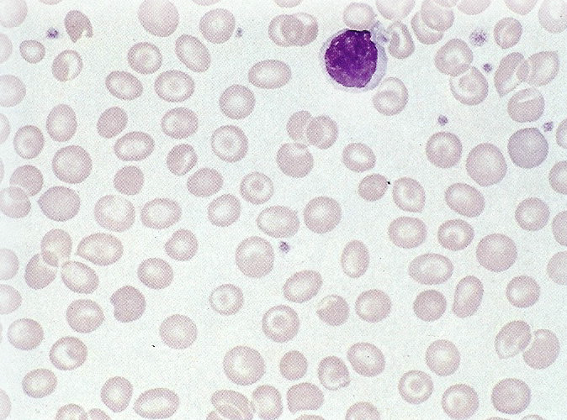
Thalassemias: red blood cell morphology
Similar in α and β thalassemia
Thalassemia minor
  Microcytosis (ddx: iron deficiency)
  Target cells
  Normal or ↑ RBC
  RDW not markedly increased
  Basophilic stippling
Thalassemia major
  Microcytic anemia
  Reticulocytosis
  Teardrop cells
  Nucleated RBC

Slide 11
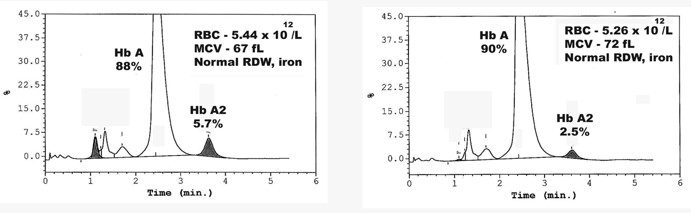
Thalassemias: hemoglobin analysis
HPLC
HPLC
β thalassemia minor
α thalassemia minor
(Increased Hb A2)
(Normal Hb A2)

Slide 12
Hemoglobin variants

Slide 13
Classification of hemoglobinopathies
Several hundred mutations have been described
  Many are clinically silent
  Variants are catalogued in the HbVar relational database
    http://globin.cse.psu.edu/hbvar/menu.html
Abnormality | Functional Effect | Clinical Disorder
Δ protein solubility | Polymerization; crystallization | Hemolytic anemia
Δ mRNA processing | ↓ expression | Thalassemia syndrome
Δ Protein stability | Denaturation | Hemolytic anemia
↑ O₂ affinity | ↓ O₂ release | Polycythemia
↓ O₂ affinity | ↓ O₂ binding | Cyanosis or anemia
↓ Heme reduction | ↓ O₂ binding | Cyanosis

Slide 14
Common hemoglobin variants
Clinical significance depends on functional effect and zygosity
Variant (Mutation) | Functional effect | Clinical disorder | Geographic distribution
Hb S (β 6 Glu–→ Val⁰) | Polymerization | Hemolytic anemia | Africa, South Asia, Mediterranean
Hb C (β 6 Glu–→ Lys⁺) | Crystallization | Hemolytic anemia | West Africa
Hb E (β 26 Glu–→ Lys⁺) | ↓ Expression | Thalassemia syndrome | Southeast Asia
Hb D (β121 Glu– → Gln⁰) | None | None* | Punjab, Africa, North Europe
Hb O (β121 Glu–→ Lys⁺) | None | None* | Africa, East Europe, rare in Arabia
Hb G (α 68 Asn⁰ → Lys⁺) | None | None | Africa

Slide 15
Hemoglobin S (sickle cell) disorders
Most common and significant hemoglobin disorder in US
Genotype | Frequency | Clinical Severity
Hb AS (trait) | 1/12 | ––*
Hb SS | 1/375 | ++
Hb S/β thalassemia | 1/1167 | +/++
Hb SC | 1/835 | +
Hb SC-Harlem | Rare | ++
Hb SD-Punjab* | Rare | ++
Hb SO-Arab* | Rare | ++
*Notes:: Genotype frequencies: US Dept HHS, 1993 Hb AS may become symptomatic in extreme stress Hb D-Punjab and O-Arab (β121 mutations) are non-sickling in trait or homozygous form, but promote Hb S polymerization in compound heterozygous disease

Slide 16
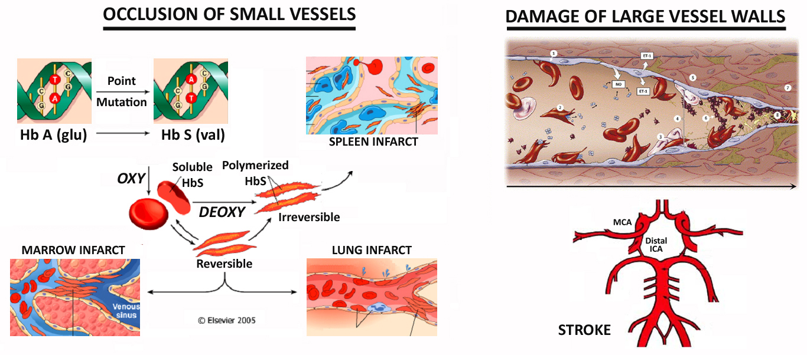
Pathophysiology of sickle cell disorders
Occlusion of small blood vessels: sickling at low O₂ tension
Damage of vascular walls: inflammatory and oxidative stress
Complications are highly prevalent in sickle cell disease

Slide 17
Therapeutic approaches for sickle cell disorders
Transfusion (simple or exchange)
  Complications: iron overload and alloimmunization
Hydroxyurea
  Induction of Hb F, which inhibits polymerization of Hb S
Pain management
Allogeneic hematopoietic stem cell transplant
  Limitations: lack of HLA matched donors, morbidity of bone marrow conditioning regimen, risk of graft-vs-host disease
Gene therapy
  Still experimental but showing promise

Slide 18
Role of laboratory testing

Slide 19
Laboratory tests for hemoglobin disorders
Peripheral blood smear morphology
Cation-exchange HPLC; capillary electrophoresis
  High-throughput analysis; FDA-approved to quantify Hb F and Hb A2
Hemoglobin electrophoresis
  Confirmation of abnormal variants on HPLC
Solubility tests for sickle hemoglobin
  Low volume screening; confirmation of Hb S on HPLC
Other
  Globin chain electrophoresis and isoelectric focusing
  α Globin PCR or gene sequencing: α thalassemia confirmation
  β Globin gene sequencing: β thalassemia confirmation

Slide 20
Indications for laboratory testing
Diagnosis of hemoglobin disorders
  Identification of sickle cells or hemoglobin C crystals
  Detection of abnormal hemoglobin phenotypes
  Quantification of Hb A2 for diagnosis of β thalassemia
Screening of newborns for sickle cell disease
  Mandated in all US states for presymptomatic diagnosis
    Penicillin prophylaxis: ↓ childhood mortality from bacteremia
    Screening of pregnant women (non-mandated) for high-risk
Monitoring of therapy for sickle cell disease
  % Hb S after exchange transfusion for acute complications
  % Hb F after hydroxyurea induction
    The presence of Hb F inhibits polymerization of Hb S

Slide 21
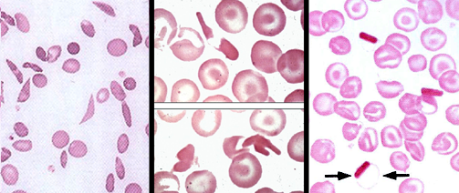
Hemoglobin S & C: red blood cell morphology
HbSS
HbSC
HbCC
Sickle Cells
Howell-Jolly Bodies
Sickle/Deformed/Target
Cells; Hb C Crystals
Target Cells
HbC Crystals

Slide 22
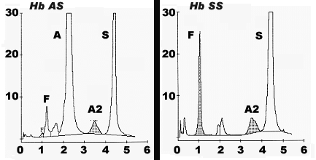
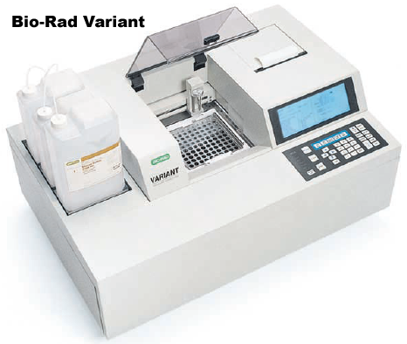
Cation-exchange HPLC
Automated, high-throughput method
  Separation by charge: Hb S, Hb C (relatively positive) elute after Hb A
Hb A1c
Time (min)
Time (min)
Limitations:
  Requires confirmation of abnormal variants
  Coelution of Hb A2 with Hb E and glycohemoglobin S

Slide 23
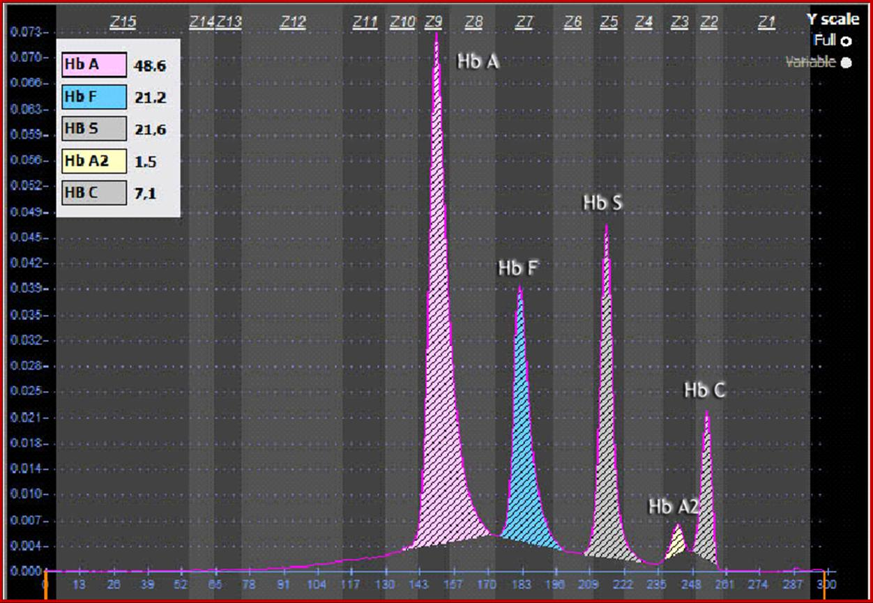
Capillary electrophoresis
Automated, high-throughput method
  Separation by charge and electrophoretic mobility
  Hb A2 does not coelute with Hb E and glycohemoglobin S
http://www.sebia-usa.com/products/capillarys.html

Slide 24
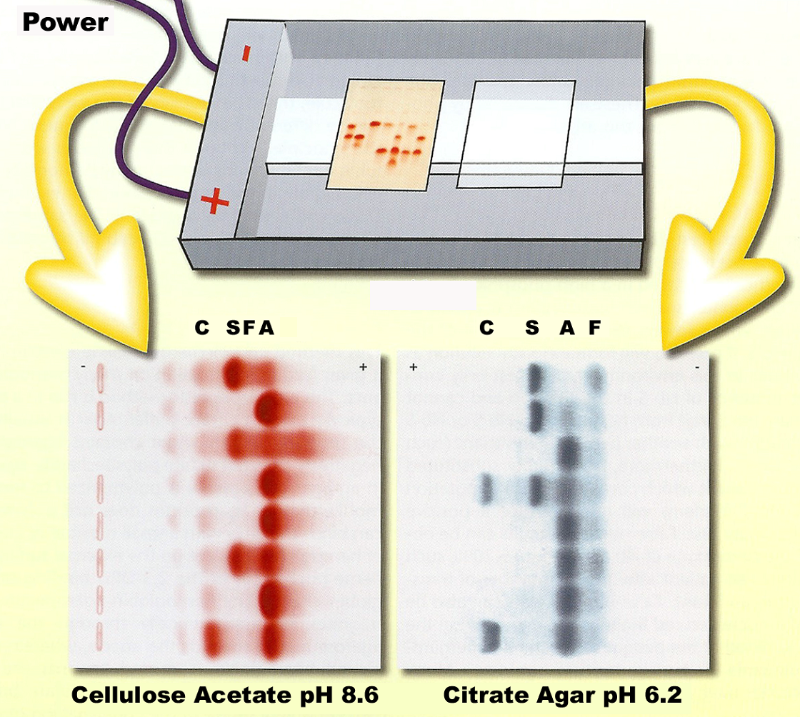
Hemoglobin electrophoresis
Labor-intensive, low-throughput method
  Separation of important variant hemoglobins

Slide 25
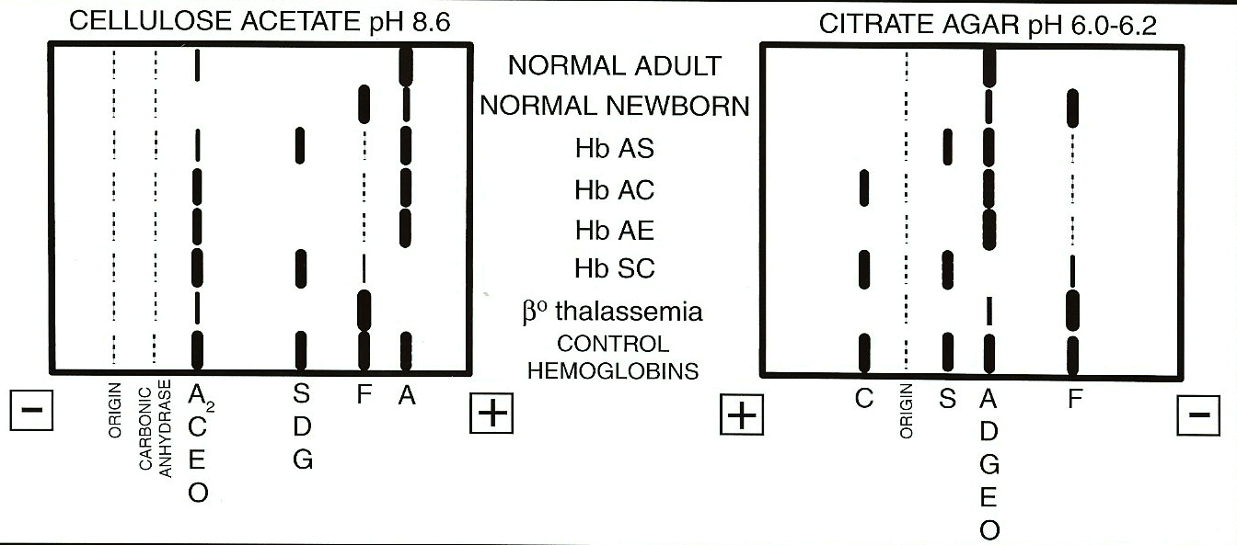
Hemoglobin electrophoresis
Cellulose acetate (alkaline): initial run
  Common variants separated from Hb A
  Hb E, Hb O migrate with Hb C; Hb D, Hb G migrate with Hb S
Citrate agar (acid): confirmation of Hb S or Hb C
  Hb E, Hb O, Hb D, Hb G migrate with Hb A

Slide 26
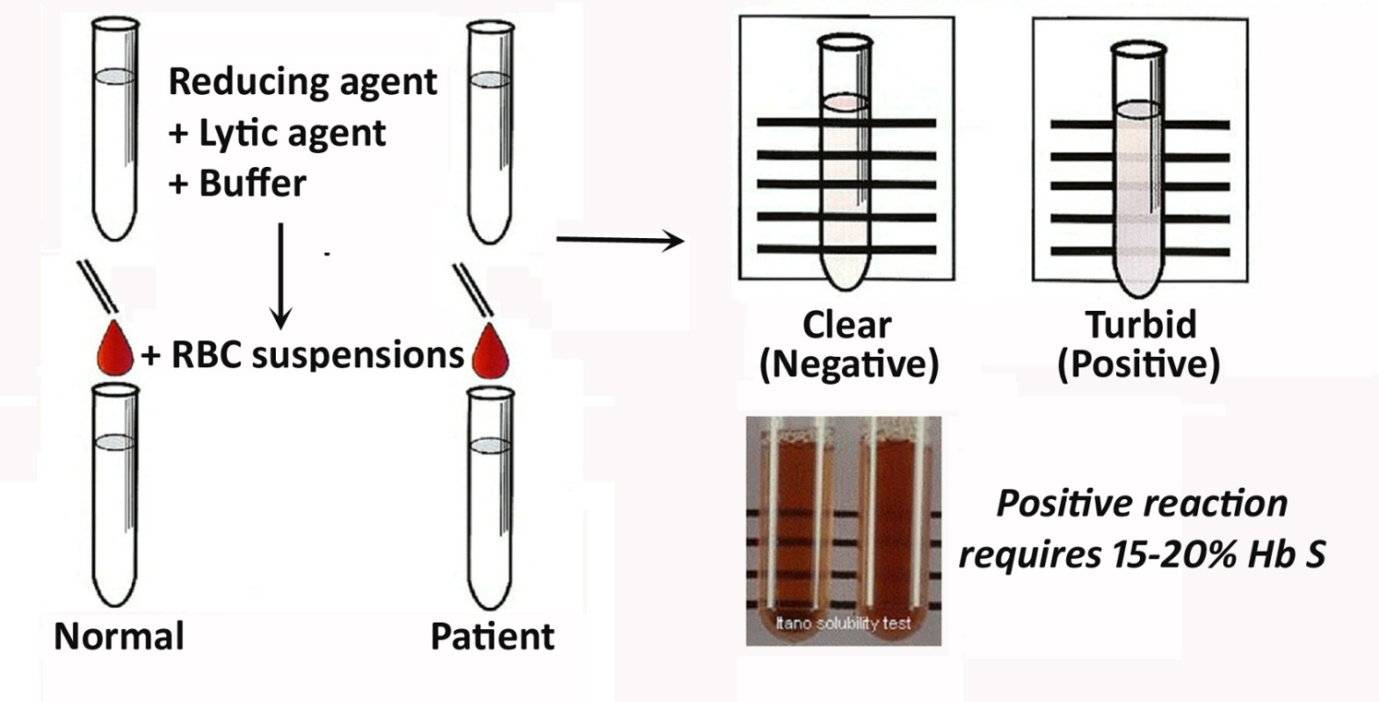
Sickle solubility test
Not a diagnostic test: Hb AS and Hb SS are both positive
Not useful for infants < 6 months: low Hb S and high Hb F levels
Potential false negative results: severe anemia or exchange transfusion
Potential false positive results: sample turbidity (eg: high lipids, paraprotein)

Slide 27
Case reviews

Slide 28
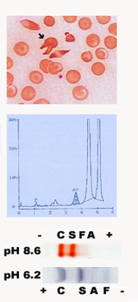
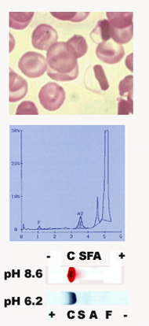
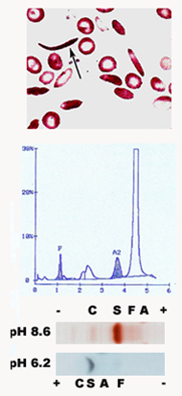
Laboratory review: major hemoglobin variants
Hb SS
Hb CC
Hb SC
Hb S (β 6 Glu–→ Val⁰)
Hb C (β 6 Glu–→ Lys⁺)

Slide 29
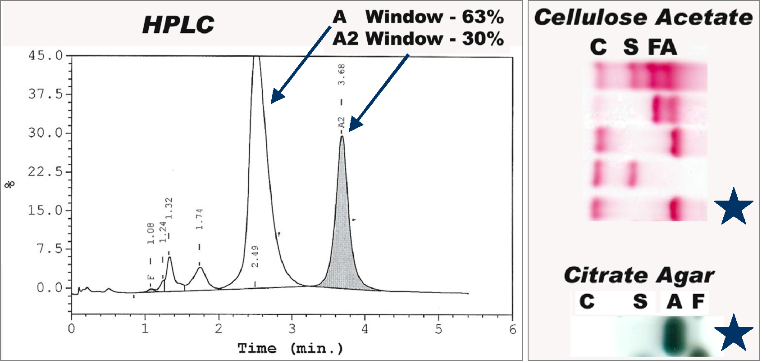
Laboratory review: major hemoglobin variants
Pregnant female at prenatal screen; mild microcytic anemia
Hb AE (hemoglobin E trait): thalassemia minor-like syndrome
Hb EE: microcytosis +/- mild anemia
Hb E (β 26 Glu–→ Lys⁺)

Slide 30
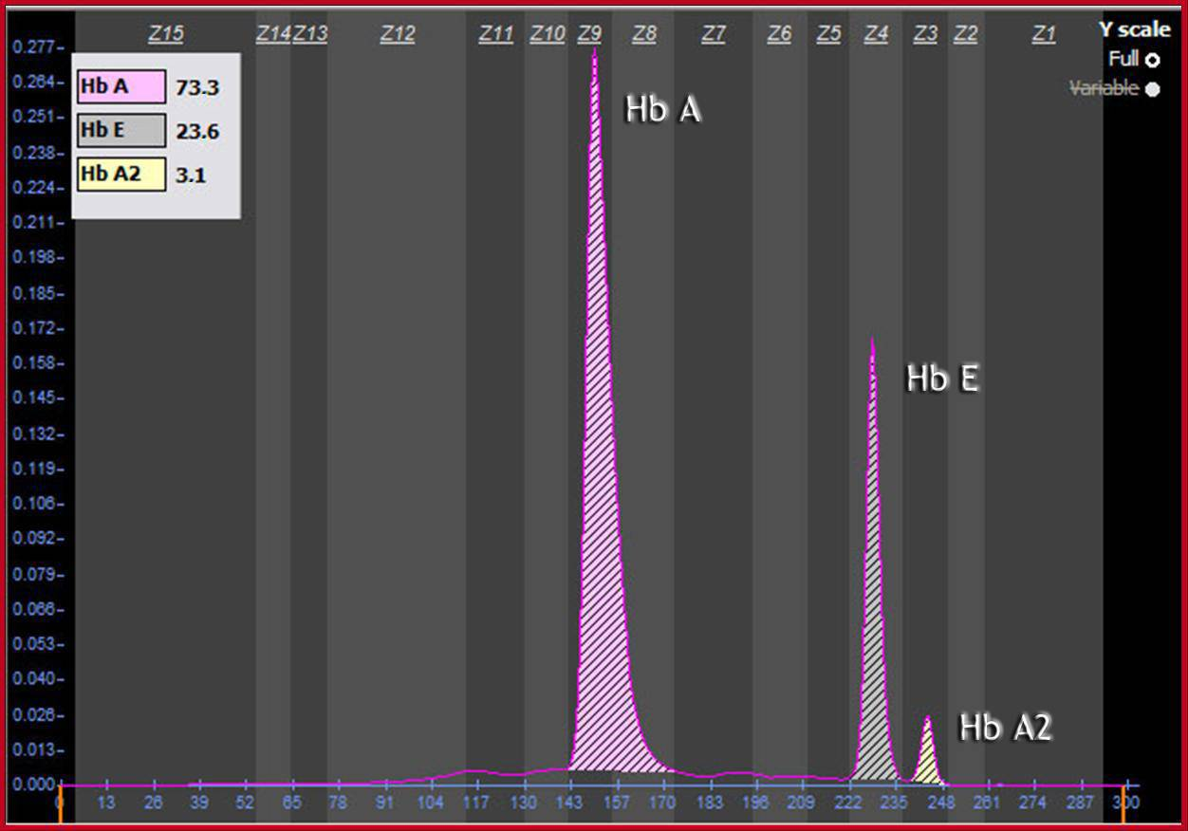
Laboratory review: major hemoglobin variants
Hb AE (hemoglobin E trait)
Capillary electrophoresis
  Greater separation of Hb A2 and Hb E by capillary electrophoresis
http://www.sebia-usa.com/products/capillarys.html

Slide 31
Laboratory review: other common variants
HPLC
Capillary Electrophoresis
Cellulose Acetate
A F S C
Hb A
Hb D
Hb A
Hb D
Citrate Agar
F A S C
Hb A2
Hb A2
Hb AD (Hemoglobin D-Los Angeles trait): clinically silent
Hb D (β 121 Glu–→ Gln⁰)

Slide 32
Laboratory review: other common variants
HPLC
Capillary Electrophoresis
Cellulose Acetate
A F S C
Hb A
Hb G
Hb A
Hb G
α^{G}₂β₂
Citrate Agar
F A S C
Hb A2
Hb G2
Hb G2
α^{G}₂δ₂
Hb AG (Hemoglobin G-Philadelphia trait): clinically silent
Hb G (α 68 Asn⁰ → Lys⁺)

Slide 33
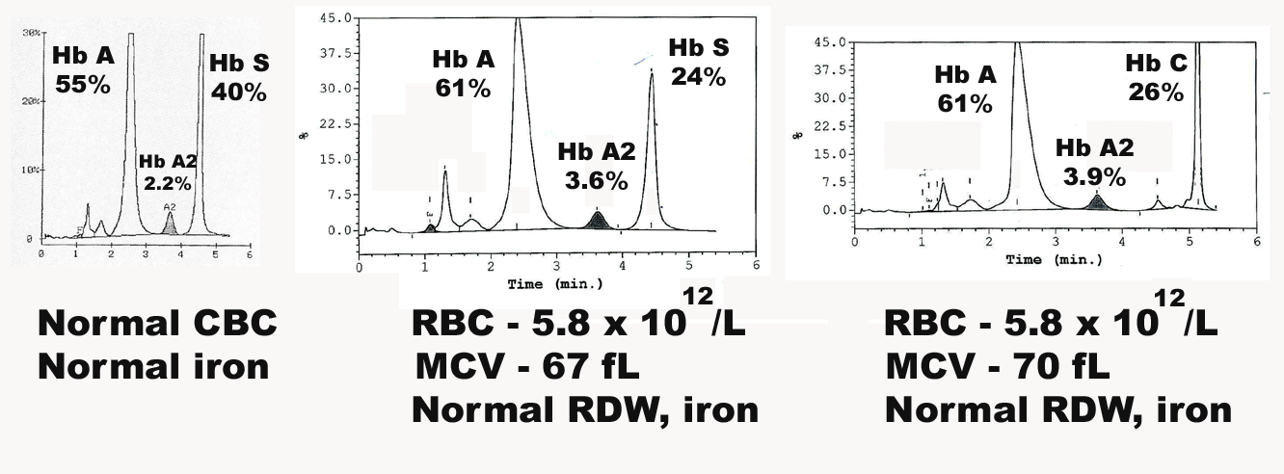
Laboratory review: compound disorders
HPLC
Hb AS
(Sickle cell trait)
Hb AS plus
α thalassemia minor
Hb AC plus
α thalassemia minor

Slide 34
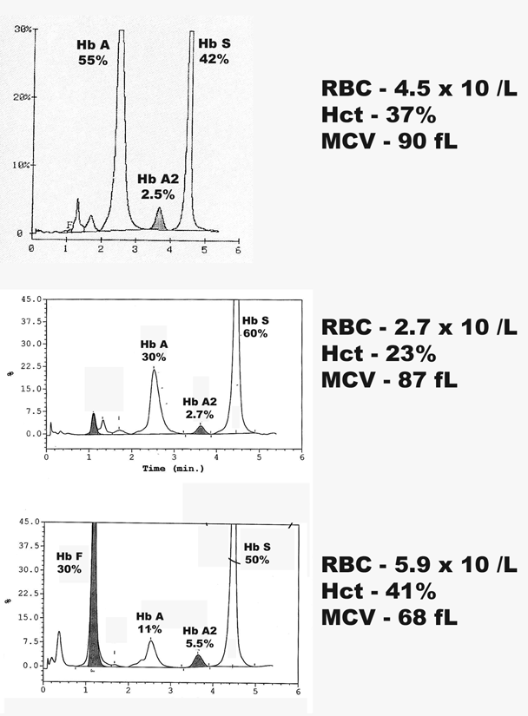
Laboratory review: hemoglobin A & S
HPLC
Hb AS
  Consistent with
  Sickle cell trait
Hb SA
  Consistent with
  Hb SS and recent transfusion
Hb SA
  Consistent with
  Hb S/β+ Thalassemia

Slide 35
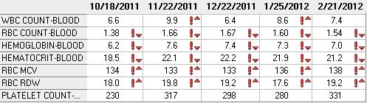
Laboratory review: hemoglobin F quantification
46 year old with sickle cell disease
HPLC
Diagnosis:
Hb SS with ↑ Hb F
Macrocytosis:
Hydroxyurea therapy

Slide 36
Laboratory review: neonatal testing
4 month old female; normal CBC
  Follow up of abnormal newborn screen
HPLC
Capillary Electrophoresis
HPLC
Hb F
Hb F
Hb A
Hb S
Hb A
Hb S
Hb A2
Hb A2
Hb AS (sickle cell trait) with residual Hb F

Slide 37
Thank you

