Slide 1
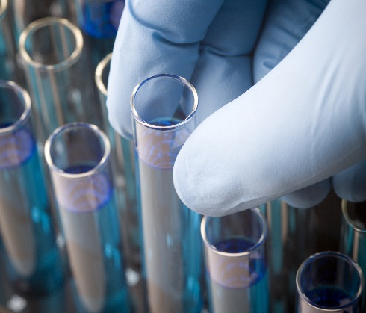
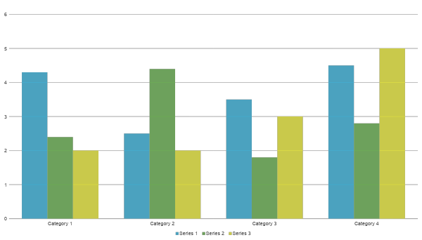
Science Project Title
Scienteer Project #
Problem / Question
Materials
Photos
Results
Enter your question here (statement of the problem)
Quantity (detailed list) | Materials (be specific)
Amount | Item
Amount | Item
Amount | Item
Amount | Item
Amount | Item
Amount | Item
Amount | Item
Include results based on your experiments
Result 2
Result 3
Hypothesis
Write hypothesis before you begin the experiment
This should be your best educated guess based on your research
If you are doing an engineering project, this section should be your Engineering Goal
Procedure
Conclusion
Write out all steps in your procedure in a numbered list
This should be step 2
Brief summary of what you discovered based on results
Indicate and explain whether or not the data supports your hypothesis
Variables
Charts
Controlled variables
Independent variable
Dependent variable
These are kept the same throughout your experiments
The one variable you purposely change and test
The measure of change observed because of independent variable
Decide how you will measure the change
Works Cited
Include print and electronic sources in alphabetical order
Background Research
Data / Observations
Graphs
Add a brief overview of the background research for your project.
Observation 1
Observation 2
Observation 3
Photo Credit
All photos, images, and graphics were done by the researcher or parent unless otherwise stated.
IF YOU TOOK IMAGES FROM A WEBSITE, GIVE THEM CREDIT ON YOUR BOARD.

