Slide 1
Covid-19 and Physical Activity
Michael R. Esco, PhD, FACSM
Professor, Exercise Physiology
Department of Kinesiology
University of Alabama

Slide 2
Physical Activity: Body movement that results in an elevated level of caloric expenditure Structured vs Unstructured

Slide 3
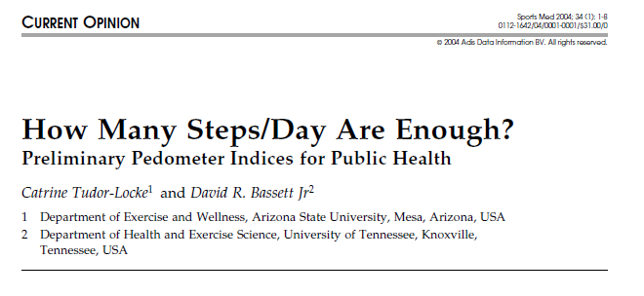
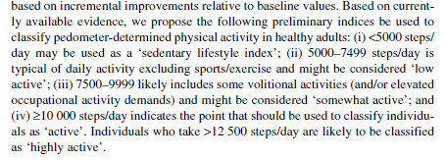
30 minutes of activity = 3,500 to 4,000 steps

Slide 4
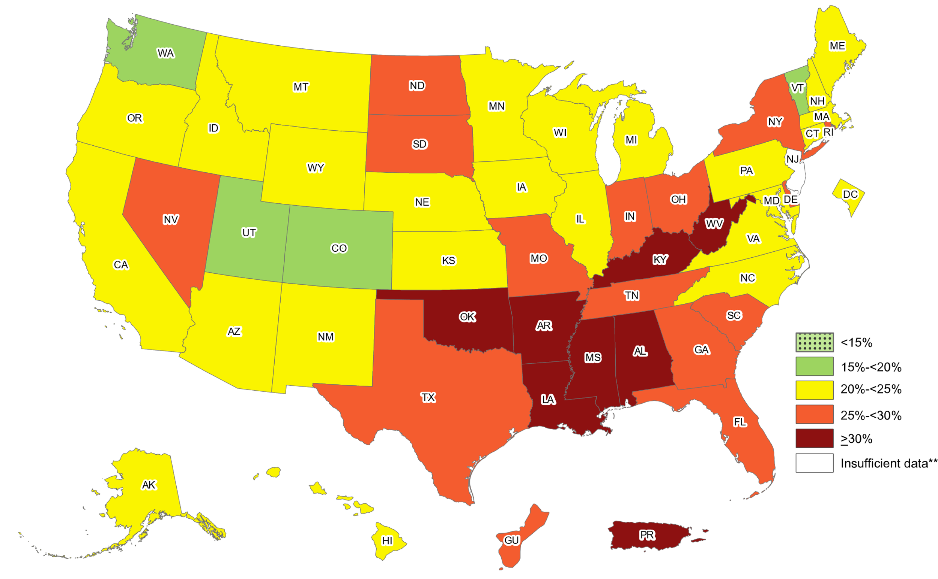
Prevalence of Sedentary Behavior in the US 25.3% of US is sedentary (no physical activity)
Behavioral Risk Factor Surveillance System

Slide 5
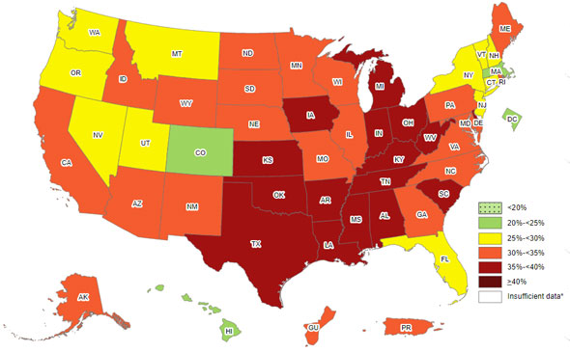
Prevalence of Obesity in the US
Behavioral Risk Factor Surveillance System

Slide 6
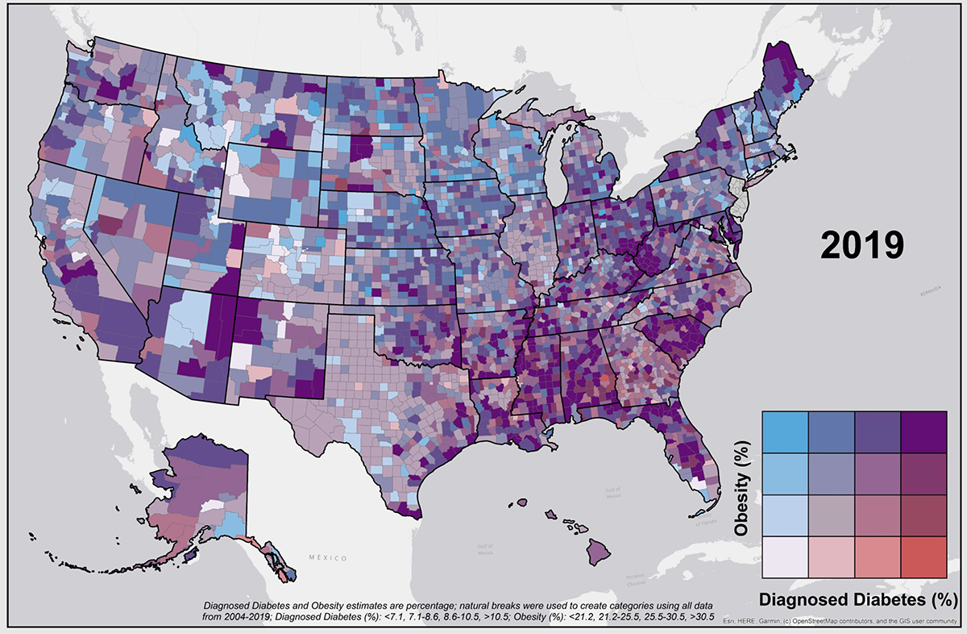
90% of Type 2 Diabetics are Obese

Slide 7
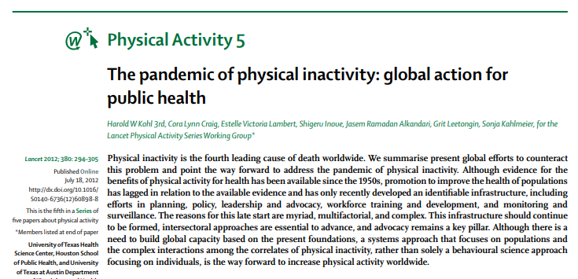
According to the World Health Organization
Over 31% of adults worldwide are not getting sufficient level of physical activity
Over 3.2 billion deaths per year are attributed to physical inactivity
“Hypokinetic diseases”

Slide 8
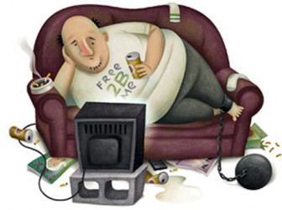
Hypokinetic Diseases
Kraus et al., (1956) Role of inactivity in production of disease: hypokinetic disease, J Am Geriatr Soc, 4: 463-471
“Hypo” – too little or low
“Kinetic” – Movement
Include:
Heart disease
Stroke
Type 2 diabetes
Most forms of cancer
Obesity
Etc.

Slide 9
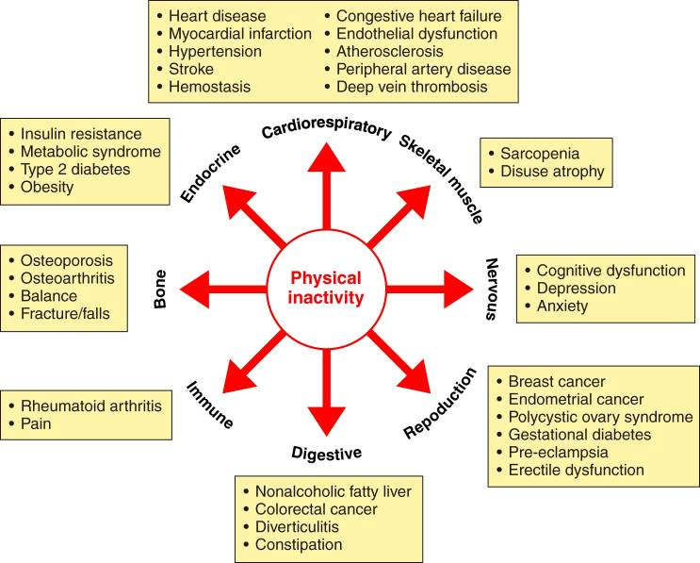
Physical Inactivity is linked to at least 35 chronic diseases/conditions
Booth et al. (2017) Physiol Rev 97, 1351-1402

Slide 10
US Physical Activity Guidelines:
Every adult should engage in at least:
150 mins/wk of moderate intensity physical activity
Or
75 mins/wk of vigorous intensity physical activity

Slide 11
Since physical activity/exercise is “medicine”, does it help prevent or lessen symptoms with Covid-19?
Maybe, but it depends

Slide 12
Emerging Research
Pubmed.gov search “Covid-19”
>180,000 total citations
290 citations in 2019
60,457 citations in 2020
110,233 citations in 2021
30,048 citations in 2022
Pubmed.gov search “Covid-19” and “physical activity”
>2,000 total citations
576 citations in 2020
1,441 citations in 2021
349 citations in 2022
Most research does not examine the direct impact of physical activity on Covid-19

Slide 13
Patients had at least 3 outpatient visits with an exercise vital sign measure.
Minutes per week of moderate to vigorous physical activity were calculated from two questions:
“On average, how many days per week do you engage in moderate to strenuous exercise (like a brisk walk)?”
“On average, how many minutes do you engage in exercise at this level?”
Three categories were created:
Consistently meeting guidelines (>150 mins/wk)
Some activity (11-149 mins/wk)
Consistently inactive (0-10 mins/wk)
Notes:
N = 48,440, Kaiser Permanente Southern California aged 18 years or older with a positive Covid-19 test or diagnosis between 1/2020 and 10/2020.

Slide 14
Results: Physical Activity Levels
Consistently inactive: 14.4%
Some activity: 79.2%
Consistently active: 6.4%
Over twice as many people in the “Consistently inactive” group compared to the “Consistently active” group

Slide 15
Results: Odds of Covid-19 Complications
Based on PA Levels
 | Hospitalized | Admitted to ICU | Death
Cons. Inactive | 2.26 | 1.73 | 2.49
Some Activity | 1.89 | 1.58 | 1.88
Cons. Active | - | - | -
Major Findings:
Consistently meeting PA guidelines before being infected with Covid-19 was associated with reduced odds for hospitalization, ICU admission, and death.
NOTE: the findings were adjusted for several chronic conditions that are benefit from PA (e.g., diabetes, obesity) but also increase the chance of severe Covid-19 outcomes
Thus, the reported odds ratio for physical inactivity are “strong but conservative”.

Slide 16
Authors conclusions:
“Physical inactivity was the strongest risk factor across all other modifiable risk factors: e.g., smoking, obesity, type 2 diabetes, hypertension, cardiovascular disease, and cancer.”
This evidence “contrast with the limited efforts by US public health authorities to educate the population about the benefits of PA related to adverse Covid-19 outcomes or to systematically promote regular PA during the pandemic.”
“Short of vaccination and following public health safety guidelines…engaging in regular PA may be the single most important action individuals can take to prevent severe Covid-19 and its complications, including death.”
Notes:
N = 48,440, Kaiser Permanente Southern California aged 18 years or older with a positive Covid-19 test or diagnosis between 1/2020 and 10/2020.

Slide 17
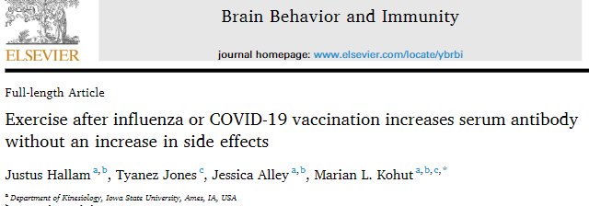
Examined the effect of 90-minute light- to moderate-intensity exercise after immunization on serum antibody response to the COVID-19 vaccination
36 participants (over 50% were overweight/obese)
Blood draws for antibodies occurred before vaccination and at 2 and 4 weeks following
The third time point was 1 week following second dose
Two groups: no exercise or 90-minutes of walk/jog

Slide 18
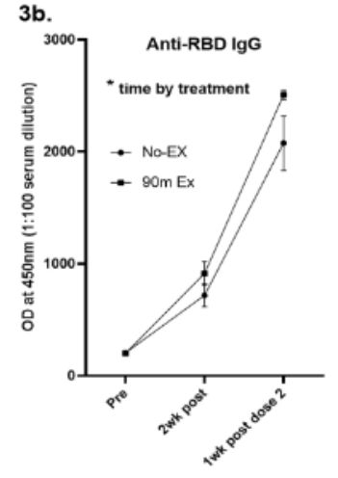
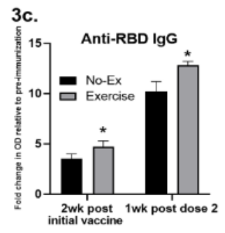
Hallam et al. - Results
During the 90-minute exercise bout, participants walked/jogged a distance between 4 – 10 miles
Significantly higher antibodies at the two post-vaccination time points in the exercising group compared to controls, with no difference in side effects

Slide 19
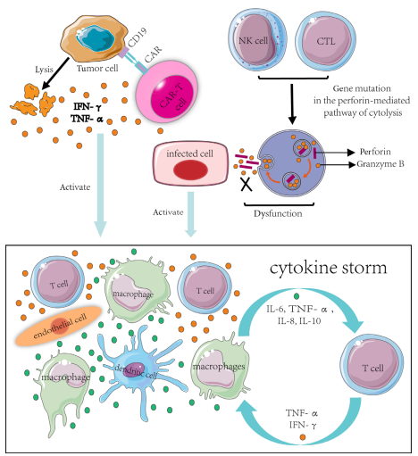
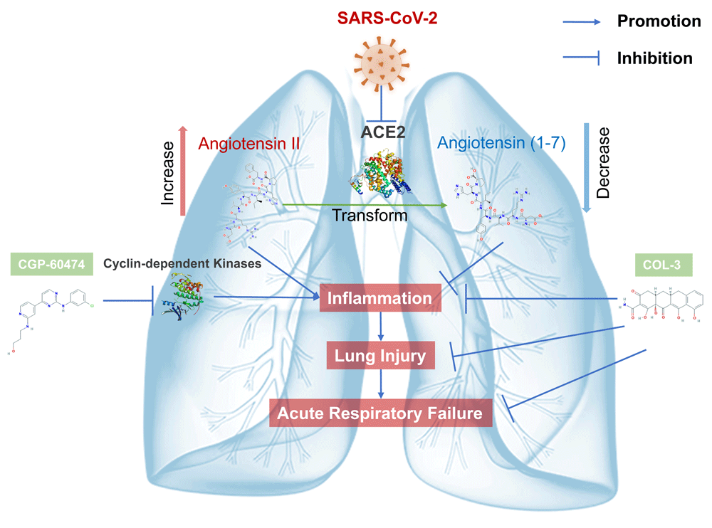
Physiological Rationale Why PA/Ex improves Covid-19 outcomes?
Inflammation is a main contributor of lung damage and ARDS
e.g., cytokine cascade: Gao et al., 2020

Slide 20
Exercise Improves Immune Function
High cardiorespiratory fitness and regular physical activity is linked to a reduced risk of systemic inflammation
Increase circulating anti-inflammatory cytokines
IL-1
“Myokine” IL-6
IL-10
Etc
Zbinden-Foncea et al., 2020

Slide 21
Inactive = pro-inflammation Active = anti-inflammation

Slide 22
Inactive = pro-inflammation Active = anti-inflammation

Slide 23
“Bell Shaped” Dose-Response

Slide 24
Being physically active appears to lessen symptoms with Covid-19 and may help prevent it. What about exercise during and after infection?

Slide 25
The risk of Covid-19 and exercise
Cardiac involvement:
Myocarditis
Angina
Dyspnea
Palpitations or rapid resting heart rate
Lightheadedness
Syncope

Slide 26
American College of Cardiology Guidelines
If symptoms of cardiac involvement are present, cardiac evaluation should be performed prior to physical activity
ECG, Echocardiography, cardiac troponin
At the end of the 5-day self-isolation period, exercise can resume if symptoms (except anosmia or ageusia) are not present
Masks should be worn indoors for an additional 5 days
Alternatives:
Obtain a negative test
Isolate during indoor exercise
Exercise outdoors

Slide 27
In general, resuming exercise is safe following Covid-19 infection
Small chance of cardiac involvement, in previously active individuals
Previously sedentary???

Slide 28
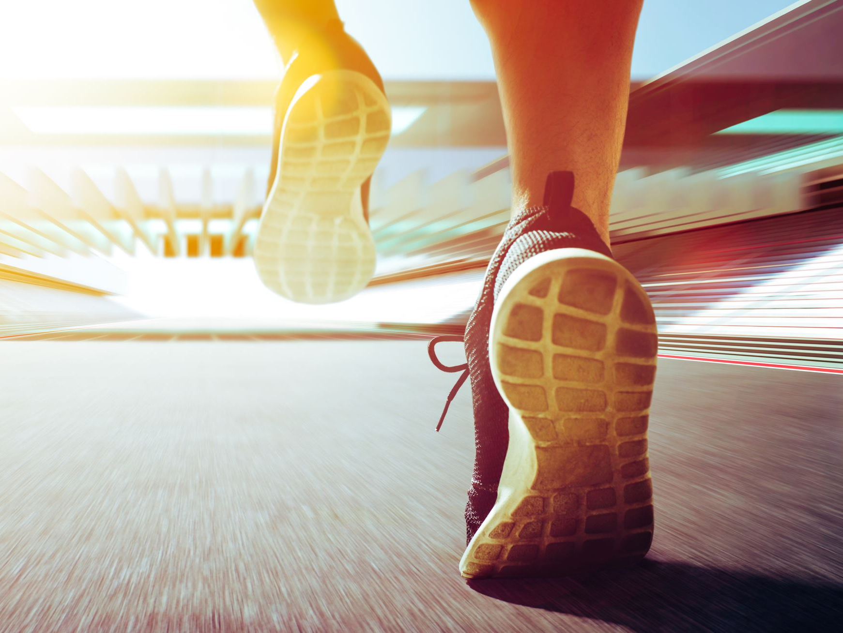
Physical Fitness/Activity is Great and Possible Reduces Risk for Severe Covid-19 Infection
However, the pandemic has brought numerous challenges!

Slide 29
Impact of Pandemic on PA Patterns
Systematic literature review from 4 meta-analyses
Decreased physical activity reported during Covid-19 was shown in:
32 out of 57 studies
Wunsch et al. (2022)
57 out of 84 studies
Rossi et al. (2021)
9 out of 10 studies
López-Valenciano et al. (2021)
“Majority” of 66 studies
Stockwell et al. (2021)
Key findings:
On average, children and adults from countries all over the world reported decreased PA during the pandemic
Decreases in PA were greater in adults over 60 yrs old
In Adolescents, PA from sport was significantly lower

Slide 30
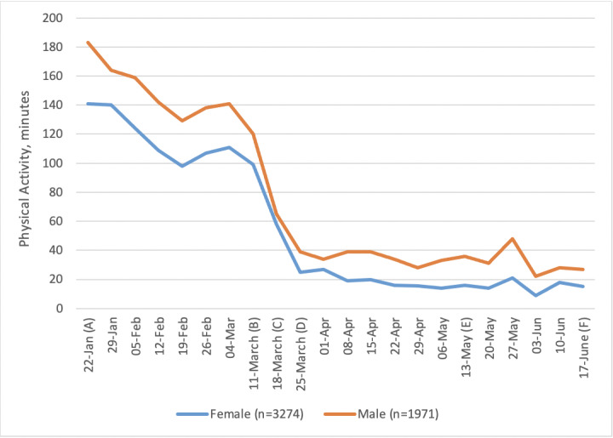
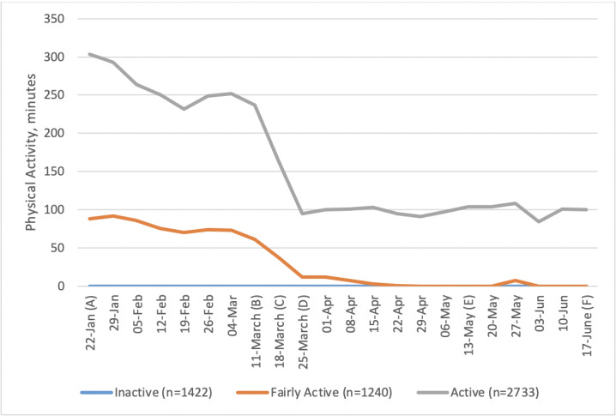
McCarthy et al. (2021) Physical Activity Behavior Before, During, and After COVID-19 Restrictions: Longitudinal Smartphone-Tracking Study of Adults in the United Kingdom. J Med Internet Res, 23(2) e23701
Greatest magnitude decrease in PA in previously active subjects

Slide 31
Studied the changes in physical inactivity of university students (n=603) during the COVID-19 pandemic, with reference to their academic calendar.
iPhone Health App was used to collect steps per day.

Slide 32
Konda et al. (2022): Results
Average steps per day decreased from 5,000 at the start of the “lockdown” to 2,000 and remained for a full semester.
Activity patterns remained suppressed until the end of the second semester.

Slide 33
Ammar et al. (2021) Four weeks of detraining induced by Covid-19 reverse cardiac improvements from eight weeks of fitness-dance training in older adults with mild cognitive impairment. IJERPH, 18:5930.
Purpose was to investigate the effect of 8 weeks of fitness and dance training, followed by 4 weeks of Covid-19 induced detraining, on cardiac adaptations and physical performance indicators in older adults with mild cognitive impairment.
N=12 (6 men, 6 women), age 73+/-4.4 yrs

Slide 34
Ammar et al. (2021) Four weeks of detraining induced by Covid-19 reverse cardiac improvements from eight weeks of fitness-dance training in older adults with mild cognitive impairment. IJERPH, 18:5930.
Methods:
8 weeks of combined dance/fitness training
2 days/week
90 mins/session
Followed by 4 weeks of Covid-19 lockdown induced detraining
Outcome measures:
Resting heart rate
Resting heart rate variability (cardiac autonomic control)
Several performance parameters
E.g., total distance, maximal and average speed

Slide 35
Ammar et al. (2021) Four weeks of detraining induced by Covid-19 reverse cardiac improvements from eight weeks of fitness-dance training in older adults with mild cognitive impairment. IJERPH, 18:5930.
Results:
Following 8 weeks of training:
Resting HR decreased
Resting HRV increased
Total distance covered increased
Average speed increased
No change in maximal speed
Following 4 weeks of detraining:
All variables that improved with training were reversed and not significantly different compared to baseline

Slide 36
Detraining and VO_{2max}
Cessation of training
The initial drop in VO_{2max} is cause by ↓ in SV_{max}
The later drop in VO_{2max} is cause by a ↓ mitochondria and capillary densities

Slide 37
Declining Fitness Industry
According to IHRSA
By the end of 2020
22% of fitness centers permanently closed
Fitness industry fell in revenue by 58% relative to 2019
$29.2 billion in revenue lost
44% of the fitness industry workforce lost jobs

Slide 38
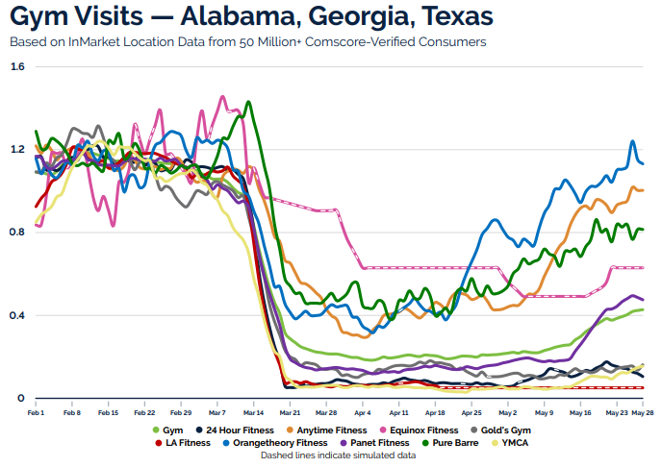
Fitness Center Participation: Gym closures 2-5 months
Covid-19 Impact Report by MMA (mmaglobal.com)

Slide 39
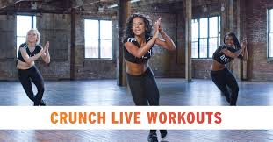
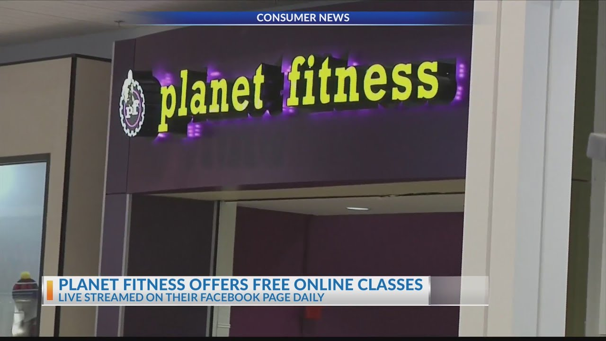
The “Virtual Shift”
Most fitness centers have developed a virtual platform for at-home/at-a-distance training

Slide 40
Unfortunately…
Virtual exercise programs are not often utilized.
Fuzeki et al. (2022) assessed the use and opinions of online exercise classes during lockdown (n=785).
Findings:
80% of responders were aware of OECs
However, less than 20% of responders utilized OECs on at least 1 day per week
>30% stated OECs were boring
>50% missed guidance of in-person trainers
>70% missed the interaction with other exercisers

Slide 41
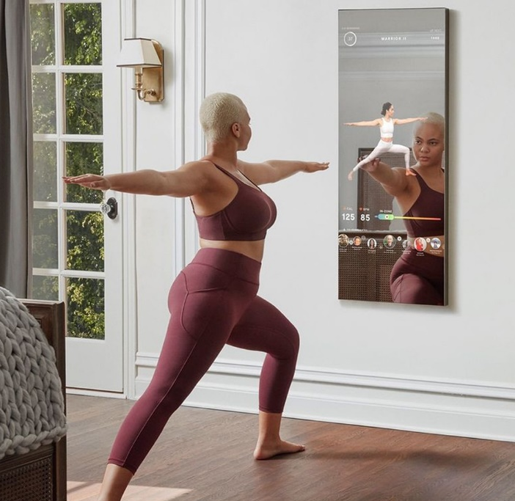
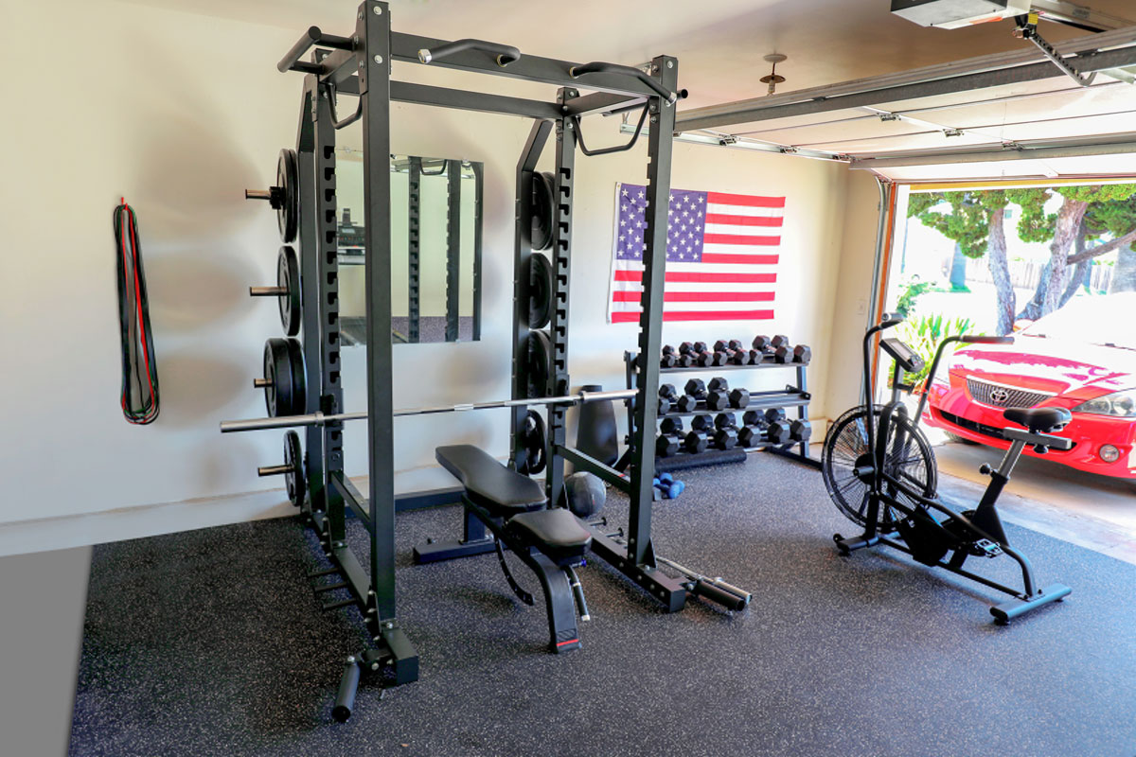
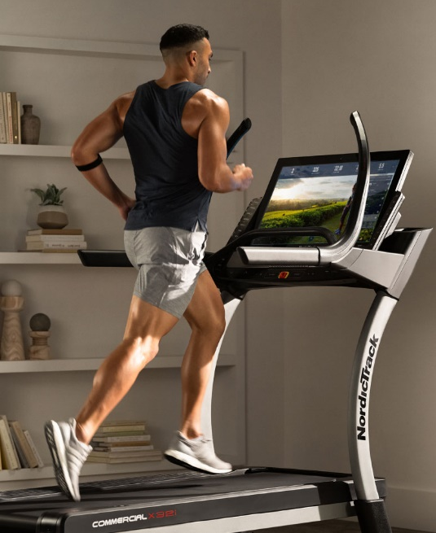
Explosion in Home Exercise

Slide 42
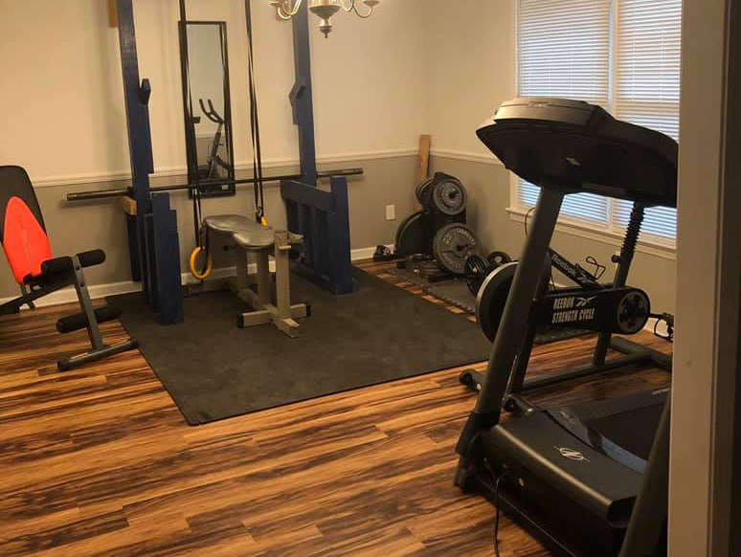

Slide 43
Home exercise equipment industry more than doubled from March to October 2020
Treadmill sales increased by 135%
Stationary cycles sales tripled
Inventory for weight equipment depleted

Slide 44
Fitness is more convenient than ever before

Slide 45
Conclusions
Physical activity may offer protective benefits from Covid-19 infection
Lessen symptoms
Decrease inflammation
Increase the efficacy of vaccination
The pandemic has brought an array of challenges and barriers toward physical activity
However, exercise is now more convenient than ever

Slide 46
Thank you!

