Slide 1
Medical Laboratory Scientists Choose Wisely
George A. Fritsma MS, MLS The ASCLS Choosing Wisely Task Force
The Fritsma Factor, Your Interactive Hemostasis Resource
george@fritsmafactor.com--fritsmafactor.com
Notes:
Hello and welcome to this seminar, Medical Laboratory Scientists Choose Wisely. I’m George Fritsma, and this presentation illustrates the value of laboratory assays in the Consumer Reports and American Board of Internal Medicine Foundation’s Choosing Wisely initiative.

Slide 2
American Board of Internal Medicine Foundation and Consumer Reports
Beginning in 2012, national organizations representing medical specialists have asked members to identify tests or procedures commonly used in their field whose necessity should be questioned and discussed. This call to action has resulted in specialty-specific lists of “Things Providers and Patients Should Question.”
Example, ASCP, 2/21/13: “Avoid routine preoperative testing for low risk surgeries without a clinical indication.”
Notes:
In 2010 Howard Brody, MD, published “Medicine’s Ethical Responsibility for Health Care Reform — The Top Five List” in the New England Journal of Medicine. In the piece, Dr. Brody called on U.S. medical specialty societies to identify five overused tests and treatments that did not provide meaningful benefit for patients. Shortly after, the National Physicians Alliance (NPA) piloted the “Five Things” concept through an ABIM Foundation grant and created a set of specific steps physicians in internal medicine, family medicine and pediatrics could take in their practices to promote the more effective use of health care resources. These lists were first published in Archives of Internal Medicine.
Building on the work of Dr. Brody and NPA, in April 2012 the ABIM Foundation, along with Consumer Reports, formally launched the Choosing Wisely campaign with the release of “Top Five” lists from nine specialty societies. The widespread media coverage from nearly every top-tier outlet, along with positive reaction among the health care community, inspired 17 additional societies to join the campaign and release lists in February 2013. More than 70 societies comprising over one million clinicians are now partners of the Choosing Wisely campaign.
In 2013, the ABIM Foundation received a grant from the Robert Wood Johnson Foundation (RWJF) to advance the Choosing Wisely campaign by funding 21 state medical societies, specialty societies and regional health collaboratives to help physicians and patients engage in conversations aimed at reducing unnecessary tests and procedures. In 2015, the RWJF awarded a second grant to the ABIM Foundation to continue this important work.

Slide 3
American Board of Internal Medicine Foundation and Consumer Reports
Choosing Wisely promotes conversations among clinicians and patients by helping patients choose care that is…
Not duplicative of other tests or procedures already received
Supported by evidence
Truly necessary
Free from harm
Medicine’s Ethical Responsibility for Health Care Reform — The Top Five List: Howard Brody, NEJM 2010
Notes:
CW recommendations always begin with “Don’t” or “Avoid,” and include in addition to laboratory testing, diagnostic procedures (mostly imaging) and therapies such as the indiscriminate use of antibiotics.

Slide 4
ASCLS Choosing Wisely Task Force
Dana Bostic, U of Kansas MC; BB, Health Care Simulation
Lisa Cremeans, MLS, MMDS, U. No. Carolina, Molecular Diagnostics
Josephine Ebomoyi, Northern Illinois U; Microbiology
Muneeza Esani, U of Texas Med Branch, Galveston, Clin Chem
George Fritsma, Birmingham; Hematology, Hemostasis
Deborah Josko, Rutgers U; Immunology
Brianna Miller, U of Alabama at Bham, Hematology, Hemostasis, BB
Rick Panning, Health Partners, Minnesota, Lab Management
Claude Rector, U of Arkansas, Microbiology
Dawn Rudnick, U of Michigan Hlth Svc; Micro, Lab Mgt, General
Eddie Salazar, U of Texas Med Branch, Galveston, Clin Chem, UA
John P. Smith, Kansas; Micro, Hlth Care Utilization
Notes:
Recommendations are developed with transparency; the method is summarized with the recommendation.
Recommendations are accompanied by description of the contributing society.
ABIM sends each recommendation to two independent reviewers for comments and approval.
ABIM then sends recommendations to all partners to ensure there is no conflict with existing recommendations.
When published, recommendation copyrights belong to the contributing society.

Slide 5
The Duke Bleeding Time
In 1910, WW Duke established that platelets came from bone marrow megakaryocytes, that they are needed in blood clotting, and that low platelet counts were associated with bruising.
Duke developed the bleeding time test…
Puncture the earlobe with a surgical blade.
Start a timer.
Dab the wound with filter paper every 30s until bleeding stops.
Stop the timer. Normal is 1–9 minutes.
Prolongation signals aspirin, thrombocytopenia, PLT functional abnormality, VWD, or afibrinogenemia.
Brinkhous KM. W. W. Duke and his bleeding time test. A commentary on platelet function. JAMA. 1983;250:1210–14.
Notes:
The bleeding time test, first described in France in 1902, was formalized and documented by WW Duke at Johns Hopkins University in 1910. Duke was two years out of medical school when he established the assay. He also proved that platelets came from large bone marrow cells called megakaryocytes and that platelets were needed for normal blood clotting. His bleeding time test required a small puncture in the earlobe using a surgical blade. Once the puncture is made, the technologist starts a stopwatch and dabs the blood drop every 30 seconds until bleeding stops, normally between 1 and 9 minutes. A long bleeding time signals aspirin, a low platelet count, functional platelet abnormality, von Willebrand factor deficiency, or afibrinogenemia. This test was the best thing we had for platelet function, though the puncture was technique and temperature dependent. Cold earlobes really don’t bleed at all, and many bleeding times were performed by puncturing a finger tip.

Slide 6
Ivy Bleeding Time, 1935
AC Ivy further standardized the BT by placing a blood pressure cuff on the (upper) arm, inflating to 40 mm Hg, and making an incision parallel to the length of the arm on the forearm inner surface. Grad students would often substitute a tourniquet.
BT scars on a grad student’s arm
Notes:
Dr. AC Ivy, University of Illinois in Chicago, in 1935 refined the bleeding time by puncturing not the earlobe but the volar surface of the forearm, where the circulation is unaffected by temperature and skin thickness is relatively uniform among patients. Ivy’s staff recommended inflating a blood pressure cuff on the arm to 40 mm of mercury to standardize the venous pressure in the arm. As illustrated here, this approach leave visible scars.
Ivy later discredited for the Krebiozin scandal, but managed to maintain his superlative reputation.

Slide 7
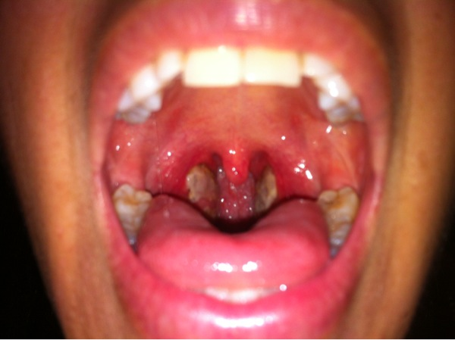
Tonsillectomy
BTs were used as screens to predict surgical bleeding. People with prolonged BTs were taken off the surgery schedule.
1% risk of postoperative hemorrhage
Notes:
In 1958, following a series of strep throat infections, my primary care physician referred me to an ENT for a tonsillectomy. As part of my admission, I visited the lab for a bleeding time test. This fascinated me and it seemed perfectly logical to assume, as did the experts, that if your bleeding time is long, you will tend to bleed during or after surgery. In fact, the risk of postoperative bleeding following a tonsillectomy is a relatively common 1%, and the bleeding time was meant to prevent bleeding episodes.

Slide 8
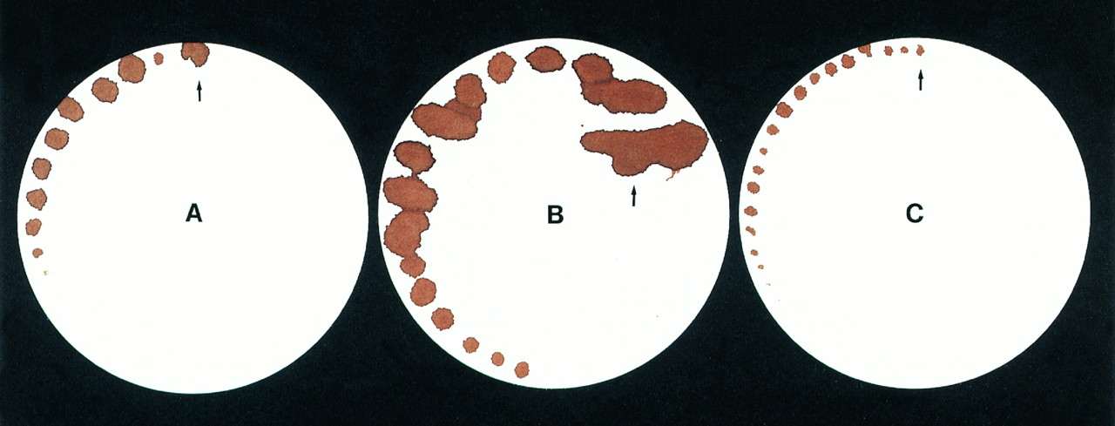
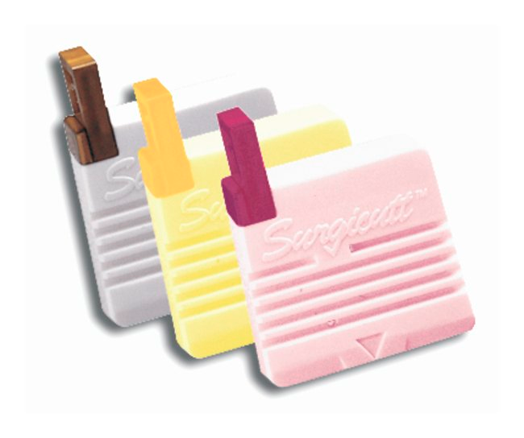
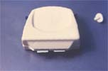
Mielke Template Bleeding Time
In 1969, CH Mielke, Jr. developed a template that further standardized the incision to 1–2 mm deep by 10 mm long. This was replaced by the 1972 Harker and Slichter Simplate.
Simplate
Blades remained exposed
ITC Surgicutt
Blade sweeps, disappears
Notes:
In 1969, CM Mielke developed a small metal template that technologists used to standardize the bleeding time puncture. Using the template, the technologist could employ a surgical blade to make a precise cut 2 mm deep and 10 mm long. Soon, International Technidyne Company developed an automated Simplate that the operator could simply hold to the skin and snap, releasing the blade and making a precise cut. The Simplate represented a small risk to the operator and to trash haulers because the blade remained exposed subsequent to deployment. A competitor developed the “Surgicutt” device whose blade made a sweeping motion and disappeared after deployment, a safer design. International Technidyne bought out the company and used their patent. Today, ITC is owned by Accriva Diagnostics, which in turn is owned by Instrumentation Laboratory, a subsidiary of Werfen Diagnostics.

Slide 9
Bleeding Time, a Screening Test
A screen is a test on an “unselected” population.
Sensitive: test sacrifices specificity for sensitivity
High false positive rate, low false negative rate
A positive screen requires a confirmatory test
Specific: high false negative rate, low false positive rate
Safe to use subsequent to a positive screen
Notes:
In the 1980s when every test generated income, we eagerly screened for anything, reasoning that we didn’t want to miss any condition, no matter how rare. A screen is a lab test or imaging procedure performed on an unselected population, meaning a random population. You test everyone without knowing their history, like finger-stick cholesterols at a mall. In today’s age of cost containment and good public health outcomes studies, screening without an indication is frowned upon.
When designing a screening test, you want one that generates no false negatives, which misses disease in a patient and create liability. You design the test to be sensitive, so it will generate a high false positive rate. When a screening test result is positive, it is necessary to perform a confirmatory test, one that is specific with a higher false negative rate and a low false positive rate. You don’t worry about the false negative rate on a patient whose results were already positive on the screen.

Slide 10
False Positive, False Negative
True positive: assay result correctly identifies those with a disease or condition
False positive: assay result incorrectly identifies disease where none is present (false alarm)
True negative: laboratory assay correctly identifies those without a disease or condition
False negative: assay result incorrectly rules out disease where it is present (miss)
Notes:
No laboratory test is perfect. All come with a false negative and false positive rate. There are four possibilities:
True positive: assay result correctly identifies those with a disease or condition.
False positive: assay result incorrectly identifies disease where none is present. False positives alarm the patient, generate expensive follow up testing, and unnecessarily postpone procedures.
True negative: laboratory assay correctly identifies those without a disease or condition. Good news for everyone.
False negative: assay result incorrectly rules out disease where it is present. This is the worst case, as a patient will go untreated.

Slide 11
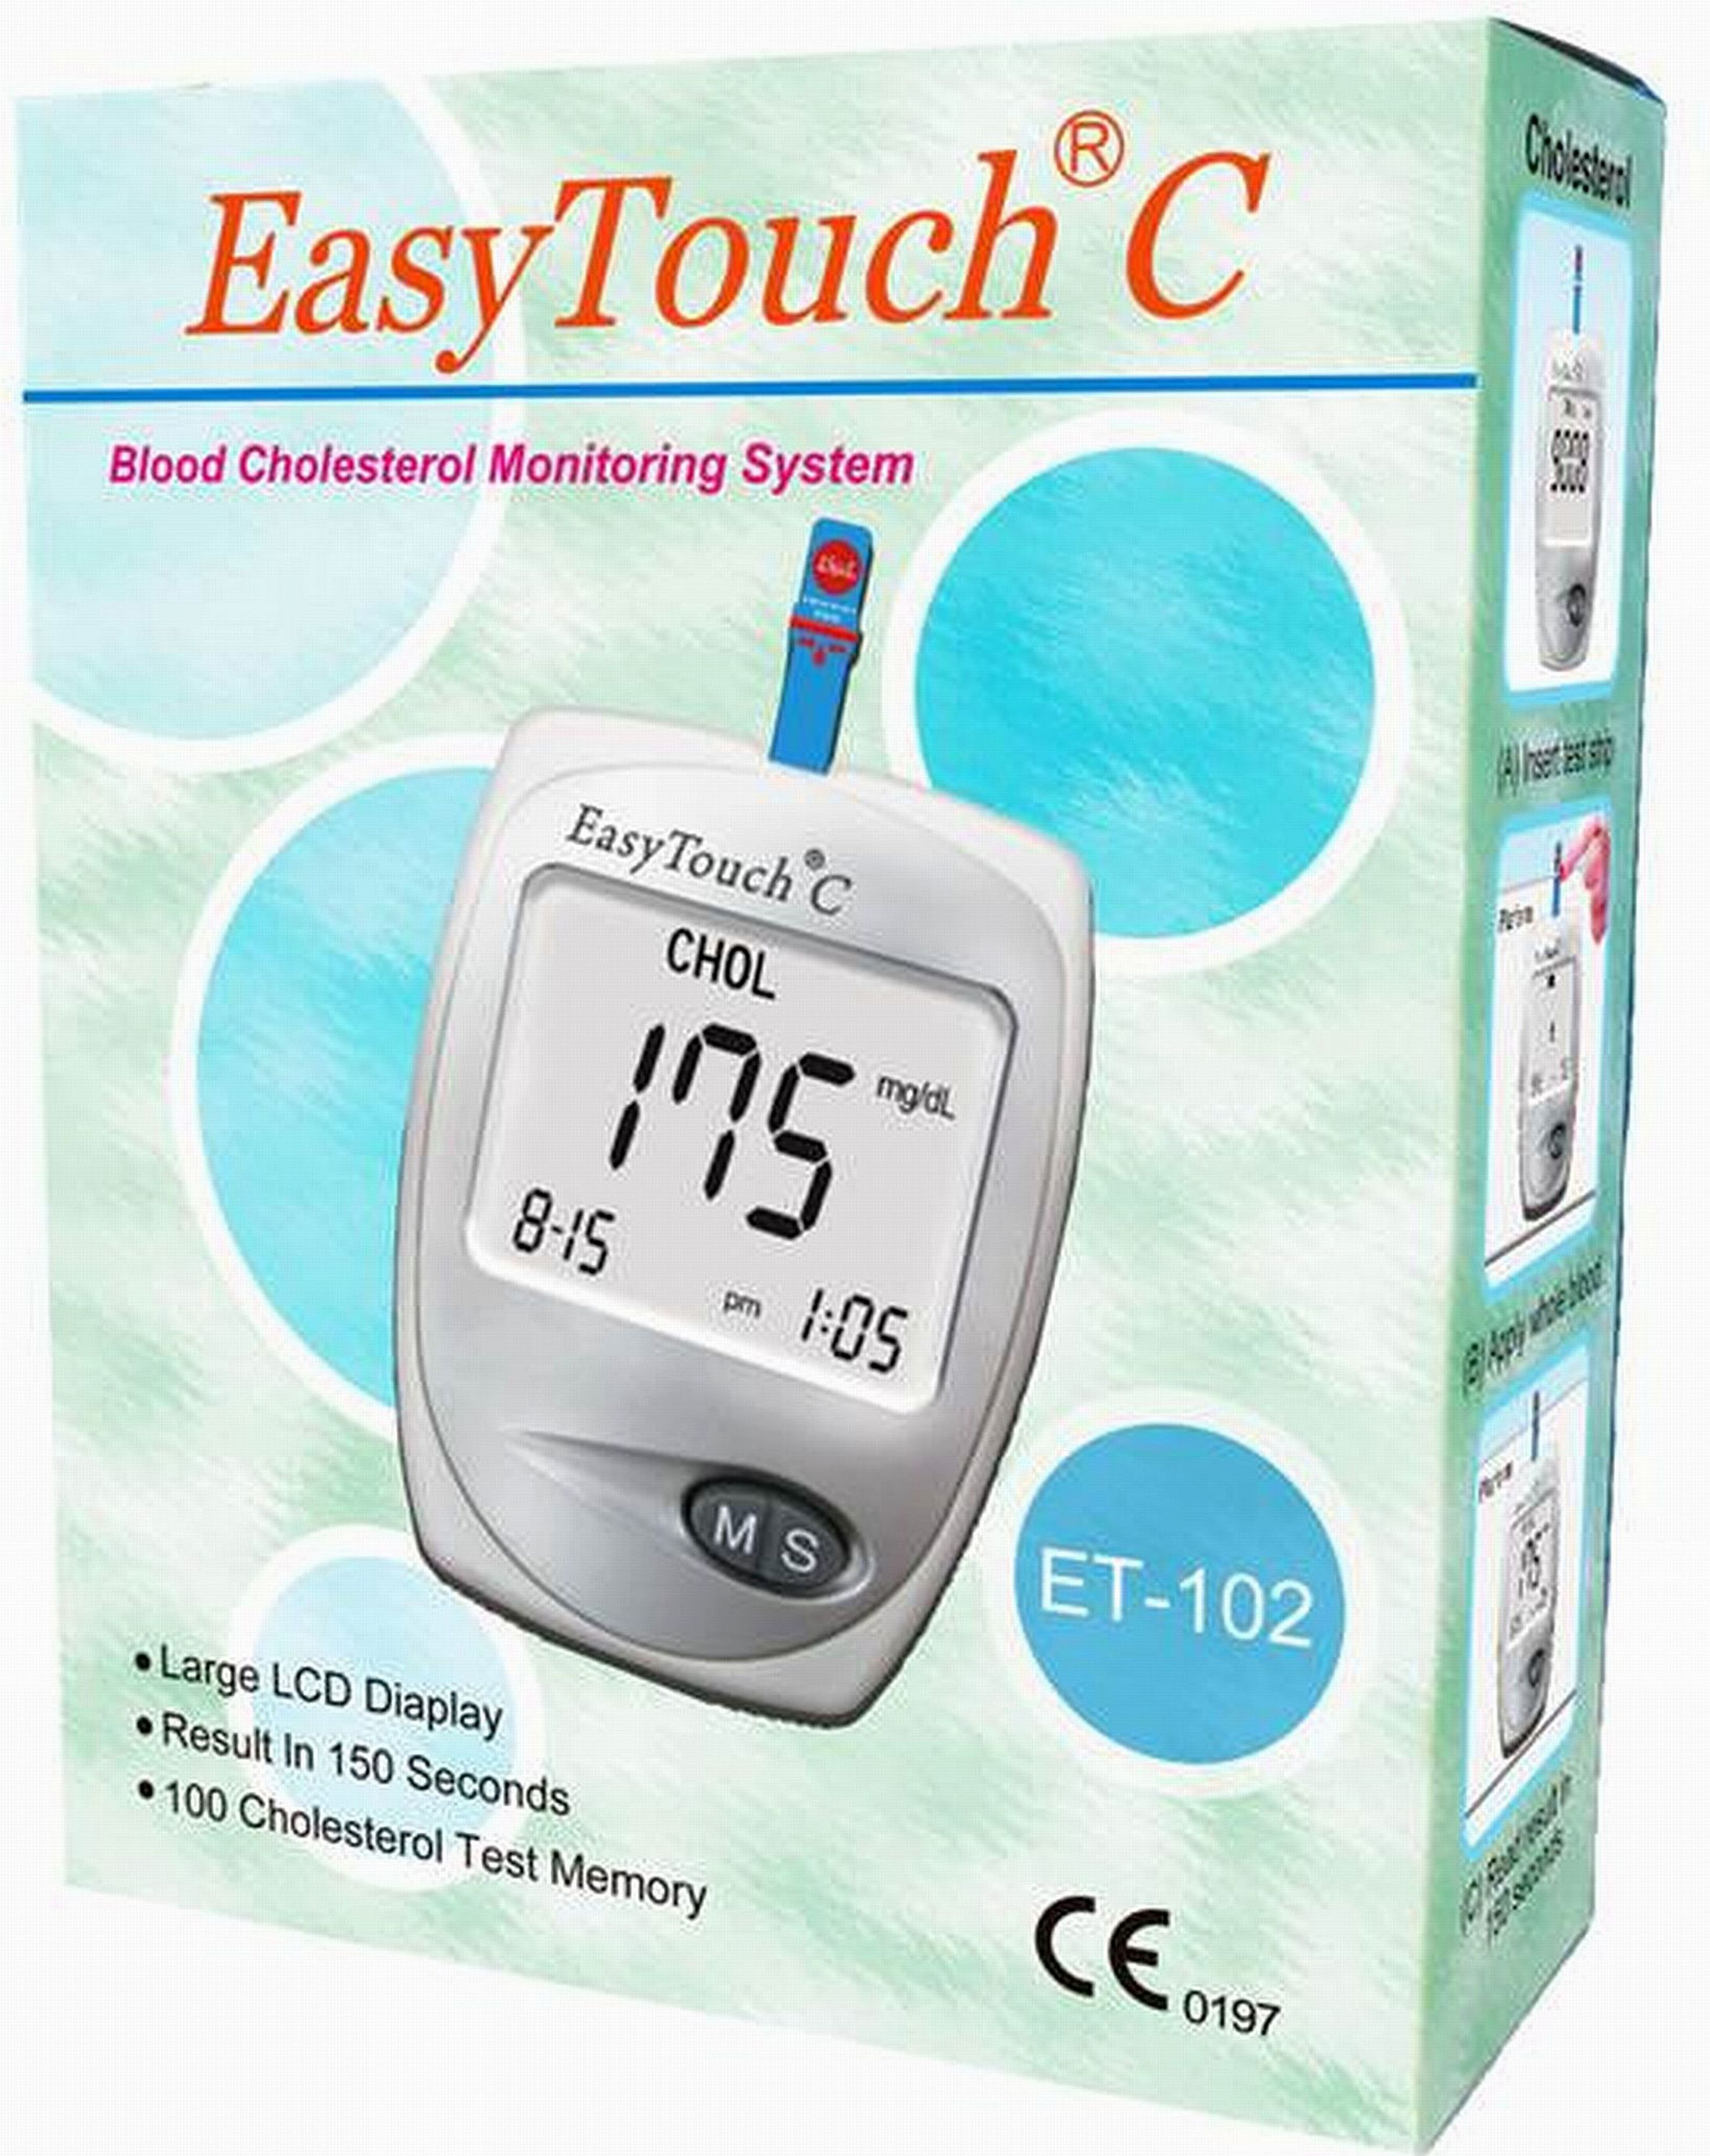
Prevalence Effect on the True and False Positive Rates
Total Sample: 10,000 | Sample Prevalence | With Disease | Without Disease | TP | FP | FP/TP Ratio
Selected sample | 10% | 1000 | 9000 | 1000 | 180 | 0.18
Unselected/common | 1% | 100 | 9900 | 100 | 198 | 1.98
Unselected/rare | 0.01% | 1 | 9999 | 1 | 200 | 200.0
False positive rate is 2.0%; The assay classifies a constant 2% of subjects without disease as positive for the disease. 98% of subjects with disease are correctly classified. At a prevalence of 1/10,000, an assay with a 2% false positive rate identifies 200 false positive results for every true positive result
Notes:
This table illustrates the effects of screening. You employ a reasonably sensitive assay with only a 2% false positive rate.
Presume you test 10,000 people who are suspected of having a disease based on your having identified an indication. Public health records indicate that 10% of people with the indication have the disease, so your test will accurately classify 98%, or 980 patients. It will generate false positive results in 2% or 180 patients. This is reasonable if it is a serious disease, and you can use specific follow-up assays to confirm or rule out.
Suppose you test an unselected population and you know from Public Health records the prevalence of the disease is common at 1% or 100 people). Your test now identifies 98% of the people, or 98, but also classified 2% of the 9900 people without disease, or 198 people. Now your false positive rate is double the true positive rate. The test is generating a lot of unnecessary work.
At 1 in 1000, you identify only 9.8 people with disease (call it 10), but 200 false positives, and at 1 in 10,000, a rare disease, you identify only 1 true positive and 200 false positives. This is what happens when you screen an unselected population for a rare disorder. Your test becomes a nuisance, generating a lot of work for no measurable return.

Slide 12
Receiver-Operating Characteristic Curve (ROC): TP V FP Rate For Each Limit
Useless
AUC ~0.85
AUC ~0.70
AUC ~0.50
Good
Mediocre
Notes:
In the 1980s researchers began applying outcomes analysis to our time-honored assays. For any assay they plotted the false positive result rate against the true positive rate for each limit in a continuous variable. A good test provided a distinct curve with a clear limit and an area under the curve near 90. A mediocre test had a lower area under the curve, and a useless test has no identifiable cutoff and an AUC of 0.50, the lowest you can go. If a test generates a non-predictive curve, it could be replaced with a coin toss. Guess what.

Slide 13
Bleeding Time Efficacy
Standardization did not enhance the BT PPV or NPV.
The BT is not a specific indicator of platelet function.
The BT does not predict the risk of hemorrhage in invasive. procedures or anticoagulant therapy.
BT doesn’t prolong ahead of actual bleeding.
BT does not measure therapeutic efficacy.
Ironically, Channing-Rodgers developed the Surgicutt in 1990
Channing-Rodgers RP, Levin J. A critical reappraisal of the bleeding time. Sem Thromb Hemostasis 1990;16:1–19.
Notes:
A lengthy 1990 publication reviewing 220 primary publications that applied clinical efficacy studies such as ROC analysis showed, among other findings, that
The standardization attempts of Ivy, Mielke, and ITC Surgicutt did not improve on the BT
The BT is not a specific indicator of platelet function, it is affected by too many variables such as operator management, skin thickness, and temperature
The BT does not predict the risk of hemorrhage in surgery or any other condition. In nearly every case where the surgeon decides to proceed despite a prolonged BT, there is no adverse event. Conversely, in the instance where bleeding does occur, a look back reveals that the BT is normal.
BT prolongation doesn’t occur ahead of actual bleeding symptoms. If, for instance, you are using the BT to predict VWD, the systemic bleeding symptoms of bruising, menorrhagia, or epistaxis will appear at the same time that the bleeding time is prolonged.
The BT is not useful in testing efficacy of therapy. In the 1990s we used the BT to test for the effects of aspirin and to identify people who were “aspirin resistant.” This met with partial success, but was surpassed by more reliable, reproducible laboratory assays.
So in other words, the BT is useless and it leaves scars. Despite these findings, it is still available and is used around the world, though it is disappearing from labs in the industrialized world.

Slide 14
Choosing Wisely Recommendation
Don’t use the bleeding time test to guide patient care.
The bleeding time test is an old assay that has been replaced by alternative coagulation tests. The relationship between the bleeding time test and the risk of a patient’s actually bleeding has not been established. Further, the test leaves a scar on the forearm. There are other reliable tests of coagulation available to evaluate the risks of bleeding in appropriate patient populations (2013).
Notes:
This was an original CW recommendation by ASCP, 2013.

Slide 15
Inherited Thrombosis Risk Factors (“Hypercoagulability,” Thrombophilia)
Antithrombin (antithrombin III, AT, ATIII) 1965 (Egeberg)
Protein C (PC, 1984) and protein S (PS): 1986 (Comp)
Activated protein C resistance (APCR), 1993 (Dahlbach)
Factor V Leiden (FVL) mutation: 1994 (Bertina)
Prothrombin G20210A mutation: 1996 (Poort)
Factor VIII, homocysteinemia, MTHFR polymorphisms
Notes:
In 1965, Egeberg described a relationship between antithrombin deficiency and thrombophilia. Antithrombin is one of the coagulation control proteins. People with low antithrombin levels produce excessive thrombin and were prone to venous thromboembolic disease such as deep venous thrombosis or pulmonary embolism. Lab scientist believed we had found the answer to what was then called hypercoagulability, now hereditary thrombophilia and by 1970 we were routinely performing plasma antithrombin assays.
Then Comp and Esmon established similar relationships for congenital protein C deficiency, and then in 1986, protein S deficiency. These are also coagulation control proteins and they were named by their position in polyacrylamide gel electrophoresis. 1993 when Dahlback described activated protein C resistance, and 1984 when Bertina showed the factor V Leiden mutation was the cause for APCR.
Poort’s described prothrombin G20210A, meanwhile, elevated coagulation factor VIII, hyperhomocysteinemia, and two polymorphisms of the methylene tetrahydrofolate reductase enzyme were also implicated as hereditary causes for thrombophilia.

Slide 16
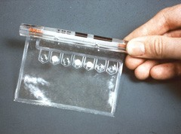
The Dupont ACA—1983
Notes:
Here is the 1980s DuPont ACA, which used plastic bags as reaction chambers. These were attached to a bicycle chain that moved the bag from reaction station to reaction station inside the instrument. You had to keep your hands outside to avoid injury. Besides PT and PTT, the ACA made us lots of income doing AT, PC, and PS.
In Denver there is a medical reference laboratory that specializes in coagulation testing. This was a narrow specialty, and in 1992 the lab was just getting by with four employees, including the owner. When Dahlbach and Bertina described APCR and FVL, the concept of thrombosis risk testing caught on. By 1997, the lab had grown to over 40 employees, using a thrombophilia risk panel like this one. The reason FVL caught on was its prevalence of 3–8% of the Caucasian population, and because it was one of our first molecular diagnostic assays. However, its penetrance varied by patient, many with the mutation experience no thrombosis, while meanwhile, half of thrombotic events occur in the absence of inherited risk factors. Here are data I’ve used for a presentation on thrombosis risk factors that remain relevant, however, the last time I gave this talk was in 2009, indicating the waning interest.

Slide 17
Prevalence of Inherited Risk Factors in Unselected Populations and in Thrombotic Disease
Factor | Random | Thrombosis*
APCR (FVL) | 3–8%** | 20–25%
Prothrombin G20210A | 2–3%** | 4–8%
AT deficiency | 0.02–0.05% | 1–1.8%
Protein C deficiency | 1 in 300 | 2.5–5%
Protein S deficiency | 1% | 2.8–5%
Homocysteinemia ( MTHFR 667 mutation) | 11% | 13.1–26.7%
* Subjects with at least one thrombotic event ** Caucasians, Arabs, Hispanics, absent from Africans and Asians

Slide 18
Thrombophilia Testing Limitations
Antithrombin
Acute phase reactant rises in acute inflammation
Proteins C and S
Activity of both falls in acute inflammation following a clotting episode
Vitamin K dependent, activity of both falls in Coumadin therapy
All three: high false positive rate
Reference interval is 60–140% of the mean
False positives are low values in apparently healthy people or during inflammation or Coumadin therapy
Notes:
In 2004, Dr. Marisa Marques requested a review of four years of thrombosis risk testing orders at the University of Alabama at Birmingham Hospital. The data were never published, but she found that 20% of the profiles documented combined PC and PS deficiencies. Dr. Craig Kitchens of Jacksonville tells of an OB-Gyn physician who advised his patient to get an abortion because she had both deficiencies. The theoretical prevalence of combined PC and PS deficiency is 1 in 30,000, an unlikely occurrence. What really happened? The assays were ordered shortly after a thrombotic event when the patient had been placed on Coumadin,. Both PC and PS are vitamin K dependent, and Coumadin is a vitamin K antagonist. In addition, specimens collected within a few hours of a thrombotic event are likely to give low results because PC and PS levels drop rapidly in acute inflammation. Further, AT, PC, and PS assays generated high false positive rates in apparently healthy people.

Slide 19
Appropriate Thrombophilia Testing Profile Indications
Retrospective observational study of consecutive unselected patients undergoing thrombophilia testing in 2009
Pregnancy morbidity: pre-eclampsia, intrauterine growth retardation
Recurrent pregnancy loss, three or more instances
Unprovoked arterial thrombosis
Unprovoked venous thrombosis
Department of Pathology, University of Texas Southwestern Medical Center, Dallas, TX,
Shen YM, Tsai J, Taiwo E, et al. Analysis of thrombophilia test ordering practices at an academic center: a proposal for appropriate testing to reduce harm and cost. Plos ONE 11: e0155326. doi:10.1371/journal.pone.0155326
Notes:
A clinical research group in the Department of Pathology, University of Texas Southwestern Medical Center, Dallas, TX, headed by Dr. Ravi Sarode conducted a retrospective observational study of consecutive unselected patients on whom were ordered thrombophilia testing from October and November of 2009. They reviewed the profiles ordered for people with thrombosis risk indications, including…
Recurrent, ≥3, pregnancy loss
Unprovoked arterial thrombosis
Unprovoked venous thrombosis
Pregnancy morbidity: pre-eclampsia, intrauterine growth retardation

Slide 20
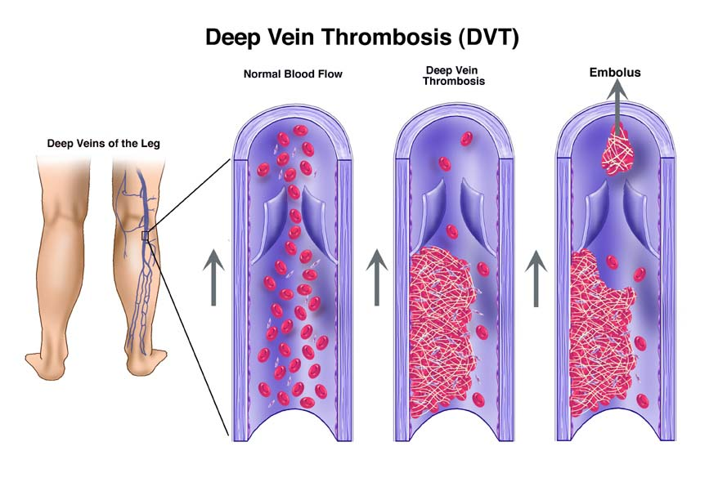
Thrombophilia Testing Non-Indications
One or two pregnancy losses
Provoked venous thrombosis: immobilization, surgery, trauma, and malignancy prior to or at the time of the event
Provoked arterial thrombosis: hypertension, dyslipidemia, diabetes mellitus, atherosclerotic disease
Testing without a prior thrombotic event or adverse pregnancy outcome (screen)
Notes:
Sarode’s group also counted those patients whose conditions did not rise to the level of thrombophilia risk factor indications, including…
Provoked venous thrombosis: immobilization, surgery, trauma, and malignancy prior to or at the time of the thrombotic event
Provoked arterial thrombosis: hypertension, dyslipidemia, diabetes mellitus, atherosclerotic disease
1–2 pregnancy losses
Testing without a prior thrombotic event or adverse pregnancy outcome

Slide 21
University of Texas Southwestern Medical Center Patient Results
69% had suffered a current thrombotic event or preg loss.
29% had testing performed without a documented thrombotic event or pregnancy morbidity.
80% of these had connective tissue or autoimmune disorders.
34% possessed an appropriate indication, but...
146 patients had incomplete workups
136 patients had no follow-up tests
59 patients were on anticoagulant
Altogether, 85% of thrombosis risk orders were inappropriate
Notes:
The Dallas group found that 29% of patients had testing performed without a documented thrombotic event or pregnancy morbidity, of these, 80% with connective tissue or autoimmune disorders, 69% had a known thrombotic event or pregnancy loss, of whom only 34% possessed an appropriate indication. 59 patients were on anticoagulant, 146 patients had incomplete workups. 136 patients had no follow-up tests, and Altogether, 85% of thrombosis risk orders were inappropriate.

Slide 22
The Dallas Intervention
Lab advisory committee (LAC), “do not perform thrombophilia testing of patients admitted with an acute VTE, arterial thrombosis, or patients diagnosed with a thrombotic event during their hospital stay,”
Investigate as outpatients if they met the criteria (young age, unprovoked event) ≥2 weeks following D/C of anticoagulation.
Hemostasis service communicated with clinicians to cancel testing that was deemed inappropriate.
Intervention reduced total orders from 87/m to 5/m.
Reduced inpatient orders by 90%
Notes:
Sarode’s group formed a lab advisory committee whose task was to educate clinicians, beginning with the statement, , “do not perform thrombophilia testing of patients admitted with an acute VTE, arterial thrombosis, or patients diagnosed with a thrombotic event during their hospital stay,” In essence this means there is really no reason to ever perform thrombosis risk profiles on inpatients. Instead, they should Investigate subsequent to discharge as outpatients if they met the criteria (age under 50, unprovoked event) ≥2 weeks following D/C of anticoagulation. They required that the hemostasis service communicate with clinicians to cancel testing that was deemed inappropriate. Subsequent to implementing the policy, orders were reduced from an average of 87/month to 18/month, an overall reduction of 79%. The group considers this to still be too many orders and are continuing the program and policy.

Slide 23
Choosing Wisely Recommendation
Don’t test for thrombophilia in adult patients with venous thromboembolism (VTE) occurring in the setting of major transient risk factors (surgery, trauma or prolonged immobility).
Thrombophilia testing is costly and can result in harm to patients if the duration of anticoagulation is inappropriately prolonged or if patients are incorrectly labeled as thrombophilic. Thrombophilia testing does not change the management of VTEs occurring in the setting of major transient VTE risk factors. When VTE occurs in the setting of pregnancy or hormonal therapy, or when there is a strong family history plus a major transient risk factor, the role of thrombophilia testing is complex and patients and clinicians are advised to seek guidance from an expert in VTE.
Notes:
Dr. Sarode’s work led to this ASH Choosing Wisely recommendation. Don’t test for thrombophilia in adult patients with venous thromboembolism (VTE) occurring in the setting of major transient risk factors (surgery, trauma or prolonged immobility). Thrombophilia testing is costly and can result in harm to patients if the duration of anticoagulation is inappropriately prolonged or if patients are incorrectly labeled as thrombophilic. Thrombophilia testing does not change the management of VTEs occurring in the setting of major transient VTE risk factors. When VTE occurs in the setting of pregnancy or hormonal therapy, or when there is a strong family history plus a major transient risk factor, the role of thrombophilia testing is complex and patients and clinicians are advised to seek guidance from an expert in VTE.

Slide 24
Choosing Wisely Recommendation
Do not test for PS, PC, or AT during an active clotting event to diagnose a hereditary deficiency; these tests are not analytically accurate during an active clotting event.
Assays may be useful to test for an acquired deficiency in DIC. Tests are inaccurate during an active clotting event. Moreover they are not clinically actionable at the time of an acute clot because the same anticoagulation is used regardless of results. Deferral to the outpatient/non-acute setting allows for the testing to be done when the results would change patient management such as continuing anticoagulation. Because PC and PS decrease on warfarin, while AT is elevated, testing while on anticoagulants also yields misleading results and should be avoided.
Marlar, RA. Gusman, JN. Laboratory testing issues for protein C, protein S, and antithrombin. 2014. [cited 7-17]. Available from http://onlinelibrary.wiley.com/doi/10.1111/ijlh.12219/full
Notes:
This supporting recommendation from the ASCP was posted in October of 2017, based largely on the work of Marlar and Gusman. the recommendation states, Do not test for PS, PC, or AT during an active clotting event to diagnose a hereditary deficiency; these tests are not analytically accurate during an active clotting event. Assays may be useful to test for an acquired deficiency in DIC. Tests are inaccurate during an active clotting event. Moreover they are not clinically actionable at the time of an acute clot because the same anticoagulation is used regardless of results. Deferral to the outpatient/non-acute setting allows for the testing to be done when the results would change patient management such as continuing anticoagulation. Because PC and PS decrease on warfarin, while AT is elevated, testing while on anticoagulants also yields misleading results and should be avoided.

Slide 25
Electronic Best Practice Alert: Stanford
In 2016, every thrombophilia order generated an interruptive BPA highlighting the CW thrombophilia recommendations.
12m pre-BPA versus 7m post-BPA orders, no hard stop
Outpatients
Pre-BPA: 471.5 tests/m; post-BPA: 471.6 test/m, p = 1.0
“Orders could be legitimate.”
Inpatient
Pre-BPA: 101.1 tests/m; post-BPA: 73.3 tests/m, p = 0.03
Jun T, Kwang H, You E, et al. Using electronic best practice alerts to improve thrombophilia testing based on ASH choosing wisely guidelines. ASH Poster, Atlanta, 12-10-17, 6–8 PM
Notes:
Failed Stanford attempt. You need constant communication.

Slide 26
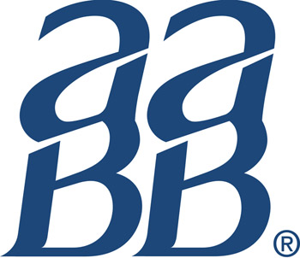
Blood Usage Recommendation
Don’t transfuse more units of blood than absolutely necessary
Each unit of blood carries risks. A restrictive threshold (7.0-8.0 g/dL) should be used for the vast majority of hospitalized, stable patients without evidence of inadequate tissue oxygenation (evidence supports a threshold of 8.0 g/dL in patients with pre-existing cardiovascular disease). Transfusion decisions should be influenced by symptoms and hemoglobin concentration. Single unit red cell transfusions should be the standard for non-bleeding, hospitalized patients. Additional units should only be prescribed after re-assessment of the patient and their hemoglobin value.
Notes:
Here is an example of a therapeutic recommendation made by the AABB. Don’t transfuse more units of blood than absolutely necessary Each unit of blood carries risks. A restrictive threshold (7.0-8.0 g/dL) should be used for the vast majority of hospitalized, stable patients without evidence of inadequate tissue oxygenation (evidence supports a threshold of 8.0 g/dL in patients with pre-existing cardiovascular disease). Transfusion decisions should be influenced by symptoms and hemoglobin concentration. Single unit red cell transfusions should be the standard for non-bleeding, hospitalized patients. Additional units should only be prescribed after re-assessment of the patient and their hemoglobin value.

Slide 27
July, 2018
Don’t proceed with elective surgery in patients with properly diagnosed and correctable anemia until the anemia has been appropriately treated.
Don’t perform laboratory blood testing unless clinically indicated or necessary for diagnosis or management in order to avoid iatrogenic anemia.
Don’t transfuse plasma in the absence of active bleeding or significant laboratory evidence of coagulopathy.
Avoid transfusion when antifibrinolytic drugs are available to minimize surgical bleeding.
Avoid transfusion, outside of emergencies, when alternative strategies are available as part of informed consent; make discussion of alternatives part of the informed consent process.
Notes:
Society for the Advancement of Blood Management, most recent recommendations.

Slide 28
Choosing Wisely Champions Program
The Choosing Wisely Champions program recognizes clinicians who are leading efforts to reduce overuse and waste in medicine. The program was created to acknowledge the work of those dedicated to providing appropriate care and encourage others to follow their lead.
Champions are selected by participating societies and include clinicians or teams of clinicians whose work in their respective specialties represents significant contributions to advancing the goals of the campaign. Such contributions can include:
Creation of an intervention to implement Choosing Wisely in their clinical practice;
Designing local initiatives to educate colleagues; or…
Playing a leadership role in developing society recommendations.
Notes:
The Choosing Wisely champion program relies on its partners to nominate champions who who are leading efforts to reduce overuse and waste in medicine. The program was created to acknowledge the work of those dedicated to providing appropriate care and encourage others to follow their lead. Champions are selected by participating societies and include clinicians or teams of clinicians whose work in their respective specialties represents significant contributions to advancing the goals of the campaign. Such contributions can include:
creation of an intervention to implement Choosing Wisely in their clinical practice;
designing local initiatives to educate colleagues; or
playing a leadership role in developing society recommendations.

Slide 29
Choosing Wisely Champion Ravi Sarode
“Ravi Sarode, MD, UT Southwestern Medical Center discovered that approximately 85 percent of thrombophilia tests at UT Southwestern’s two teaching hospitals were ordered incorrectly or incompletely. Thrombophilia tests are frequently ordered for patients with acute thrombotic events, often while on anticoagulation therapy; however, these additional variables cause these standard tests to return false positive results. These abnormal results are not always checked for reproducibility or accuracy, causing some patients to be inappropriately placed on long-term anticoagulation therapy. To promote appropriate use of testing, Dr. Sarode’s team developed local guidelines and implemented them in the EHR via a series of cascading questions that providers must answer before ordering. After implementation of the intervention and an associated education campaign, UT Southwestern has reduced testing for inpatients by more than 90 percent.”
Notes:
Dr. Sarode was recognized in 2016 through the American Society of Hematology and the Choosing Wisely ABIM Foundation as a Choosing Wisely Champion. Ravi Sarode, MD, UT Southwestern Medical Center discovered that approximately 85 percent of thrombophilia tests at UT Southwestern’s two teaching hospitals were ordered incorrectly or incompletely. Thrombophilia tests are frequently ordered for patients with acute thrombotic events, often while on anticoagulation therapy; however, these additional variables cause these standard tests to return false positive results. These abnormal results are not always checked for reproducibility or accuracy, causing some patients to be inappropriately placed on long-term anticoagulation therapy. To promote appropriate use of testing, Dr. Sarode’s team developed local guidelines and implemented them in the EHR via a series of cascading questions that providers must answer before ordering. After implementation of the intervention and an associated education campaign, UT Southwestern has reduced testing for inpatients by more than 90 percent.

Slide 30
Choosing Wisely Champions Nominated by ASCP, 2017
Jack Jordan, MLS, MA—As Director of Performance Excellence and Quality at Henry Ford Health System, he has worked to make the utilization of laboratory services evidence-based, safer and compliant with Choosing Wisely recommendations.
Meghan Kapp, MD—Dr. Kapp served as a founding member and co-chair of Vanderbilt UMC’s Choosing Wisely steering committee, educating house staff and faculty about the potential harm of daily labs, encouraging discussions of lab results and the need for future labs during rounds and providing data feedback with peer comparisons.
Christopher Polage, MD—Dr. Polage published research that contributed to the Infectious Diseases Society of America’s (IDSA) Choosing Wisely recommendation for clinicians to avoid testing for Clostridium difficile in certain situations.
Notes:
Here are three of the 8 choosing wisely champions of 2017…
Jack Jordan, MA (2017) — As Director of Performance Excellence and Quality at Henry Ford Health System, he has worked to make the utilization of laboratory services evidence-based, safer and compliant with Choosing Wisely recommendations.
Meghan Kapp, MD (2017) —Dr. Kapp served as a founding member and co-chair of VUMC’s Choosing Wisely steering committee, educating house staff and faculty about the potential harm of daily labs, encourage discussions of lab results and the need for future labs during rounds and provide data feedback with peer comparisons.
Christopher Polage, MD (2017) — Dr. Polage published research that contributed to the Infectious Diseases Society of America’s (IDSA) Choosing Wisely recommendation for clinicians to avoid testing for Clostridium difficile in certain situations.

Slide 31
Choosing Wisely Champions Nominated by ASCP, 2018
Ila Singh, MD, PhD created the CLSI document on test utilization, and was a member on the committee on Lab Test Utilization and Stewardship that co-authored a consensus document on the subject.
Curtis A. Hanson, MD led the incorporation of laboratory utilization rules into Mayo’s inpatient hospital practice and clinical decision support tool.
Diane George, DO led a group at Henry Ford Medical Group in Detroit, MI to establish a baseline of ordering volume and developed an analytics tool to monitor total volume, as well as highlight low and high utilizers. Within the first year of implementation, the number of vitamin D orders decreased from 685 per month to 150 per month, and the number continues to decrease at an annual rate of 23 percent.
Notes:
Here are three of the 8 choosing wisely champions of 2017…
Jack Jordan, MA (2017) — As Director of Performance Excellence and Quality at Henry Ford Health System, he has worked to make the utilization of laboratory services evidence-based, safer and compliant with Choosing Wisely recommendations.
Meghan Kapp, MD (2017) —Dr. Kapp served as a founding member and co-chair of VUMC’s Choosing Wisely steering committee, educating house staff and faculty about the potential harm of daily labs, encourage discussions of lab results and the need for future labs during rounds and provide data feedback with peer comparisons.
Christopher Polage, MD (2017) — Dr. Polage published research that contributed to the Infectious Diseases Society of America’s (IDSA) Choosing Wisely recommendation for clinicians to avoid testing for Clostridium difficile in certain situations.

Slide 32
Choosing Wisely Grant Program
In 2013, RWJF provided funding to support 21 projects led by state medical societies, specialty societies and regional health collaboratives to educate physicians about the recommendations and build skills to have conversations with patients about the care they need.
In spring 2015, the ABIM Foundation—with continued funding from RWJF—awarded seven grants to organizations that promote the goals of the Choosing Wisely campaign. These new grants support seven initiatives focused on reducing utilization of inappropriate tests and treatments. Each initiative includes delivery systems, hospitals and/or medical groups collaborating with multi-stakeholder community-based groups and physician-led organizations.
Notes:
Choosing wisely also teams with the Robert Wood Johnson Foundation to provide community grants.
In 2013, RWJF provided funding to support 21 projects led by state medical societies, specialty societies and regional health collaboratives to educate physicians about the recommendations and build skills to have conversations with patients about the care they need.
In spring 2015, the ABIM Foundation—with continued funding from RWJF—awarded another round of 7 grants to organizations that promote the goals of the Choosing Wisely campaign. These new grants support seven initiatives focused on reducing utilization of inappropriate tests and treatments. Each initiative includes delivery systems, hospitals and/or medical groups collaborating with multi-stakeholder community-based groups and physician-led organizations.

Slide 33
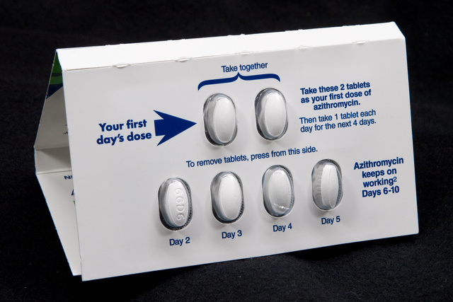
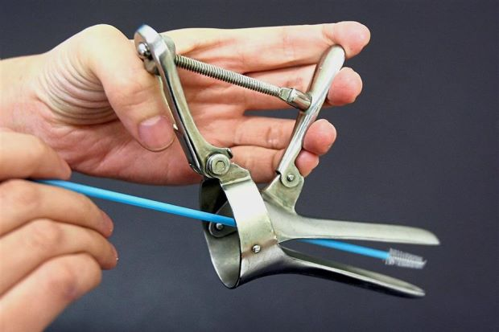
Summary of 2015 Grant Goals
Reduce…
Antibiotic use in viral infections—bronchitis, URI.
Imaging for headache and lower back pain.
Repeated lab testing on inpatients.
Blood transfusions for inpatients.
Pap smears for women 30–65.

Slide 34
A Consumer Reports Vitamin D Recommendation
Many people don’t have enough vitamin D in their bodies. Low vitamin D increases the risk of broken bones. It may also contribute to other health problems. That’s why doctors often order a blood test to measure vitamin D. But many people do not need the test. Here’s why:
A test usually does not improve treatment. Many people have low levels of vitamin D, but few have seriously low levels. Most of us don’t need a vitamin D test. We just need to make simple changes so we get enough D. We need to get a little more sun, eat foods rich in vitamin D, or take a supplement.
Notes:
Here is a recommendation made in Consumer Reports by ASCP about Vitamin D.

Slide 35
A Consumer Reports Vitamin D Recommendation (Continued)
Extra tests lead to extra treatments and costs. Getting tests that you don’t need often leads to treatments you don’t need, or treatments that can even be harmful. For example, if you take too much vitamin D, it can damage your kidneys and other organs.
One blood test for vitamin D does not cost much. But doctors are ordering tests six times as often as in 2008. All these tests add up. In 2011, Medicare spent $224 million on vitamin D tests for seniors.
Talk to your doctor about your risks. Here are some conditions where you might need a vitamin D test:
If you have osteoporosis. This disease makes your bones weak, so that they are more likely to break.

Slide 36
A Consumer Reports Vitamin D Recommendation (Continued)
If you have a disease that damages your body’s ability to use vitamin D. These are usually serious and ongoing diseases of the digestive system, such as inflammatory bowel disease, celiac disease, kidney disease, liver disease, pancreatitis and others.
If your doctor suggests getting a vitamin D test, ask about your risks. If your risk is high, you should get the test. If your risk is low, ask if you can avoid the test. Ask if you can boost your vitamin D with sunlight and food, and possibly supplements.
If your doctor does need to keep track of your vitamin D, make sure the same test is used each time. Ask your doctor which tests are best.
This report is for you to use when talking with your health-care provider. It is not a substitute for medical advice and treatment. Use of this report is at your own risk.

Slide 37
Perceived CW Barriers in 2014
Is it Working?
2014 survey: 2000 US PCPs, 2500 VA PCPs
Response: 603 PCPs (34%) and 1173 VA PCPs (48%)
Low response may indicate lack of interest or knowledge of CW
PCPs rated 12 CW recommendations for ease to implement, ease to convince patients, and potential barriers
Zikmund-Fisher BJ Kullgren JT, Fagerlin A, et al. Perceived barriers to implementing individual choosing wisely recommendations in two national surveys of primary care providers. J Gen Intern Med 2016; 32:210–7.

Slide 38
Easy to Implement (80%)
Avoid repeat colorectal cancer screening within 5 years if a prior colonoscopy found and removed only 1–2 adenomatous polyps without high-grade dysplasia
Avoid conducting any form of colorectal cancer screening for 10 years if the patient had a negative colonoscopy
Avoid performing cardiovascular testing for patients undergoing low-risk surgery
Don’t screen for carotid artery stenosis (CAS) in asymptomatic adult patients

Slide 39
Moderate Difficulty (>20%)
Avoid imaging for suspected pulmonary embolism
Avoid the use of medications to achieve hemoglobin A1c <7.5 % in adults age 65 and older
Avoid DEXA screening among younger patients with no risk factors (VA PCPs considered this easy to implement)

Slide 40
Considerable Difficulty (85%)
Limit use of antibiotics for sinusitis
Avoid imaging for low back pain within the first 6 weeks
Don’t use benzodiazepines (Xanax) and other sedative-hypnotics as first choice treatments for insomnia, agitation, or delirium in older adults
Avoid brain imaging studies (CT of MRI) in evaluation of simple syncope
Avoid antimicrobials to treat bacteriuria in older adults unless specific symptoms were present

Slide 41
Why Not Implement?
Can’t ignore patient requests for tests and treatments
Tests and treatments are recommended by specialists
Lack of time for shared decision making with the patient
Avoid malpractice suits (VA not so much)

Slide 42
2017: Choosing Wisely Turns Five With Mixed Results
Is it Working?
Overall savings could be $200,000,000/year, reduce backlogs.
UCLA example…
Cataract surgery uses local anesthesia, protected site, 15” procedure
In 2015, UCLA recommended no EKG, no chest X-ray, no lab profiles
Test ordering dropped by 80%, mean wait time shortened from 245 to 64 days, resulting in good vision six months earlier, no adverse effects
Notes:
"The Choosing Wisely campaign represents a practical expression of the core mission of the ABIM Foundation, to improve healthcare by strengthening medical professionalism," Richard J. Baron, MD, president and chief executive officer of the American Board of Internal Medicine and ABIM Foundation, said in his introductory remarks.
He continued, "how you get from the aspiration to do the right thing to actually changing behavior to front-line conversations and front-line actions…that's what Choosing Wisely is all about."
When the researchers asked physicians why they continued to provide services deemed to be low-value, they listed malpractice concerns most often, followed by "dealing with uncertainty," and "patient demand."
However, Mainor pointed out that such concerns don't align with the literature on what is actually driving the practices and their impact. For example, Mainor and lead author Carrie H. Colla, PhD, note in their paper that there is little evidence that patients are demanding these low-value services, or that not offering them increases the risk for malpractice suits.

Slide 43
2017: Choosing Wisely Turns Five With Mixed Results
Is it Working?
10-25-17: One in four US physicians knows about CW (21% in 2014)
The increase in US physicians with difficulty having patient conversations about avoiding low-value services was from 42% in 2014 to 46% in 2017.
No data support patient demands for low-value services.
What next? Greater Detroit Area Health Consortium president Kate Kohn-Parrott say, “you have to hear it seven ways from seven sources.”
Kerr, EA, Kullgren JT, Saini SD Choosing Wisely: how To fulfill the promise In the next 5 years. Health Affairs 2017;36:11 doi.org/10.1377/hlthaff.2017.0953
Notes:
"The Choosing Wisely campaign represents a practical expression of the core mission of the ABIM Foundation, to improve healthcare by strengthening medical professionalism," Richard J. Baron, MD, president and chief executive officer of the American Board of Internal Medicine and ABIM Foundation, said in his introductory remarks.
He continued, "how you get from the aspiration to do the right thing to actually changing behavior to front-line conversations and front-line actions…that's what Choosing Wisely is all about."
When the researchers asked physicians why they continued to provide services deemed to be low-value, they listed malpractice concerns most often, followed by "dealing with uncertainty," and "patient demand."
However, Mainor pointed out that such concerns don't align with the literature on what is actually driving the practices and their impact. For example, Mainor and lead author Carrie H. Colla, PhD, note in their paper that there is little evidence that patients are demanding these low-value services, or that not offering them increases the risk for malpractice suits.

Slide 44
33% of Accountable Care Organizations Attempt to Adopt CW Recommendations 2017
What worked? ACOs with commercial risk-based provider contracts who have prior experience reduce “low-value” care.
Uninsured, Medicaid, and privately insured patients, indigents and minorities, receive ever-increasing percentage of low value care
Associated with lack of high-value care
Poorer health upon presentation
What didn’t work? Education, CMS quality measures, shared decision-making with clinical decision support, audits, performance feedback, pay for performance
Haverkamp MH, Peiris D, Mainor AJ, et al. ACOs with risk-bearing experience are likely taking steps to reduce low-value medical services. Am J Manag Care. 2018;24:e216–e21.

Slide 45
If Your Society Wants to Partner
Submit up to five recommendations for consideration.
Recommendations begin with the term “Don't” or “Avoid.”
Recommendations are evidence-based with current citations.
Recommendations address frequent diagnostic or therapeutic choices.
Recommendations are developed within the contributing society using internal society processes.
Contributing societies may send recommendations that overlap with existing recommendations.
Conversely, contributing societies should avoid redundancy, CW advocates for new recommendations.
Notes:
To participate,
Submit five recommendations for consideration.
Recommendations begin with the term “Don't” or “Avoid.”
Recommendations are evidence-based with current citations.
Recommendations address frequent diagnostic or therapeutic choices.
Recommendations are developed within the contributing society using internal society processes.
Contributing societies may send recommendations that overlap with existing recommendations.
Conversely, contributing societies should avoid redundancy, CW advocates for new recommendations.

Slide 46
If Your Society Wants to Partner
Recommendations are developed with transparency; the method is summarized with the recommendation.
Recommendations are accompanied by description of the contributing society.
ABIM sends each recommendation to two independent reviewers for comments and approval.
ABIM then sends recommendations to all partners to ensure there is no conflict with existing recommendations.
When published, recommendation copyrights belong to the contributing society.
Our ASCLS process: present to respective Scientific Assemblies➔ ASCLS fall 2018 BOD ➔ ABIM
Notes:
Recommendations are developed with transparency; the method is summarized with the recommendation.
Recommendations are accompanied by description of the contributing society.
ABIM sends each recommendation to two independent reviewers for comments and approval.
ABIM then sends recommendations to all partners to ensure there is no conflict with existing recommendations.
When published, recommendation copyrights belong to the contributing society.

Slide 47
ASCLS Choosing Wisely Task Force “Primacy:” Educational Modules
Brianna Miller, UAB, Hematology, Hemostasis, BB
Muneeza Esani, U of Texas Med Branch, Galveston, Clin Chem
Josephine Ebomoyi, Northern Illinois U; Micro
Dana Bostic, U of Kansas MC; BB, Health Care Simulation
Lisa Cremeans, MLS, MMDS, U. No. Carolina, Molecular
Deborah Josko, Rutgers U; Immunology
Dawn Rudnick, U of Michigan Hlth Svc; Micro, Lab Mgt, General
Notes:
Recommendations are developed with transparency; the method is summarized with the recommendation.
Recommendations are accompanied by description of the contributing society.
ABIM sends each recommendation to two independent reviewers for comments and approval.
ABIM then sends recommendations to all partners to ensure there is no conflict with existing recommendations.
When published, recommendation copyrights belong to the contributing society.

Slide 48
Fourth-Year Med Students Text or Video Case Studies of Low-Value Procedures
Prospective randomized control trial with crossover assessed 93 fourth-year med students
Repeated video (intervention) or text (control) cases
Pre-test mean: 28.5 ± 13.5%
Exit test video: 74.3 ± 17.4; text: 67.8 ± 18.5%; p = 0.026
Retention (9 mo) video mean: 69.2 ± 20.2%, text mean: 66.4 ± 20.3%; p = 0.108 (NS)
Retention test revealed many errors
Thrombolytic treatment without confirmation of a diagnosis of pulmonary embolism (17.7%)
Oxygen supplementation for CO2 poisoning (16.9%)
Rapid sodium supplementation for chronic hyponatremia (11.0%) and more
Ludwig S, Schuelper N, Brown J, et al. How can we teach medical students to choose wisely? A randomised controlled cross-over study of video- versus text-based case scenarios.BMC Med. 2018;16:107. doi: 10.1186/s12916-018-1090-y.

Slide 49
Our Recommendations
Josephine & LIsa: “Do not order rapid multiplex molecular assays for microbial infections unless the assays will impact patient management decisions.”
George & Brianna: “Avoid routine prothrombin time (PT) and partial thromboplastin time (PTT, APTT) pre-operative screens on unselected patients.”
Brianna & George: “Avoid routine blood typing and screening for low risk surgeries without a clinical indication.”
Muneeza: “Avoid using HGB to screen for iron deficiency. Instead use ferritin.”
Dana: “Do not transfuse red blood cells for expansion of circulatory volume unless necessary for patient cases with severe hemorrhage.”
Suggestions from CLEC and ASCLS: Reduce influenza testing, identify based on symptoms and treatment response; eliminate erythrocyte sedimentation rates, recommend C-reactive protein; reduce frequency of hemoglobin A1C assays; reduce testing for hemoglobin variants; review panel charging practices, use targeted assays; do not order testosterone on men >90 YO
Notes:
Josephine: Molecular, presented by Lisa Cremeans
George & Brianna, Hematology/Hemostasis
Brianna & George, Immunology/Immunohematology
Muneeza, Hematology/Hemostasis
Dana, Immunology/Immunohematology

Slide 50
2019 Recommendations
Dawn Rudnik: “Avoid antibody screening for asymptomatic Herpes simplex type II.”
Muneeza Esani: “Reduce frequency of hemoglobin A1C assays.”
Deborah Josko: “Reduce influenza testing, and identify based on symptoms and treatment response.”
George Fritsma: “Avoid ordering an initial factor V Leiden, first perform the activated protein C resistance.”
Dana Bostic: “Review profile charging practices, use targeted assays.”
Notes:
Josephine: Molecular, presented by Lisa Cremeans
George & Brianna, Hematology/Hemostasis
Brianna & George, Immunology/Immunohematology
Muneeza, Hematology/Hemostasis
Dana, Immunology/Immunohematology

Slide 51
Your Recommendations?

