Slide 1

Vaccine Development for Pandemic Response
Rick A. Bright, Ph.D.
CEO, Pandemic Prevention Institute, The Rockefeller Foundation
The Robert and Jean Adams Foundation
Medical and Clinical Laboratory Sciences Symposium
Auburn University at Montgomery
April 1, 2022

Slide 2
Learning Objectives
How ongoing vaccine development prior to the pandemic was advancing new technologies
How technologies were selected to develop emergency vaccines against SARS-CoV-2 at the start of the pandemic
How the development/manufacturing of vaccines was accelerated
The future of vaccines against SARS-CoV-2

Slide 3
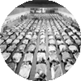
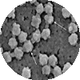

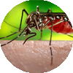



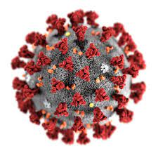
Recent Outbreaks and Pandemics
1918-19 Influenza A (H1N1) Pandemic
~50M death worldwide
2015-
ZIKA epidemic leading to Congenital Zika Syndrome, GBS
2002-04
SARS emerged in China
~1,000 deaths
2012-
MERS first identified in Saudi Arabia
1981-
First CDC reporting for HIV
36.9 M people living with HIV/AIDS worldwide in 2017
2009-10 Influenza A (H1N1)
Estimated 151,700 - 575,400 deaths worldwide
2014-16 Ebola epidemic in West Africa
Over 11K deaths
2019 - Present SARS-CoV-2 global pandemic
Over 6M deaths

Slide 4
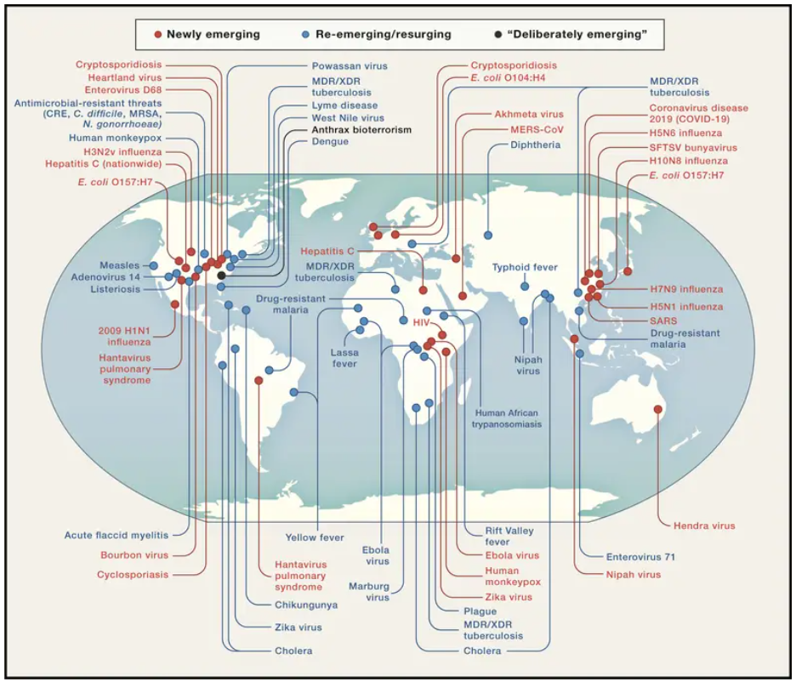
The Risk of Outbreak Potential Pathogens is Rapidly Increasing
Cell. 2020 Sep 3; 182(5): 1077–1092.
Notes:
Disease X (change over time -- Ebola 70s, AIDS 80s, SARS 2000s, Zika 2010s, etc.)
Continually increasing risk over time

Slide 5
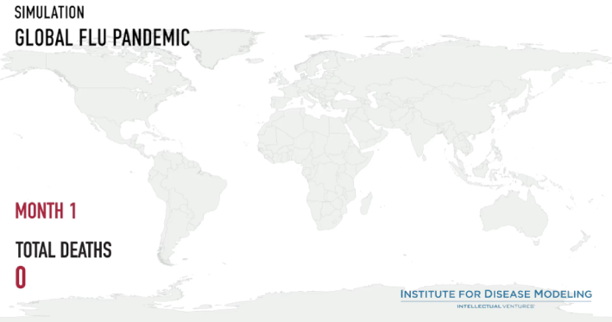
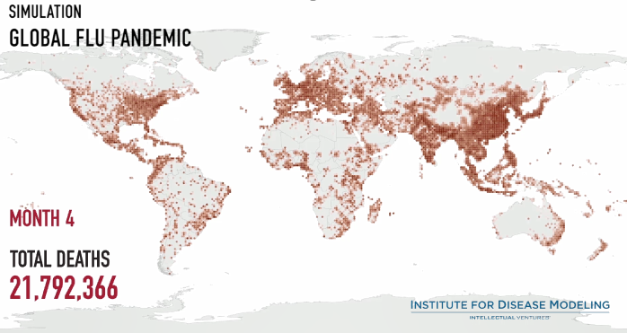
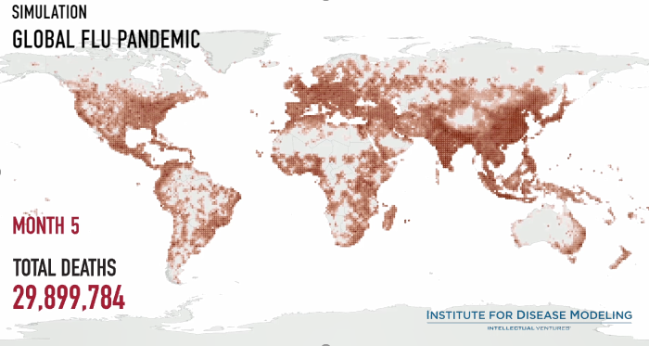
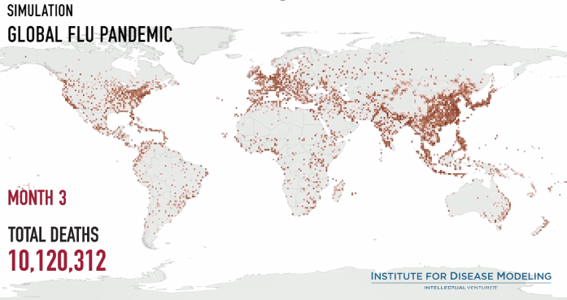
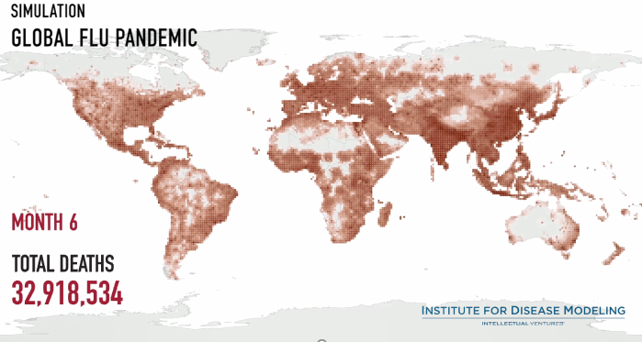
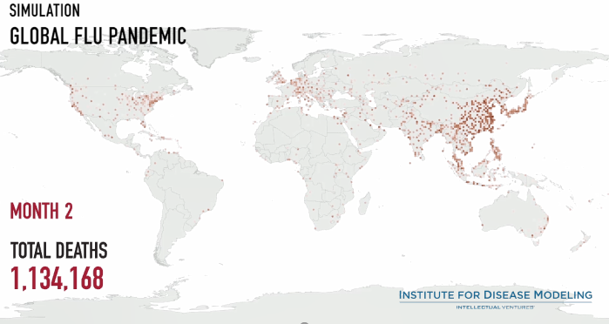
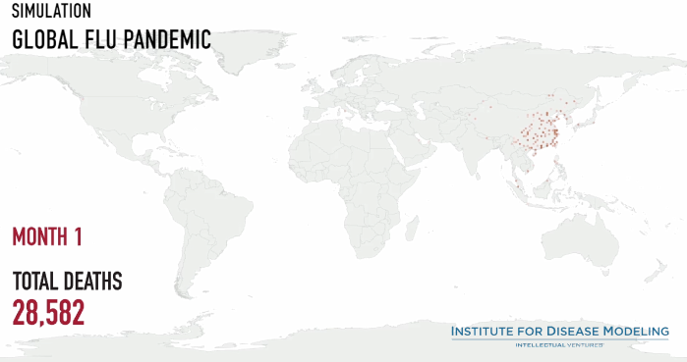
Notes:
The “Shattuck Flu Map” animated simulation shows what would happen if a highly contagious and lethal airborne pathogen – like the 1918 flu – were to occur today. Nearly 33 million people worldwide would die in just six months. Courtesy: Institute for Disease Modeling

Slide 6
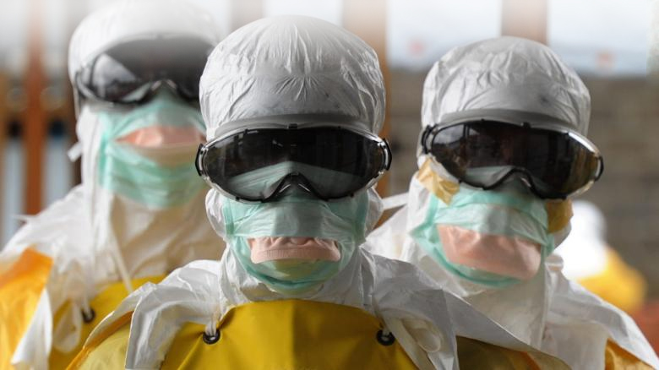
Disease X
It is estimated that as many as 631,000 - 827,000 undiscovered viral species exist with zoonotic potential in mammal or bird hosts.¹ ¹"The Global Virome Project." D Carroll et al. Science 359 (6378), 872-874. DOI: 10.1126/science.aap7463
CREDIT: DOMNIQUE FAGET/AFP/GETTY IMAGES

Slide 7

Pandemic Preparedness Principles
Flexible
Agreements
Sustainable
Platforms for Faster Development
Improved Delivery
Pandemic
Influenza
Preparedness
Emerging Infectious Diseases
Preparedness
Expand Access
Production Capacity

Slide 8

Speed is the critical component of response.
Even the most advanced countermeasures fail unless present in sufficient quantities with minimal delay at the location of need.
Notes:
MCMs are the core of BARDA’s mission space. When we talk about MCMs, we tend to focus on their efficacy, on their safety profile, on their underlying science. But I want to start by stressing one other critical dimension of MCM development that we often overlook… SPEED.
For any attack, outbreak, or exposure… our ability to save lives will not only be dictated by our capacity to develop effective MCMs, but also by our capacity to get them where they are needed, when they are needed, and in sufficient quantities.
Even the most advanced MCMs will fail, unless they are compatible with this need. In this respect, we must design MCMs with this need in mind.

Slide 9
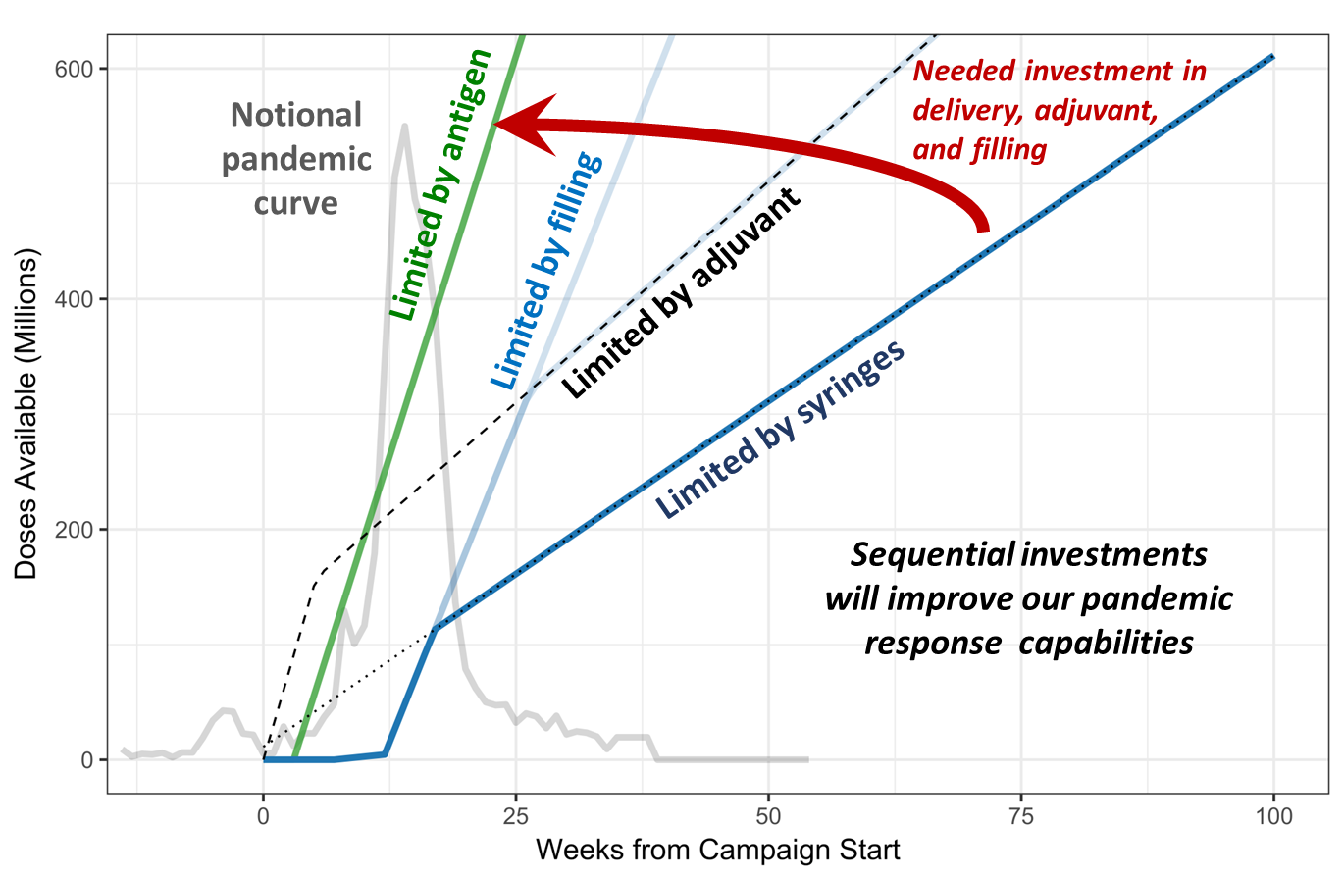
Vaccine Capacity Limitations

Slide 10


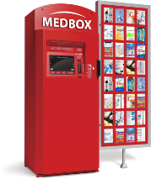
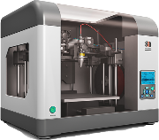
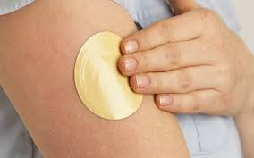

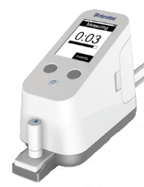
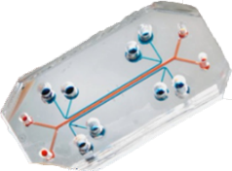

Addressing End to End Solutions
Situational Awareness/Recognize
Design
Production
Administration
Identify/ Characterize
Validation
Distribution
Notes:
- Across BARDA, we will remain focused on integrated, end-to-end solutions for our medical countermeasure enterprise.
- Again, it is not only the safety and efficacy of the MCMs we develop, but also our ability to get them to the patients in need quickly enough.
- For all of the advances made in science and healthcare, it STILL takes too long to identify, inform and respond to emerging threats.
Our strategies will focus on
Early awareness to empower patients and healthcare providers with actional data,
Tools and technology to accelerate our ability to develop and produce new medicines
And innovation to ensure that everyone has access to lifesaving medicines when and where they are needed.

Slide 11







Vaccines and Vaccination Future Technologies
TECHNOLOGIES TO IMPROVE:
Production
X
Effectiveness
Distribution/
Administration

Slide 12
Traditional Pathway – Early Development to Large Scale Production
Advanced Manufacturing
Scale-Up
Validate
PPQ
Large Scale Production and Storage
IND
NDA/BLA
Discovery
Preclinical Development
Phase I
Phase II
Phase III
EUA/BLA
Preparation
and Filing
Product &
Delivery
PRODUCT PIPELINE

Slide 13


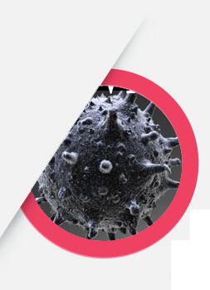
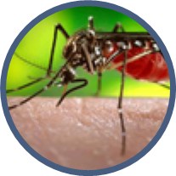
Vaccine Readiness from Previous Outbreaks and Pandemics
2014-16 Ebola
Influenza Pandemics
2015-16
Zika
ERVEBO® (V920) is a vaccine licensed by FDA for the prevention of disease caused by Zaire ebolavirus
Zabdeno® (Ad26.ZEBOV) and Mvabea® (MVA-BN-Filo), European Commission-approved and World Health Organization-Prequalified using proprietary AdVac® technology
Flublok Influenza Vaccine is licensed by FDA for active immunization against disease caused by influenza virus subtypes A and type B
mRNA – BARDA/DoD
mRNA - BARDA
DNA Vaccine - DoD

Slide 14
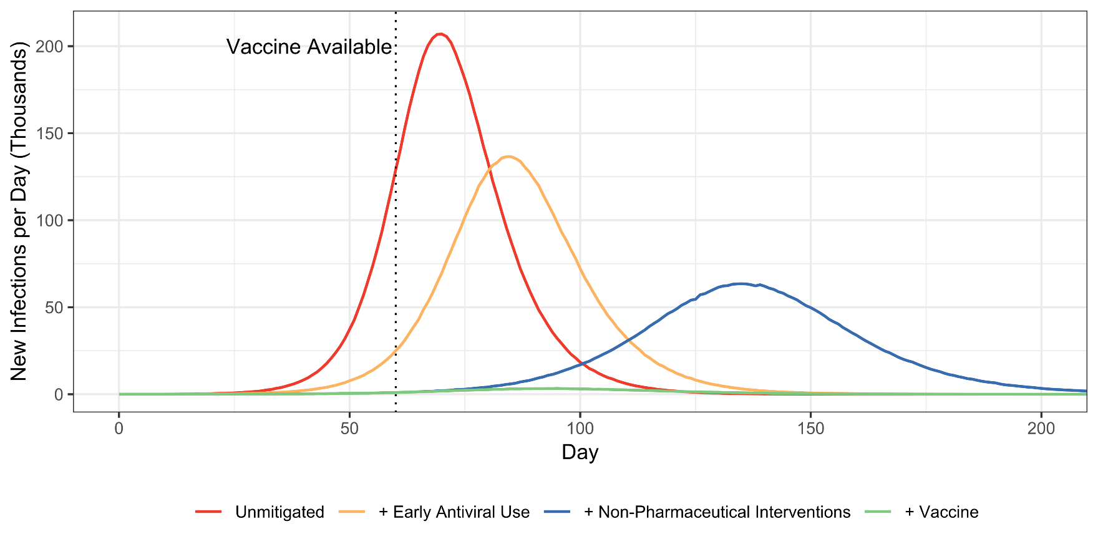
Combined Effects Suppress Pandemic Curve
Early Antiviral Use
Combined with NPIs
Combined with Vaccine
BARDA Agent-Based Simulation of DC, MD, and VA
Asher, Arguello, Durham, Romero

Slide 15
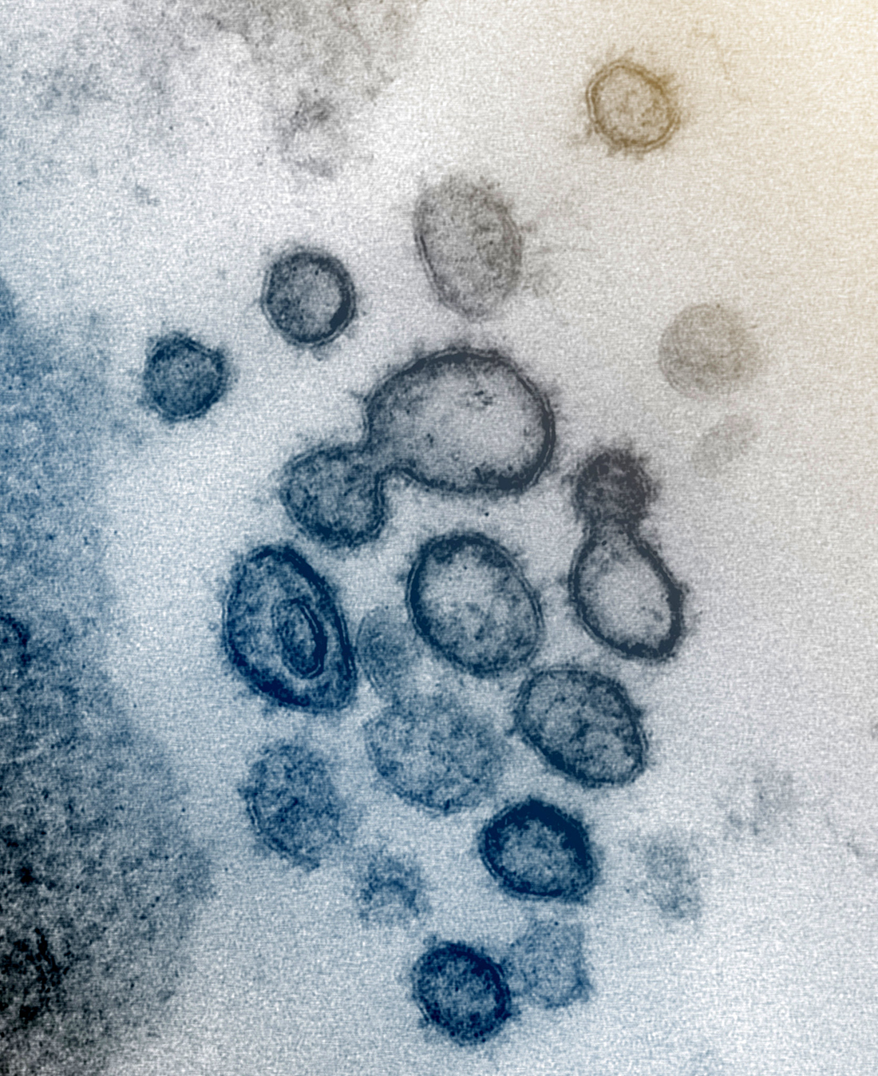
16
3rd Coronavirus Outbreak
No Licensed products
Years

Slide 16





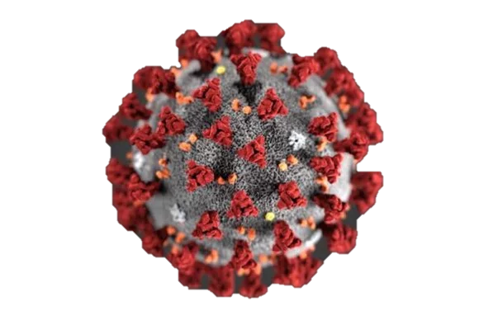





COVID-19 Medical Countermeasures Task Force
Align and prioritize MCM development across interagency partners to avoid duplication of effort, identify opportunities for synergy, and fill potential gaps
medicalcountermeasures.gov
Notes:
USG developers sharing information to make the best use of government funds

Slide 17
Agency-Wide Engagement with Developers
Industry and Congressional Engagements
Industry Call
Corona Watch
COVID-19
MCM Portal
Funding Announcement
(14 NIH/NIAID Funding Opportunities; FDA BAA, BARDA EZ BAA and BAA)

Slide 18
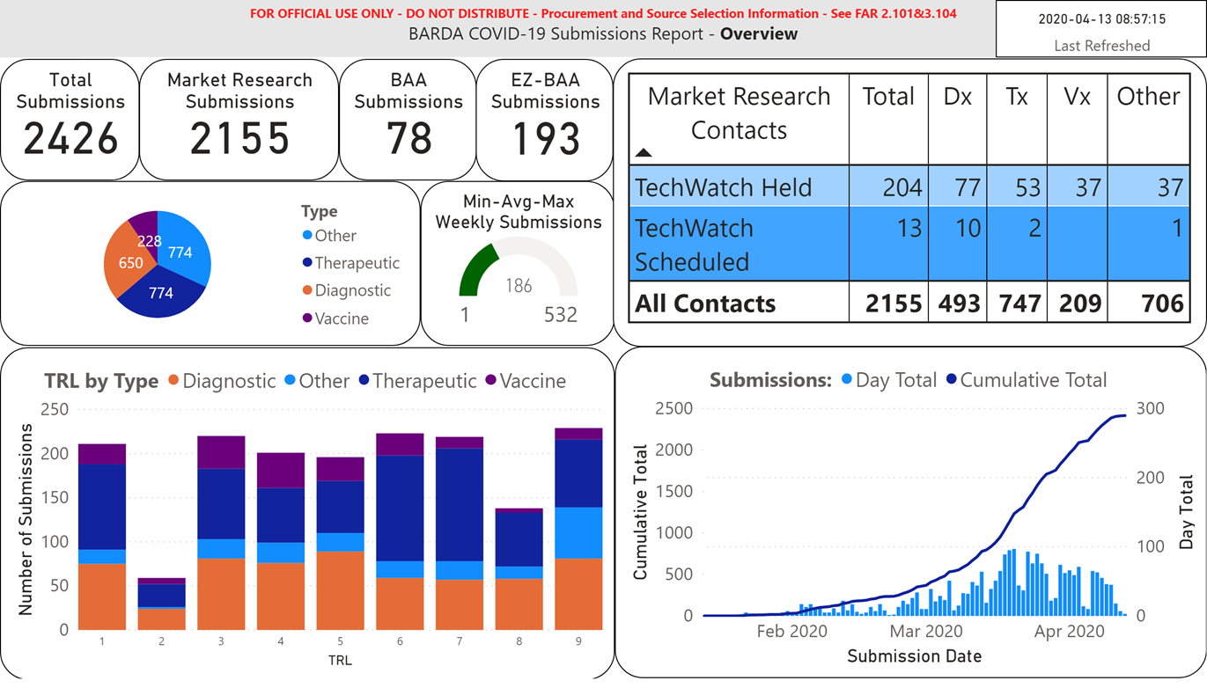
COVID-19 Market Research Portal Submissions

Slide 19
COVID-19 Medical Countermeasure Development Strategy
ACCELERATE DEVELOPMENT
Platform technologies
Repurpose licensed products
Parallel, not sequential activities
MITIGAGE RISK
Multiple technologies
Multiple targets
Redundancy
DOMESTIC MANUFACTURING
Scale Up & Scale Out
Raw materials and supply chains
Leverage existing facilities

Slide 20
Vaccine Development
First to Clinic
Proven Platform
Production Scalability
Innovation
e.g., mRNA based vaccines that allow rapid early development
e.g., viral vectors with demonstrated safety and efficacy
e.g., existing or readily amenable to large scale manufacturing, including experienced workforce
e.g., novel platforms, delivery approaches, or new thinking to transform the field
Leverage existing infrastructure for rapid MCM generation and production through partnerships (contracts and OTA) including other USG agencies

Slide 21

Vaccine Approach
Accelerate Development
Mitigate Risk
Domestic Manufacturing
Rapid Vaccine Platform Approaches
Nucleic Acid
Vectors
Recombinant protein
Multiple Platforms
Address potential yield risks
Address potential dose risk
Scale Up & Scale Out
Validate large scale process (i.e. larger tanks)
Technology transfer to more facilities
Increase fill/finish capacity
Multiple Presentations (recombinant, vector, etc.)
Disease enhancement mitigation
Alternative routes of delivery
Repurpose Licensed Products
Viral Vector
Recombinant Protein
Raw Materials Supply Chains
Remove bottlenecks
Establish stockpiles
Parallel Activities
Overlapping clinical trials
Scale up in parallel with clinical development
Redundancy
Take multiple products through large scale clinical trials
Multiple manufacturing facilities for each product
Leverage Existing Facilities
Facilities of large pharma partners
CMOs

Slide 22
Accelerating Development of Safe and Effective Vaccines
Advanced Manufacturing
Discovery
Preclinical Development
Scale-Up
Validate
PPQ
Large Scale Production and Storage
Platform Technologies
Multiple Candidates
Large Scale Manufacturing in Parallel with Clinical Trials
Large Phase III Trials
Strong Partnerships Among FDA, CDC, NIH, BARDA, MCM TF and Industry
End to End solution
Expertise and Resources
IND
Phase I
Phase II
Phase III
PRODUCT PIPELINE
EUA and BLA
Preparation & Filing
EUA/BLA
Vaccine Delivery
Vaccine Administration
Kitting
Shipping to Vaccination Sites
Pharmacovigilance
Stability Testing
Tracking for Second Dose
TIME
PIPELINE
Platform Tech.
Emergency Time Scale

Slide 23

MCM Development – Vaccine Horse Race
DNA
Recombinant Protein
mRNA
Adeno Virus
VSV

Slide 24
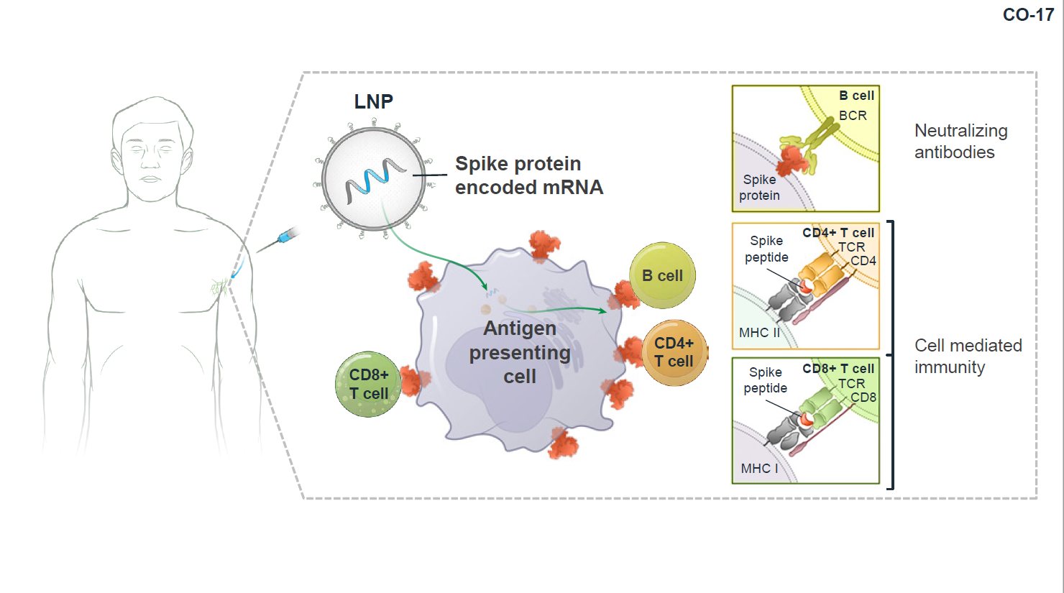
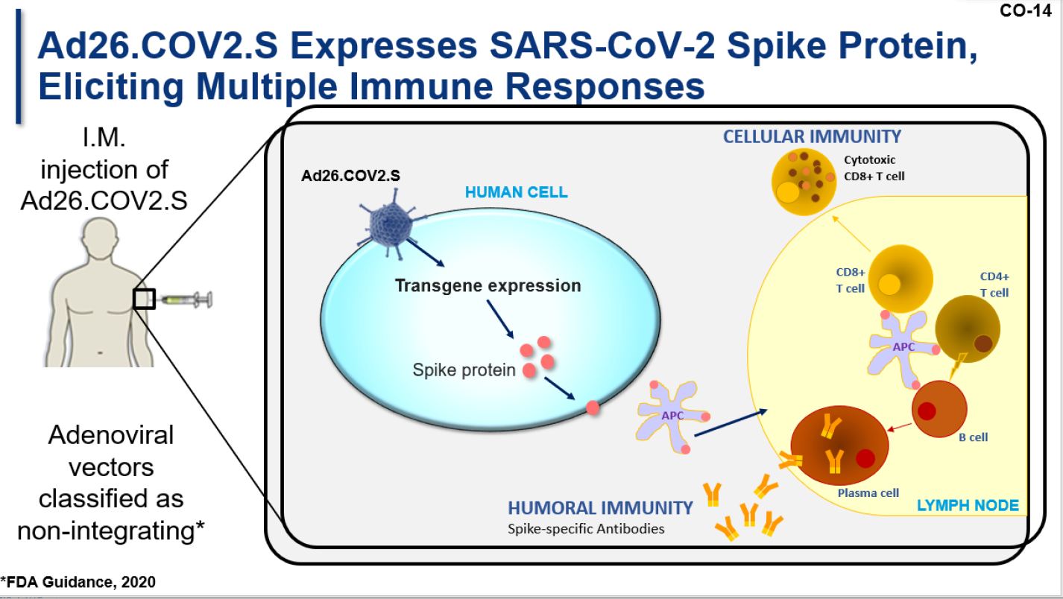
Overview of Two COVID Vaccine Platforms
Moderna
SPIKEVAX (COVID-19 Vaccine, mRNA)
Janssen
COVID-19 Vaccine (Ad26 COV2.S)
https://www.fda.gov/advisory-committees/advisory-committee-calendar/vaccines-and-related-biological-products-advisory-committee-december-17-2020-meeting-announcement
https://www.fda.gov/advisory-committees/advisory-committee-calendar/vaccines-and-related-biological-products-advisory-committee-february-26-2021-meeting-announcement

Slide 25
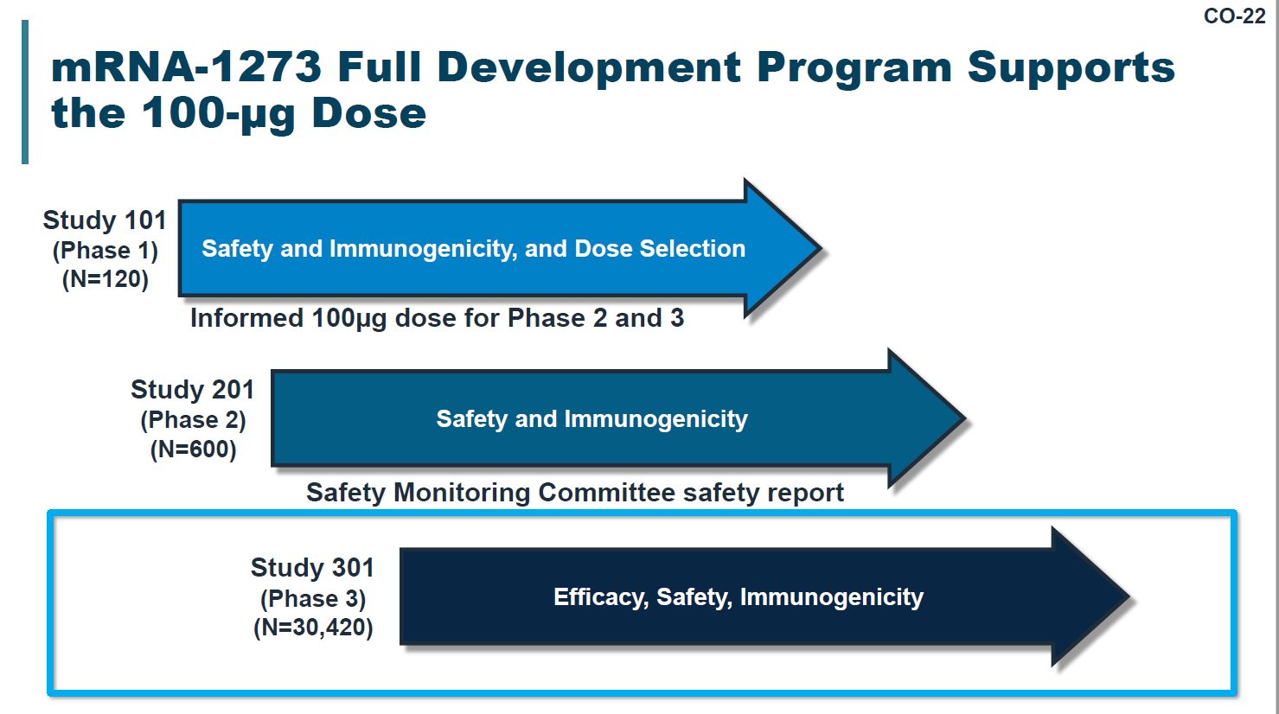
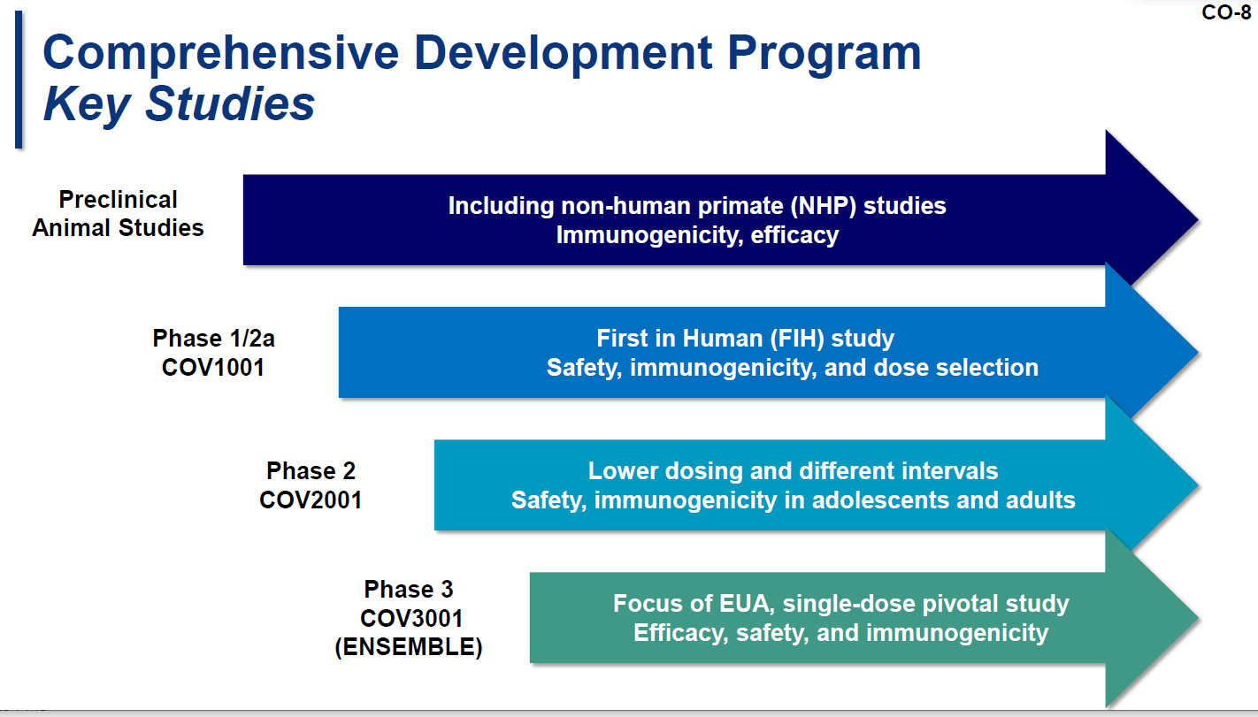
COVID Vaccine Development Pathway
Moderna
SPIKEVAX (COVID-19 Vaccine, mRNA)
Janssen
COVID-19 Vaccine (Ad26 COV2.S)
https://www.fda.gov/advisory-committees/advisory-committee-calendar/vaccines-and-related-biological-products-advisory-committee-december-17-2020-meeting-announcement
https://www.fda.gov/advisory-committees/advisory-committee-calendar/vaccines-and-related-biological-products-advisory-committee-february-26-2021-meeting-announcement

Slide 26
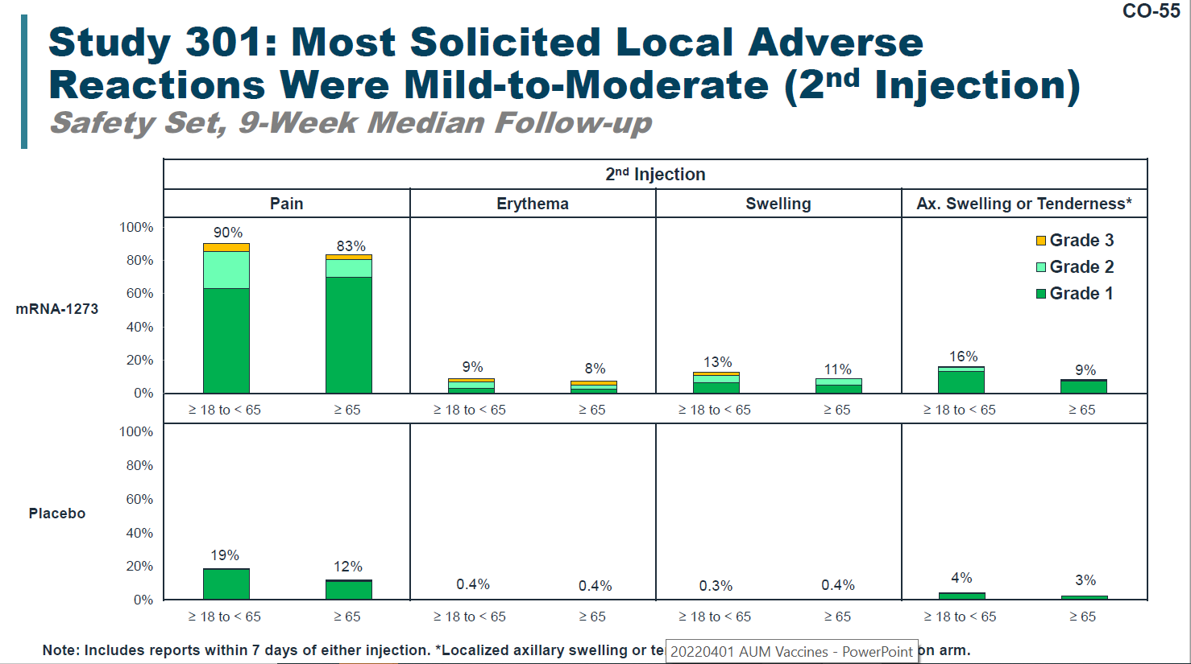
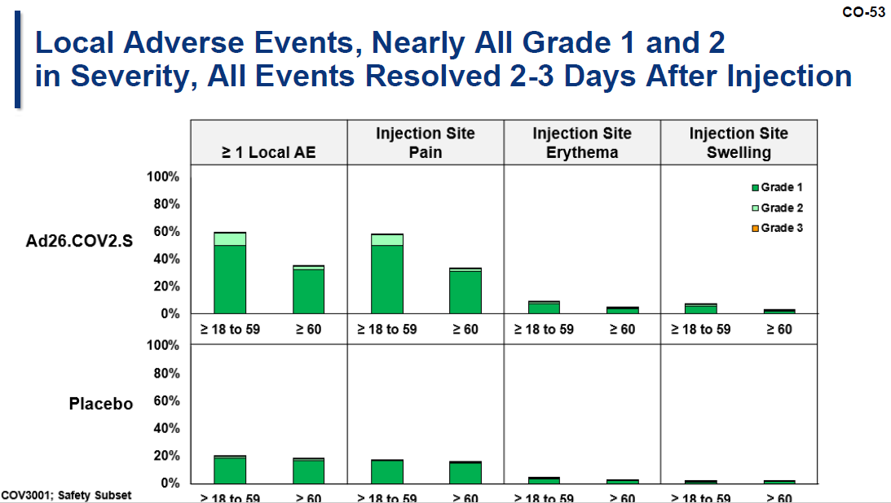
Solicited Local Adverse Events
Moderna
SPIKEVAX (COVID-19 Vaccine, mRNA)
Janssen
COVID-19 Vaccine (Ad26 COV2.S)
https://www.fda.gov/advisory-committees/advisory-committee-calendar/vaccines-and-related-biological-products-advisory-committee-december-17-2020-meeting-announcement
https://www.fda.gov/advisory-committees/advisory-committee-calendar/vaccines-and-related-biological-products-advisory-committee-february-26-2021-meeting-announcement

Slide 27
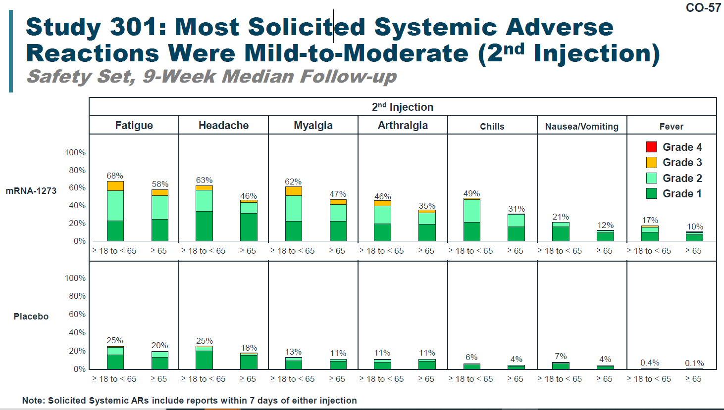
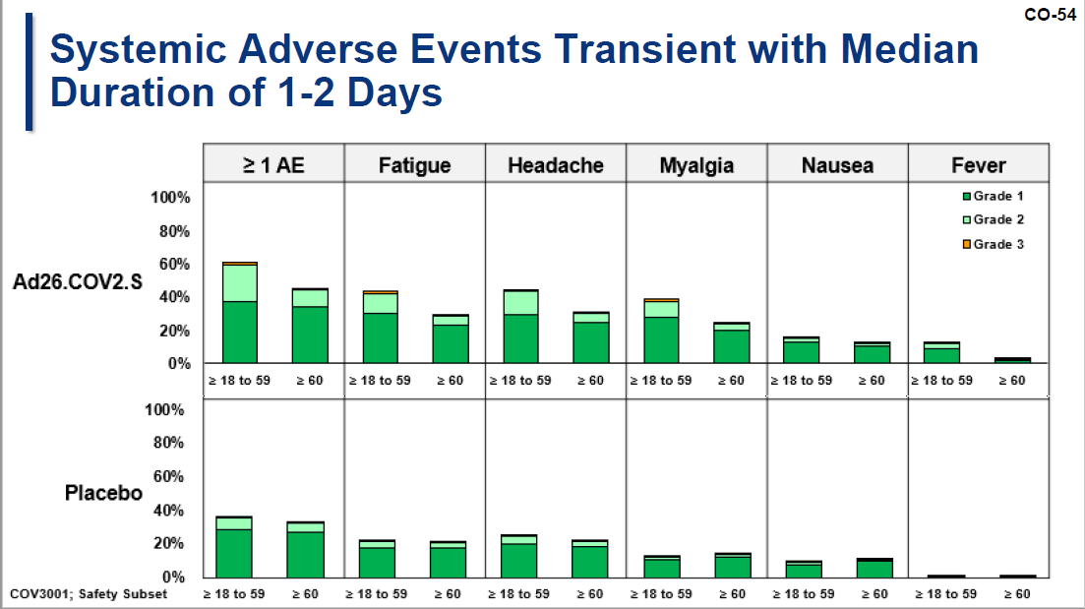
Solicited Systemic Adverse Events
Moderna
SPIKEVAX (COVID-19 Vaccine, mRNA)
Janssen
COVID-19 Vaccine (Ad26 COV2.S)
https://www.fda.gov/advisory-committees/advisory-committee-calendar/vaccines-and-related-biological-products-advisory-committee-december-17-2020-meeting-announcement
https://www.fda.gov/advisory-committees/advisory-committee-calendar/vaccines-and-related-biological-products-advisory-committee-february-26-2021-meeting-announcement

Slide 28
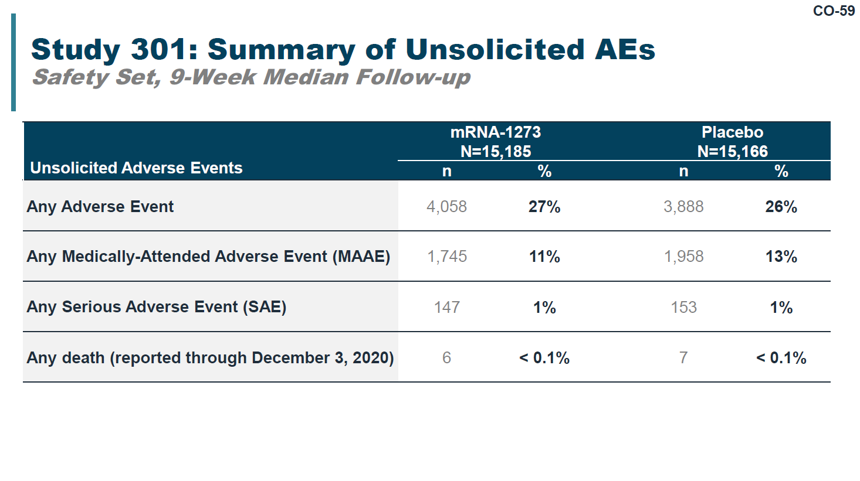
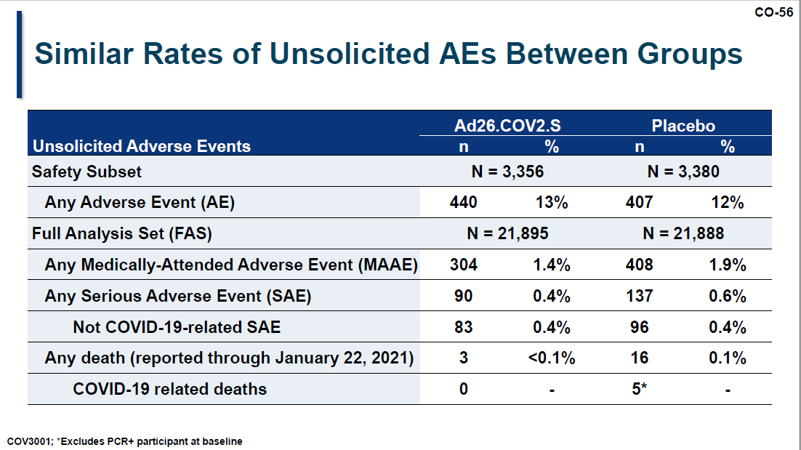
Non-Solicited Adverse Events
Moderna
SPIKEVAX (COVID-19 Vaccine, mRNA)
Janssen
COVID-19 Vaccine (Ad26 COV2.S)
https://www.fda.gov/advisory-committees/advisory-committee-calendar/vaccines-and-related-biological-products-advisory-committee-december-17-2020-meeting-announcement
https://www.fda.gov/advisory-committees/advisory-committee-calendar/vaccines-and-related-biological-products-advisory-committee-february-26-2021-meeting-announcement

Slide 29
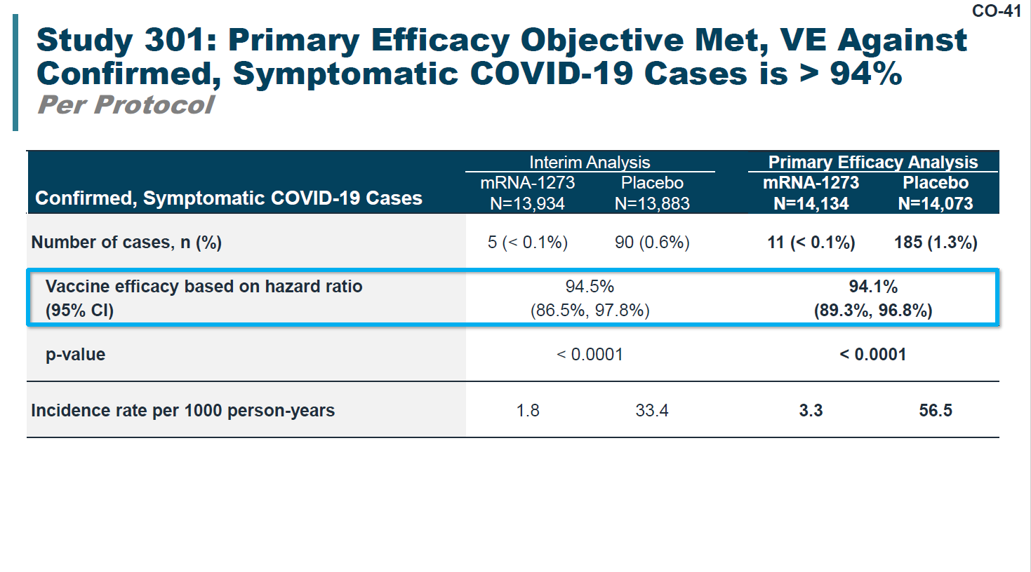
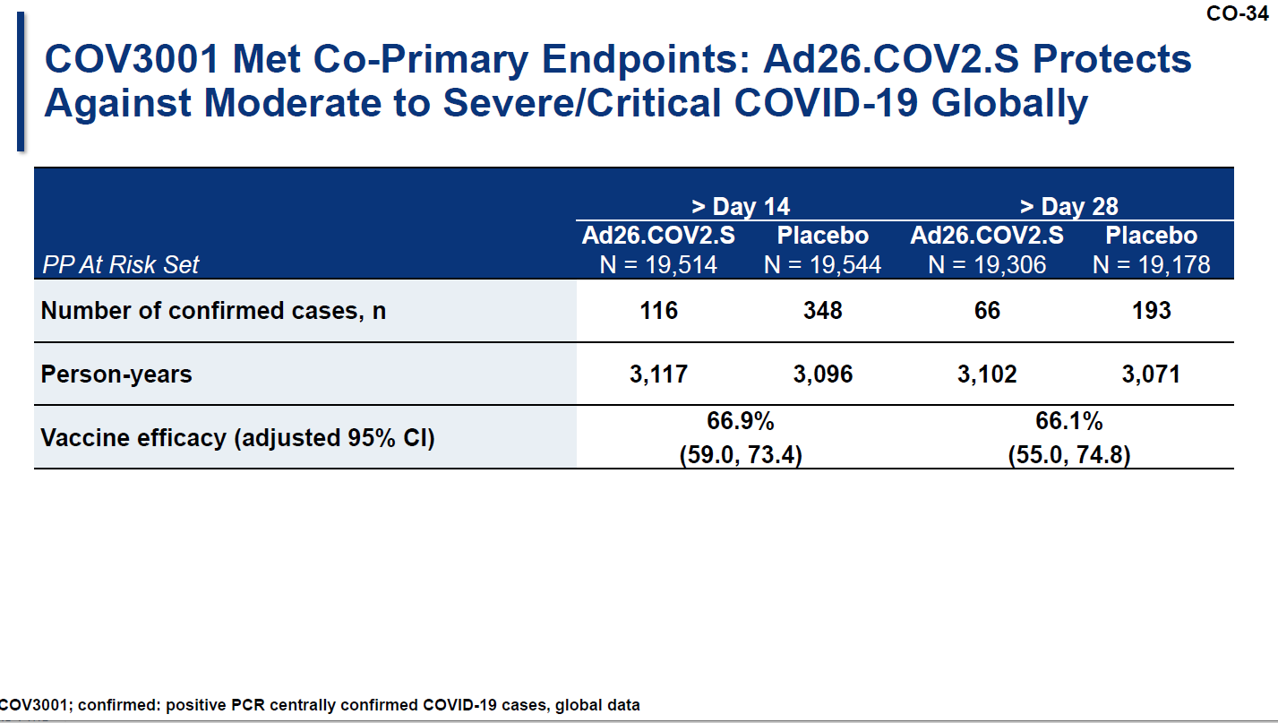
Primary Efficacy Objectives
Moderna
SPIKEVAX (COVID-19 Vaccine, mRNA)
Janssen
COVID-19 Vaccine (Ad26 COV2.S)
https://www.fda.gov/advisory-committees/advisory-committee-calendar/vaccines-and-related-biological-products-advisory-committee-december-17-2020-meeting-announcement
https://www.fda.gov/advisory-committees/advisory-committee-calendar/vaccines-and-related-biological-products-advisory-committee-february-26-2021-meeting-announcement

Slide 30
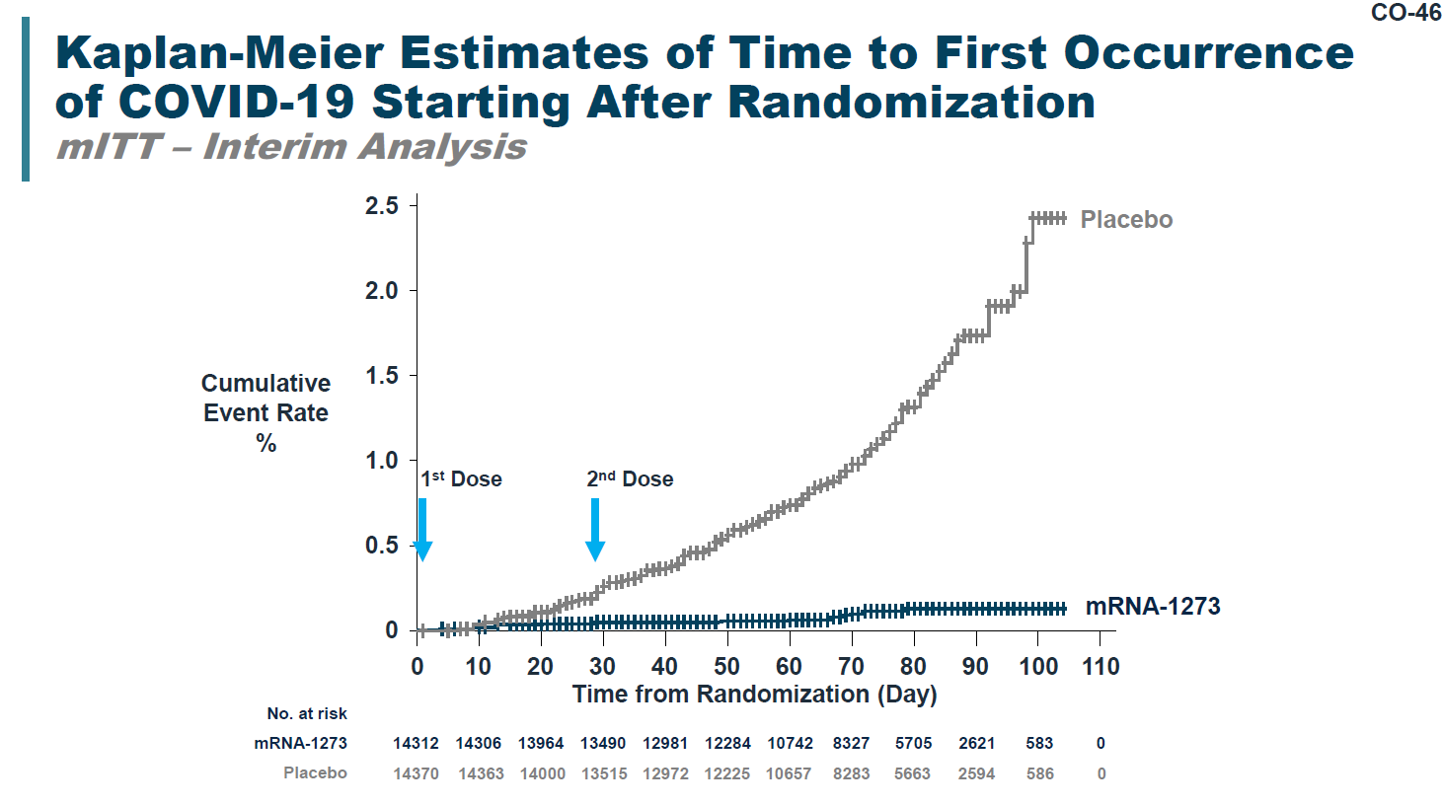
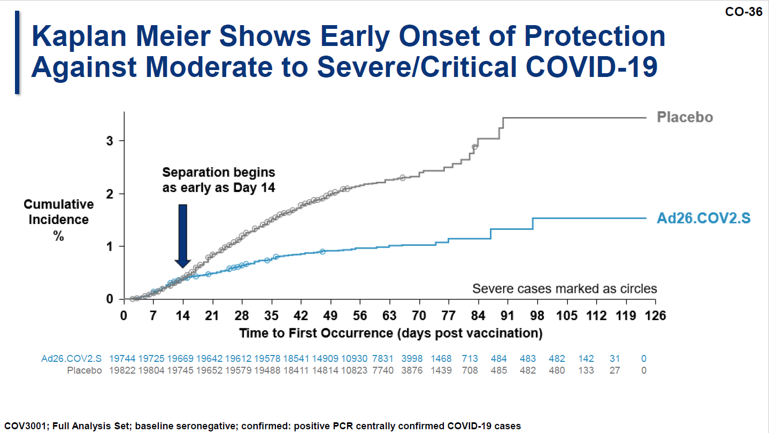
Primary Endpoint Analysis
Moderna
SPIKEVAX (COVID-19 Vaccine, mRNA)
Janssen
COVID-19 Vaccine (Ad26 COV2.S)
https://www.fda.gov/advisory-committees/advisory-committee-calendar/vaccines-and-related-biological-products-advisory-committee-december-17-2020-meeting-announcement
https://www.fda.gov/advisory-committees/advisory-committee-calendar/vaccines-and-related-biological-products-advisory-committee-february-26-2021-meeting-announcement

Slide 31
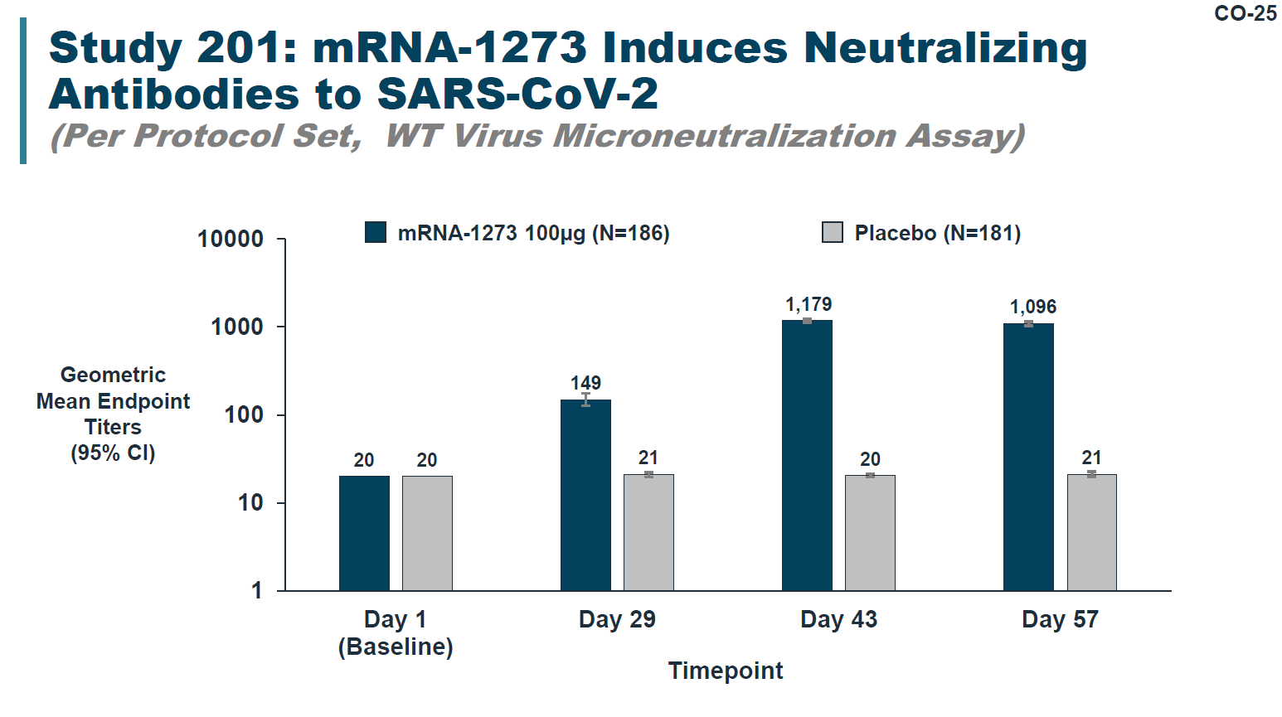
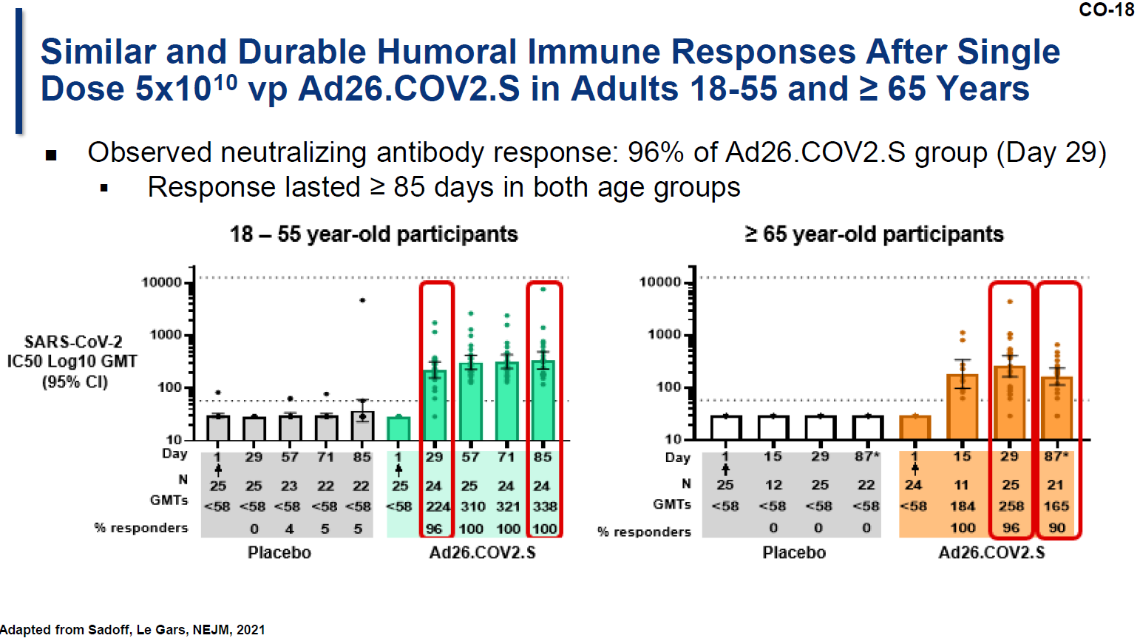
Immunogenicity Analysis
Moderna
SPIKEVAX (COVID-19 Vaccine, mRNA)
Janssen
COVID-19 Vaccine (Ad26 COV2.S)
https://www.fda.gov/advisory-committees/advisory-committee-calendar/vaccines-and-related-biological-products-advisory-committee-december-17-2020-meeting-announcement
https://www.fda.gov/advisory-committees/advisory-committee-calendar/vaccines-and-related-biological-products-advisory-committee-february-26-2021-meeting-announcement

Slide 32
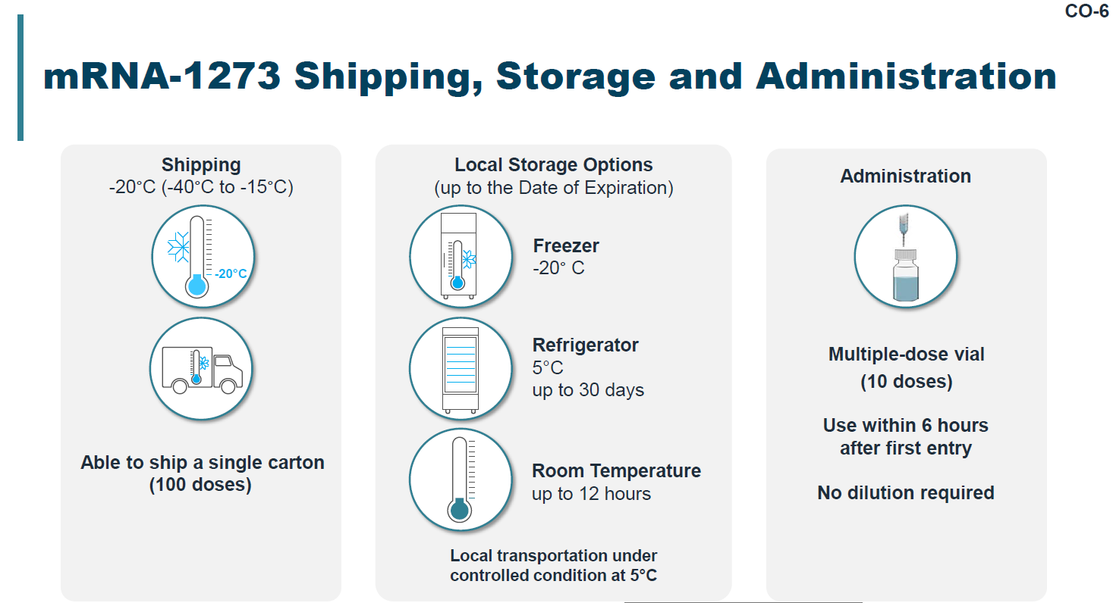
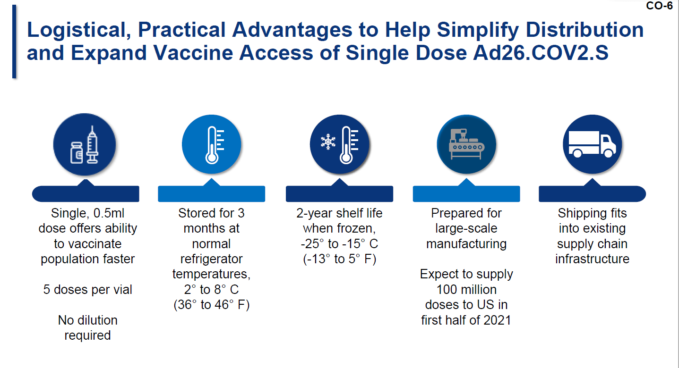
Logistics
Moderna
SPIKEVAX (COVID-19 Vaccine, mRNA)
Janssen
COVID-19 Vaccine (Ad26 COV2.S)
https://www.fda.gov/advisory-committees/advisory-committee-calendar/vaccines-and-related-biological-products-advisory-committee-december-17-2020-meeting-announcement
https://www.fda.gov/advisory-committees/advisory-committee-calendar/vaccines-and-related-biological-products-advisory-committee-february-26-2021-meeting-announcement

Slide 33
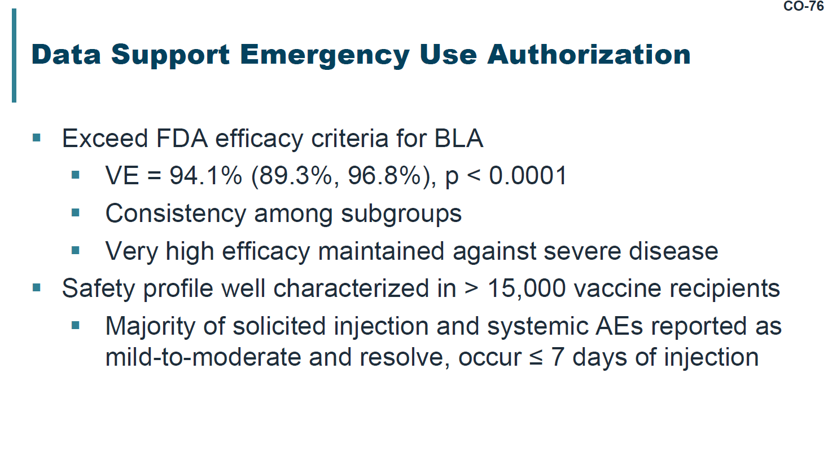
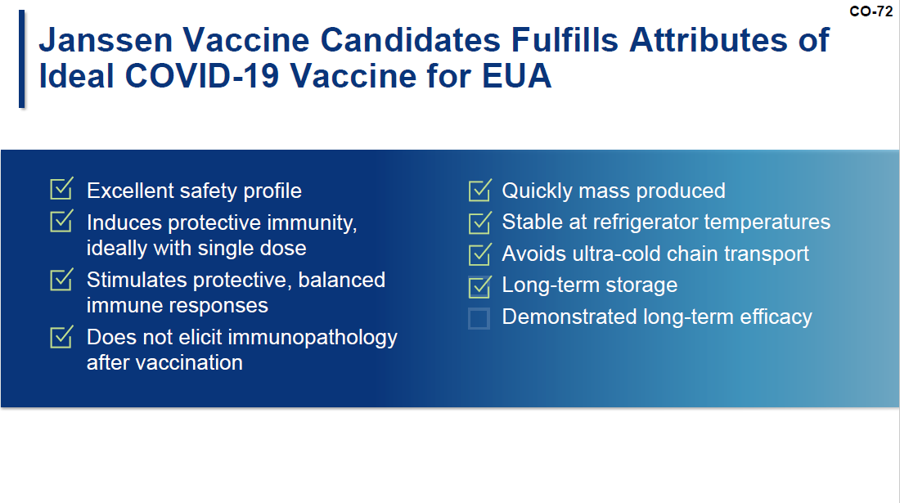
EUA Summary
Moderna
SPIKEVAX (COVID-19 Vaccine, mRNA)
Janssen
COVID-19 Vaccine (Ad26 COV2.S)
https://www.fda.gov/advisory-committees/advisory-committee-calendar/vaccines-and-related-biological-products-advisory-committee-december-17-2020-meeting-announcement
https://www.fda.gov/advisory-committees/advisory-committee-calendar/vaccines-and-related-biological-products-advisory-committee-february-26-2021-meeting-announcement

Slide 34
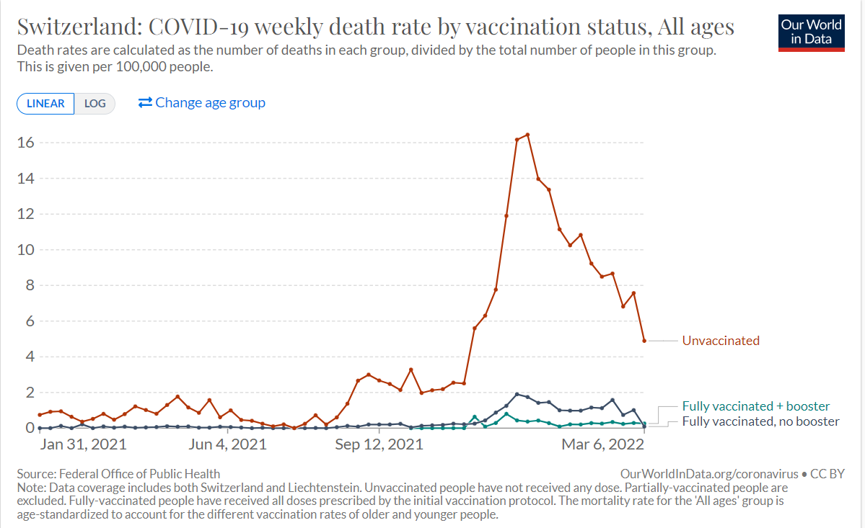
Effect of Vaccination on Death Rates

Slide 35
Addressing End to End Solutions
Situational Awareness/Recognize
Design
Production
Administration
Identify/ Characterize
Validation
Distribution
Notes:
- Across BARDA, we will remain focused on integrated, end-to-end solutions for our medical countermeasure enterprise.
- Again, it is not only the safety and efficacy of the MCMs we develop, but also our ability to get them to the patients in need quickly enough.
- For all of the advances made in science and healthcare, it STILL takes too long to identify, inform and respond to emerging threats.
Our strategies will focus on
Early awareness to empower patients and healthcare providers with actional data,
Tools and technology to accelerate our ability to develop and produce new medicines
And innovation to ensure that everyone has access to lifesaving medicines when and where they are needed.

Slide 36
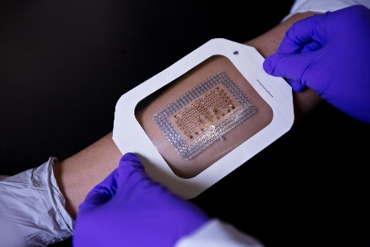
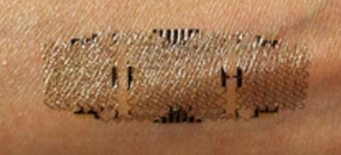


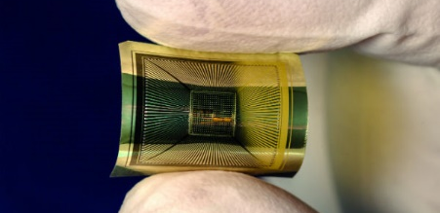

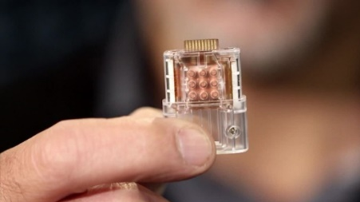
Vaccines and Future Vaccination Technologies
TECHNOLOGIES TO IMPROVE:
Production
Distribution
Delivery/
Administration

Slide 37






Early Detection: Home-Diagnostics & Wearable Devices
FLU OUTBREAK IN YOUR AREA DETECTED
WARNING:
FLU DETECTED
XYZ NEWS
WARNING
Flu
Detected
BREAKING NEWS!

Slide 38


Novel H7N9 Detected!
H7N9
Notes:
https://www.fludb.org/brc/structureOperation.spg?accession=4LN3&proteinid=2799512#
A/Shanghai/02/2013 structure taken from the Influenza Research Database

Slide 39

It’s All Connected: Areas for Greatest Impact
Global collaboration
Simplify and regionalize medical countermeasure production
Local/Community/Hospital Preparedness and Exercises
Empower the individual with tools and information

Slide 40




Thank you
To learn more follow us:
@PPI_Insights
@PPI_Insights
The Pandemic Prevention Institute

