Slide 1
NIPT: Laboratory Experience
Anami Patel, Ph.D
Poplar Healthcare, Memphis, TN
March 30, 2018

Slide 2
OBJECTIVES
Prenatal testing paradigm shift
NIPT overview
PHC Experience

Slide 3
1959
Cause of Down syndrome elucidated by Lejeune
1966
Chromosomal analysis of cultured cells from amniotic fluid
1979
Analysis of nucleated fetal cells in maternal blood
1997
Lo et al report successful detection of fetal cfDNA in maternal blood, sex determination
2000
Diagnosis of myotonic dystrophy based on testing of cffDNA
2002
RhD determination based on testing of cfDNA
2008
Enrichment of chr21 sequences in maternal plasma with triploid fetuses
1st application of NGS to cffDNA analysis
2011
1st clinical large scale trial of using MPS in diagnosis of trisomy 21
2012
Several large scale reports of >99% accuracy for detection of Ts21 using MPS
2013
Over 100,000 NIPT performed worldwide

Slide 4
What is Non-invasive Prenatal Testing (NIPT)?
NIPT is a DNA test on maternal blood to screen pregnancies for the most common fetal chromosome anomalies: trisomy 21 (Down syndrome), trisomy 18 (Edwards syndrome) and trisomy 13 (Patau syndrome). Also the sex of the fetus is determined.¹
The first NIPT was developed in 2011 by Sequenom-MaterniT21²
ACOG/SMFM state “…any patient may choose cell-free DNA analysis as a screening strategy for common aneuploidies, regardless of her risk status…”³
ACMG recommendation is that all women be informed that NIPS is the most sensitive screening option for commonly screened for aneuploidies...⁴
Note: NIPT testing is currently available via lab-developed tests and have not been cleared or approved by the FDA.
1. www.downsyndromenipt.info/?lang=en Accessed 9/23/16 2. http://www.downsyndromeprenataltesting.com/three-years-on-what-have-we-learned-about-non-invasive-prenatal-screening/ accessed 9/23/16 3. ACOG Committee on Practice Bulletin No.640. Sept. 2015 4. ACMG Statement, GREGG et al Noninvasive prenatal screening for fetal aneuploidy: 2016 update
Notes:
4

Slide 5
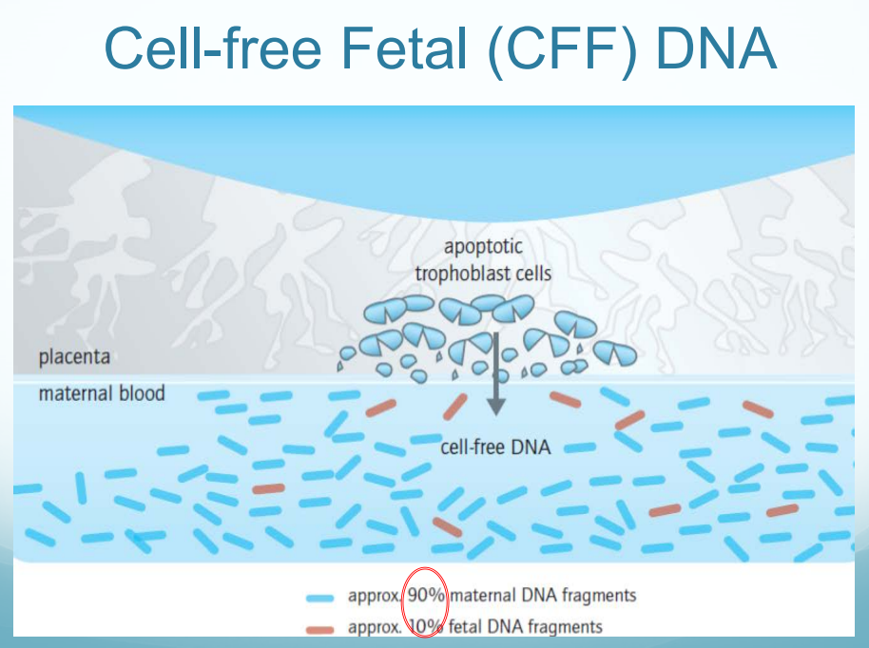
http://ftp.cdc.gov/pub/CLIAC_meeting_presentations/pdf/Addenda/cliac1115/10_Bellcross_Genetics_NIPS_CLIAC_Nov2015.pdf

Slide 6
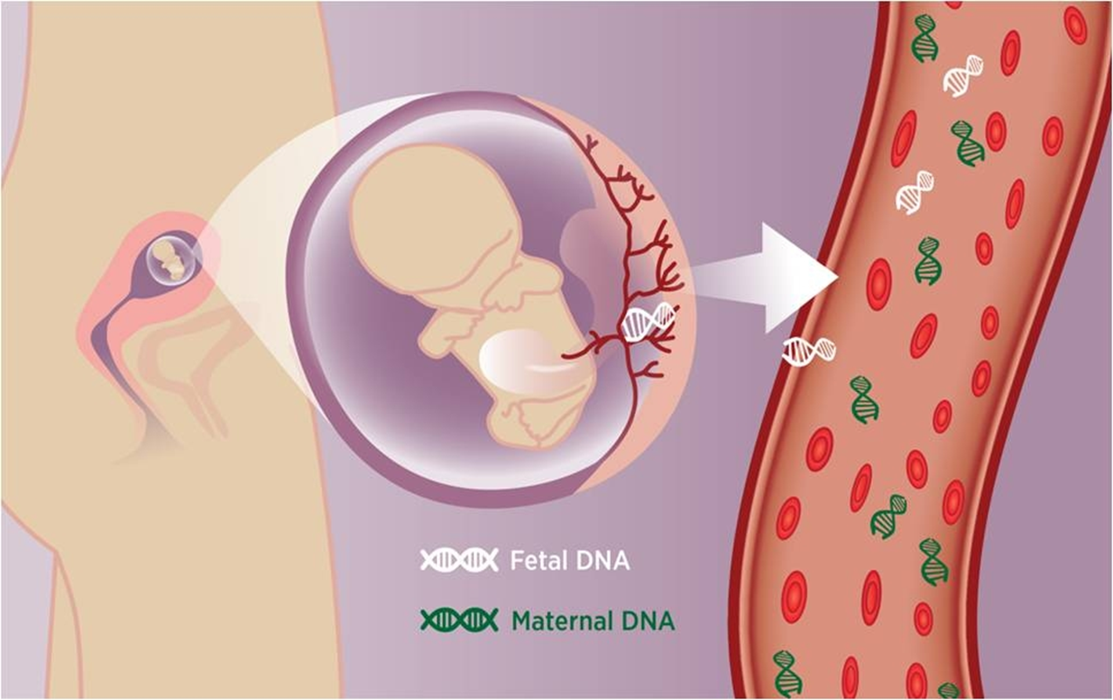
http://www.tmrblog.com/2015/05/global-non-invasive-prenatal-testing.html

Slide 7
NIPT or NIPS?
NIPS = Non-Invasive Prenatal Screening (cffDNA)
NIPT = Non-Invasive Prenatal Testing
NIPD = Non-Invasive Prenatal Diagnosis
“ …. Is a screening test that utilizes cfDNA in maternal serum to determine the probability of certain chromosome conditions in a pregnancy.”
Not to be confused with “Preimplantation Genetic Screening” (PGS)!

Slide 8
NIPT: Clinical Demand & Perspective
It is not the holy grail of prenatal testing, it is a screening test of placental DNA for high-risk populations.
Fewer invasive diagnostic procedure
Increasingly being covered by insurance

Slide 9
What we’ve learned about NIPS
Clinicians viewed as beneficial but cited concerns related to access: Financial & geographic access (counseling & testing)
Need for educational materials about Down syndrome for patients

Slide 10
Pre-test Counseling for cfDNA should include:
All genetic screening is optional and may be declined
cfDNA appears to be the most accurate screening test for trisomy 21
False positive and false negative results do occur with cfDNA
Confirmatory diagnostic testing is recommended for abnormal cfDNA results
Limitations of the test are explained
ACOG/SMFM Committee Opinion – “…any patient may choose cfDNA analysis as a screening strategy for common aneuploidies regardless of her risk status…”

Slide 11
Post-test Counseling:
If a positive NIPT result:
- Remember False Positives occur
- What is the PPV for this patient?
- Refer for genetic counseling
- Always offer invasive testing for confirmation
If parents decline invasive testing, postnatal confirmation should be completed
If a Negative NIPT result:
- Remember False Negatives occur – especially in higher risk pregnancies
- Always offer invasive testing if parents want to “know for sure”

Slide 13
Major NIPS Test Companies
Test/Company | Trisomies | Sex Chromosome Aneuploidy | Microdeletions | Technology | Result Reported
Harmony (Ariosa) | 21,18,13 | Yes | No | Targeted Sequencing/Array | High Risk, Low Risk
Panorama (Natera) | 21,18,13 | 45,X, 47,XXY, 47,XXX, 47,XYY | 22q11.2, 1p36 deletion, 5p, 15q11.2 | SNP via sequencing | High Risk, Low Risk
Verifi (Illumina) | 21,18,16,13,9 | 45,X, 47,XXY, 47,XXX, 47, XYY | 22q11.2, 1p36, 15q11.2, 5p, 4p | Genome wide sequencing | No Aneuploidy Detected, Not Detected or Suspected
MaterniT21 Plus (Sequenom) | 22,21,18,16,13 | 45,X, 47,XXY, 47,XXX, 47,XYY | 22q11.2, 1p36 deletion, 5p, 15q11.2, 4p, 8q, 11q | Genome wide sequencing | Positive, Negative, Additional Finding

Slide 14
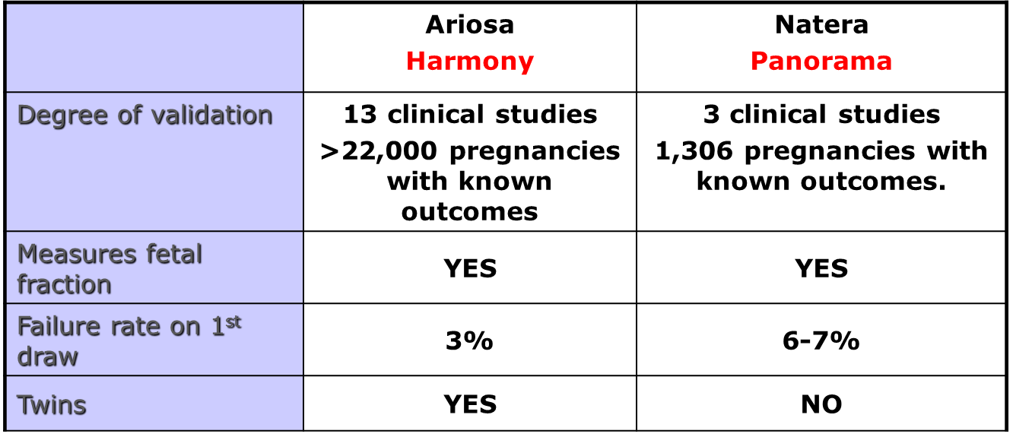
Comparison of Tests:

Slide 15
Harmony™ Prenatal Test
Combined Harmony Performance Across All Clinical Studies¹⁻¹⁰
Detection Rate
False Positive Rate
T21
(418 of 421) >99%
<0.1%
T18
(147 of 151) 97.4%
<0.1%
T13
(30 of 32) 93.8%
<0.1%
1. Sparks AB et al., Am J Obstet Gynecol. 2012 Apr;206(4):319.e1-9. 2. Ashoor G et al., Am J Obstet Gynecol. 2012 Apr;206(4):322.e1-5. 3. Verweij EJ et al., Prenat Diagn. 2013 Oct;33(10):996-1001. 4. Nicolaides KH et al., Am J Obstet Gynecol. 2012 Nov;207(5):374.e1-6. 5. Norton M et al., Am J Obstet Gynecol. 2012 Aug;207(2):137.e1-8. 6. Norton et al. N Engl J Med. 2015 Apr 23;372(17):1589-97. 7. Gil et al. Fetal Diagn Ther. 2014;35:204-11. 8. Juneau et al., Fetal Diagn Ther. 2014;36(4):282-6. 9. Ashoor G et al., Ultrasound Obstet Gynecol. 2013 Jan;41(1):21-5. 10. Stokowski et al. Prenat Diagn. 2015 35: 1243–1246.
Notes:
15

Slide 16
Differentiate Harmony from Competitors
Harmony uses propriety, targeted DNA-based technology DANSR™ and FORTE™. It targets DNA fragments from the specific chromosomes of interest, allowing for deeper analysis and clear results.
Harmony both accurately measures and incorporate the amount of fetal DNA in the assessment, which delivers exceptional accuracy with a detection rate of >99%.¹
Harmony is extensively validated in all women, regardless of age or risk*. The NEXT Study², a blinded prospective head-to-head comparison study, included pregnancies of women in the low-risk and high-risk population.
Harmony may minimize anxiety and invasive procedures by delivering clear information about trisomy 21 risk.
1. Stokowski et al. Prenat Diagn. 2015 35: 1243–1246 2. Norton et al. N Engl J Med. 2015 Apr 23;372(17):1589-97
Age is defined as both under 35 and over 35 age groups; studies have included women ages 18-48
Notes:
Just like with cobas we do not want to give the competition air time. We have created specific messaging that will help when you are in the field talking to clinicians. The marketing brochure will help you deliver the messages.
When discussing Harmony’s technology utilize the illustration in the marketing brochure to leverage the assay design. The image shows cell-free DNA in Blood and how it is analyzed with different approaches. MaterniT21 analyzes random fragments from all chromosomes and Harmony (DANSR) targets specific chromosomes 21, 18, 13 and analyzes those fragments. The directed approach is a much deeper analysis of the cell-free DNA providing confidence in the test results.
Fetal DNA measurement is needed to ensure proper performance of any non-invasive prenatal test. Harmony not only measures fetal fraction and distinguishes between high and low risk results, it also provides the clinician with the percentage of fetal cell-free DNA. Harmony also provides clinicians with individual risk scores which is recommended by ACOG and SMFM. This is not done with the MaterniT21 Test.
Harmony validated in pregnant women of all ages (both under 35 and over 35 age groups, studies have included women ages 18-48). While not yet recommended for all patients ACOG and SMFM acknowledge that any patient may choose cell-free DNA analysis as a screening strategy for common aneuploidies regardless of her risk status…
Benefits of Harmony, review final bullet point. (NEXT SLIDE)
16

Slide 17
Harmony™ Prenatal Test
Unique Methodology
DANSRTM
FORTETM
(Digital ANalysis of Selected Regions)
(Fetal-fraction Optimized Risk of Trisomy Evaluation)
Targeted DNA assay
Targeting chromosomes of interest allows for deeper analysis¹
Accurately measures fetal DNA amount using SNPs¹
Incorporates:
Chromosome quantification
Fetal DNA amount
Maternal age
Gestational age
Individualized risk score
1. Sparks et al. Prenat Diagn. 2012 Jan;32(1):3-9. 2. Sparks et al. Am J Obstet Gynecol. 2012 Apr;206(4):319.e1-9.
Notes:
The two distinguishing features of the Harmony test allow us to measure, report, and incorporate the fetal fraction:
DANSR (Digital ANalysis of Selected Regions) – directed cfDNA assay that focuses on the chromosomes of interest (13, 18, 21, X, and Y). As compared to other methods of cfDNA testing (such as massively parallel shotgun sequencing, MPSS), DANSR is more efficient and allows for deeper sequencing on the chromosomes of interest. It also provides a highly accurate measurement of fetal fraction (percentage of cfDNA in the sample that originates from the pregnancy).
FORTE (Fetal-fraction Optimized Risk of Trisomy Evaluation) – algorithm that incorporates chromosome counts, fetal fraction, maternal age and gestational age in order to provide an individualized risk score for each patient.
17

Slide 18
Counting methodologies Counted vs. expected HARMONY
= Maternal DNA from chr. 21
= Fetal DNA from chr. 21
Unaffected pregnancy
Pregnancy with Trisomy 21
~ 10% of cfDNA in maternal blood is fetal (placental)
The difference in the amount of DNA in an unaffected pregnancy vs an affected pregnancy is small: 21/20 = 1.05

Slide 19
Harmony Test:
Can be ordered for any patient as early as 10 weeks
High accuracy, low false-positive rate compared to traditional screening test
Designed to assess risk for trisomy 21, 18, and 13 and sex chromosome aneuploidy only. Does not detect all genetic defects!
Patients who desire definitive information about chromosome conditions in their pregnancy should be offered the option of amniocentesis or CVS
Confirmatory diagnostic testing is recommended for abnormal cfDNA results
A negative cfDNA result indicates a decreased risk and does not definitively rule out chromosome conditions
cfDNA screening may not yield a result (inconclusive), which may indicate an increased risk for a chromosome condition
cfDNA does not evaluate for all chromosome conditions
Limitations of the test are explained

Slide 20
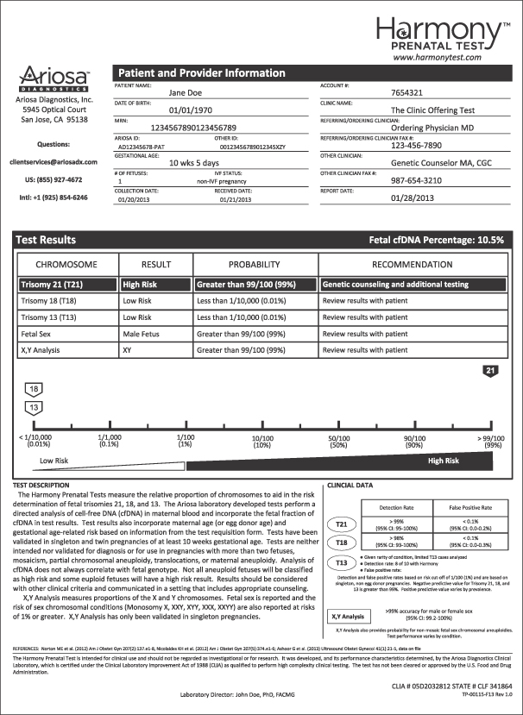

Slide 21
General limitations from ACOG:

Slide 22
ACOG / SMFM – September 2015
“…conventional screening methods remain the most appropriate choice for first-line screening for most women in the general obstetric population…”
“…any patient may choose cell-free DNA analysis as a screening strategy for common aneuploidies, regardless of her risk status…”
“…routine cell-free DNA screening for microdeletion syndromes should not be performed…”
“…cell-free DNA screening is not recommended for women with multiple gestations…”
“…the amount of the cell-free DNA is the maternal blood that is of fetal origin, is essential for accurate test results.”
Key Takeaway: While not yet recommended for all patients as a first-line option, the committee opinion does acknowledge that patients of any risk group may choose non-invasive cfDNA-based prenatal screening for common aneuploidies.
Source: ACOG Committee on Practice Bulletin No.640. Sept. 2015
Notes:
22

Slide 23
ISPD Position Statement – April 2015
“…cell-free DNA screening “as a primary test offered to all pregnant women” is an “appropriate” protocol option…”
Key Takeaway: Supports Harmony key message – Harmony Prenatal Test is validated for use in pregnant women, of any age (both under 35 and over 35 age group, studies have included women ages 18-48) or risk category, to access the likelihood of fetal trisomies 21, 18, 13.
Source: Aneuploidy Screening Committee on behalf of the ISPD Board of Directors; April 2015
Notes:
23

Slide 24
ACMG Statement – June 2016
“ACMG recommends informing all pregnant women that NIPS is the most sensitive screening option for traditionally screened aneuploidies (i.e. Patau, Edwards, and Down syndromes.)”
All laboratories should include a clearly visible fetal fraction on NIPS reports.”
Key Takeaway: All patients should be presented with NIPS as a screening option, in the NEXT study women in both the average and high-risk population had NIPS. Harmony measures, reports, and incorporates fetal fraction into the risk score. We have always insisted that fetal fraction is a crucial quality metric and it is now supported by ACMG and ACOG.
Source: ACMG Statement, GREGG et al Noninvasive prenatal screening for fetal aneuploidy: 2016 update
Notes:
24

Slide 25
False Negative NIPS:
- Too little fetal DNA (usually reported as failed)
- Mosaicism confined to the fetus
False Positive NIPS:
- Placental mosaicism
- Vanishing twin
- Maternal sex chromosome abnormality
- Neoplasia – apoptosis of cancer cells, aneuploidy common

Slide 26
Take home messages
NIPT is no longer a “research” tool
NIPT is performed from cell-free fetal DNA
Validated applications:
- Trisomies 13, 18 and 21 in high-risk women
- Second-line test after positive screening
More research needed for screening in low risk women/integration with existing screening strategies
Does not “replace” the accuracy and precision of invasive testing

Slide 27
Why clinicians are demanding NIPT?
Literature research: e.g. The overwhelming majority of a cohort of 1,003 pregnant women considered prenatal examinations good. Moreover, the majority had a positive attitude towards NIPT and would like to use the test if available.
PHC Women’s Health: Addition of NIPT along with CF testing
Send testing to Ariosa, internalize NIPT testing at PHC
Harmony technology & Roche support/relationship, IVD status!

Slide 28
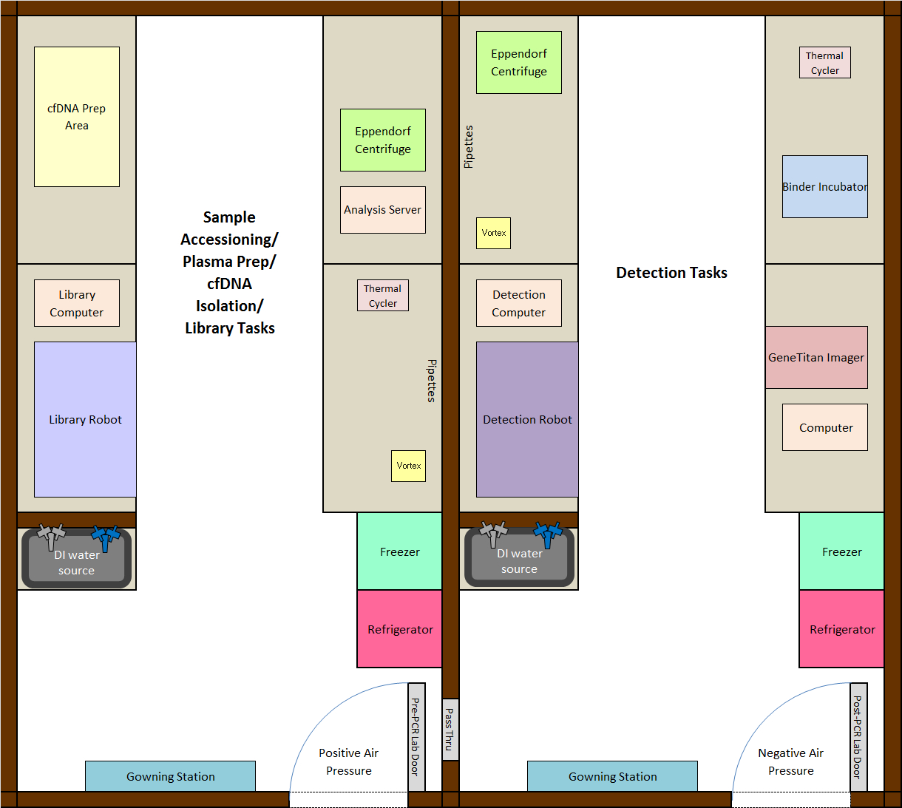
Suggested Laboratory Setup
Dedicated Pre & Post-PCR rooms
Pre-PCR Lab: Positive Air Pressure
Post-PCR Lab: Negative Air Pressure
Required for both areas:
- DI water (dedicated in both areas)
- Lab Temp: 68F – 75F
- Air is not shared with office space
- Manual defrost fridge & freezer

Slide 29
Thank you!
5TH Annual Robert and Jean Adam’s Foundation CLS symposium

