Slide 1
AUM WARHAWK
MENTOR COLLECTIVE
2020-21
mentorcollective.org

Slide 2
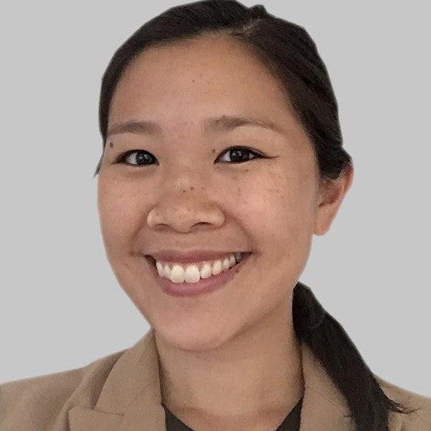
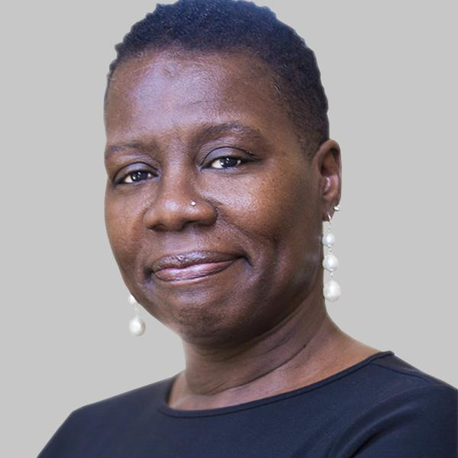
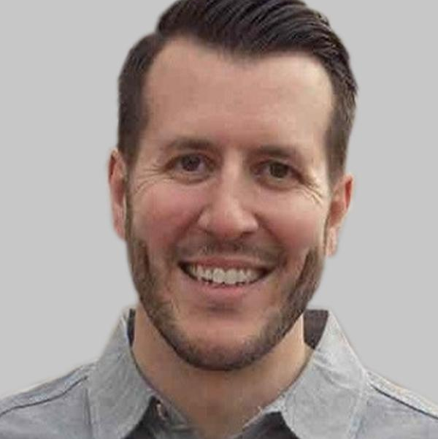
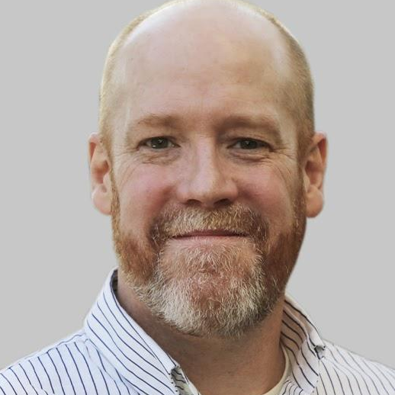
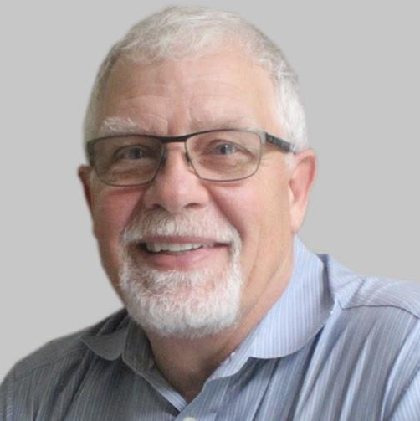
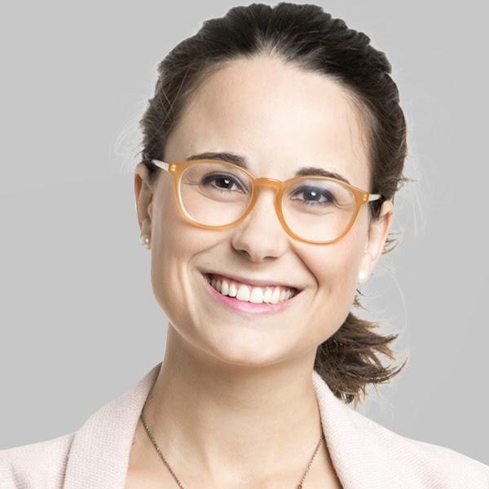
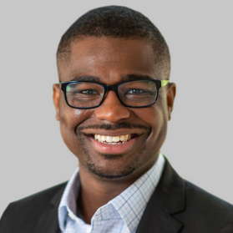
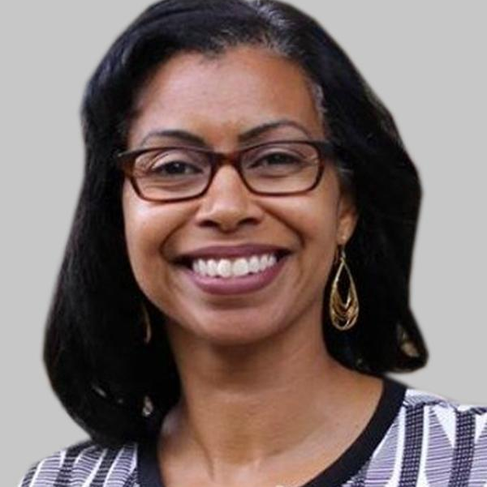
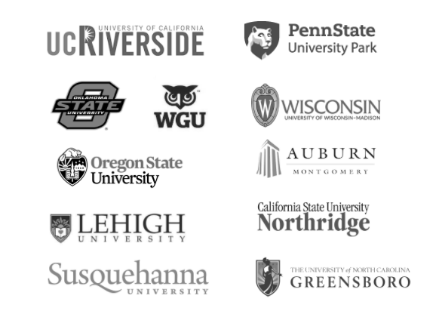
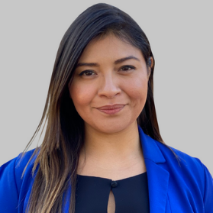
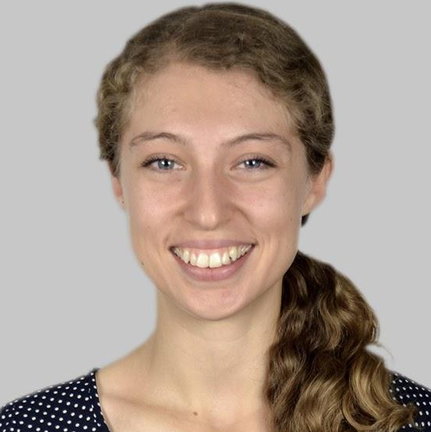
Mentorship Experts • Partner Institutions • Mentorship Scholars & Institutes • Mission-Aligned Investors
A Collective Mission
A group of Higher Education leaders and institutions dedicated to making life-changing relationships a feature of every student’s college experience.
100+ Partners
© Mentor Collective 2021 All Rights Reserved
‹#›

Slide 3
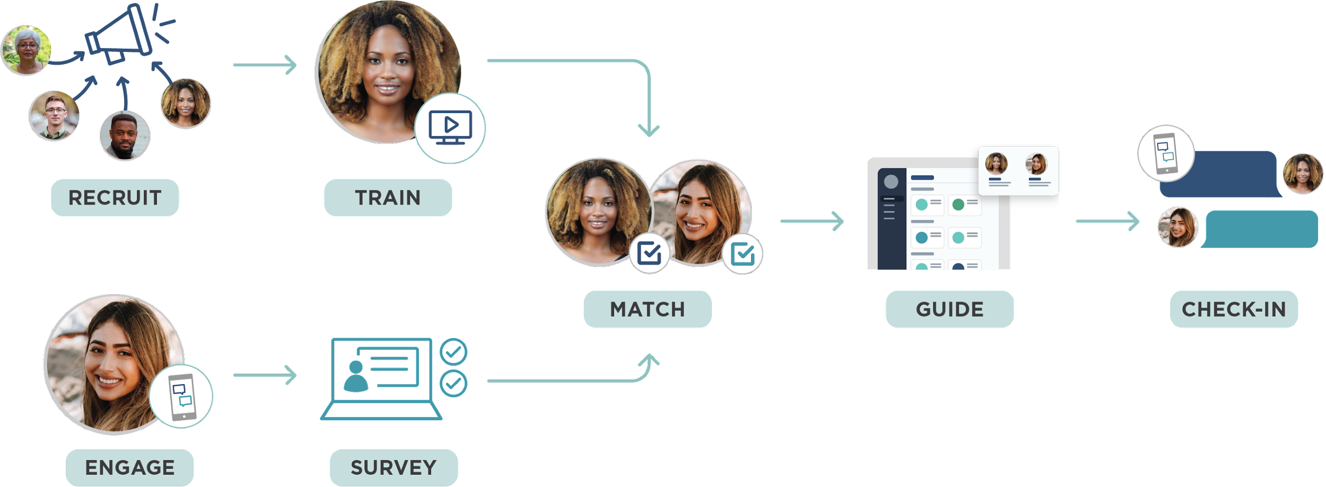
Program Operations
© Mentor Collective 2021 All Rights Reserved
‹#›

Slide 4
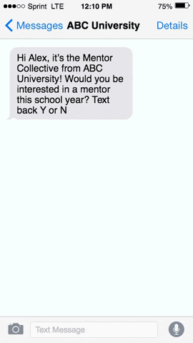
Mentor Recruitment Design
Mentor Collective program experts work with you to establish your goals, define your target audience, and design your recruitment campaigns.
Mentor recruitment services are delivered via multiple channels to achieve highest engagement levels.
Field-tested email and text messaging campaigns
A/B-tested messaging to increase engagement
Mentor Collective monitors and adjusts your campaigns to ensure maximum effectiveness and desired results
Mentors receive a Linkedin certification upon training completion
Coaching & Advising
Mentor recruitment services are fully designed, automated, and supported by the Mentor Collective team.
Mentors can promote their important role to their networks with the MC LinkedIn certification.
MC’s Text Chatbot makes it easy to invite mentors, and for mentees to sign-up for the program.
© Mentor Collective 2021 All Rights Reserved
‹#›

Slide 5
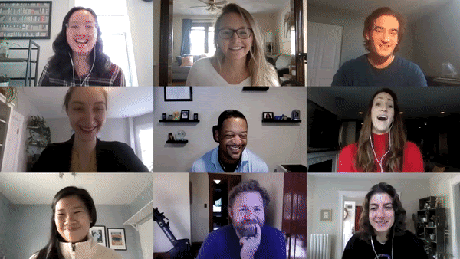
Equip Your Mentors for Mentee Success
Equipping mentors for mentee success
Synchronous and asynchronous trainings available
Synchronous formats are live webinars hosted by mentor training experts in 30+ time slots each week.
Training covers program expectations, logistics, self-efficacy and help-seeking behavior concepts, and how to best leverage Mentee Success Plans.
Coaching & Advising
In 2021, MC trainings will be certified by the Mentoring Institution at the University of New Mexico
© Mentor Collective 2021 All Rights Reserved
‹#›

Slide 6
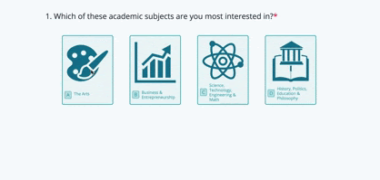
Make a Relevant Match
MC’s matching surveys, taken by both mentees and mentors, are unique to specific program design goals.
Most importantly, our process gives agency to the mentee in determining what they want most in a mentor.
Unlike standard software alone, MC uses a unique model of both algorithms and matching specialists to establish the strongest possible matches.
Coaching & Advising
© Mentor Collective 2021 All Rights Reserved
‹#›

Slide 7
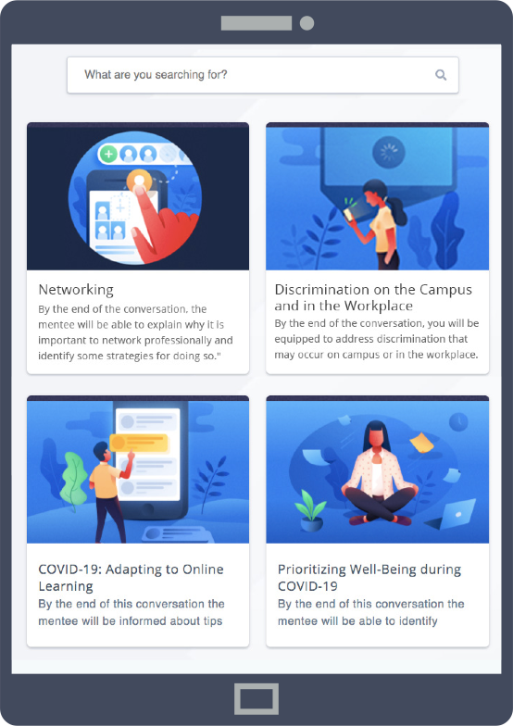
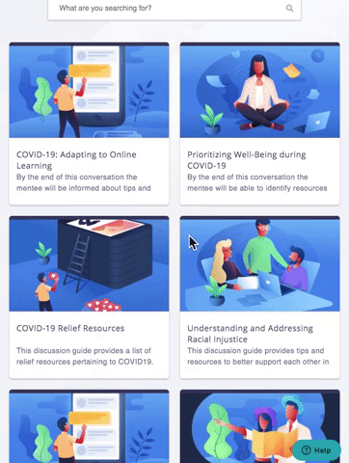
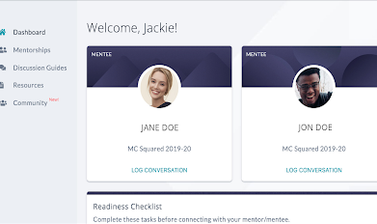
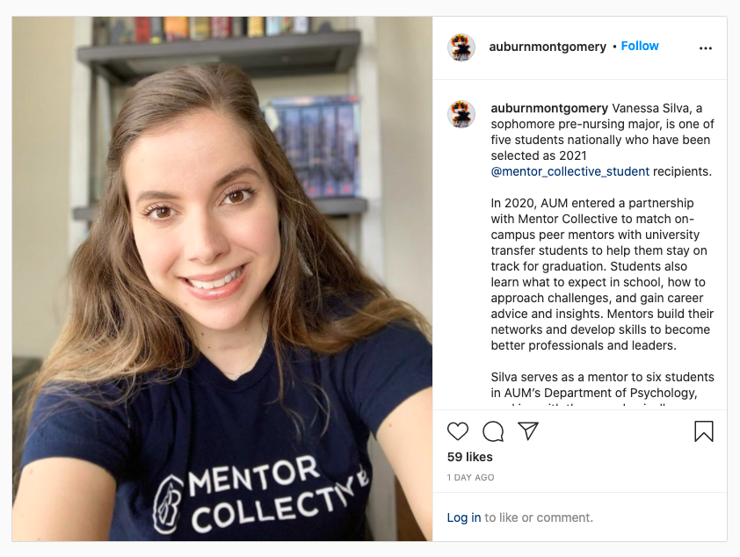
Engagement Platform & Community Building
Accessible by any device, the Mentee/Mentor Platform equips mentees and mentors with the info they need to learn more about each other, access to resources such as discussion guides, opportunities to connect with our mentorship community and more.
Coaching & Advising
How MC helps build community for your program:
Facilitate a Facebook Group
Community of Trained Mentors on LinkedIn
Ambassador program
Scholarship program
Mentor office hours
© Mentor Collective 2021 All Rights Reserved
‹#›

Slide 8
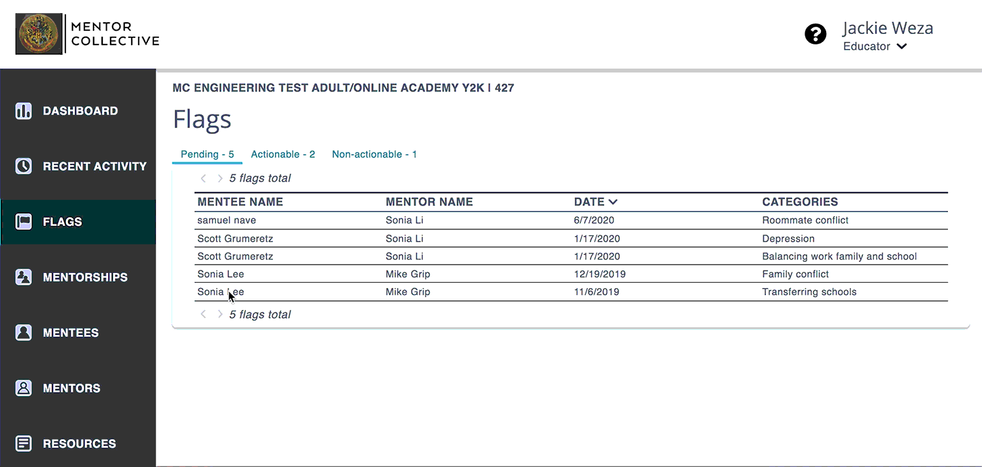
The Power Of Insight Flags
Insight Flags from mentors alert school leadership when a mentee is experiencing a serious challenge, such as housing insecurity, academics or financial stress.
With this real-time intel, you can:
Identify early warning signs for students and assign admins to be notified of these updates
Track actionable flags and follow-up actions
Coaching & Advising
© Mentor Collective 2021 All Rights Reserved
‹#›

Slide 9
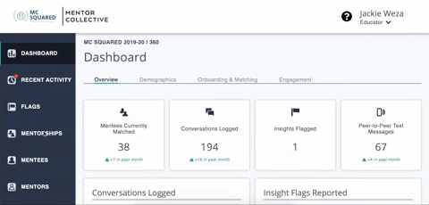
Impact And Outcomes: Real-time Reporting
The Educator Dashboard offers real time engagement tracking and reporting, with data you can use to make decisions
How many participants have signed up, taken their matching survey, trained, and matched?
How many conversations have mentees had?
How many Insight Flags have been shared by mentors?
What topics are being discussed?
Coaching & Advising
© Mentor Collective 2021 All Rights Reserved
‹#›

Slide 10
PROGRAM OVERVIEW

Slide 11
Reasons for Collaboration
Individualized Support. First-year and transfer students are matched with a peer mentor to support them in their first year at AUM.
Leadership Skill Development. Engage upperclass students in leadership roles on campus.
Building Connections. Connect students to AUM and to each other.
Impact on Outcomes. Improve 1st year retention and persistence rates.
‹#›
Notes:
We know that this is not really your territory, but you wanted to take it on because there’s a gap. Growing pains, you’re not built out to support these case loads. We are learning from this, because of your work, to better support students across the CSU system and across the country.

Slide 12
2020-21 Learnings Summary
The program is bringing desired social capital and increasing sense of belonging and retention by pairing first time students with upper-division mentors:
Higher engagement when compared to other first-year experience programs
48% of pairs reporting text conversations, compared to the MC benchmark of 42%
Mentees in the program were retained at a 2.3% higher rate than peers not in the program (Fall to Spring).
Both mentors and mentees are having a positive mentorship experience:
Participant’s high satisfaction has been demonstrated throughout the program via surveys and testimonials:
90.02% of matched mentees in the program reported high satisfaction (>=5 out of 7)
97.83% of matched mentors in the program reported high satisfaction (>=5 out of 7)
‹#›

Slide 13
Video from Lydia Cobb, Mentee
Lydia is currently matched with mentor: Bailey Arant
What is something your mentor has helped you with?: “He has encouraged me when I was stressed about classes/tests because he has done them before and understands how to help me understand the class.”
Thoughts from her mentor, Bailey: “I just want to make an impact and make it easier for someone who is just starting...I just want to help someone.”
‹#›

Slide 14
Program Usage
 | AUM 2020-21 | Benchmark*
Students matched | 480 38.74% of invited | 30.74% of invited
Mentors matched | 208 8.02% of invited | 6.17% of invited
Conversations logged* | 1,748 3.64 per mentorship | 4.19 per mentorship
% pairs logged 1+ conversation | 65.63% | 68.07%
% pairs logged 3+ conversations | 42.08% | 44.74%
% pairs using SMS relay* | 48.48% | 42.33%
Avg SMS exchanged per pair | 20.85 | 16.3
Insight Flags | 119 0.25 per mentorship | 0.12 per mentorship
Key Findings:
AUM students used the SMS relay more often than their peers in other programs.
More AUM students signed up for the program than in similar MC programs - both mentors and mentees.
AUM mentors are using the insight flag feature more often than mentors in similar MC programs.
*Conversations are self-reported by mentors and mentees. SMS relay usage is directly measured.
*Benchmark based on 93 first-year-experience Mentor Collective programs in 2020-21

Slide 15
Demographic Overview
 | Matched Mentees* | Matched Mentors*
Transfer Students | 53 11.40% of mentees | 78 36.11% of mentors
First Generation Students | 147 31.61% of mentees | 139 64.35% of mentors
Race Demographics
Hispanic/Latino | 9 1.94% of mentees | 13 6.02% of mentors
White (non-Hispanic) | 99 21.29% of mentees | 52 24.07% of mentors
Asian or Asian-American | 19 4.09% of mentees | 16 7.41% of mentors
Multiracial | 17 3.66% of mentees | 13 6.02% of mentors
Black/African-American | 230 49.46% of mentees | 118 54.63% of mentors
Key Findings:
More than ⅓ of mentors were transfer students.
Almost ⅔ of mentors were first-generation students.
Almost ⅓ of mentees were first-generation students.
Almost 50% of mentees and more than 50% of mentors identify as Black or African-American.
*This data is self reported, based on 465 matched mentees and 216 matched mentors.

Slide 16
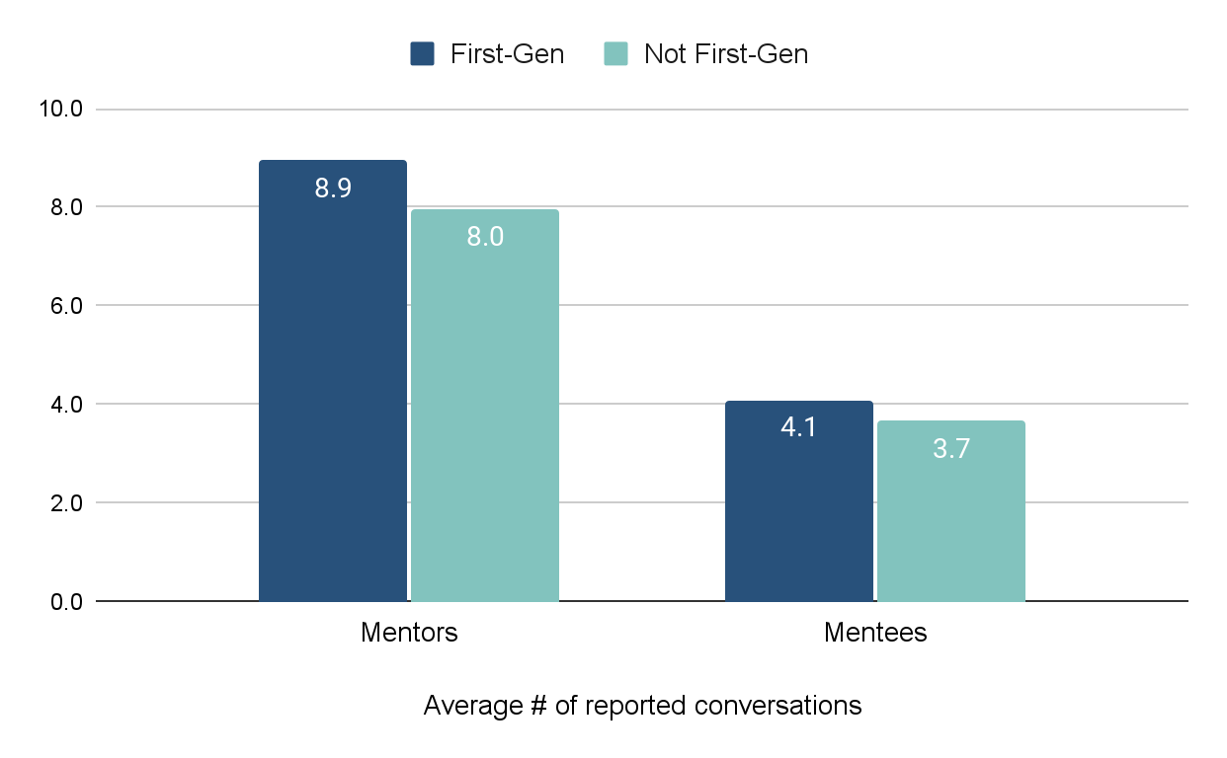
First Generation Student Engagement
8.9
average conversations reported by FG-identifying mentors
4.1
average conversations
reported by FG-identifying mentees
vs
vs
8.0
average conversations reported by non-FG-identifying mentors
3.7
average conversations
reported by non-FG-identifying mentees
First generation students are more engaged in mentorship than their peers.

Slide 17
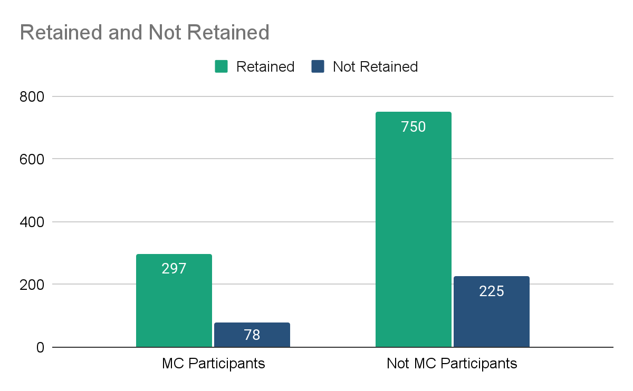
Fall to Spring Retention: 2020-21 Participants v. Non-Participants
Fall to Spring 2020-21 | Not retained | Retained | Grand Total
MC Participant | 78 (20.8%) | 297 (79.2%) | 375
Not MC Participant | 225 (22.4%) | 750 (77.6%) | 975
New students matched with a mentor were retained at a 2.3% higher rate than new students not matched with a mentor in 2020-21.
For the 2021-22 academic year, we have offered mentorship to incoming students sooner than we did in 2020-21, and hope to see the retention rate increase for mentored students. We will do a Fall to Fall retention analysis for this cohort in December.
*This data was provided by AUM’s Institutional Research team.

Slide 18
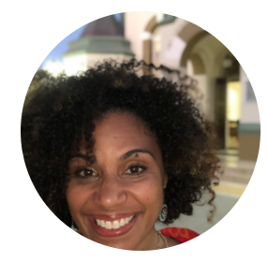
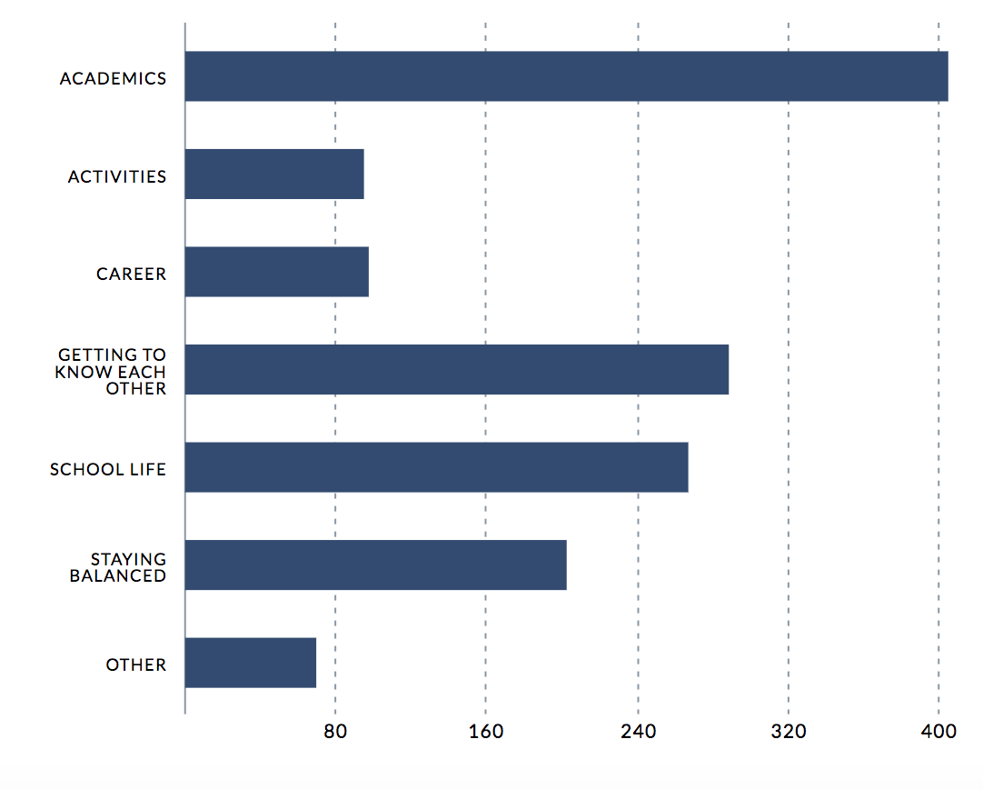
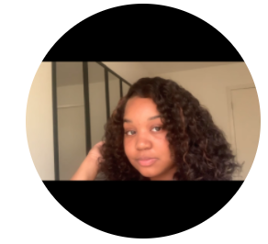
Conversation Reports and Trends
Conversation Topics Logged by Students
"[My mentor did not] necessarily [help with] a question, but it was nice to have common ground with a student who has experienced similar challenges." - mentee Naomi Higby about mentor, Carol Tyson
"Participating in this mentorship has brought me to love my school even more. This is such a good thing to be a part of, especially helping others." - mentor Tyranie Henderson about her mentorships with mentees Zekera Watts and Heath Horn

Slide 19
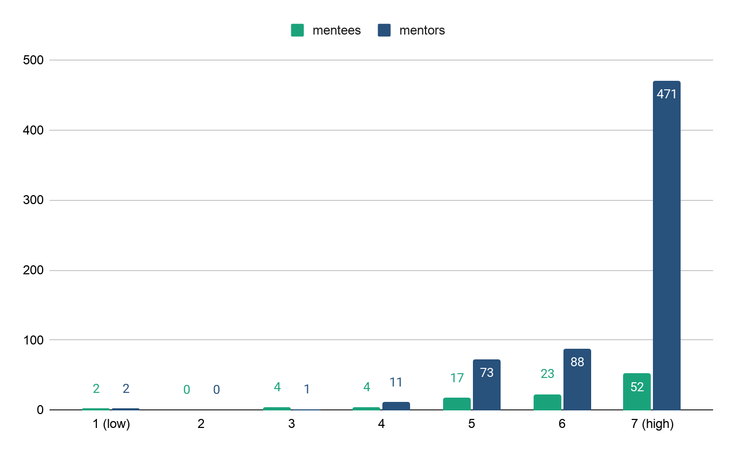
Mentee and Mentor Satisfaction - Conversation Reports (1-7 scale)
 | # respondents | # responses
Mentees | 61 | 102
Mentors | 134 | 646
What can we learn?
When asking mentors if they are enjoying their experience as a mentor, their average response is 6.56/7.
When asking mentees how likely it is that they would recommend this program to a peer/friend, their average response is 6.05/7.

Slide 20
Learnings from Insight Flags

Slide 21
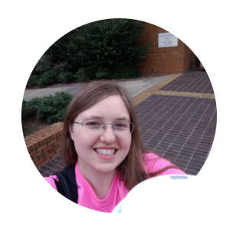
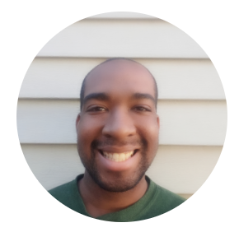
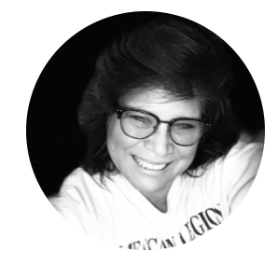
Early Alerts from Insight Flags
Note: mentors are trained to ask mentees for permission to share information with AUM before doing so.
“[My mentee] stated that she was in need of the contact info for any mental health resources that I knew of. I gave her the contact info for the Counselling Center here on campus. She also said she was struggling in math. I am giving her the info for tutoring services and some tips.” - Christina Buntyn, Mentor
“[My mentee] was struggling with sociology. He had surgery this semester and made some mistakes that may have affected his grade.” - Brendan Collins, Mentor
“[My mentee] is only taking a couple classes at a time due to finances. She rec'd a scholarship award, but still had to pay out of pocket. She is thankful for what she's got and doing well in her classes.” - Carol Tyson, Mentor

Slide 22
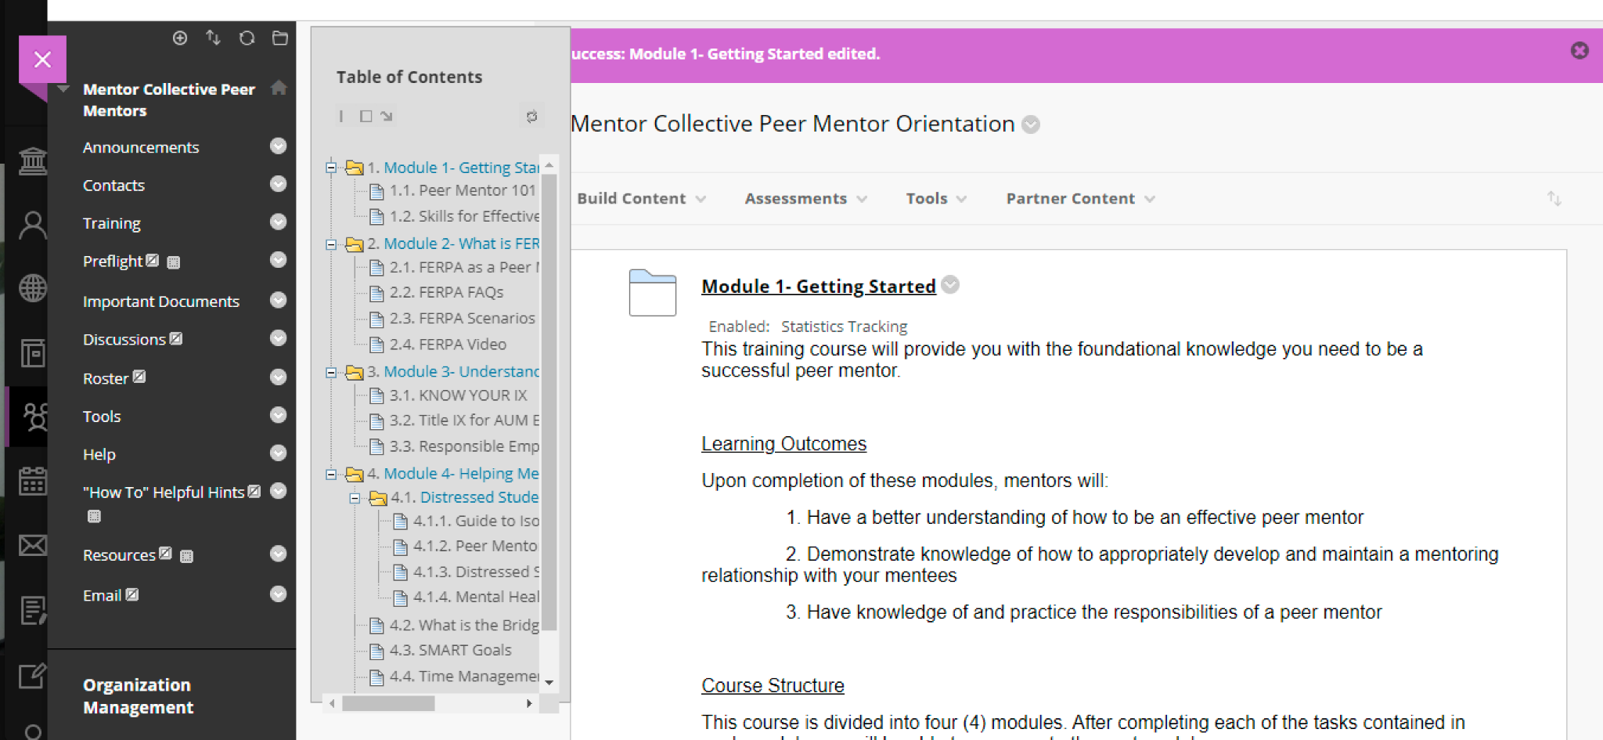
Blackboard Resource Page for Mentors
The chat feature will be available for mentors to reach me or one of our Student Success Mentors (faculty) during certain hours.

Slide 23
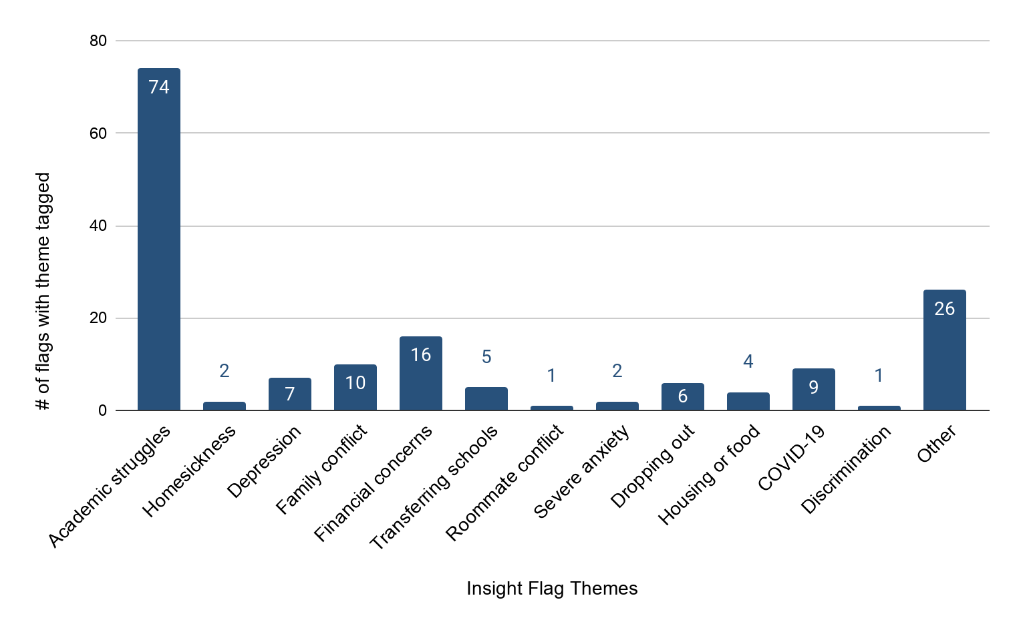
Early Alerts from Insight Flags
Key Findings:
The majority of insight flags were related to academic struggles.
“Other” is the second most flagged, and includes themes like health difficulties, deaths in the family, social struggles, language barriers, and being both a student and parent.
Financial concerns is the third highest flag, including themes around difficulties paying for classes, balancing work and school, and the inability to begin classes due to financial holds.
*Categories represented above reflect the options available to mentors in the insight flag form used to alert AUM.

Slide 24
In Their Own Words

Slide 25
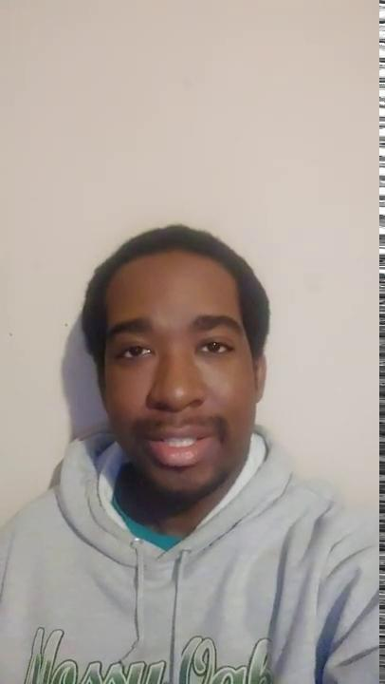
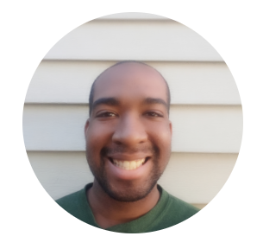
Video from Brendan Collins, Mentor
Brendan is currently supporting 1 mentee: Richard Wills
Why are you volunteering as a mentor?: “I want to volunteer as a mentor to be involved in community service and I think I would be able to give good advice.”
Thoughts from his mentee, Richard: “Just having someone to listen and talk too in itself is great!”
‹#›

Slide 26
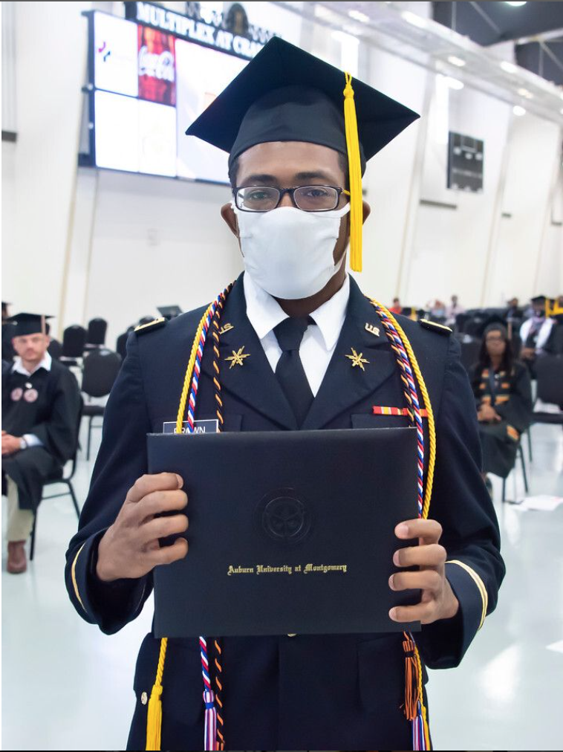
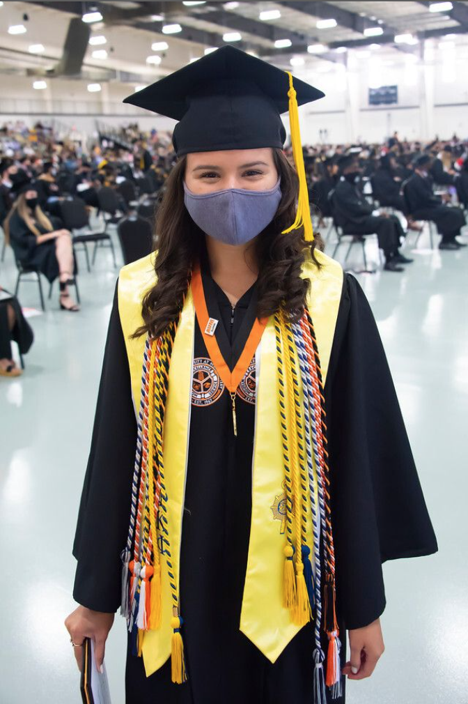
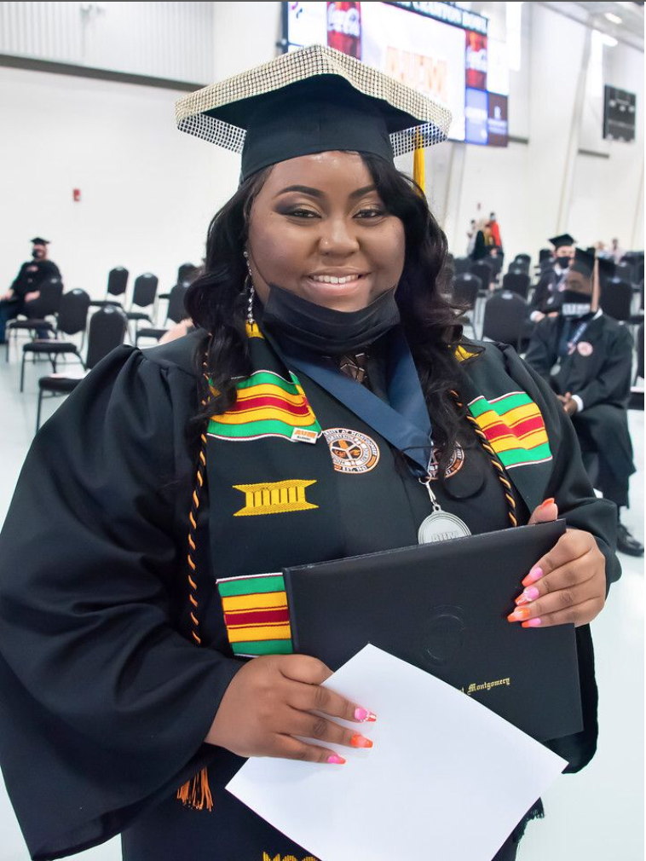
Cords for Graduating Mentors
This year, the AUM Warhawk MC team organized mentor cords for mentors who participated in the program.
For the 2021-22 academic year, we will be incentivizing mentor cords in an effort to increase engagement.
Mentors will be encouraged to reach out to their mentees at least once per week, and mentors who are graduating and meet their engagement criteria will receive mentor cords at commencement.
Highly-engaged mentors and mentees will also be invited to participate in the Ambassador and Scholarship Programs.
‹#›

Slide 27
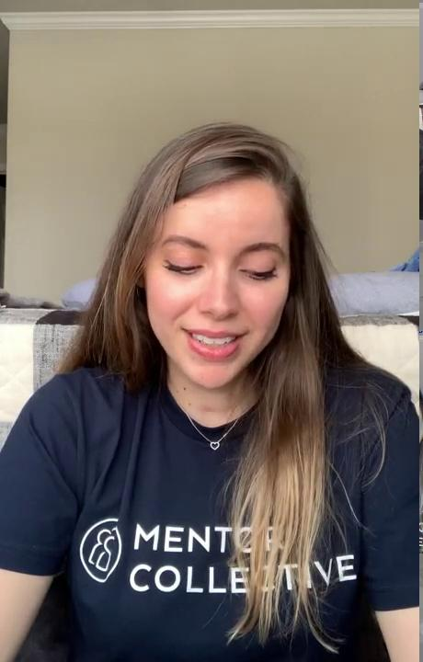
Mentor Collective Scholarship Winner: Vanessa de Alencar Silva
Mentor Collective hosts an annual scholarship contest for highly-engaged mentors and mentees in our programs.
Students are encouraged to submit a video about their experience in the program, such as the video here.
Vanessa is one of our 2020-21 Mentor Collective Scholarship winners!
‹#›

Slide 28
What is one question your mentor helped you answer?
"How to balance my work while grieving? Take some time to myself." - mentee Rayna Steward
“How do you keep a social life while also doing well in classes? She told me to try and join clubs or organizations around campus to meet more people. She also suggested taking a day as a sort of "mental help" day to focus on myself and my needs while not focusing heavily on coursework. Finally, she recommended me to try talking to people in my class even if it is something I would not normally do." - mentee Christopher Ennis
Mentee
Voice
“How to manage my classwork throughout the week? She talked about how she made a habit to check blackboard everyday to know about any assignments that week.” - mentee Ryan Medley
"Learning about campus. My mentor described campus locations to me." - mentee Mikayla Halley

Slide 29
What would you share with a friend interested in participating as a mentor?
"It is the best experience ever to be at the help of different students and help provide guidance." - mentor DaNidrah Carson
"This is an amazing experience which I think everyone who has the opportunity to do it should do. You learn a lot about yourself and how to communicate and listen to people effectively." - mentor Nyaradzai Mahachi
Mentor
Voice
"I highly recommend the experience of mentor for those who are thinking about joining. I just talked with my mentee about final exams and I was able to help him get ready for finals, which include tips for concentration, emotional intelligence and academic resources. All of this makes me feel better since I am able to help someone else. As a mentor, I also gain new perspectives, develop my soft skills, I improve productivity and strengthen lessons that I've already learned." - mentor Julia Simoes

Slide 30
How has participating in this mentorship program impacted your relationship with your school?
"I feel closer to AUM and feel like I get to help others while being more involved at school." - mentor Christina Buntyn
“I would advise my friend that having a mentor will make them feel more comfortable on campus.” - mentee Diamond Dailey
Mentor
Voice
"It has made me feel like much more of a leader on campus." - mentor Skylar Coppinger
"Helped me appreciate all of the experience my school offers, so that I could learn how to grow as a student and person. I recognize what all I have learned that will help me prosper in other areas besides schoolwork." - mentor Samantha Mejia

Slide 31
Program Learnings + 2021-22 Program

Slide 32
Recommendations & Learnings
Given mentor responses to the sense of belonging and persistence survey, mentors may benefit from more support.
Creating a mentor resource page, similar to the one UCR created, might help mentors feel more empowered to help mentees, and by extension increase their knowledge of and connection to the university.
This would also help decrease inactionable insight flags, and free up time for the AUM admin team to focus on flags that require direct intervention.
Overall engagement (by conversations logged) is slightly below MC benchmark in other FYE programs.
Encouraging mentors to reach out to mentees more often would help increase engagement.
We are already planning to do this for 21-22, including updating expectations from once-per-month conversations to once-per-week, adding mentor incentives through the ambassador program, and offering graduation cords to highly engaged mentors.
‹#›

Slide 33
2021-22 Program Implementation
2020-21 mentorship pairs are encouraged to continue their mentoring relationships through the 2021-22 academic year.
Students and mentors will retain access to their dashboards, can continue to log conversations, can access resources, and flag insights.
Promote engagement through intentional initiatives and in-person events.
Incentivize mentors to increase engagement with mentees through Ambassador Program and graduation cords.
Plan in-person events for students who participate in the program, and/or incentivize in-person meet ups with free/reduced tickets to events and/or raffles for those who participate.
Launch the program earlier to intervene with incoming students as soon as possible.
Invite and begin matching summer and fall admits as soon as they are admitted to the university; help reduce melt and retention.
2020-21 launch was in August; 2021-22 launch was in May.
We’ve been connecting with students during orientation to recruit mentees to the program with high success.
‹#›

Slide 34
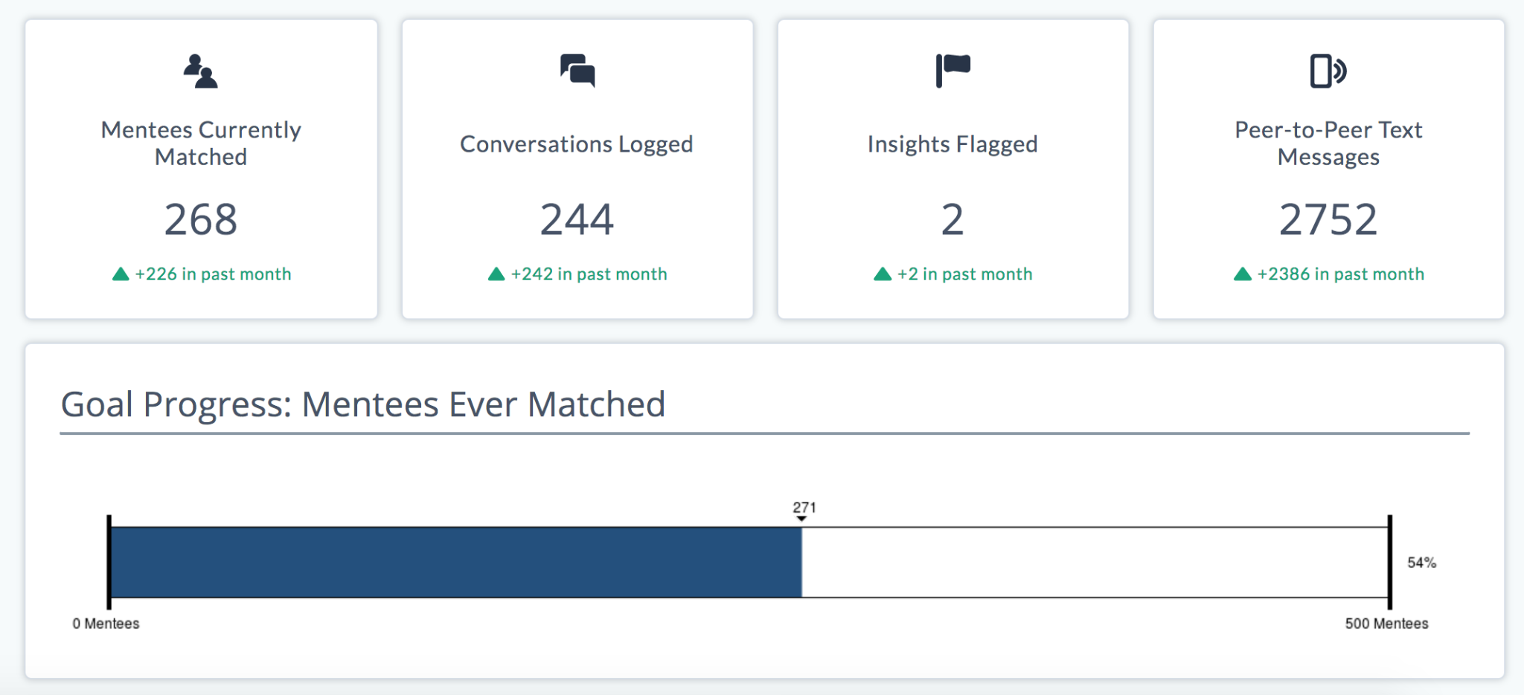
2021-22 Program Metrics so far
We are in our sixth week of matching pairs for this year’s program. Incoming students will continue to be invited on a rolling basis through the start of fall classes. Includes both summer and fall admits.
‹#›

Slide 35
MC PRODUCT ROADMAP

Slide 36
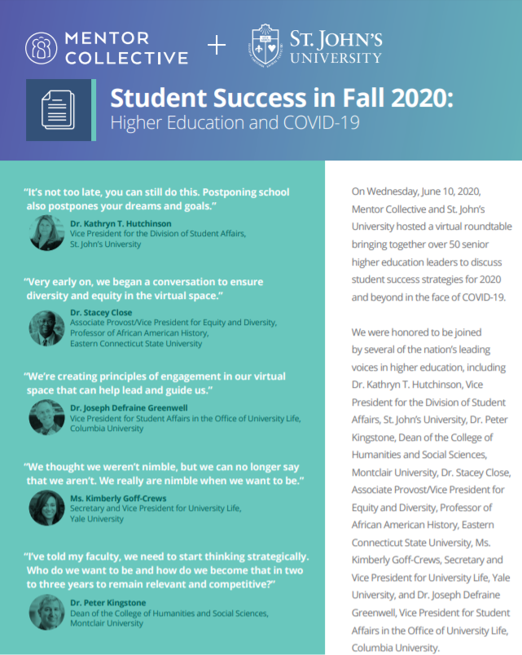
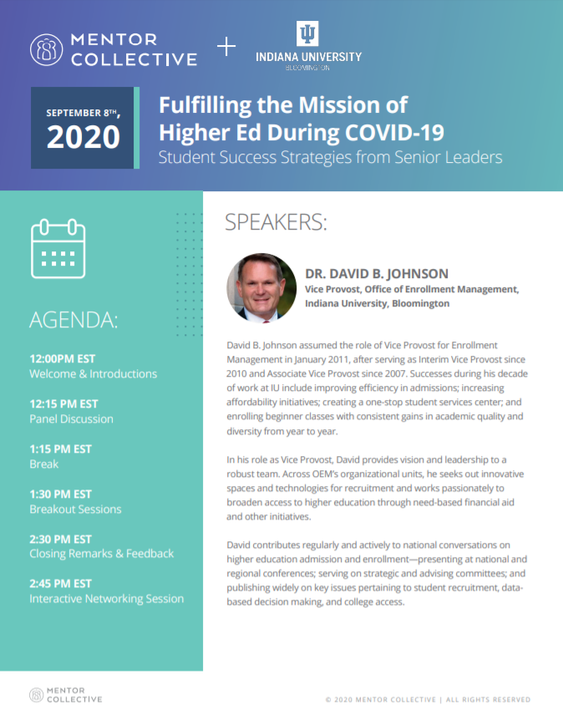
MC’s Exclusive Thought Leadership Forums
MC has convened 1,000+ of Higher Ed’s most innovative leaders across the U.S. for exclusive deep dives into best practices and lessons learned throughout the pandemic.
A Partner-only Masterclass: Building a Culture of Mentorship feat. Dr. EJ Edney Register here
03/23
Executive Roundtable: Building A Culture of Mentorship feat. Dr. Julia Freeland Fisher
Register here
03/25
PLUS Monthly Communities of Practice Webinars
Updates available on our website here
‹#›
Join us for an upcoming Roundtable!
Notes:
Talking points:
MC piloted a new Roundtable initiative about 1 year ago - these events are our way of giving back to the higher education community.
These events are not a sales pitch; rather, they are a forum for higher education leaders to engage with their peers in breakout sessions.
This is also an opportunity to hear from some incredible thought leaders. For example, we recently hosted a roundtables with the Chancellor of UC Davis, the VP of Undergrad at UC Berkeley, and the Chief Diversity Officer at University of Florida.
We would love to have you join one of our coming events - the commitment is minimal and you will have the chance to exchange ideas with peer institutions and everything from financial aid, supporting faculty/staff, to student success initiatives.
We are planning to continue hosting 4-5 of these every quarter.
At this stage, we already have folks who have attended 2-3 Roundtables.

Slide 37
THANK YOU
Lauren Harnett
Program Success Operations Manager
laurenharnett@mentorcollective.org
Vanessa Ford
University Relations Director
vanessa@mentorcollective.org

